Slide 1
Contributors
Mr. Hayrettin BACANLI
Turkish State Meteorological Service
Head of Research and Information Department
hbacanli@dmi.gov.tr
Mr. Ayhan SAYIN
Research division
Turkish State Meteorological Service
asayin@dmi.gov.tr
With the contribution of HRC, WMO, NOAA and USAID.

Slide 2
Background of the FFGS project
The WMO Congress XV in 2007 approved the implementation of a Flash Flood Guidance System (FFGS) project with a global coverage, developed by Commission for Hydrology (CHy) jointly with WMO Commission for Basic System (CBS) in collaboration with the US National Weather Service, the US Hydrologic Research Centre and USAID/OFDA.
On 25 February 2009 WMO signed a Memorandum of Understanding (MoU) with USAID, HRC, and NOAA on the implementation of the project. Based on the Memorandum of Understanding, WMO, HRC and USAID agreed to start preparations for the implementation of the project in the Black Sea and Middle East Regions.

Slide 3
Participating Countries
Specifically the countries that to be included in a first phase of the global project are decided in the initial workshop held in Istanbul on 29-31 March 2010 are Armenia, Azerbaijan, Georgia, Turkey, Iraq, Syria and Lebanon. Romania and Bulgaria are seen as potential candidates in a possible later phase of the project.
Armenia, Azerbaijan, Georgia, Turkey, Iraq, Syria and Bulgaria have sent Letter of commitment (LoC) to WMO. Romania and Moldova will also join the project in the next phase of the project.

Slide 4
General Objective of the Project
To contribute towards reducing the vulnerability of regions around the world to hydrometeorological disasters, specifically flash floods, by developing and implementing flash flood guidance systems to strengthen regional capacity to develop timely and accurate flash flood warnings.

Slide 5
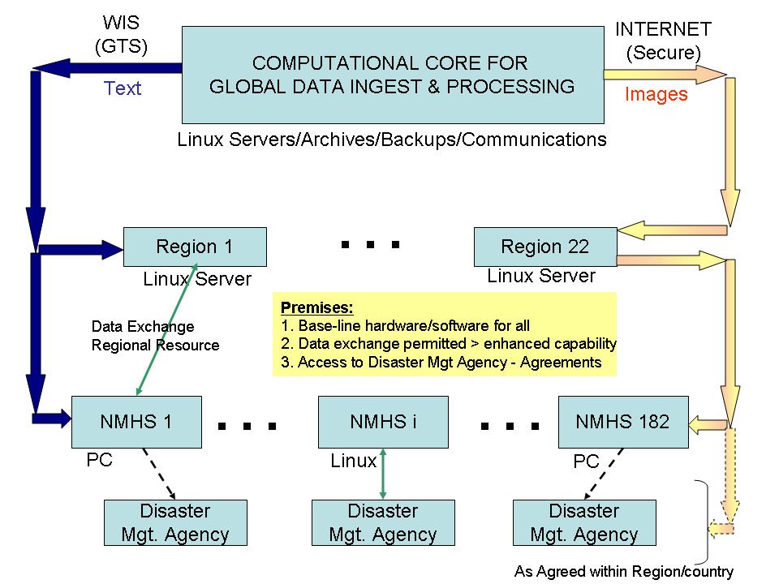
Design Concept

Slide 6
Works Accomplished:
Before the FFG model is implemented operationally,
The following three phases are to be carried out:
Set up model parameters;
Calibration, and
Tests.

Slide 7
Works Accomplished:
To set up Model Parameters more than 40 Hidro-meteorological historical data variables processed in GIS and put FFG FTP server at TSMS. Some of these parameters are as follows:
Soil data;
Land cover and usage;
DEM (SRTM 90m) data.

Slide 8
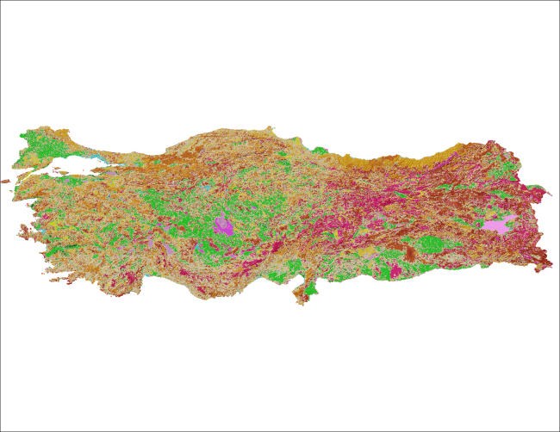
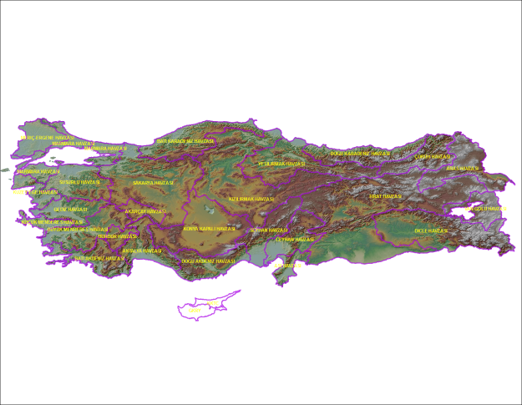
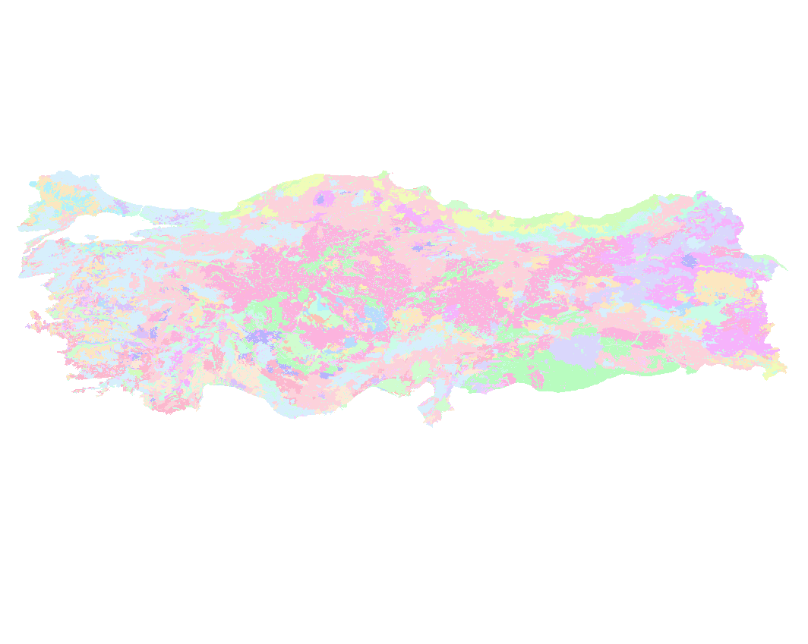
Work Accomplished:
Land Cover
DEM (SRTM)
Source: Ministry of Environment and Forestry
Soil Data
Kaynak: USGS
Source: Ministry of Food, Agriculture and Animal Husbandry.

Slide 9
Works Accomplished:
Stream flow data;
Dams and Lakes;
Rivers;
Long term precipitation, Temperature, Humidity, Winds data;
Evaporation;
Soil moisture;
Radiation data etc..

Slide 10
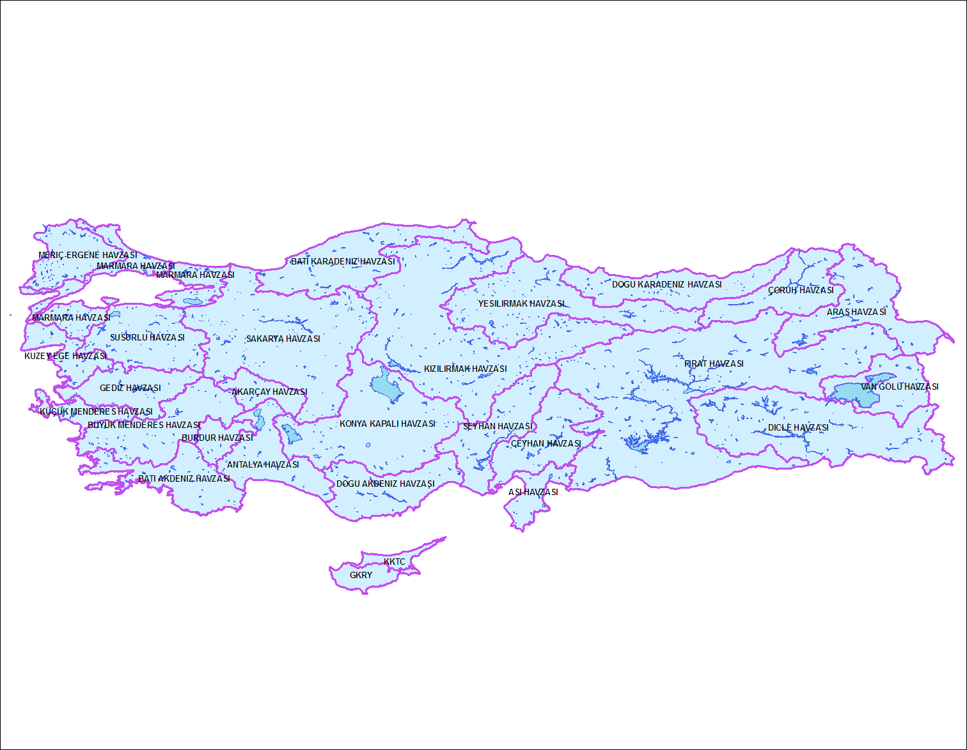
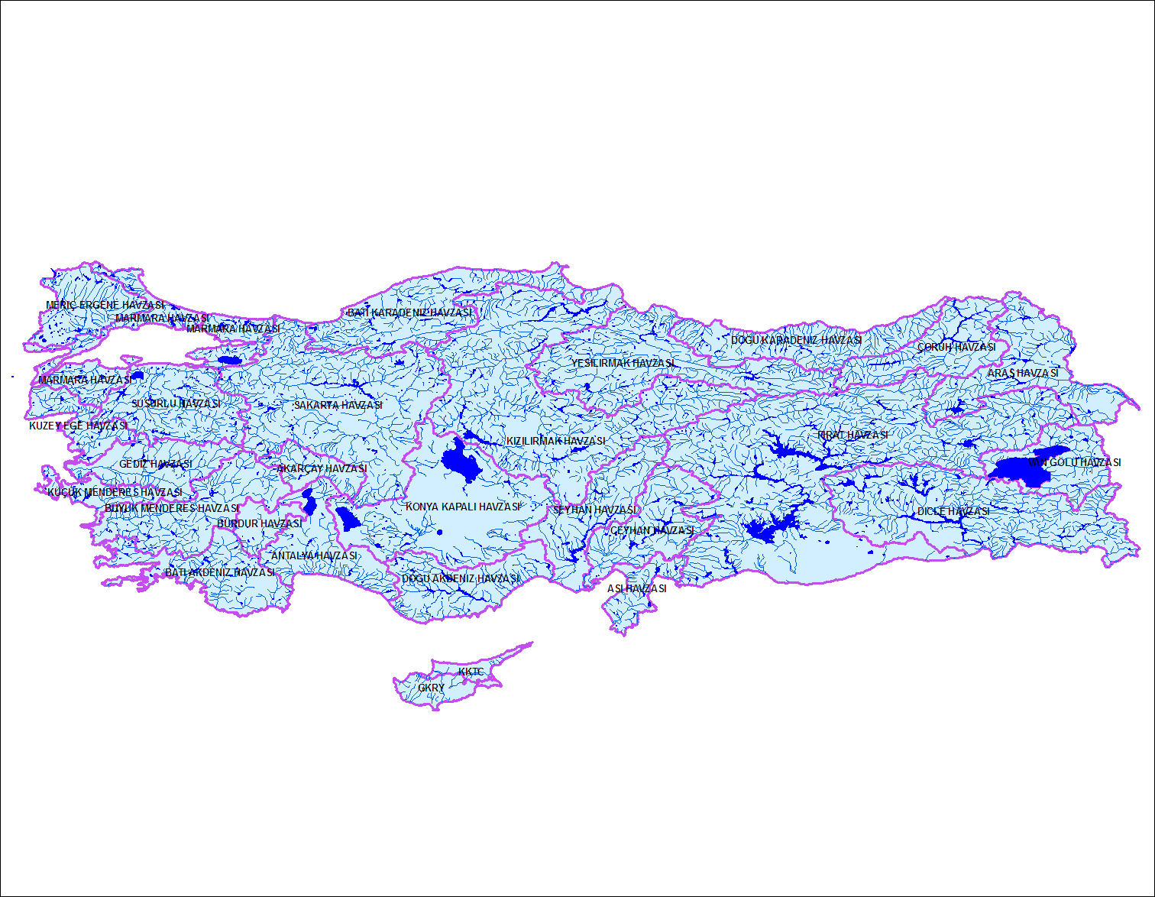
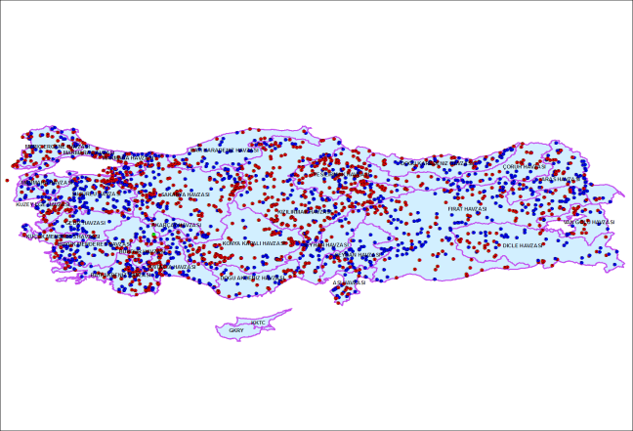
Work Accomplished:
Dams and Lakes
Rivers
Stream Flow stations
Source: DSİ
Kaynak: DSİ
Source: DSİ
Kaynak: DSİ
Source: DSİ

Slide 11
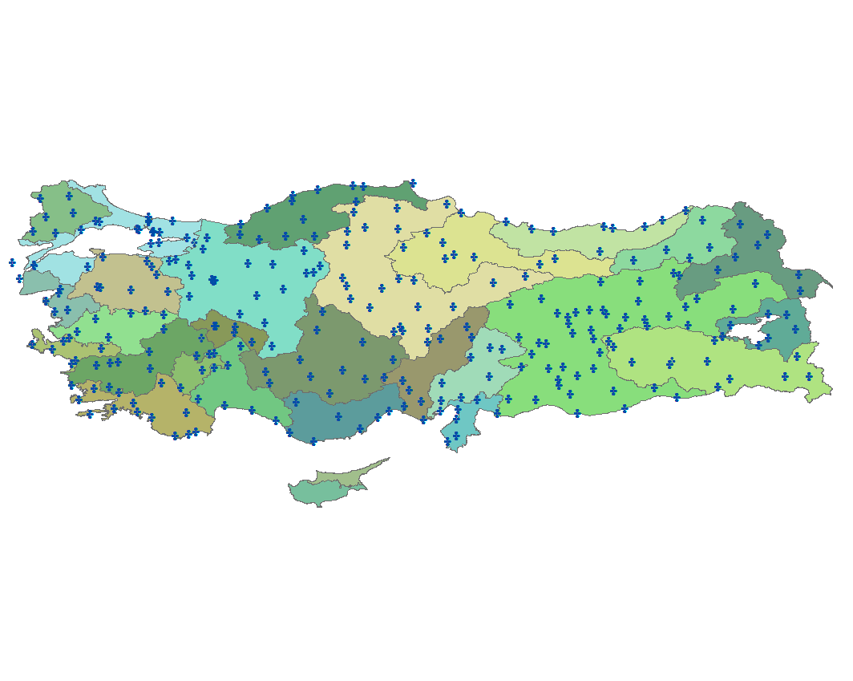
Work Accomplished:
Meteorological Data
Precipitation
Temperature
Evaporation
Radiation
Soil moisture
Winds
Source: TSMS

Slide 12
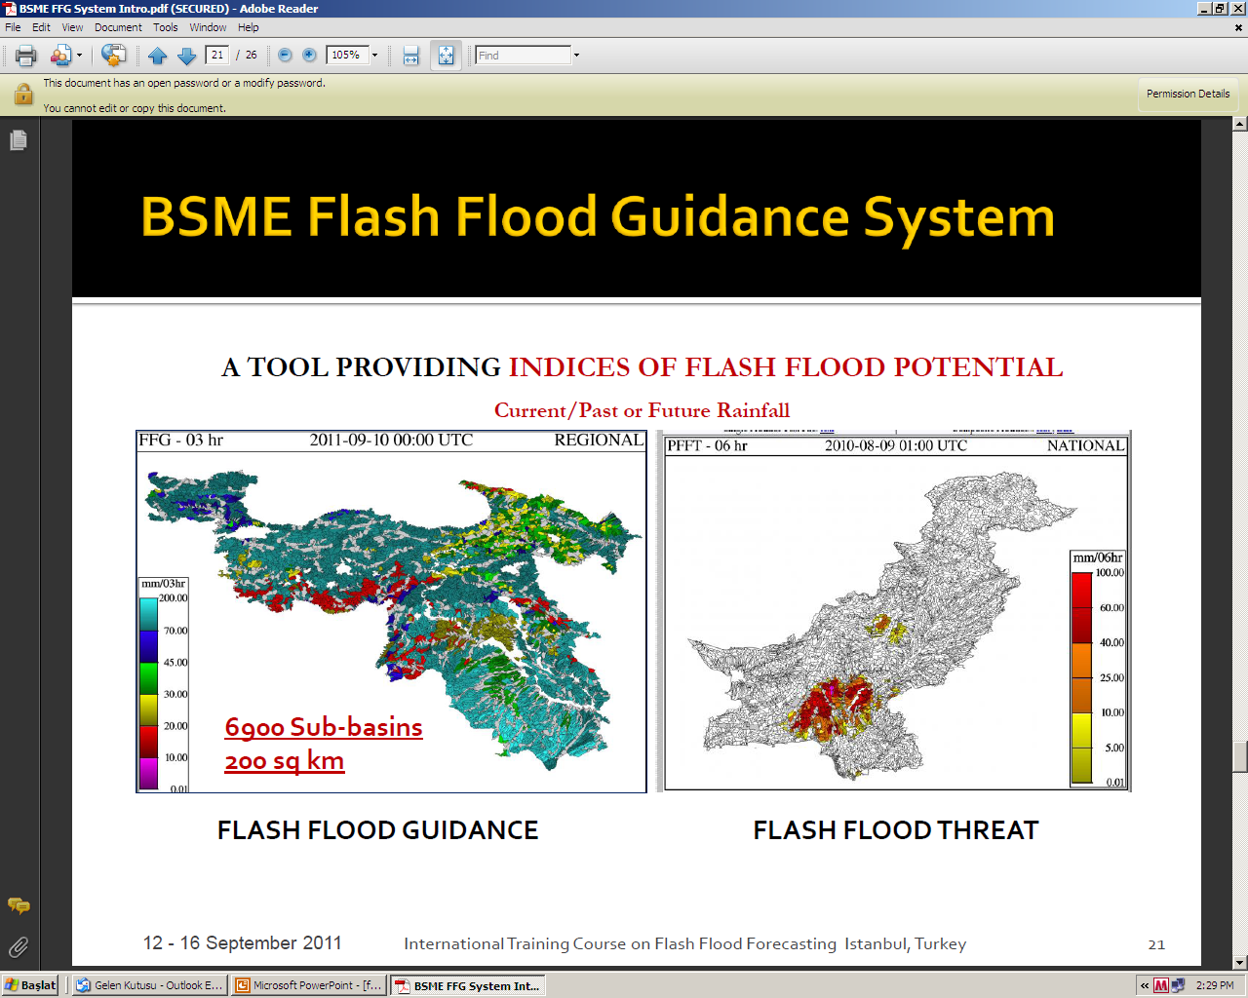
Work Accomplished:
Notes:
More than 6900 sub basins were created for all participating countries

Slide 13
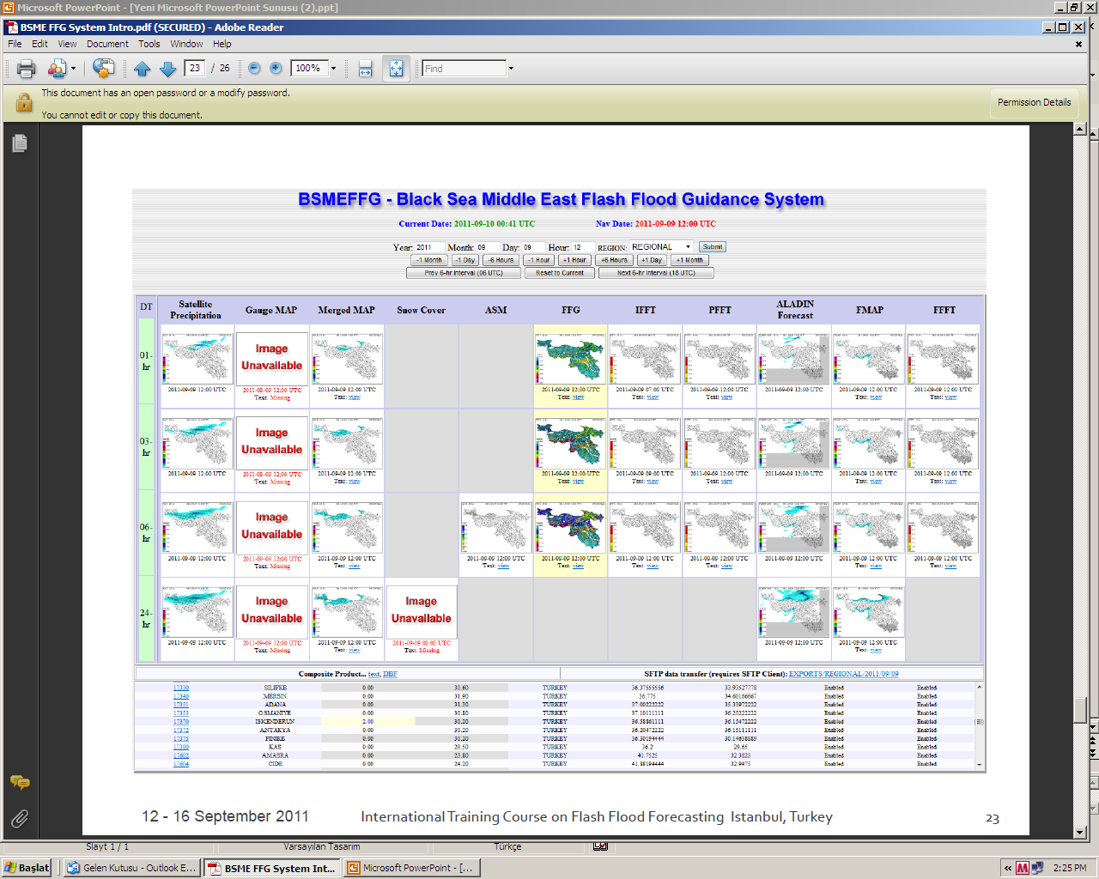
Work Accomplished: Test Studies
Notes:
Real Time Meteorological data are provied to HRC to conduct model test studies. BSME-FFG user interface is shown here. Some Products are Satellite rainfall, ALADIN model precipitation output, FFG (Flash Flood Guidance) and Flash Flood Threat.

Slide 14
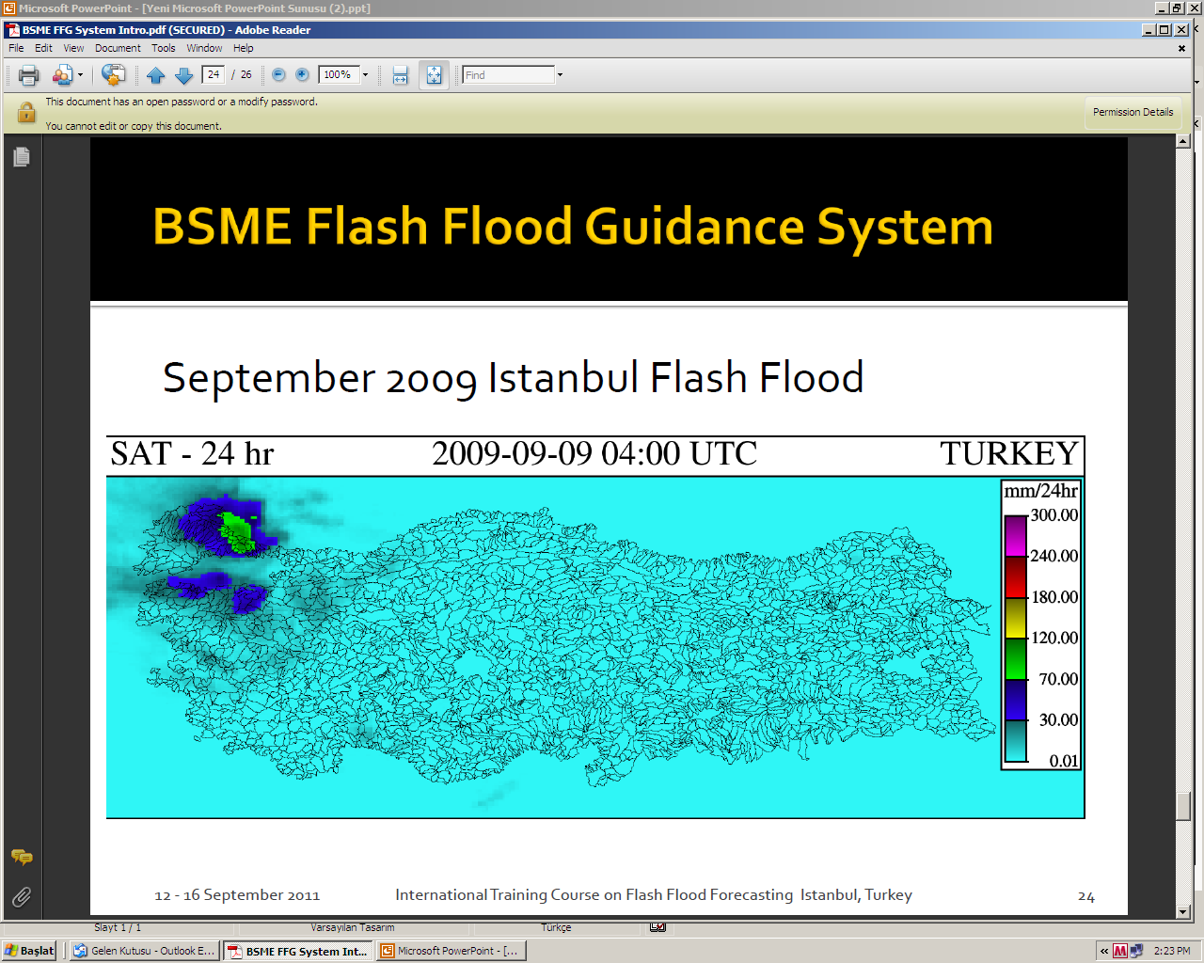
Work Accomplished: Case Study
Notes:
BSME-FFG test study catched falsh flood aooucred in Istanbul on 9 September 2009. There were considarable amount of property damages and human lost.

Slide 15
Study visit to USA
OFDA was so kind to invite BSME-FFG participant countries Director Generals and their staff to USA to visit NWS, NCEP, OFDA, USGS, Atlantic RFC and Sacramento- Nevada RFC to show flash flood and flood forecasting activities in these institutions on 4-14 April 2011. The following Countries participated in the study Visit:
  Armenia;
  Azerbaijan;
  Bulgaria;
  Georgia;
  Turkey.

Slide 16
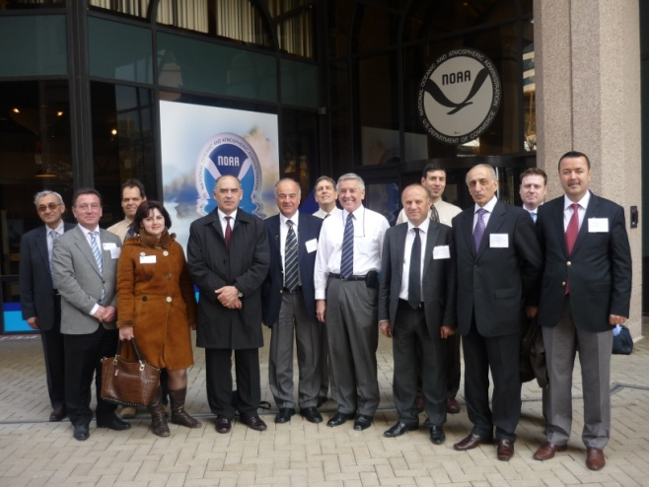
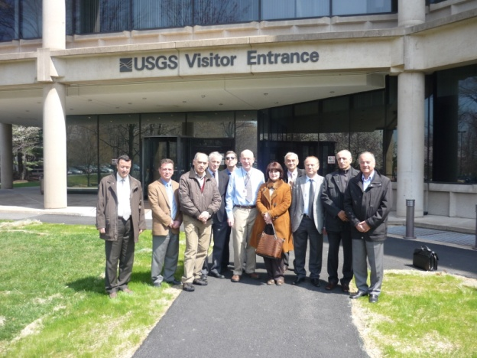
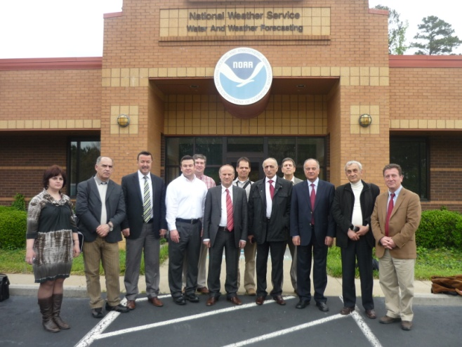
Work Accomplished: USA Study Visit
Visit to NWS
Visit to USGS
Visit to Atlantic RFC

Slide 17
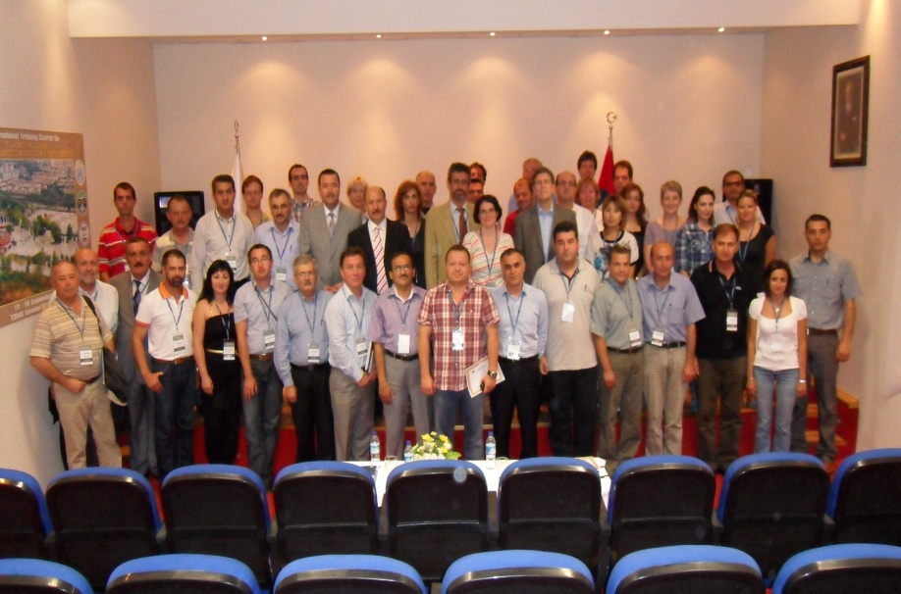
Flash Flood Workshop –Participants
WMO Flash Flood Forecasting Model Concept Training Course was organized in Istanbul on 12-16 September 2011. Participants from the following countries attended the course:
Bulgaria;
Armenia;
Azerbaijan;
Georgia;
Croatia;
Slovenia;
Bosnia
Herzegovina;
Moldova;
Montenegro.
  Hungry;
  Czech Republic;
  Romania;
  Russia;
  Tunisia;
  Kazakhstan
Notes:
Course topics were as follows: Model calibrations, BSME-FFG model works done so far, flood forecasting and early warning system in France, flood forecasting and early warning system at Atlantic RFC, QPE/QPF and GIS applications in FF.
TSMS supported participants from nine countries.

Slide 18
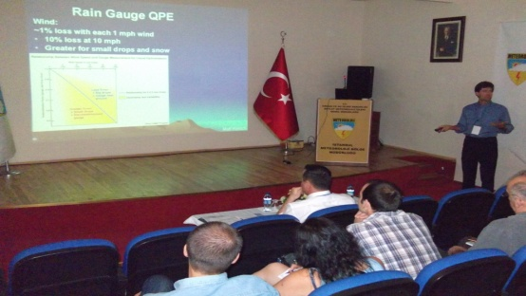
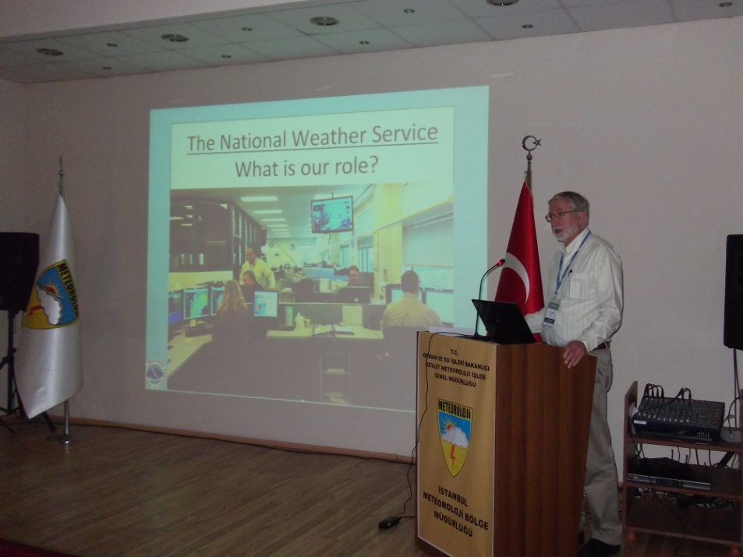
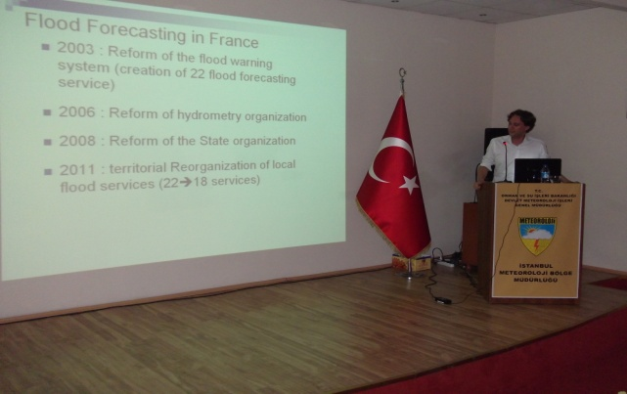
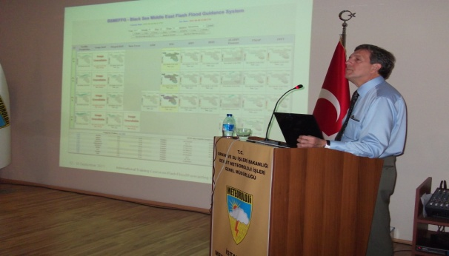

Work Accomplished: FF Workshop-Instructors
Dr.Thomas Hopson of UCAR
Dr.Peter Ahnert of Atlantic RFC
Dr. Arthur Merchandise of SCHAPI
Dr. Robert Jubach of HRC
Notes:
There were both Turkish and foreign instructors. Foreign course instructors were from HRC, UCAR, SCHAPI, Atlantic RFC, Russia. Turkish instructors were fro Middle East Technical University, Gazi University, Water Foundation and Selcuk University.

Slide 19
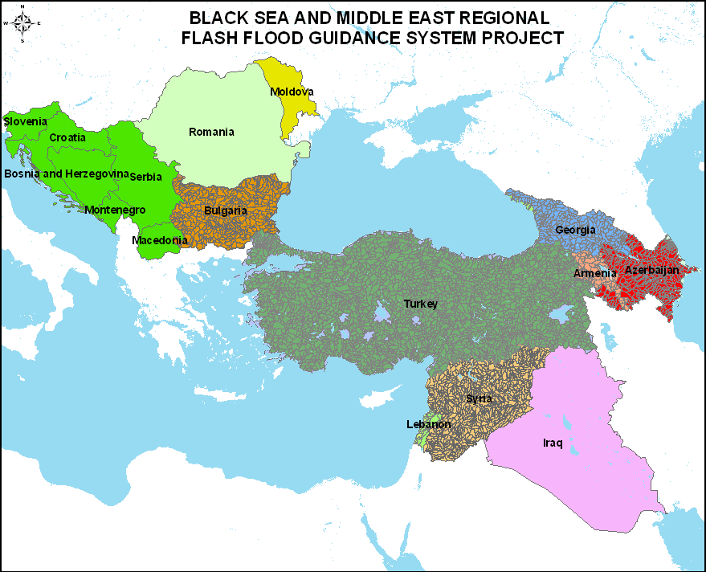
Extension of BSME-FFG
Turkish Meteorological Service took initiative with WMO to include some ICEED members, Slovenia, Croatia, Bosnia and Herzegovina, Serbia, Montenegro, Macedonia
Black Sea and Middle East Flash Flood Guiding
System (BSME-FFGS).
Funding of these countries is under consideration by USAID.
Notes:
TSMS has been in contact with OFDA that funding for the extension of BSME-FFG will be provided for the budget year starting October 2011. TSMS in cooperation with WMO will be very happy to hold initial meeting in Turkey.

Slide 20
Thank you for kind your attention…

