Slide 1
MCH
In February we installed MCH
We are importing data in MCH now
It is very useful for us, we planed to import all data that is digitized so far and than to digitalize and import all other data
All new data are importing in MCH

Slide 2
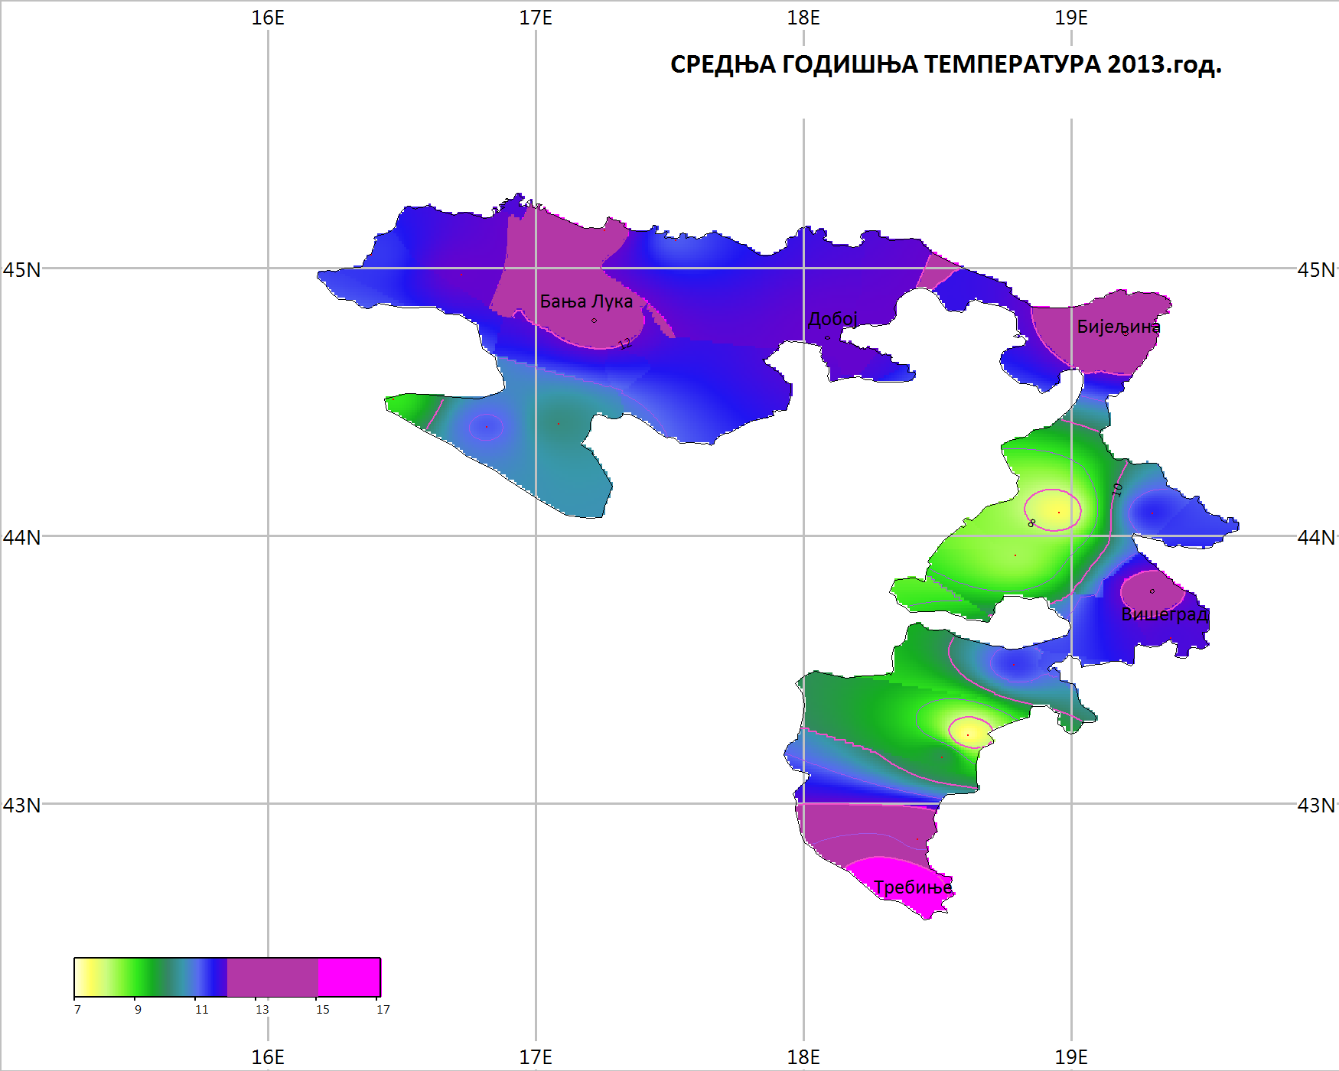
Average temperature 2013.

Slide 3
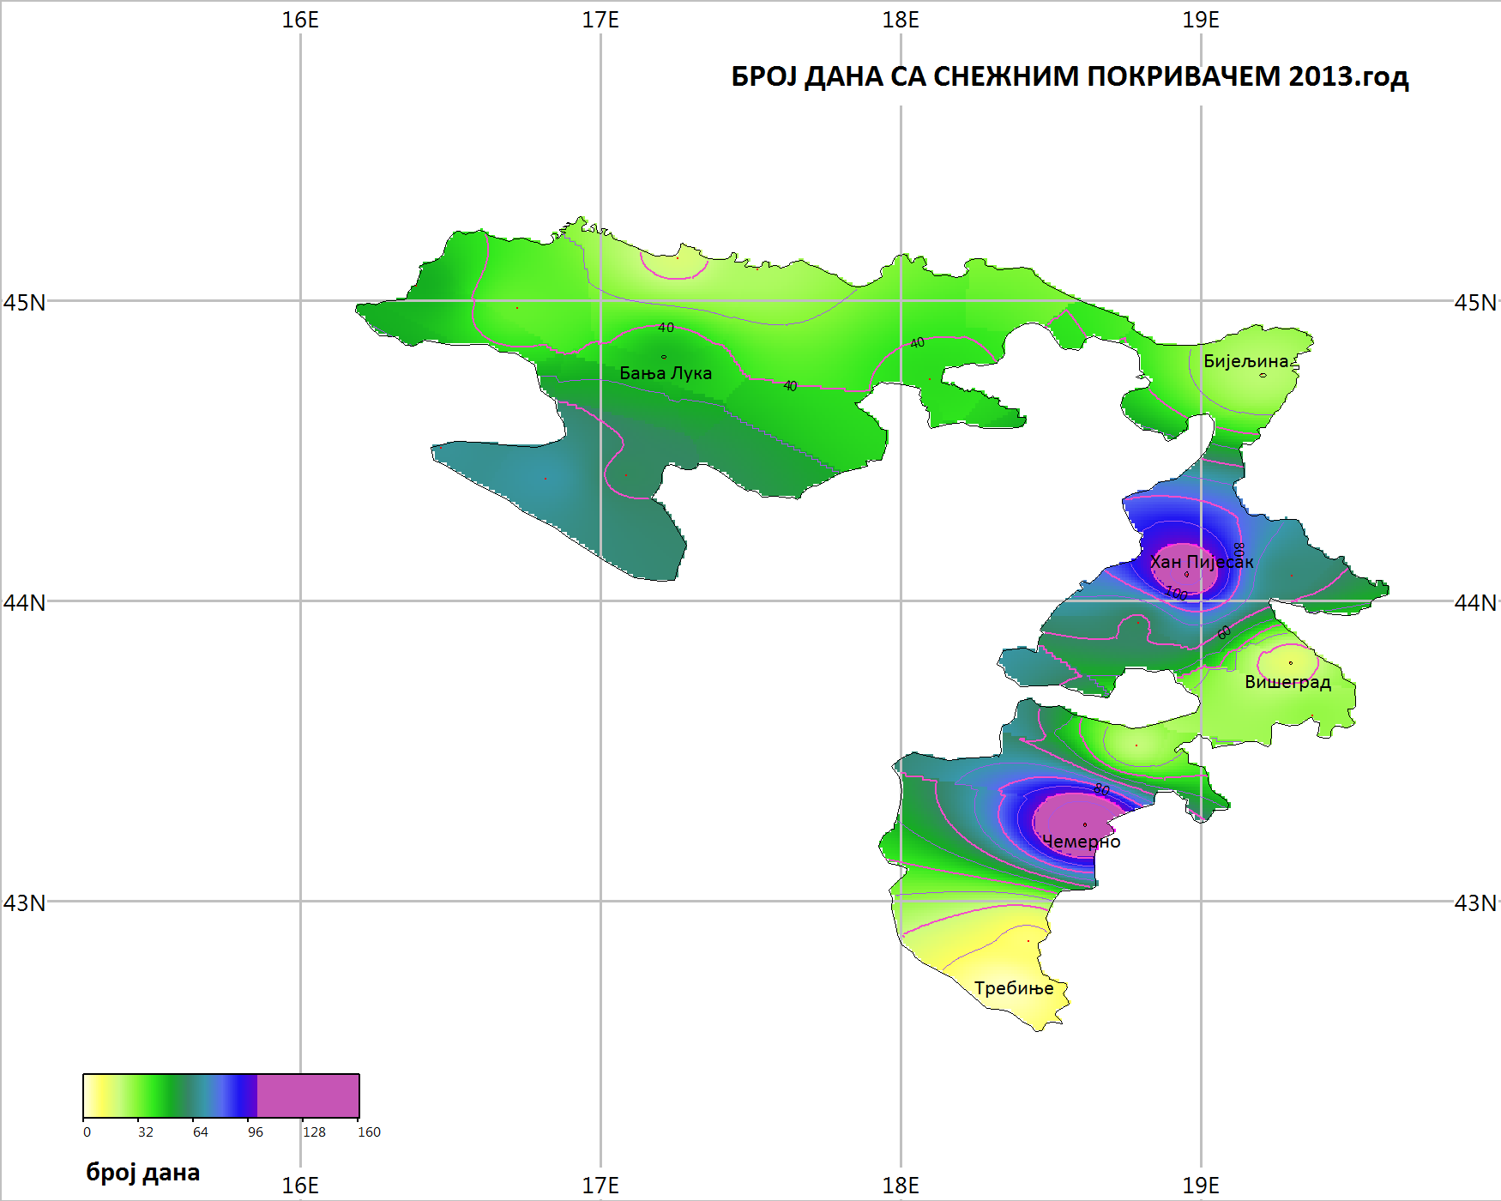

Slide 4
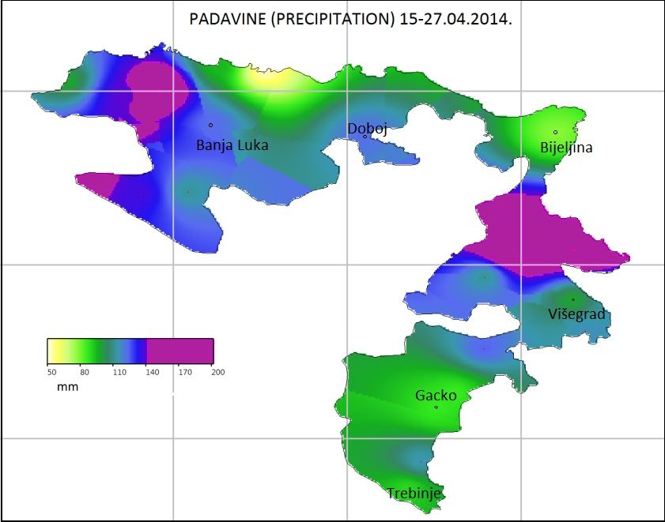

Slide 5
Building Resilience to Disasters in Western Balkans and Turkey
Quality control of data
Homogenization of monthly data and partly of daily data (ACMANT)
Climate indicators

Slide 6
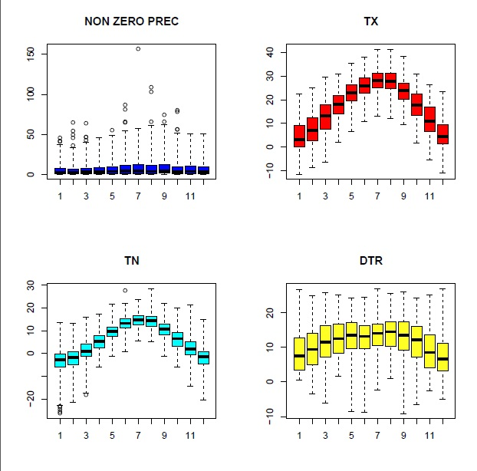

Slide 7
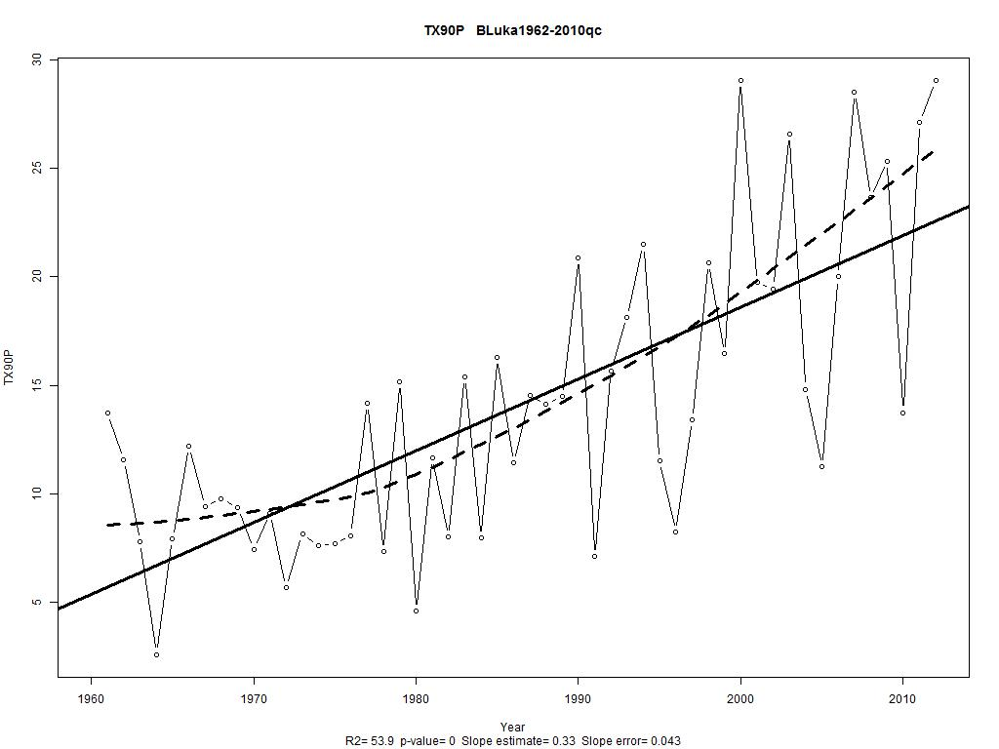

Slide 8
