Slide 1

REPUBLIC HYDROMETEOROLOGICAL SERVICE
OF SERBIA – INTERSESSIONAL ACTIVITIES
ICSEED 13th Session
Banja Luka, Bosnia and Hercegovina, Republic of Srpska, 28 – 29 April 2014

Slide 2
MAIN ACHIEVEMENTS OF THE REPUBLIC HYDROMETEOROLOGICAL SERVICE OF SERBIA (RHMSS) BETWEEN TWO ICSEED SESSIONS :
Legal and institutional framework of RHMSS
Modernisation
Research, development and operational activities
International cooperation
Projects
Capacity building

Slide 3
IMPROVED LEGAL AND INSTITUTIONAL
FRAMEWORK OF RHMSS
IMPLEMENTATION OF REGULATIONS ADOPTED ON THE BASIS OF the Law on Meteorological and Hydrological Activity ("Official Gazette of the Republic of Serbia, No. 88/10) that had entered into force in November 2010
Five-year program of meteorological and hydrological research and development activities for the 2013-2017 period; 05/12/2013
Regulation on establishing state networks of meteorological stations, on their work programme, and on their manner of reporting;
Regulation on establishing the locations of meteorological and hydrological stations included in the state network, as well as on establishing protective zones in the stations’ vicinity which shall be subject to restrictions;
Regulation on determining the amount of compensation for the provision of services from the field of meteorology and hydrology;
Rulebook on the content, management and maintenance of the meteorological and hydrological data and information fund, on the methods of quality control and of data validity verification, as well as on the manner of their publication; 07/06/2013
Rulebook on the manner of production, issuance and distribution of exceptional meteorological and hydrological information and warnings; 01/11/2013
Directions on the manner of coding, filing and gathering of data from the state hydrological observation system;

Slide 4
IMPROVED LEGAL AND INSTITUTIONAL
FRAMEWORK OF RHMSS
Rulebook on the content, keeping and filling in of the Register of state meteorological and hydrological station networks and additional meteorological and hydrological station networks;
Rulebook on the form and contents of the identification document of the inspector for hydrological and meteorological activity;
Rulebook on the measures to be taken in order to protect the hydrometeorological information system and on the manner of giving authorization to access that system;
Rulebook on detailed conditions concerning technical and human resources capacities for performing other meteorological and hydrological activities; 31/01/2014
Instruction on the hydrological measurement and observation methods;
Rulebook on the conditions for establishing additional meteorological and hydrological station networks; 14/03/2014.
Instruction on the manner and periodicity of technical validity checks for the instruments and equipment from the state meteorological and hydrological observation system;
Rulebook on establishing confidential meteorological and hydrological information;
Instruction on coding, filing, and gathering data from the state meteorological observation system;
Instruction on the meteorological measurement and observation methods.

Slide 5

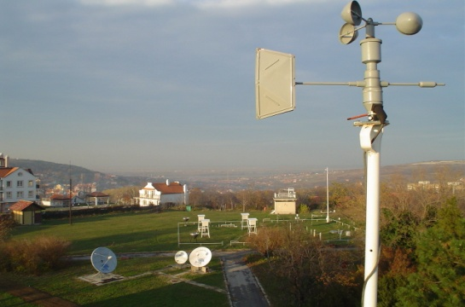
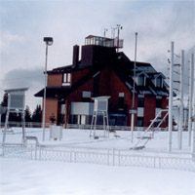
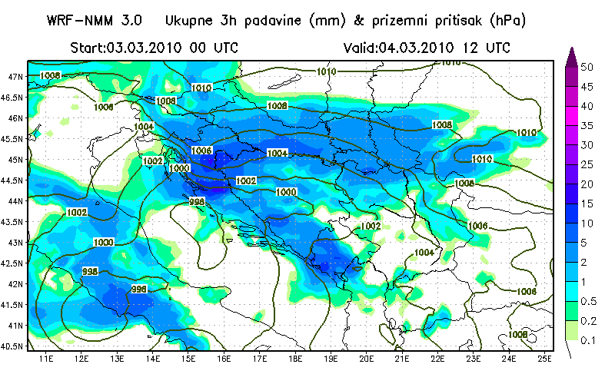
MODERNISATION – METEOROLOGICAL AND HYDROLOGICAL EARLY WARNING SYSTEM
Basic components of the Hydrometeorological Early Warning System:
Meteorological and Hydrological Observation System
Analytical – Forecasting System
Computing – Telecommunication System
Notes:
5

Slide 6
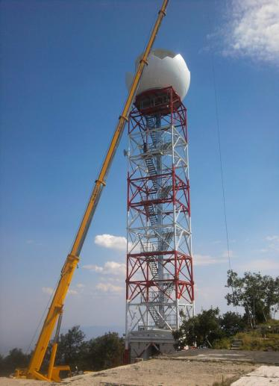

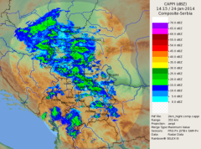
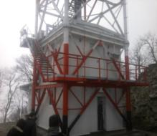
MODERNISATION– METEOROLOGICAL AND HYDROLOGICAL OBSERVATION SYSTEM
New Germatronik S-band
dual-polarization radar,
located at Jastrebac Mountain,
started to work in August 2013
Installation of 6 automatic hydrological surface water stations
Installation of 6 automatic hydrological ground water stations

Slide 7

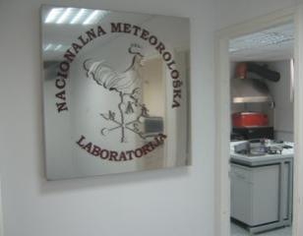
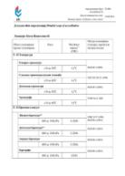
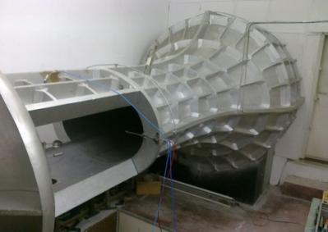

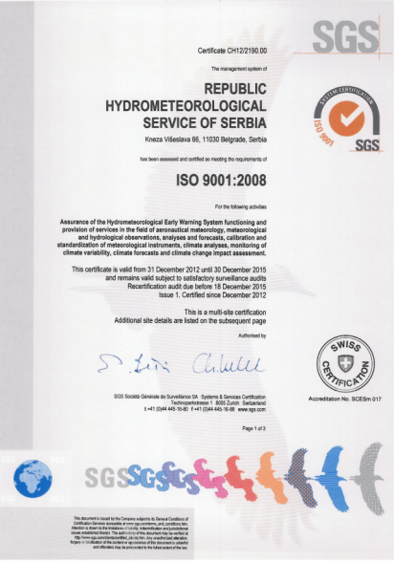
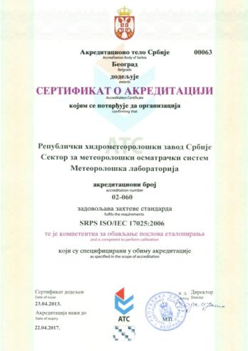

MODERNISATION – METEOROLOGICAL AND HYDROLOGICAL OBSERVATION SYSTEM
Meteorological Laboratory has been accredited in accordance with the SRPS ISO/IEC 17025:2006
The scope of accreditation has been extended to include the field of relative air humidity
We have successfully passed the second ISO 9001/2008 surveillance audit

Slide 8
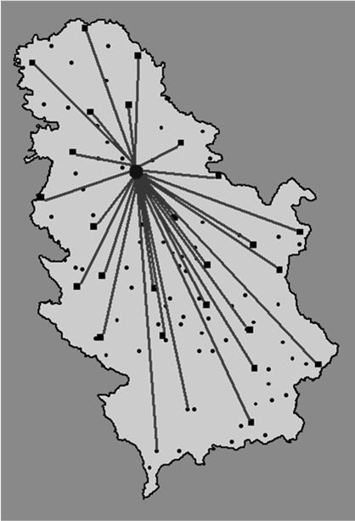


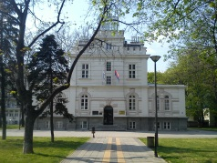

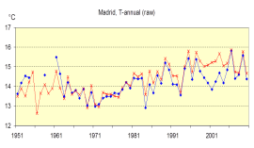
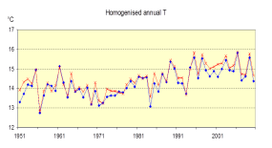
RESEARCH, DEVELOPMENT AND OPERATIONAL ACTIVITIES
METEOROLOGICAL AND HYDROLOGICAL OBSERVATION SYSTEM
Implementation of data entry software at all major meteorological stations was initiated during 2013
Activities related to data rescue (data gathering, storing, scanning and archiving)
Modern methods of quality control and homogenization have been applied to 50% digitized data within the framework of the IPA 2012/290-552 Project “Building Resilience to Disasters in Western Balkans & Turkey”

Slide 9
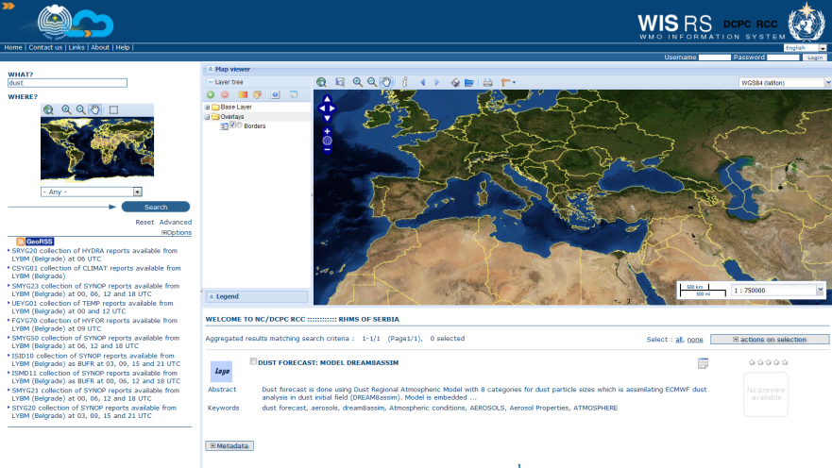

RESEARCH, DEVELOPMENT AND OPERATIONAL ACTIVITIES
COMPUTING-TELECOMMUNICATION SYSTEM
WMO/WIS/DCPC and WIS/NC
As of June 2012, RHMSS has been performing the functions of a Regional Data Collection or Production Center WMO/WIS/DCPC and WIS/NC.
Along with the initial metadata products, in the previous period we have also created all metadata records for all operative bulletins exchanged via GTS.
On 6 January 2014 we successfully completed the migration to the RMDCN next generation regional network.
We have also finalized the preparation for the migration
of TAC-cat 1 to BUFR code. Mr Šunderić, a member of the
Task Team on Regional Migration on Table Driven Code
Forms was awarded WMO/CBS special Certificate
due to his contribution to the regional activities during
the period 2010-2013.

Slide 10
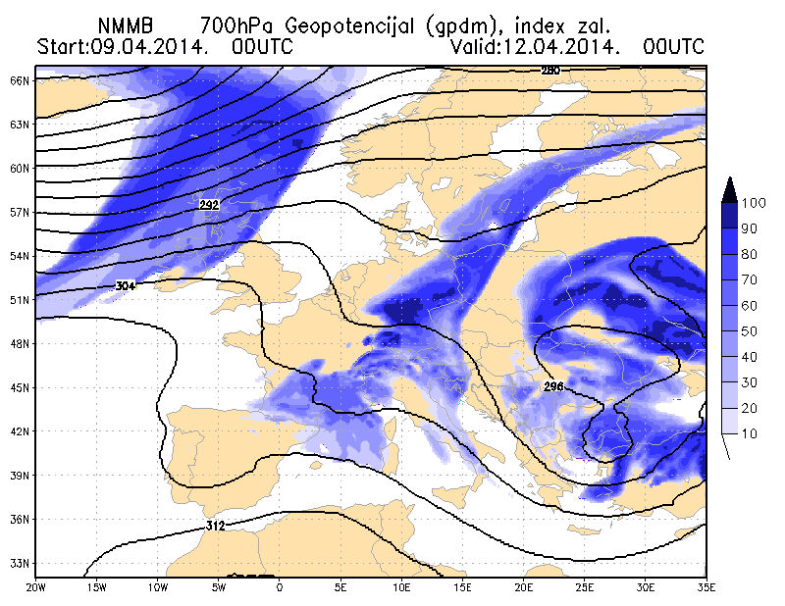
RESEARCH, DEVELOPMENT AND OPERATIONAL ACTIVITIES
ANALYTICAL – FORECASTING SYSTEM
NMMB Regional
10 km horizontal resolution
I & BC from global NMMB
Domain Euro-Atlantic
Forecast period 120 hours
Air freezing index scheme
for aeronautical purposes
WRF NMM
New version 3.5.1 for the Balkans – Adriatic domain operationally started in November 2013

Slide 11
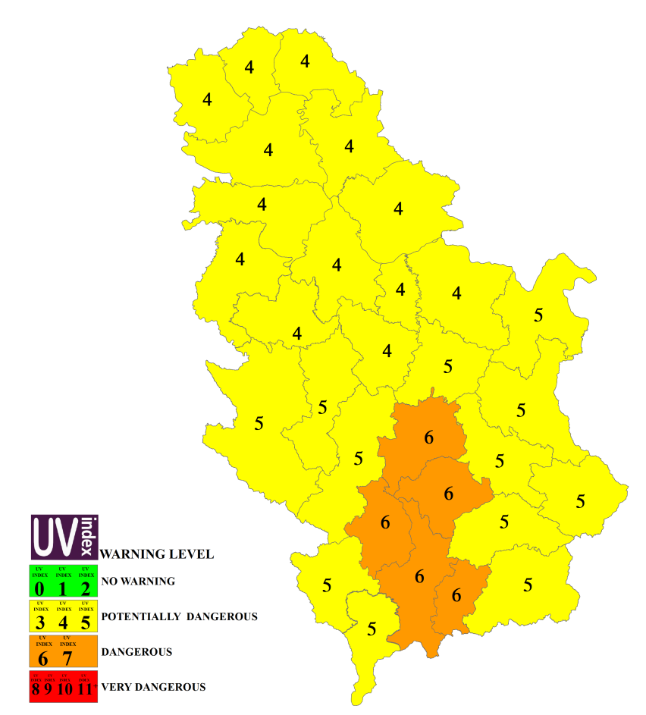
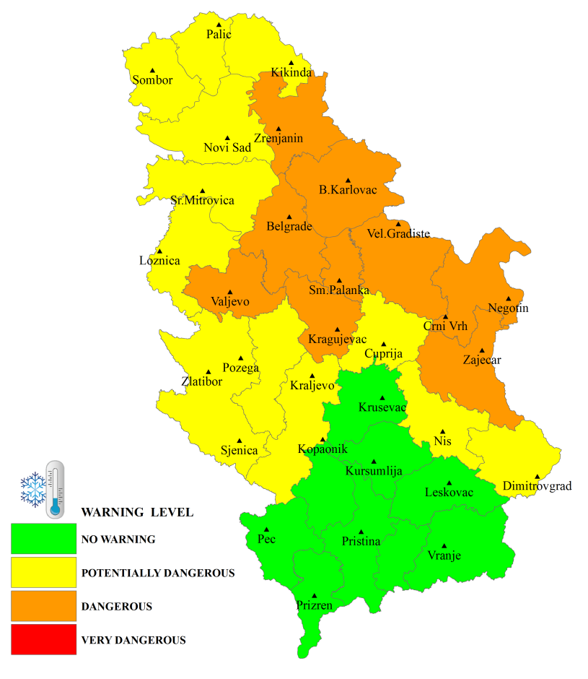
RESEARCH, DEVELOPMENT AND OPERATIONAL ACTIVITIES
NATIONAL CENTER FOR CLIMATE CHANGE
ADVISORY BULLETINS from 1 January 2014
In accordance with the provisions of the Rulebook on the manner of production, issuance and distribution of exceptional meteorological and hydrological information and warnings we have been operatively producing:
Bulletin for biometeorological forecast
Bulletin for UV forecast
Bulletin for heat/cold wave forecast
Bulletin for early warning of extreme climate events and anomalies
Warning for UV forecast – March 21
Warning for cold wave forecast – January 28

Slide 12
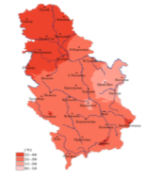
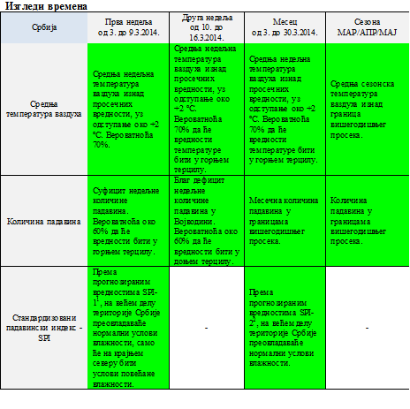
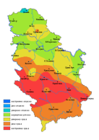
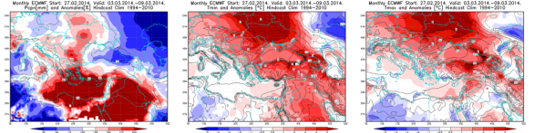
RESEARCH, DEVELOPMENT AND OPERATIONAL ACTIVITIES
NATIONAL CENTER FOR CLIMATE CHANGE
- Climate Watch System -
A climate warning contains the forecast of an extreme climate event and anomaly (drought/meteorological, agricultural and hydrological; heat wave; cold wave; meteorological conditions favourable for the occurrence of forest fires; extreme precipitation and air temperature anomalies in relation to multiannual averages) for the territory of the Republic of Serbia.
Bulletins also contain a weekly monitoring and weather outlook chart (monthly temperature, precipitation and SPI forecast and seasonal forecast).
The RHMSS’ obligation to issue national early warning bulletins on the occurrence of climate extreme events and anomalies is regulated by the Rulebook on the manner of production, issuance and distribution of exceptional meteorological and hydrological information and warnings (“Official Gazette of RS” No. 96/2013).

Slide 13
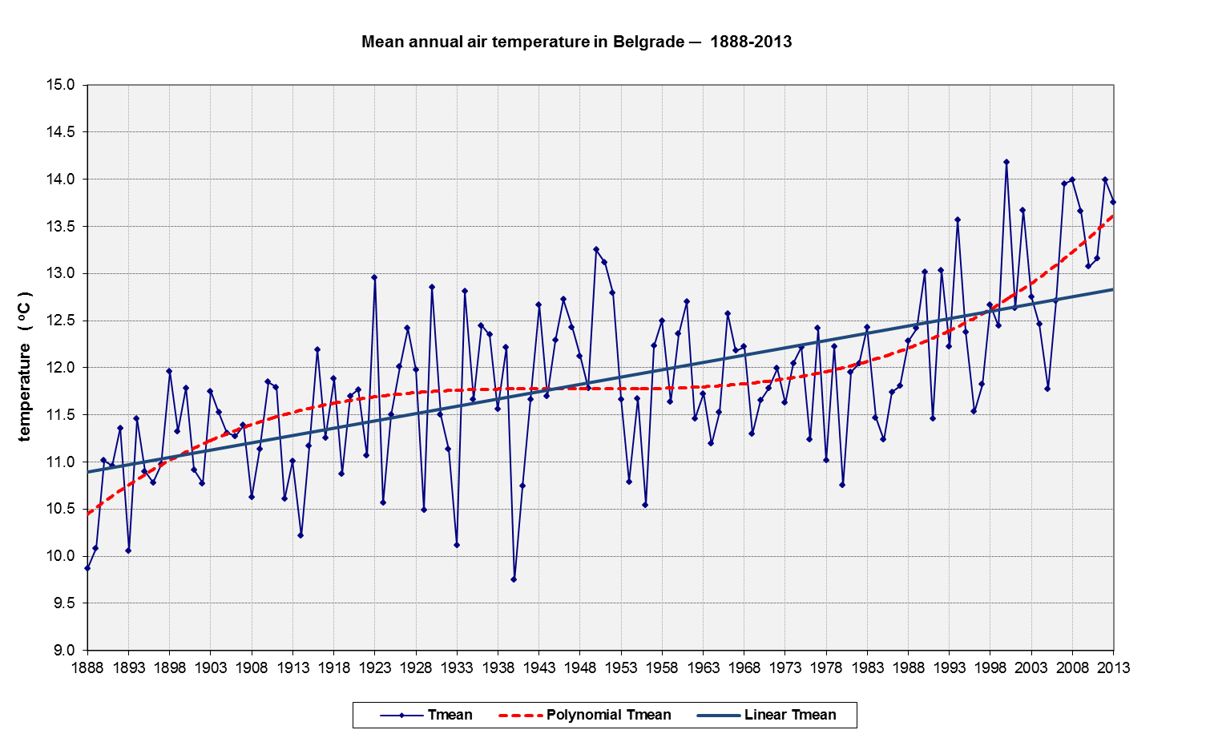
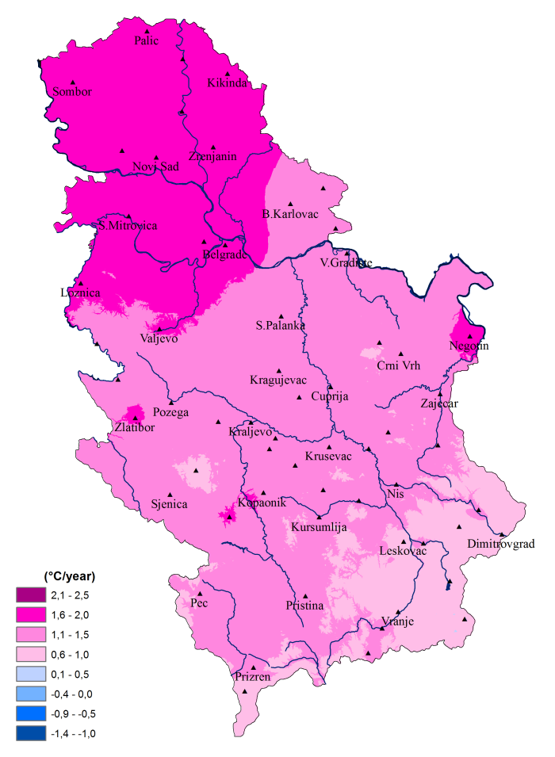
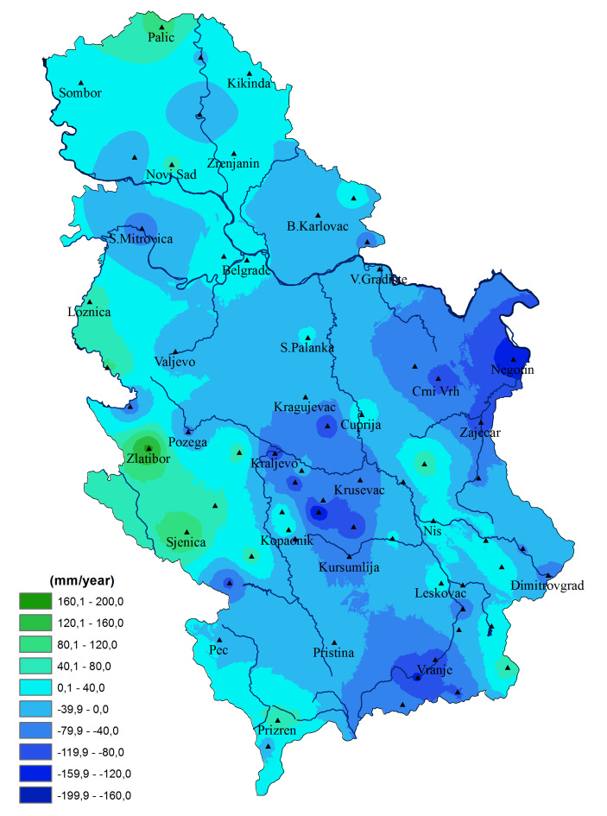
RESEARCH, DEVELOPMENT AND OPERATIONAL ACTIVITIES
NACIONAL CENTER FOR CLIMATE CHANGE
Analysis of temperature and precipitation trends based on homogenized data
Mean annual air temperature in
Belgrade – 1888-2013
Trend of mean annual air temperature
Trend of mean annual precipitation

Slide 14
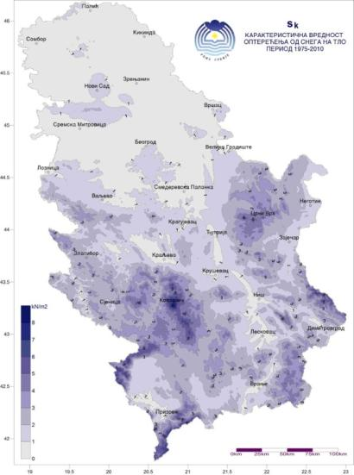
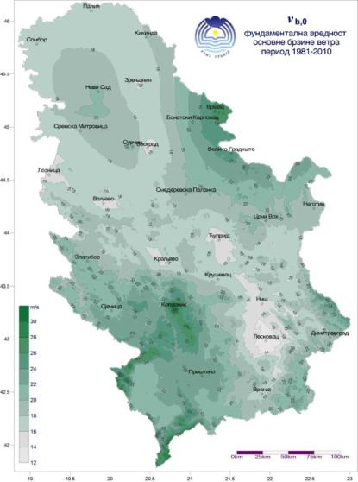
RESEARCH, DEVELOPMENT AND OPERATIONAL ACTIVITIES
NATIONAL CENTER FOR CLIMATE CHANGE
Production of a Study on wind, snow, ice and temperature effects on constructions - as required by the Institute for Standardization of Serbia (ISS).
Production of national annexes for integration into the Serbian standards which are in the process of harmonization with Eurocodes for the field of design and calculation of construction works.
  Characteristic value of snow load on the ground with altitude influence
SRPS EN 1991-1-3 Еurocode 1 – Snow load
SRPS EN 1991-1-4 Еurocode 1 – Wind impact
SRPS EN 1991-1-5 Еurocode 1 –Heat impact
Fundamental values of basic wind speed with altitude influence

Slide 15
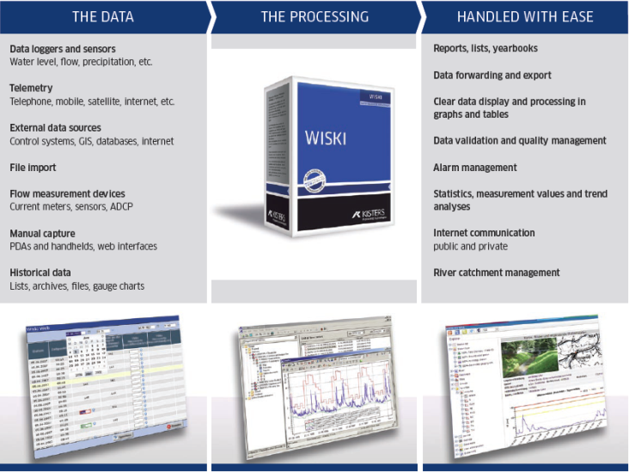

RESEARCH, DEVELOPMENT AND OPERATIONAL ACTIVITIES - WISKI – Hydrological information system -
Telemetry
Reports
Real time data
import
Graphs & Charts
Historical data
import
Processing
GIS integration
Flow measurements
Statistical tools
WISKI

Slide 16
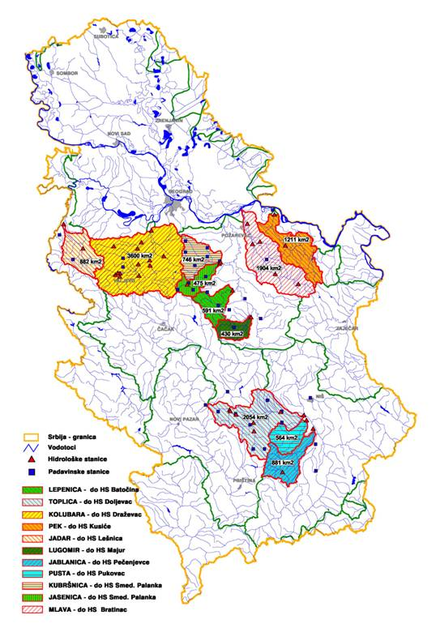
RESEARCH, DEVELOPMENT AND OPERATIONAL ACTIVITIES
IN HYDROLOGY
Hydrological forecasting models, early warnings and alerts are developed and introduced in operational practice.
At smaller and medium water flows, models based on the analysis of the rainfall-runoff process are used, along with the adapted well-known hydrological forecasting models, such as the TANK model for the Kolubara river and the HBV model for the Jadar, Kubrsnica, Jasenica, Mlava and Toplica river.
Overview of small and medium river catchments in Serbia at which the HBV model is applied

Slide 17
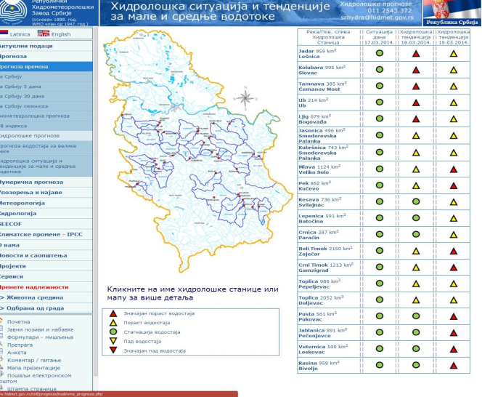
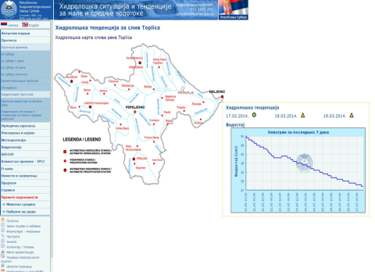
RESEARCH, DEVELOPMENT AND OPERATIONAL ACTIVITIES
Enhancement of the hydrological forecasting system for small and medium river catchments – HBV model in operational practice

Slide 18

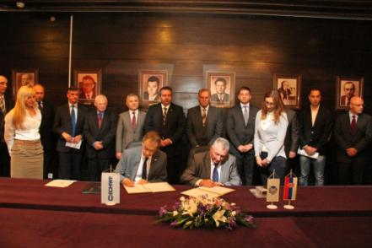
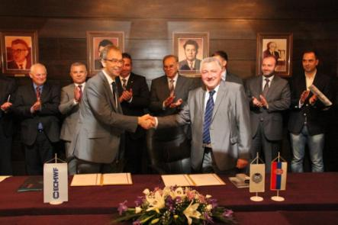
INTERNATIONAL COOPERATION
Signing of an Agreement between ECMWF and RHMSS – directors Alan Thorpe and Vladan Kocic at RHMSS, Belgrade, 27 September 2013
.
  Extension of the Cooperating State Agreement with EUMETSAT – by the end of the year
  Along with the existing agreements on technical cooperation with NMHSs from the region and Europe, in 2013 we signed:
  - Bilateral cooperation agreement with the Environmental Protection Agency of Emilia-Romagna, Italy – ARPA;
  - Technical Annex to the existing Memorandum of Understanding between SEEVCCC/RHMSS and the NMHS of Albania (SEEVCCC Research & Development Consortium).

Slide 19
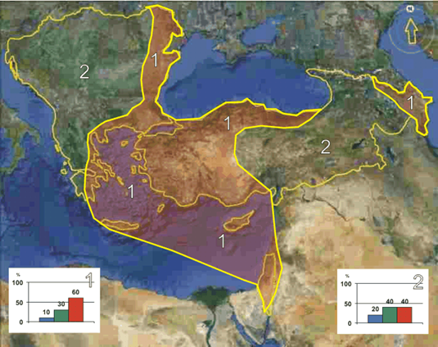
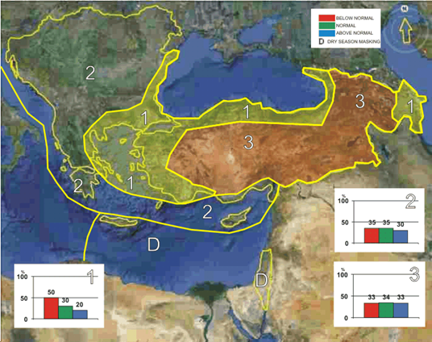
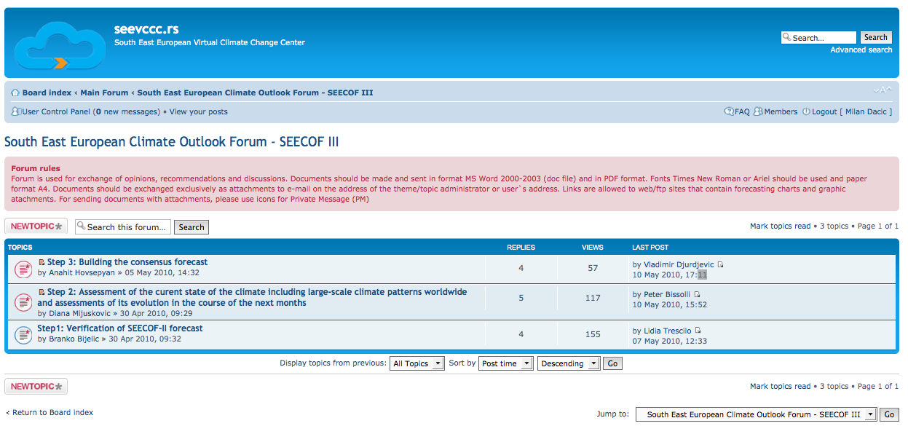
INTERNATIONAL COOPERATION
CONTRIBUTION TO WMO RCOF – SEECOF
Organization of the WMO/South East European Climate Outlook Forum – SEECOF in cooperation with WMO:
SEECOF 4 – November 2010, Belgrade
SEECOF 3, 5, 7, 9 and 11 electronic sessions, May 2010/11 /12/13/14
SEECOF 6 – Belgrade, Serbia, 28-30 November 2011
SEECOF 8 – Podgorica, Montenegro, 27-29 November 2012
SEECOF 10 – Belgrade, Serbia, November 2013
SEECOF 12 – Turkey

Slide 20
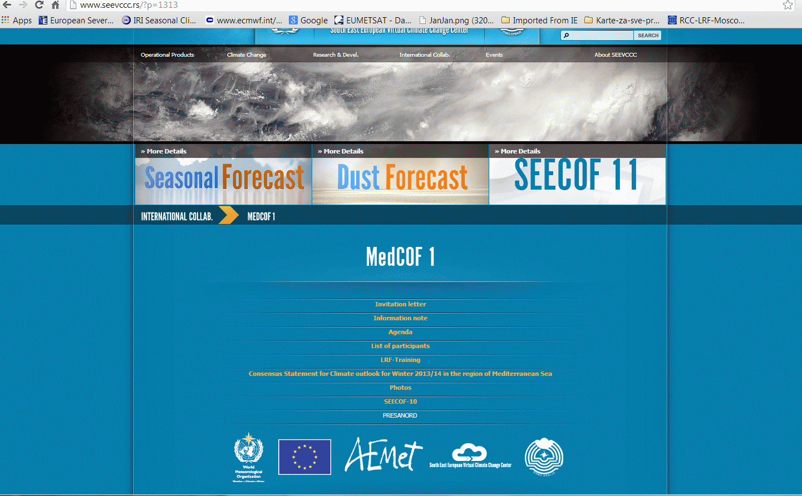
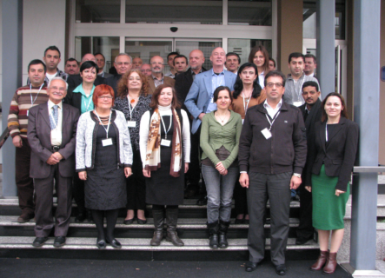
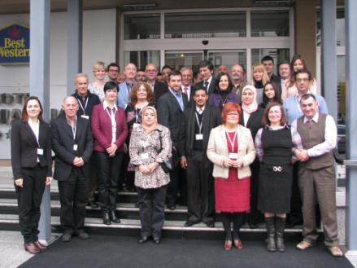
INTERNATIONAL COOPERATION
CONTRIBUTION TO WMO RCOF – SEECOF - MedCOF
13-16 November - LRF training;
18-19 November - MedCOF-1;
20-21 November - SEECOF-10.
SEEVCCC web page related to MedCOF-1
LRF/MedCOF/SEECOF
November 2013, Belgrade
During 9 days, 35 experts from 20 countries participated in the LRF training course and SEECOF-10 and MedCOF-1 meetings.

Slide 21
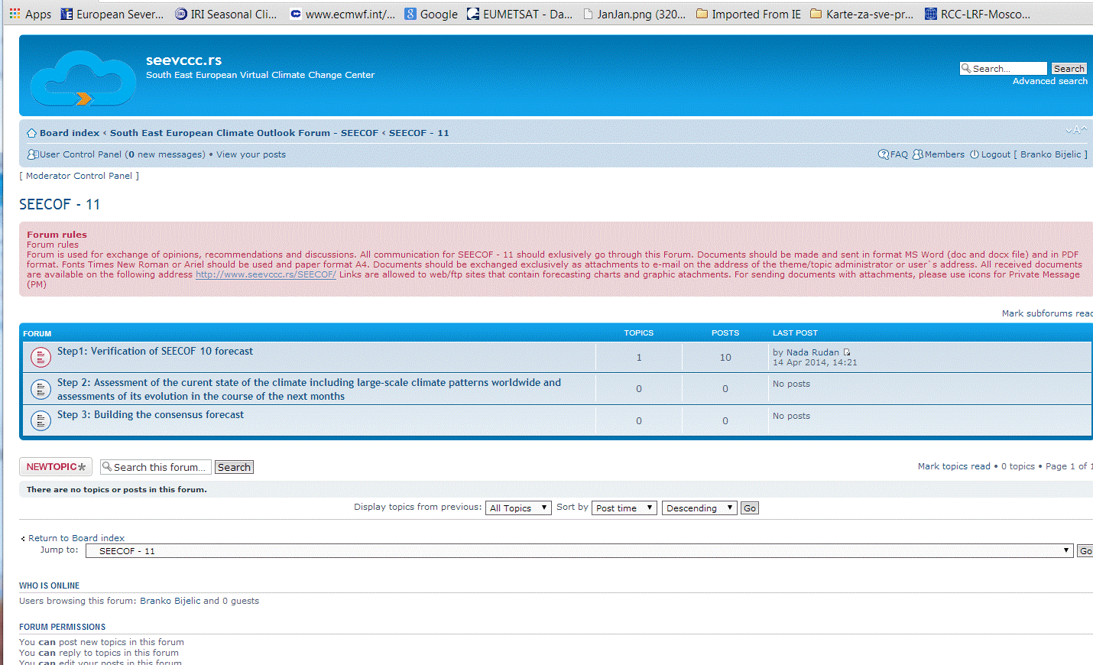
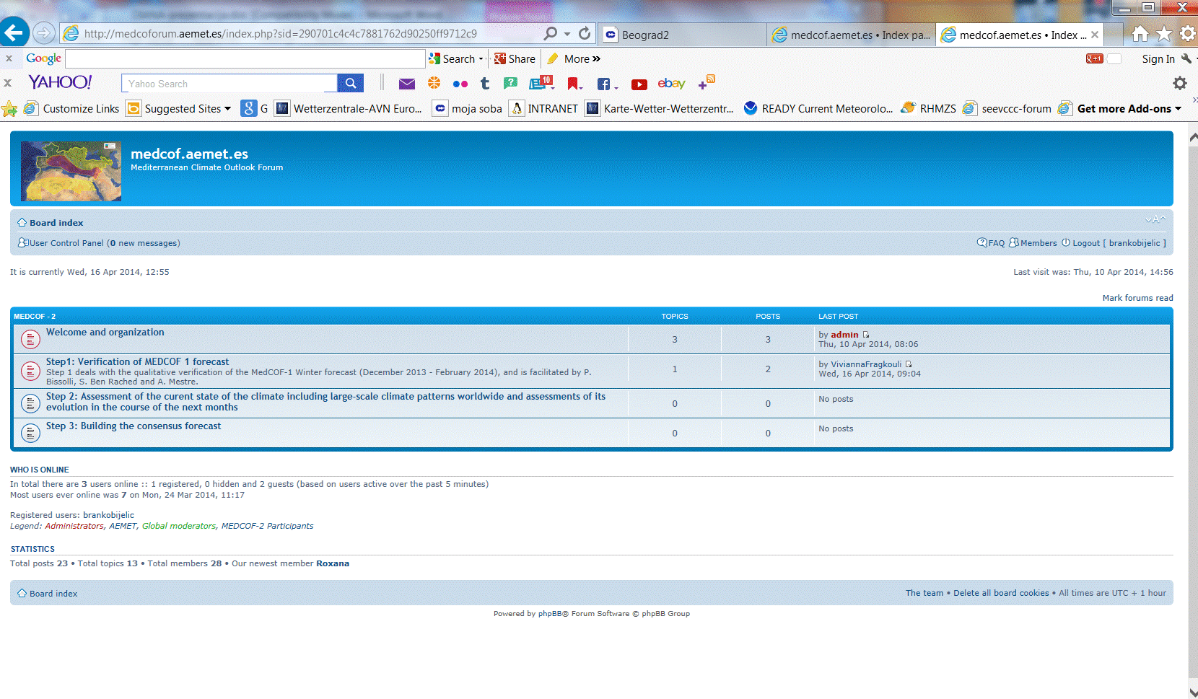
INTERNATIONAL COOPERATION
CONTRIBUTION TO WMO RCOF – SEECOF - MedCOF
Web pages of SEECOF-11 & MedCOF-2 online
SEECOF-11 online Forum page: http://www.seevccc.rs/forum/
MedCOF-2 online Forum page:
http://medcoforum.aemet.es/

Slide 22
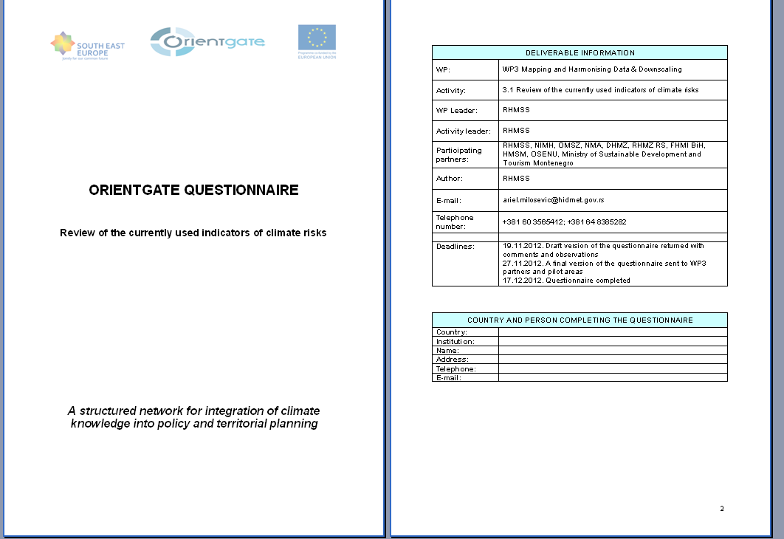
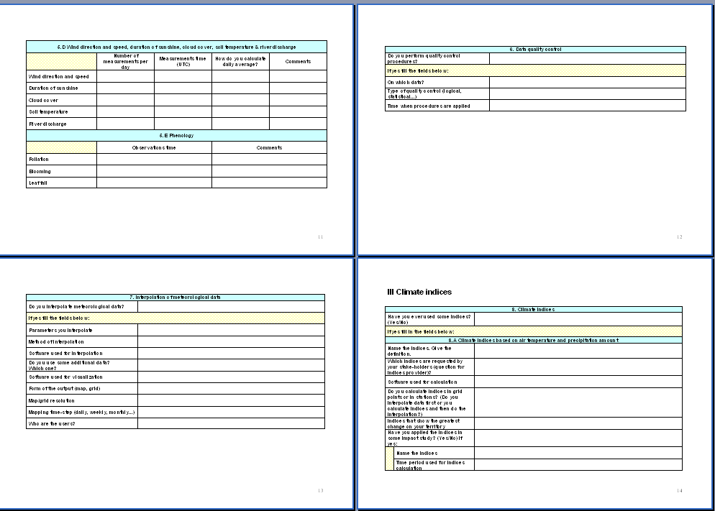
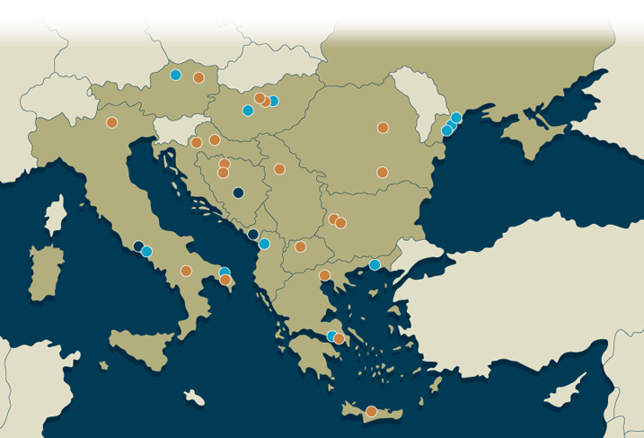
Project ”A Structured Network for Integration of Climate Knowledge into Policy and Territorial Planning – ORIENTGATE”
Our task within the project was to present the existing condition regarding climate change and to produce a proposal for a revised set of climate change indicators based on the results from pilot studies.
Production of the Emission Scenarios Proposal (Climate simulations were produced by CMCC and RHMSS, using the new NMMB model and new IPCC scenario RCP8.5 for the 1971-2100 period).
http://orientgate.rec.org/

Slide 23


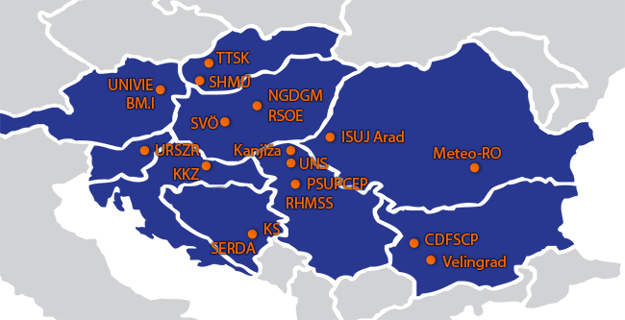
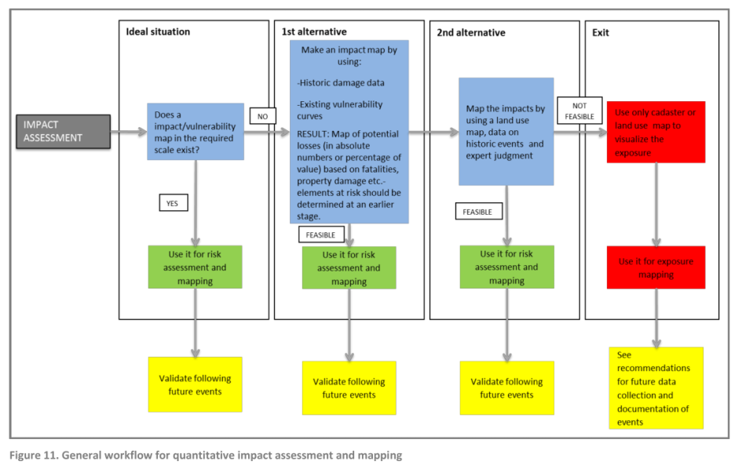
Project ”Joint Disaster Management Risk Assessment and Preparedness in the Danube Region – SEERISK”
The aim of the ongoing SEERISK project is to define a common methodology for the assessment of risk of natural hazards in the Danube macro-region.
In the territory of Serbia, Kanjiza municipality represented a pilot area for the analysis of drought and forest fire. These two hazards were selected for the production of risk assessment.
A guideline for climate change adaptation and risk assessment in the Danube macro-region was issued in two languages.
http://www.seeriskproject.eu

Slide 24













Project ”Distributed Research Infrastructure for Hydro-meteorology - DRIHM”
http://www.drihm.eu/
The goal of the ongoing DRIHM project is to enable the users to have easy access to the chains of various models through a web portal, with the aim of developing hydrometeorological early warning tools.
RHMSS has contributed to the project with its WRF-NMM model and with the distributed HBV model which is being developed in cooperation with our Dutch partners.
During last year we installed meteorological and hydrological models on a virtual server, and we defined and gathered input data for the planned numerical tests.
Distributed HBV
time step = 1 h
discharge, soil moisture and snow water for each point of a catchment
hydrogram for each point of a river network
WRF-NMM
fine resolution suitable for water discharge forecasts for small and medium catchments
precipitation
temperature

Slide 25
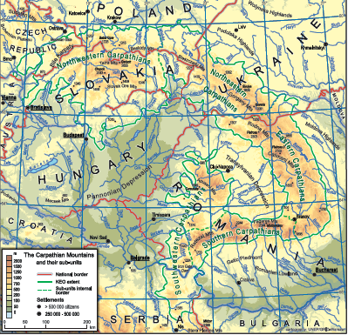
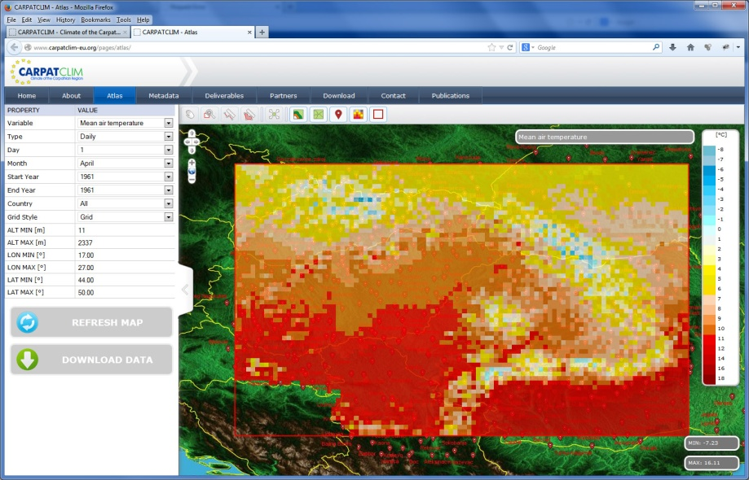
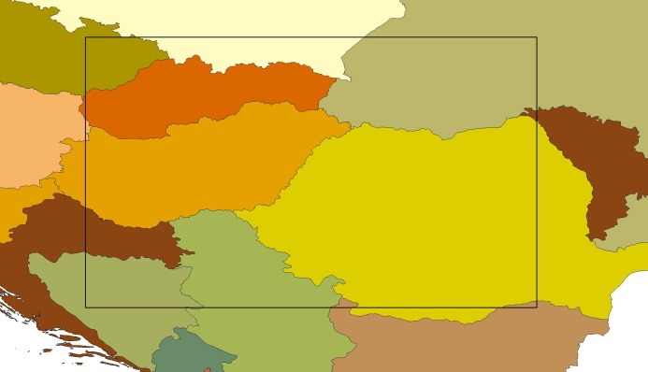
Project ”Climate of the Carpathian Region – CARPATCLIM”
The project ended in July 2013
The aim of the project was to enhance the climatological database, to produce gridded climatology and to develop a digital Climate Atlas of the Carpathian Region
The production of the CARPATCLIM web platform was completed in 2013
After finalizing all project activities our task was to continue maintaining the website
http://www.carpatclim-eu.org

Slide 26

IPA 2012/290-552 Project:
“Building Resilience to Disasters
in the Western Balkans and Turkey”
In 2013, numerous workshops and kick-off meetings have been organized within the framework of various work packages, with the participation of RHMSS experts and representatives of the Ministry of Interior of the Republic of Serbia:
Historical meteorological and hydrological data management
Meteorological forecasts
Early flood warning and integrated flood management
Establishment of a regional early warning system through the harmonization of national systems
Quality management systems

Slide 27


Project ”Further Improvement and Development of Flood Forecasting Services in Serbia”
A bilateral project between Serbia and Norway was launched in 2011 and ended in 2013
Completion of the installation of 6 new automatic rain gauges
A case study on climate change impacts on water resources in Serbia
National round table related to the analysis of climate change impact on water resources in Serbia, January 2014
Ambassador of the Kingdom of Norway, H.E. Mr Nils Ragnar Kamsvag

Slide 28
CAPACITY BUILDING
EDUCATION AND TRAINING
When it comes to the implementation of the human resources development plan, it is particularly important to mention the training programs of WMO, ECMWF, EUMETSAT and EUMETNET, those of the existing training centers specialized for certain areas of meteorology and hydrology, as well as bilateral programs and technical cooperation programs.
In accordance with the General Programme of Professional Development for Civil Servants for 2013, we had:
9 internal trainings with more than 500 participants
8 on-line trainings with 18 participants
26 employees participating in 15 trainings organized by the Human Resource Management Service of the Government of the Republic of Serbia
34 employees participating in 24 trainings organized by international institutions
8 employees going through the programme of additional education.

Slide 29
Thank you for your attention
www.hidmet.gov.rs
www.seevccc.rs
ICSEED 13th Session
Banja Luka, Bosnia and Hercegovina, Republic of Srpska, 28 – 29 April 2014

