Slide 1



Republic Hydro-Meteorological Service of Republika Srpska (one of two entity hidrometeorological services in Bosnia and Herzegovina)
ICSEED 13th Session , Banja Luka 28-29 April 2014.RS B&H
INFORMAL
CONFERENCE
OF SOUTH-EAST
EUROPE
DIRECTORS
Hosted by Republic
Hydrometeorological
Service of
Republic of Srpska,
Bosnia and Herzegovina
Achievements between two meetings and present actions
rhmz@teol.net Republic Hydro-Meteorological Service of Republika Srpska, B&H www.rhmzrs.com

Slide 2
ICSEED 13th Session , Banja Luka 28-29 April 2014.RS B&H
FOCUS ON WHOLE INSTITUTION
DOCUMENTS:
Platform: Republika Srpska Strategy for natural disaster reduction
Risk assessment of natural disasters in Republika Srpska_adopted
MEMORANDUM OF UNDERSTANDING: good practice
Memorandum of Understanding (MoU)
on the Cooperation in Meteorology, Hydrology and Related Matters
between the
Meteorological and Hydrological Service of Croatia
and the
National Meteorological Service of Bosnia and Herzegovina
equally represented by the
Federal Hydrometeorological Institute
of the Federation of Bosnia and Herzegovina
and the
Republic Hydrometeorological Service
of the Republic Srpska
rhmz@teol.net Republic Hydro-Meteorological Service of Republika Srpska, B&H www.rhmzrs.com

Slide 3
ICSEED 13th Session , Banja Luka 28-29 April 2014.RS B&H
FOCUS ON WHOLE INSTITUTION
MEMORANDUM OF UNDERSTANDING: good practice
Memorandum of Understanding between the three institutions is an excellent example of cross-border cooperation. His signing has already reached its first results:
the first meeting in Banja Luka
obtained radar images from DHMZ for both entity hydrometeorological services in B & H
Federal Hydrometeorological Institute of FBiH made ​​available to RHMZ RS archive of historical meteorological data
In future all scanned and digitized data will be exchanged
in hydrology performed the first joint measurement on the Sava River, planned new on second border river.
DHMZ is committed with the Secretary General of WMO to resolve problem of the permanent representatives of B & H in the WMO
rhmz@teol.net Republic Hydro-Meteorological Service of Republika Srpska, B&H www.rhmzrs.com

Slide 4
ICSEED 13th Session , Banja Luka 28-29 April 2014.RS B&H
ACTION:
RA VI PANORAMA SURVEY– 2013: Institutional Arrangements, Challenges and Priorities
rhmz@teol.net Republic Hydro-Meteorological Service of Republika Srpska, B&H www.rhmzrs.com

Slide 5
ICSEED 13th Session , Banja Luka 28-29 April 2014.RS B&H
FOCUS ON WHOLE INSTITUTION
ACTION:
Ministry of agriculture, forestry and water management recognized the importance of developing RHMZ RS at the time of climate change and increasingly frequent natural disasters caused by time:
-RHMZ RS budget for this year increased for the amount of € 120,000
-funds will be provided for the equipment for all sectors
-much of it is intended to replace the mercury instruments with digital
rhmz@teol.net Republic Hydro-Meteorological Service of Republika Srpska, B&H www.rhmzrs.com

Slide 6
ICSEED 13th Session , Banja Luka 28-29 April 2014.RS B&H
FOCUS ON WHOLE INSTITUTION
ACTION:within Ministry of agriculture, forestry and water management :
Coordinating body
RHMZ RS
Public institution „ vo de Srpske“
Public company „Hail prevention of Republic of Srpska“
-proper use of capacity -joint action in cases of natural disasters -coordination
Enviromental Protection and Efficiency Fund of the Republic of Srpska
Ministry of Spatrial Planing, Civil Enginnering and Ecology
rhmz@teol.net Republic Hydro-Meteorological Service of Republika Srpska, B&H www.rhmzrs.com

Slide 7

ICSEED 13th Session , Banja Luka 28-29 April 2014.RS B&H
FOCUS ON WHOLE INSTITUTION
ACTION:
RHMZ RS
Public company „Hail prevention of Republic of Srpska“
Joint center for the collection and processing of data Forecasting center
EARLY WARNING SISTEM
rhmz@teol.net Republic Hydro-Meteorological Service of Republika Srpska, B&H www.rhmzrs.com

Slide 8
ICSEED 13th Session , Banja Luka 28-29 April 2014.RS B&H
FOCUS ON METEOROLOGY
ACTION:
Project of hail suppression public company : CPAD - Center for collection, accumulation and distribution of data.(will provide meteorology radar system, regional hail suppression Centers, a network of hail suppression -automatic stations, a network of automatic weather stations and Information - Telecommunication Networks).
Joint project on early warning system, with Republic Civil Protection
Taking part in Sava River commission trough expert group for meteorology and hydrology
rhmz@teol.net Republic Hydro-Meteorological Service of Republika Srpska, B&H www.rhmzrs.com

Slide 9
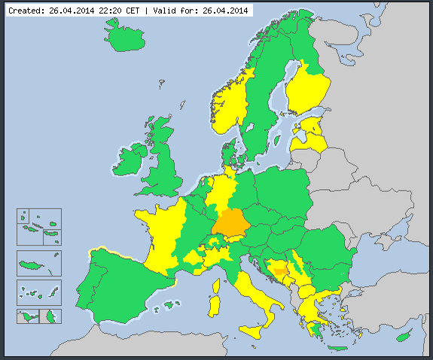
ICSEED 13th Session , Banja Luka 28-29 April 2014.RS B&H
FOCUS ON METEOROLOGY
ACTION:
Joint project on METEOALARM, with FHMS of Federation B&H
rhmz@teol.net Republic Hydro-Meteorological Service of Republika Srpska, B&H www.rhmzrs.com

Slide 10
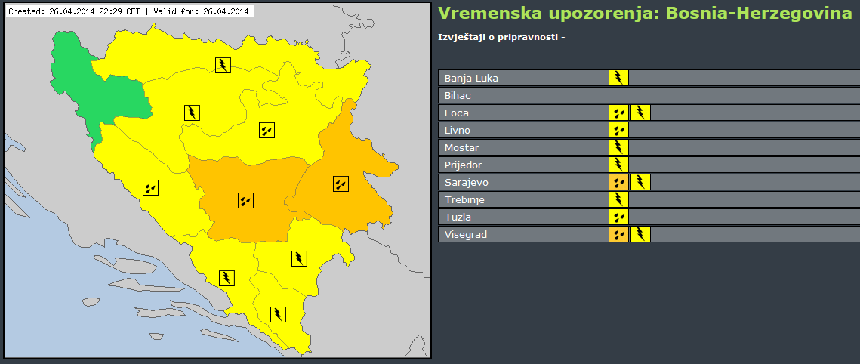
ICSEED 13th Session , Banja Luka 28-29 April 2014.RS B&H
FOCUS ON WHOLE INSTITUTION
ACTION:
Joint project on METEOALARM, with FHMS of Federation B&H
rhmz@teol.net Republic Hydro-Meteorological Service of Republika Srpska, B&H www.rhmzrs.com

Slide 11
ICSEED 13th Session , Banja Luka 28-29 April 2014.RS B&H
FOCUS ON WHOLE INSTITUTION
ACTION:
Joint project on METEOALARM, with FHMS of Federation B&H
rhmz@teol.net Republic Hydro-Meteorological Service of Republika Srpska, B&H www.rhmzrs.com

Slide 12

ICSEED 13th Session , Banja Luka 28-29 April 2014.RS B&H
FOCUS ON Project ORIENTGATE
PROJECTS:
Participation in ORIENTGATE project
RHMZ Serbia: the leader of the work package no. 3
(mapping and harmonization of data and 'downscaling') and is responsible for the following activities:
RHMZ RS PP6
Activities in 2013:
• Review of existing indicators of climate risks (development of the questionnaire through which to collect existing data and establish risk maps)
rhmz@teol.net Republic Hydro-Meteorological Service of Republika Srpska, B&H www.rhmzrs.com

Slide 13
ICSEED 13th Session , Banja Luka 28-29 April 2014.RS B&H
FOCUS ON Project ORIENTGATE
Activities in 2013:
• Proposal of harmonized set of indicators and guidelines for their calculation and use (making folders of the indicators, the development of a new set of indicators that will be used in the six pilot studies, statistical analysis of each indicator, instructions and questionnaires related to the individual needs of different partners in the project)
• Development of 'downscaling' scenario (the lead partner RHMZ and each parner for itself will develop scenarios with the same coordinates using predetermined low and high emission scenarios).
• Organization of trainings and workshops
rhmz@teol.net Republic Hydro-Meteorological Service of Republika Srpska, B&H www.rhmzrs.com

Slide 14
ICSEED 13th Session , Banja Luka 28-29 April 2014.RS B&H
FOCUS ON Project ORIENTGATE
Activities in 2014:
• Development of revised indicators at the sub regional level (inspection and harmonization results of the pilot study, and correcting instructions accordingly).
• RHMZ will also organize a seminar in June 2014th year in which the partners predstavti revised set of indicators
• Participation in other meetings organized by the project partners
rhmz@teol.net Republic Hydro-Meteorological Service of Republika Srpska, B&H www.rhmzrs.com

Slide 15

ICSEED 13th Session , Banja Luka 28-29 April 2014.RS B&H
FOCUS ON PROJECT K E P
PROJECTS:
Participation in KEP project (start in june 2014.)
IMPROVING ENVIRONMENTAL MONITORING AND DISASTER PREVENTION CAPACITY IN DRINA RIVER BASIN – PHASE II (Republic of Srpska and Montenegro).
rhmz@teol.net Republic Hydro-Meteorological Service of Republika Srpska, B&H www.rhmzrs.com

Slide 16
ICSEED 13th Session , Banja Luka 28-29 April 2014.RS B&H
FOCUS ON PROJECT K E P
IMPROVING ENVIRONMENTAL MONITORING AND DISASTER PREVENTION CAPACITY IN DRINA RIVER BASIN – PHASE II (Republic of Srpska and Montenegro).
Drina river trans-boundary among Serbia, Republic of Srpska (BiH) and Montenegro
Scope of the initiative is to improve environmental monitoring on the Drina river and to reduce risks from natural events and improve safety of population.
Starting of a permanent data exchange program, focused to the implementation of trans-boundary projects of common interest.
rhmz@teol.net Republic Hydro-Meteorological Service of Republika Srpska, B&H www.rhmzrs.com

Slide 17
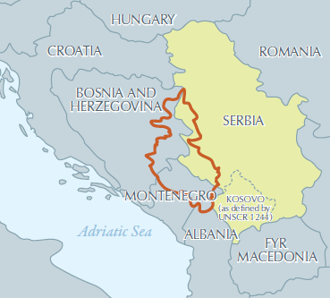
ICSEED 13th Session , Banja Luka 28-29 April 2014.RS B&H
FOCUS ON PROJECT K E P
Only commonly shared water management strategies and consequent actions may in facts lead to rational and effective exploitation of extremely high potential connected to Drina River and tributaries
rhmz@teol.net Republic Hydro-Meteorological Service of Republika Srpska, B&H www.rhmzrs.com

Slide 18
ICSEED 13th Session , Banja Luka 28-29 April 2014.RS B&H
FOCUS ON PROJECT K E P
Sectors to be investigated under the present project include: 1.water resource management,
2.hydro-meteorological monitoring and forecast,
3.risk reduction from natural events,
4.air and water quality,
5.energy and overall social and economic development.
rhmz@teol.net Republic Hydro-Meteorological Service of Republika Srpska, B&H www.rhmzrs.com

Slide 19
ICSEED 13th Session , Banja Luka 28-29 April 2014.RS B&H
FOCUS ON M C H
In February we installed MCH
We are importing data in MCH
All new data are importing in MCH
first experiences with the program are positive
there is a user and developer forum, where you can discuss any concerns and problems
very important issues is posibility to made changed in application and to add new with developer
the only disadvantage if can call it that is very complicated installation
rhmz@teol.net Republic Hydro-Meteorological Service of Republika Srpska, B&H www.rhmzrs.com

Slide 20
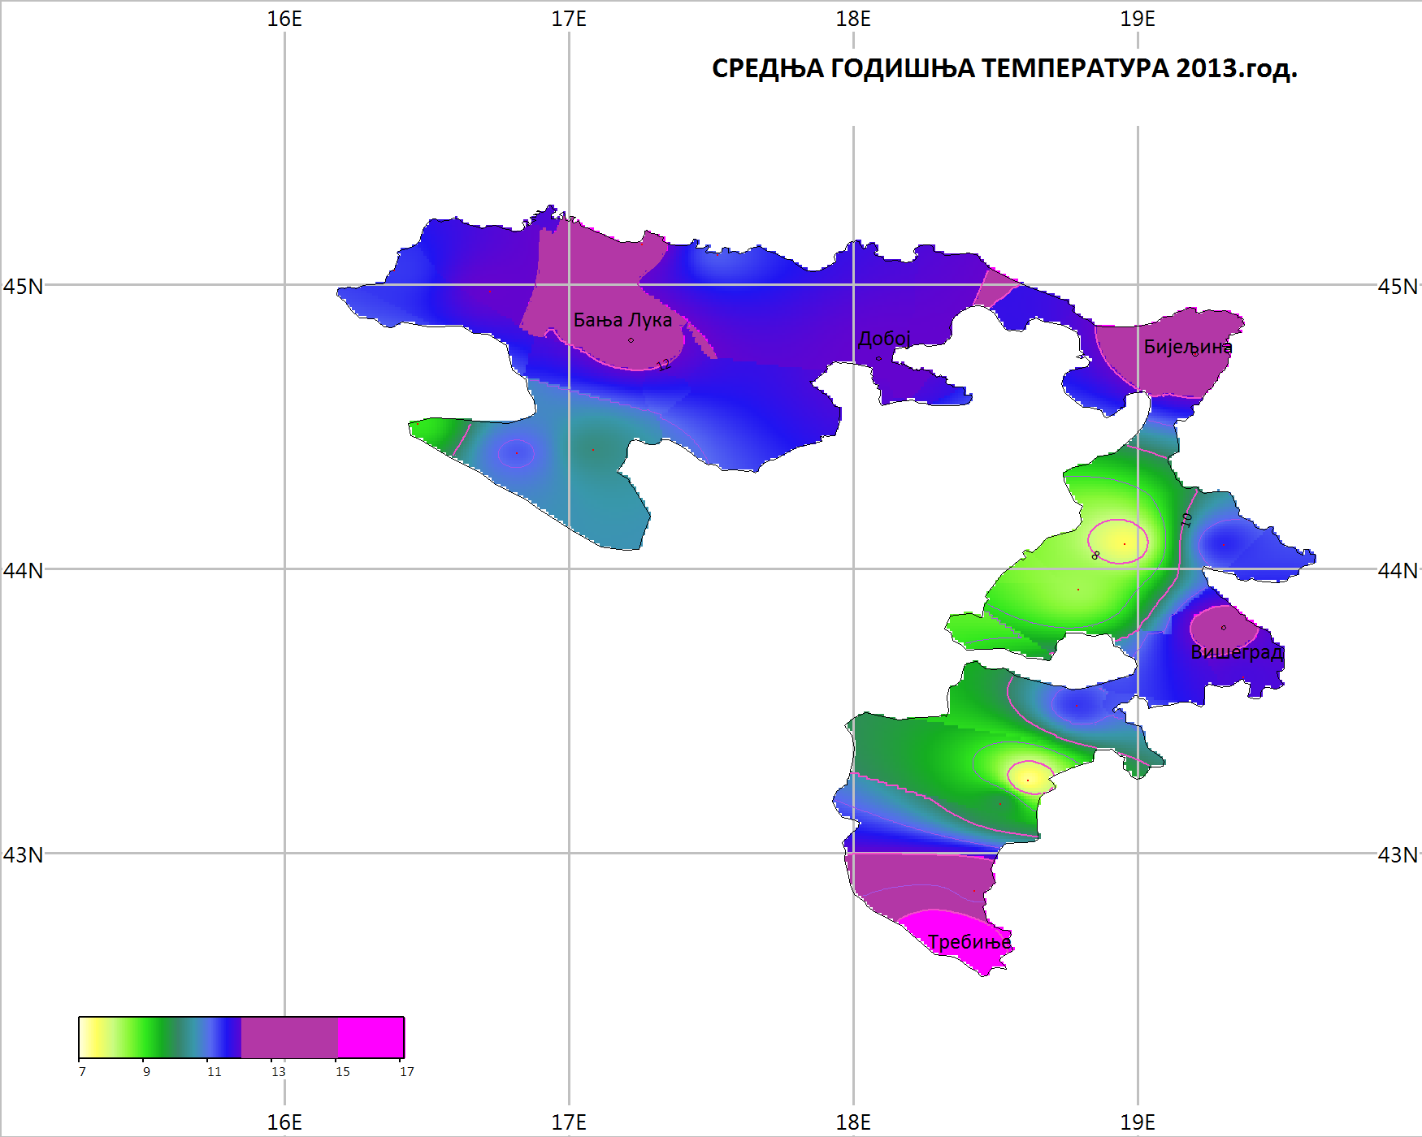
ICSEED 13th Session , Banja Luka 28-29 April 2014.RS B&H
FOCUS ON M C H
Average temperature 2013.
rhmz@teol.net Republic Hydro-Meteorological Service of Republika Srpska, B&H www.rhmzrs.com

Slide 21
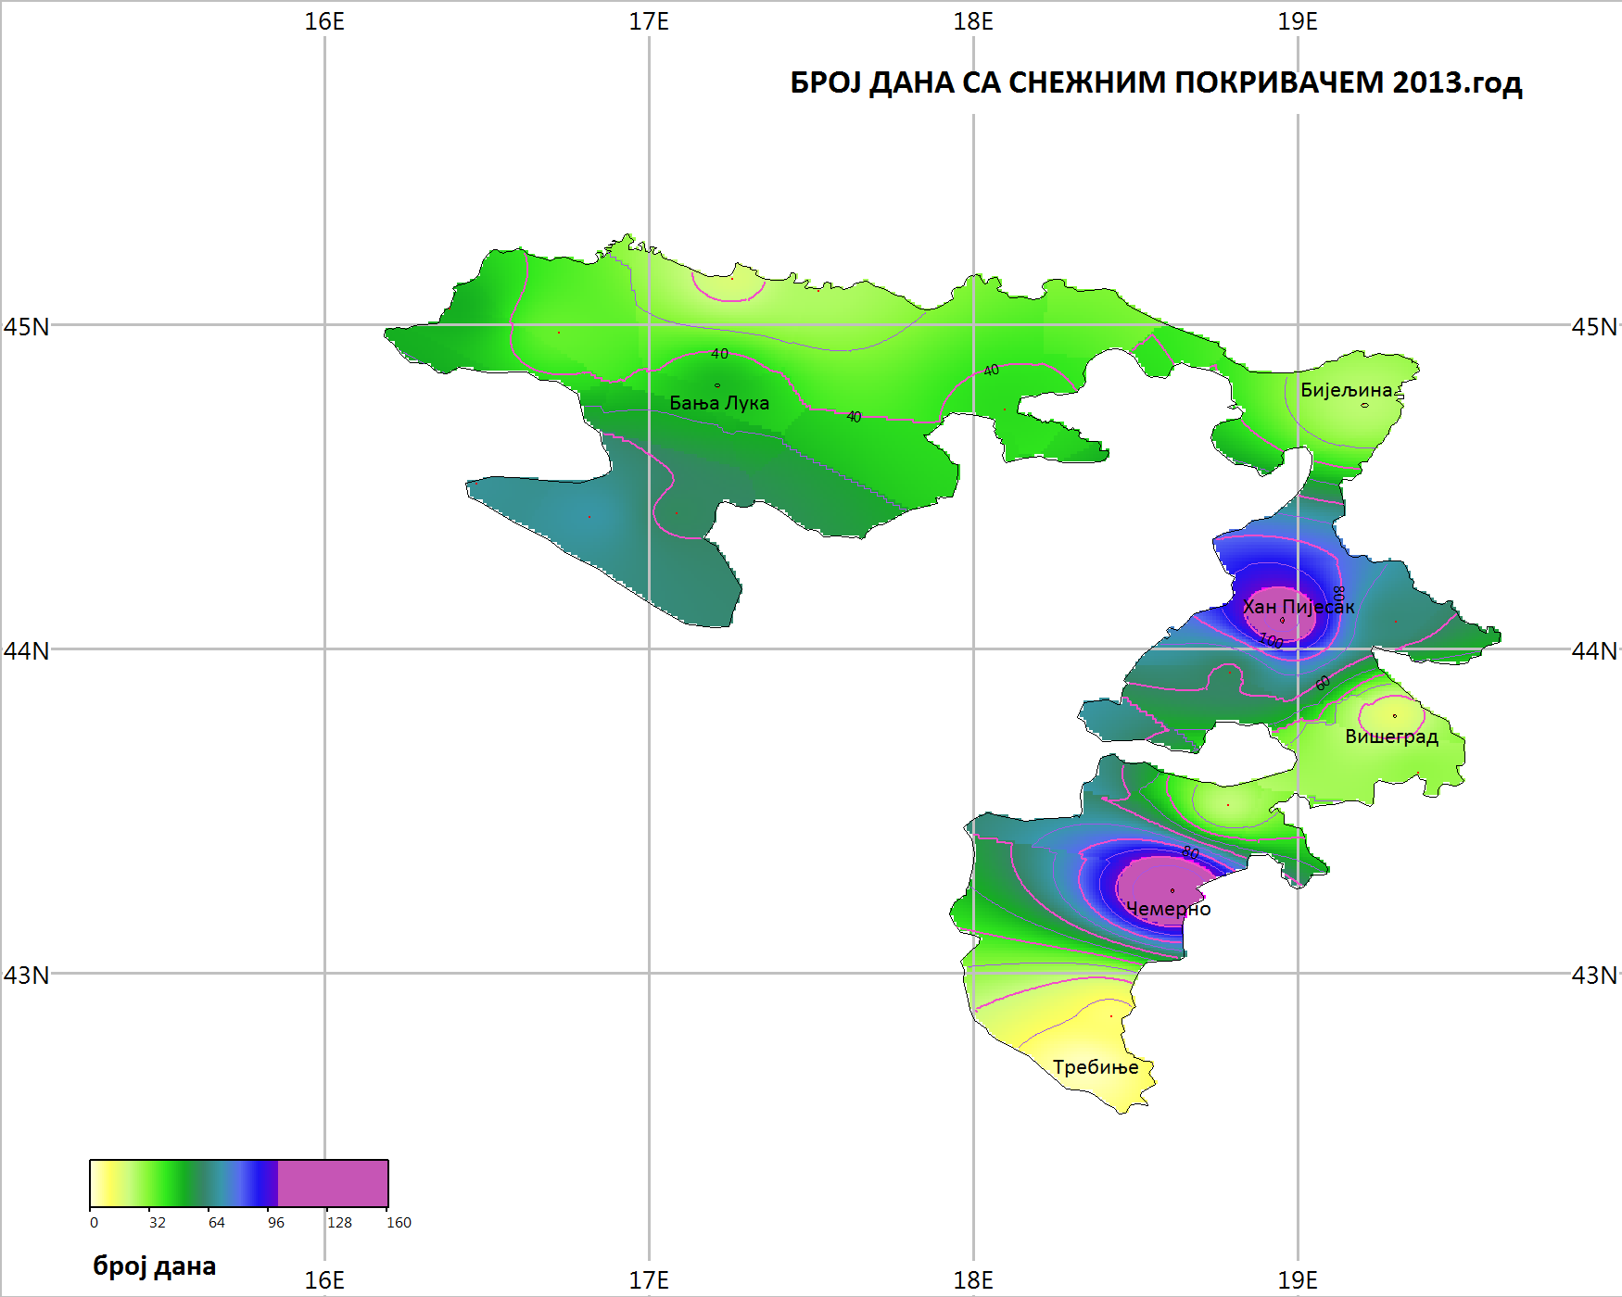
ICSEED 13th Session , Banja Luka 28-29 April 2014.RS B&H
FOCUS ON M C H
Number of day with snow 2013.
rhmz@teol.net Republic Hydro-Meteorological Service of Republika Srpska, B&H www.rhmzrs.com

Slide 22
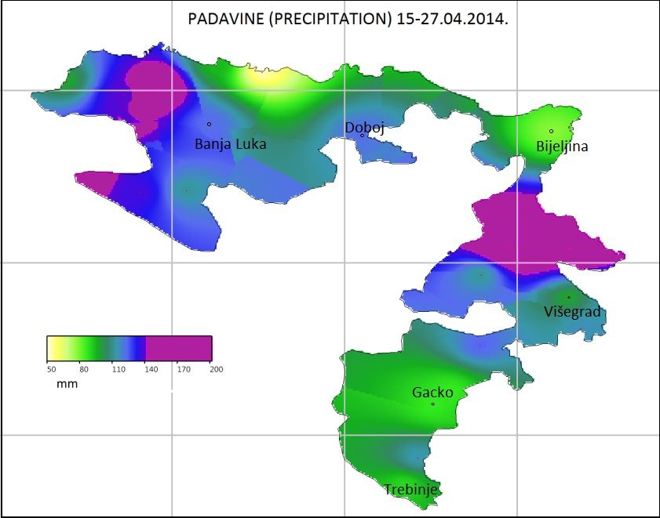
ICSEED 13th Session , Banja Luka 28-29 April 2014.RS B&H
FOCUS ON M C H
Precipitation
15-17.april
2014
rhmz@teol.net Republic Hydro-Meteorological Service of Republika Srpska, B&H www.rhmzrs.com

Slide 23
Republic Hydro-Meteorological Service of Republika Srpska (one of two entity hidrometeorological services in Bosnia and Herzegovina)
ICSEED 13th Session , Banja Luka 28-29 April 2014.RS B&H
INFORMAL
CONFERENCE
OF SOUTH-EAST
EUROPE
DIRECTORS
Hosted by Republic
Hydrometeorological
Service of
Republic of Srpska,
Bosnia and Herzegovina
Thank you very much
For your attention!
rhmz@teol.net Republic Hydro-Meteorological Service of Republika Srpska, B&H www.rhmzrs.com

