Slide 1
The Future Under Open Data?
ICSEED November 2015 Bucharest
Willie McCairns
Chief Executive, ECOMET

Slide 2
Contents
History of ECOMET
Current Aims and Activities
Open data– current situation
Open data – The Future?

Slide 3
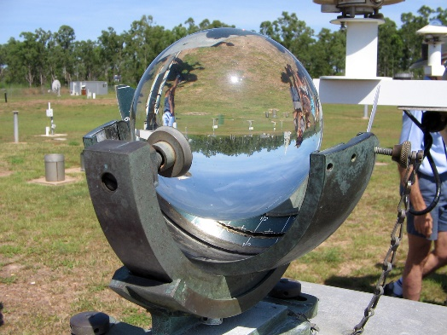
History – The Needs
Enable open competition
No abuse of dominant position
No state subsidies
No price fixing
Ensure free exchange of data under WMO Resolution 40
Access to each other’s data and products under license

Slide 4
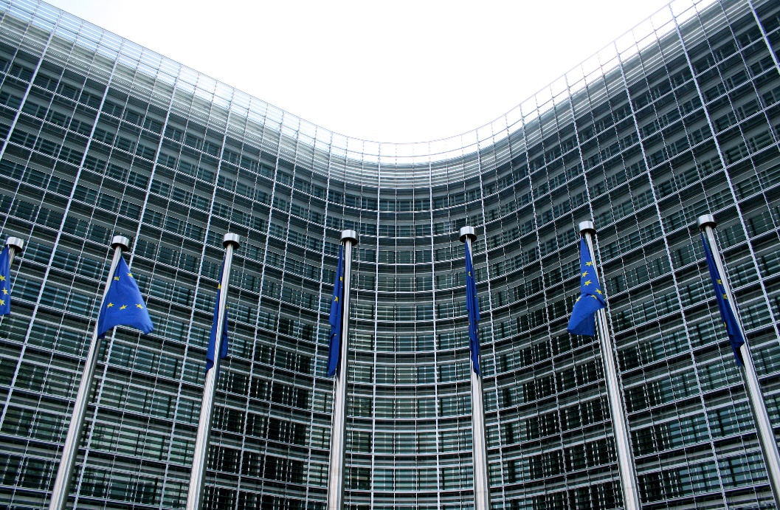
History - EU Legislation
EC Competition Law
Directive 80/723/EEC “The Transparency Directive”
Directive 2003/4/EC on the public access to environmental information
Directive 2003/98/ EC on the re-use of the public sector information

Slide 5
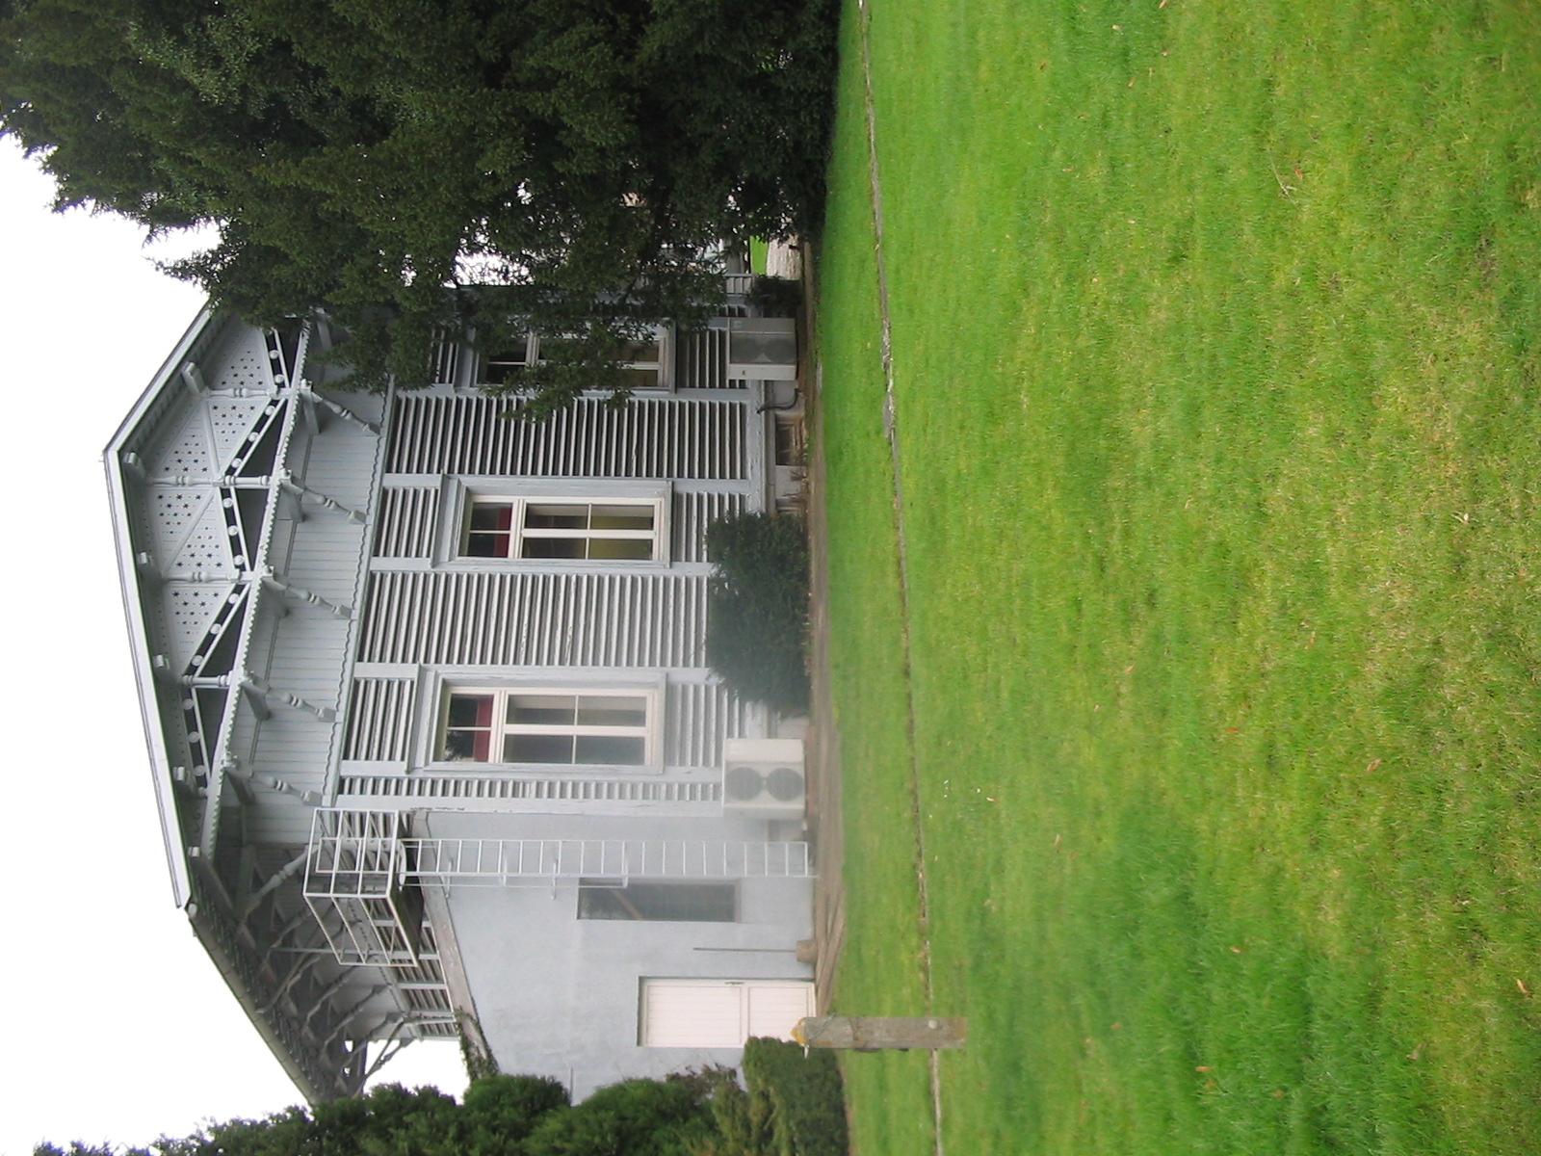
History – The Solution
ECOMET formed December 1995
An Economic Interest Grouping (eig) under Belgian Law
Based in Brussels
For benefit of European NMHSs
Current membership 25

Slide 6
ECOMET – Current Aims
To maintain a level playing field for commercial activities in Europe
To operate and maintain an administrative framework to facilitate access to data and products throughout Europe (for the ECOMET Members and Third Parties)
To act as data policy advisors towards the community and interested actors regarding the exchange of meteorological data and products in Europe

Slide 7
ECOMET– Current Activities-1
Managing Key Relationships
  European Commission
  Private Sector (PRIMET)
Membership Expansion
  Prioritising EUMETNET Members
  Joint approach of other prospective Members with EUMETNET

Slide 8
ECOMET– Current Activities-2
Liaison with other European Meteorological Organisations
  Harmonisation of definitions between ECOMET, ECMWF & EUMETSAT
  Data policy meetings now held concurrently with ECMWF & EUMETSAT
Advice to Members on data policy and licensing

Slide 9
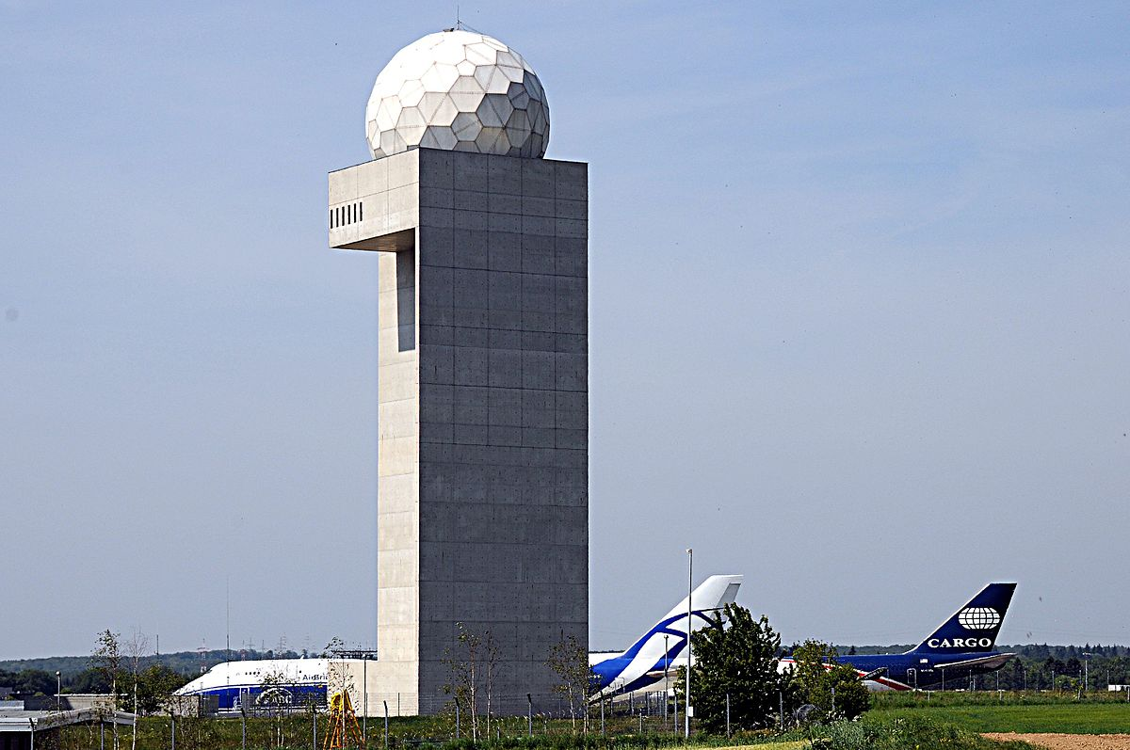
Open Data
The Current Situation - PSI
PSI Directive revised June 2013
All member states should have transposed it into law
This has resulted in:
  A move towards free or low-cost for re-use of meteorological data and products
  Pressures on infrastructure funding for some members
  Active lobbying of the EU by PRIMET

Slide 10
The Move Towards Open data
A third of member States are currently operating an Open data policy
A third of member states are currently actively considering or pursuing an open data Policy
A third of member states currently have no plans to implement an open data policy

Slide 11

Open data – the Future?
All NMHS’ in Europe will make their basic data and products free of information charge
NMHS’ will retain single authoritative voice for warnings
Commercial value added services will still exist
Some companies will still pay for guaranteed delivery of data and products
NMHS’ and the private sector will compete on service delivery quality

Slide 12
Open data –
The Unanswered questions?
Will all NMHS’ continue to produce exactly the same things?
How will we make all the data available?
  Will every NMHS’ have it’s own web based data portal?
How will we maintain the quality of the meteorological infrastructure?

Slide 13

Questions – Contact details
Any questions?
Willie McCairns MBA, Chief Executive
ECOMET
Ringlaan 3, Pavillion Magnetique sud,
B-1180 Brussel
Tel +32 2 372 13 30
Mob +0044 7805 582083
e-mail: willie.mccairns@meteo.be
website: http://www.ecomet.eu

