Slide 1
What’s cooking at EUMETNET
An overview of the issues at hand

Slide 2
Outline
Membership
Copernicus Climate Change Service
Exploring New domains
Technical challenges
  Radars, the right Obs network, capacity and training
Political/Financial challenges
  Strategy
  Eumetnet’s fitness for purpose

Slide 3
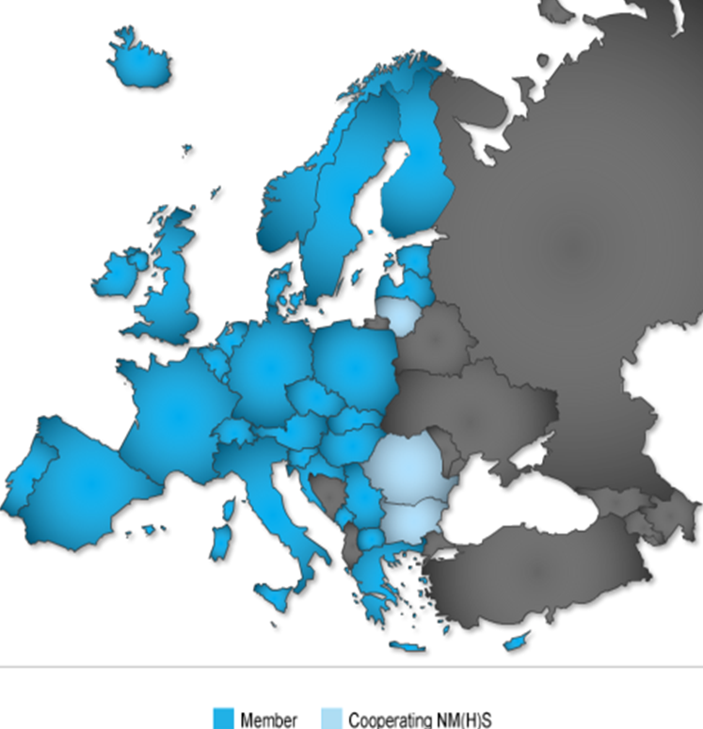
EUMETNET Membership : 31 + 4
Lithuania has joined EMMA
A new Italian Met Service is under construction
Expressions of interest from :
  Belarus (EMMA, OPERA),
  Moldova and Albania (EMMA)
  Turkey (OPERA and E-AMDAR)

Slide 4
Dealing with Copernicus/Climate challenges
Building the Climate Data Store as comprehensive as possible but avoiding duplications
  Not much information is circulating, some technical challenges ahead (e.g. interfacing to the system, quality requirements)
We will respect the ownership of the underlying national datasets. Data is provided free of charge but under strict non-redistribution conditions for those that do not have a free and open data policy
Copernicus Climate Project is struggling to get the In-Situ coordinator (EEA) to play its role. New person at EEA was appointed on October 1 (Henrik Steen Anderson of DMI) so we expect some progress from now on
Doubts on the future of legacy EUMETNET climate programmes (”support to members”, ECAD and PEP725 databases) that are theoretically funded until December 2015. Programme managers have asked for an extension.
INSPIRE implementation : Eumetnet has reactivated a WG (with wide membership)

Slide 5
Exploring new domains
SRNWP-EPS project
  Explore various aspects of EPS in the short range and user cases
ASIST project
  Explore and evaluate nowcasting techniques, identify best practices
Upper-air humidity (business case)
  Sensors are finally installed on Lufthansa A320 but wide coverage is unafordable
  T-AMDARs are of good quality but we do not have control of this network, Panasonic have been approached
  May need to envisage a hybrid network, more studies are needed
ADD (Aircraft Derived Data) feasibility study and follow-on
  Explore what strong potential benefits and challenges are ahead
  Future cost reductions that could eventually allow EUMETNET to fund aircraft-based humidity data
  Investments could be also funded by Sesar Deployment

Slide 6
Some technical challenges for the future
OPERA/Radar network
  Radars serve multiple purposes and are funded nationally
    It’s impossible to have a homogenous scanning strategy over Europe
  Aviation users are driving some of the new needs
    The US has a seperate radar network for aviation
  Will need to explore sub-regional compositing, WLAN & wind farm disruption
  Get Italy back on board for the next phase
The ”ideal” network for NWP
  Is what we are trying to achieve, but it will only be the one we can afford
  ADD is promising but more work needs to be done – and funded
  EUMETNET does not deal with ground-based Radiosonde and AWS networks
  We need more active and operational cooperation between heads of observations
Capacity building and training
  EUMETCAL is struggling, content creation is out of the official scope of this project
  Strategy : should we build (and fund) something more ambitious that fits into WMO’s ’global campus’ concept ?

Slide 7
Some political challenges
    Lots of pressure to implement open data policies
Managing EC relationship
  EC is moving into the service provision arena which can create soverignty issues w.r.t. national remits (of NMSs and other public services), subsidiarity and single authoritative voice principles
  Copernicus Climate Service creates a paradigm change as NMSs (and other institutes) will have to redesign some of their own climate services by taking into account (i.e. building upon) C3S services as they are deployed
  Is EUMETNET – with no resources at secretariat for this - fit for purpose in responding to more EC calls and proposing to lead/participate in projects ?
Strategy : EUMETNET is not really geared to deal with service provision
  Aviation services as we know them today will be very different in 5 years, big question on EUMETNET’s role in shaping future services
  The notion of ”centralized” or ”common” services is popping up everywhere
Strategy : EUMETNET is geared to deal with infrastructure cost sharing
  But the GNI principle may not work for everything
  The ED proposes to explore what can be done in sharing costs of IT and production systems (like ODYSSEY)

Slide 8
Contact Details
Eric Petermann
Executive Director
GIE/EIG EUMETNET
European Meteorological Services' Network
www.eumetnet.eu
GIE EUMETNET Secretariat
c/o L’Institut Royal Météorologique de Belgique
Avenue Circulaire 3
1180 Bruxelles, Belgique
Registered Number 0818.801.249 - RPM Bruxelles
Tel: +32 (0)2 373 05 18
Fax: +32 (0)2 890 98 58
Email: eric.petermann@eumetnet.eu

