Slide 1





The IHMS of Montenegro
between two ICSEEDs
Sanja Pavicevic, MSc Physics
Deputy Director
Institute of Hydrometeorology and Seismology of Montenegro
14th Session of the Informal Conference of SEE NMHSs Directors (ICSEED-14)
Bucharest, Romania,
5-6 November 2015

Slide 2
IHMS work between ICSEED13 and ICSEED 14
More frequent communication with WMO
Increase international, regional, national, local obligations
New NFPs: WIGOS, WIS, GDPFS, IPCC
Participation in number of projects, new projects start...

Slide 3
National strategic docs
UNFCCC –Submited INC 2010, SNC 2015, in progress TNC
National startegy on climate change to 2030
National strategy on agriculture and rural areas 2015-2020
National strategy on integral management of coastal areas
National Council on Sustainable development, climate change and integral management on coastal area
National DRR platform
MNE Country Strategy Paper, IPA II programming 2014-2020
  Air Quality and water quality equipment
  Establishment of HM radar network

Slide 4

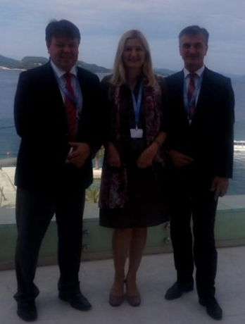
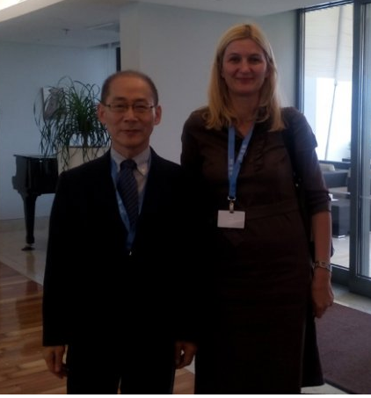
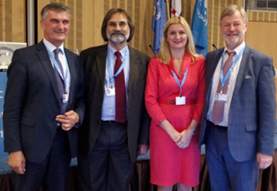

2015 Year of elections
Seventeenth World Meteorological Congress (Cg-17)
27 Oct - 31 Oct 2014 40th Session of IPCC (adoption and approval of SYR AR5)(Copenhagen, Denmark)
24 Feb - 27 Feb 2015 41st Session of the IPCC (Nairobi, Kenya)
5 Oct - 8 Oct 2015 42nd Session of the IPCC (Dubrovnik, Croatia)

Slide 5
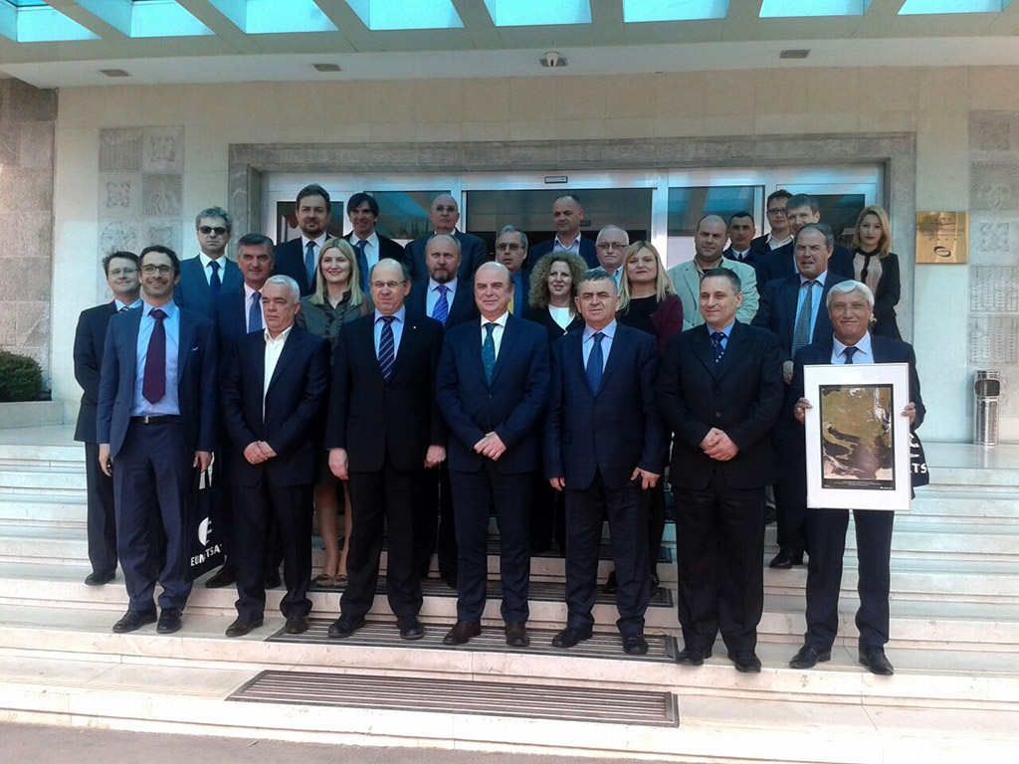
EUMETSAT
Workshop Darmstadt 2014
Traainings in Thessaloniky 2014, 2015
SEE Meeting on training needs -Ljubljana 2015
Info day Tirana Albania 2015

Slide 6
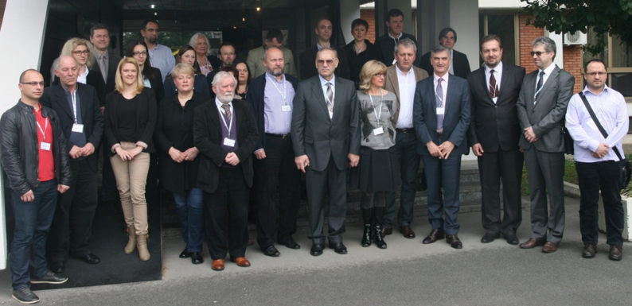
SEECOP
Based on the Technical Annex to the existing MoU between the SEEVCCC and its partners AGREEMENT on South-East European Consortium for Operational weather Prediction (SEECOP)
The long-term objective is to provide SEECOP Members with a state-of-the-art NWP system based on the application of the Nonhydrostatic Multiscale Model on B-Grid (NMMB model) provided by NCEP (National Centers for Environmental Prediction, USA)
Republic of Albania, the Federation of Bosnia and Herzegovina (Bosnia and Herzegovina), the Republic of Srpska (Bosnia and Herzegovina), the Republic of Macedonia, Montenegro and the Republic of Serbia.

Slide 7



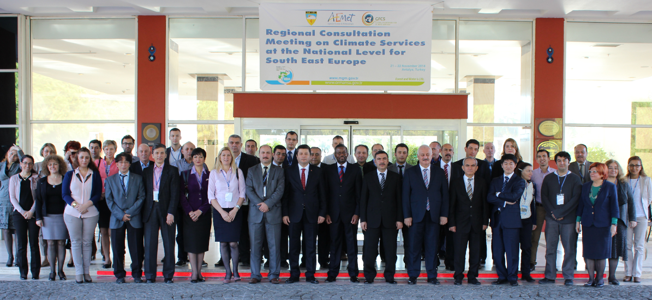
SEECOF & MEDCOF
SEECOF MEDCOF GFCS Antalya 2014
SEECOF MEDCOF Marrakesh 2015, soon

Slide 8
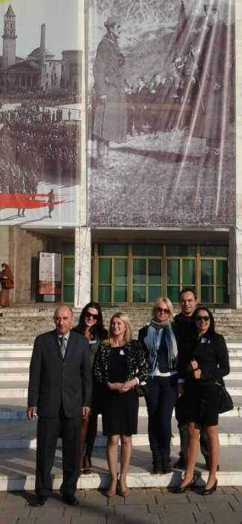
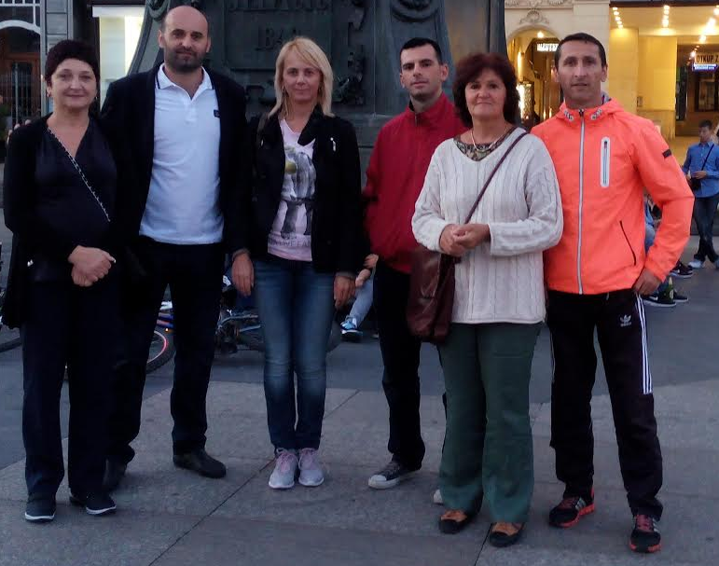

ECRAN 2014-2015
ECRAN (Environment and Climate Regional Accession Network), financed by EU and managed by the European Commission, assists the beneficiaries in exchange of information and experience related to preparation for accession.
ECRAN is strengthening regional cooperation between the EU candidate countries and potential candidates in the fields of environment and climate action and assists their progress in the transposition and implementation of the EU environmental and climate acquis.
ECRAN WG1 Capacity building on modeling, scenario development
Long-range Energy Alternatives Planning System LEAP
Skopje, Tirana, Istanbul, Zagreb,
ECRAN WG4 Climate change adaptation
to promote actions in order to be capable of taking the necessary measures to adapt as region most affected by climate change
Skoplje, Tirana, Ankara, Zagreb, Tirana, Zagreb

Slide 9
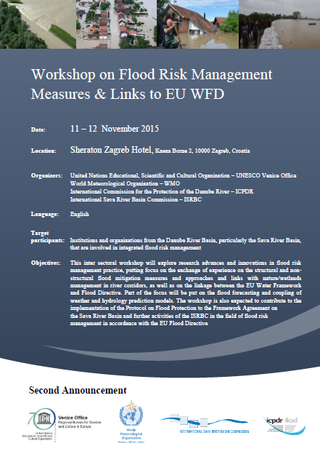

IPA Floods
Programme for Prevention, Preparedness and Response to Floods in the Western Balkans and Turkey – IPA FLOODS

Slide 10
CEI
CEI Workshop on Infrastructure development on Virtual Western Balkans Centre for Hydrometeorological Services and Climate Change, Skoplje 23 September, 2015
Improving environmental monitoring and disaster prevention capacity in Drina River Basin –
  Phase II
  Republic of Srpska (BiH) and Montenegro
visits to Bologna, Italy, 2014 and 2015

Slide 11


Lovcen
“Surveillance of invasive and native mosquito vectors and pathogens they transmit in Montenegro” – LOVCEN 2014-2017
Application for Mobile phone

Slide 12
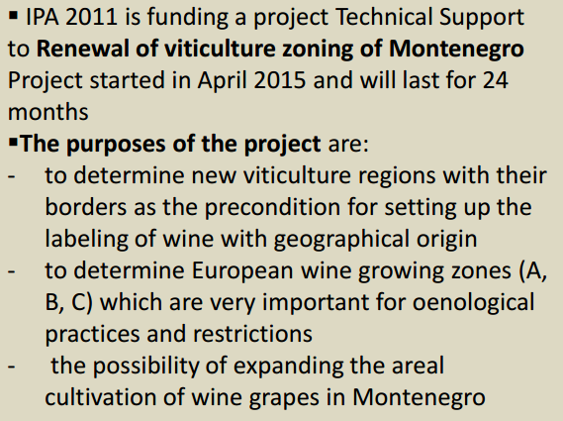
Viticulture
Project "Technical Support to Renewal of viticulture zoning of Montenegro„ April 2015

Slide 13

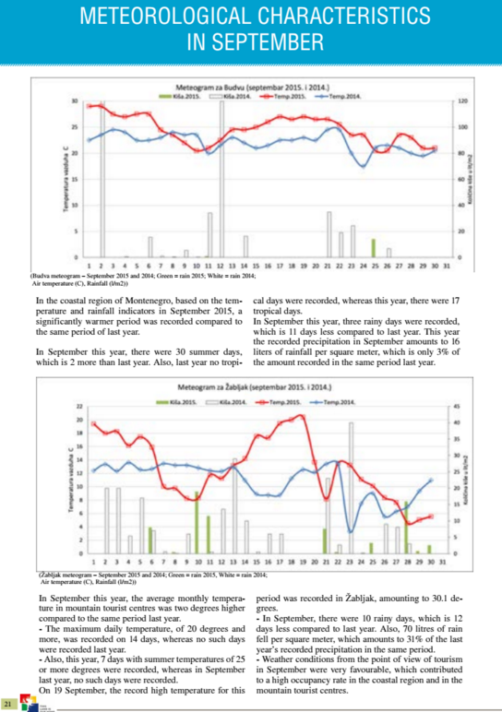



Tourism newsletter

Slide 14
EIS and DMS
EIS IPA „Establishment and Development of the Environmental Information System“, funded by EU
The objective of this project is to develop an Environmental Information System (EIS) capable of supporting the Environmental Protection Agency (EPA) of Montenegro in its mission to provide accurate, reliable and timely environmental information to policy-makers and the public.
The EIS will follow the structure of environmental topics put forward by EIONET: Air pollution, Chemicals/ Waste, Biodiversity change and nature, Climate change, Soil, Water, Air Quality.
2. Project “Capacity building for integration of global environmental commitments in investment/development decision”
management of environmental information and compliance monitoring of the national implementation of the Rio Conventions (Implementing agency –UNDP)
DMS- Document Management System software

Slide 15
Cooperation agreements in 2015
IHMS and the University Ferara, one of the oldest scientific institution in Italy, established 1371
IHMS and Navy Academy of Greece „Ikaria“

Slide 16
IHMS new projects in progress (1)
As DMCSEE continuation:
  Drought risk in Danube Region
As continuation of CARPATHCLIM project (MNE was not included) the IHMS submitted the application for tender procedure
  " Gridded Meteorological data 1961-2010 for Montenegro",
  under cooperation with The Institute for Environment and Sustainability (IES) of the European Commission's Joint Research Centre (JRC)

Slide 17
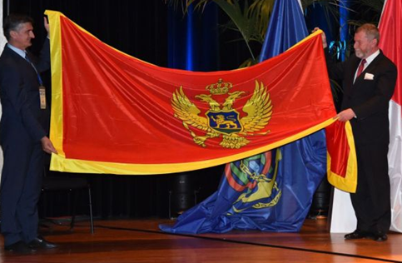
IHMS new projects in progress (2)
3. As continuation of tw succesful cooperation projects NAUTOUR and JASSPER:
"Cross-border collaborative research and awareness raising in preventative environmental protection – Establishing greater security and measures to protect the maritime region (emphasis on the coast) of Croatia and Montenegro (CORE)," 2016-2017
IHO membership, since 3rd december 2013
Specialized Education in the area of Hydrography, USA
Education in navy cartografy, UK

Slide 18
IHMS new projects in progress (3)
„Strengthening Hydrometeorological Services with equipment WORLD BANK/ GEF-SCCF“
SCCF was established to support adaptation and technology transfer in all developing country parties to the UNFCCC
Optimization of observing HM network stations in Drina River basin:
  to improve the existing meteorological and precipitation stations network,
  to provide conditions for the reliable rating curves at hydrological stations,
  to rehabilitate, modernize and complete hydrological stations facilities,
  to support modernization of the groundwater station monitoring network.

Slide 19
Next steps in near future
to improve HM Observation Networks
greater use of satellite data&products
to strengthen the human capacity of IHMS
to ensure a greater financial support and national budget allocations
  cost for maintenance, cost for education, annual salaries for „voluntary“ observers
to purchase a meteorological radar and ensure all pre-conditions for operational use of it

Slide 20


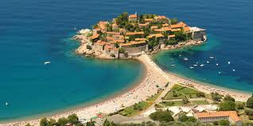
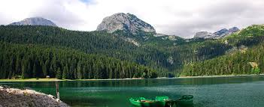
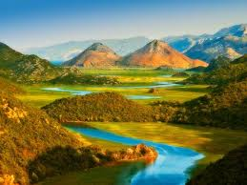
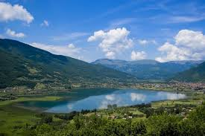
THANK YOU
FOR
YOUR ATTENTION!
sanja.pavicevic@meteo.co.me

