Slide 1
15-ISCEED
Zagreb, 6-7 October 2016
Report of the President of
RA VI (Europe)
Ivan Cacic

Slide 2
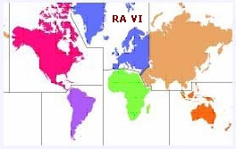
Main Challenges and Priorities
Challenges
Priorities
Lack of financial / staff resources + difficulties to maintain and sustain basic functions
Harmonization with the Copernicus capacity development segments
Fussy status of the aeronautical meteorological services
Increasing role of the private sector in service delivery and increasing requirements for compliance with data policies
Technological and institutional gaps between the developed and developing NMHSs
Coping with issues related to the economic conditions affecting the NMHSs
Implementation of WIGOS and WIS
Enhancement of Services : PWS, DRR / EWS, aviation, climate and related services
Enhancement of regional / subregional cooperation and partnership
(EMI → RA VI MI)
Enhancement of interregional cooperation and partnership, in particular with RA I and RA II (e.g. ICSEED, SEECOF, MEDCOF, ALADIN, COSMO, EMI)
Update of the RA VI questionnaire regarding challenges and needs of the region

Slide 3
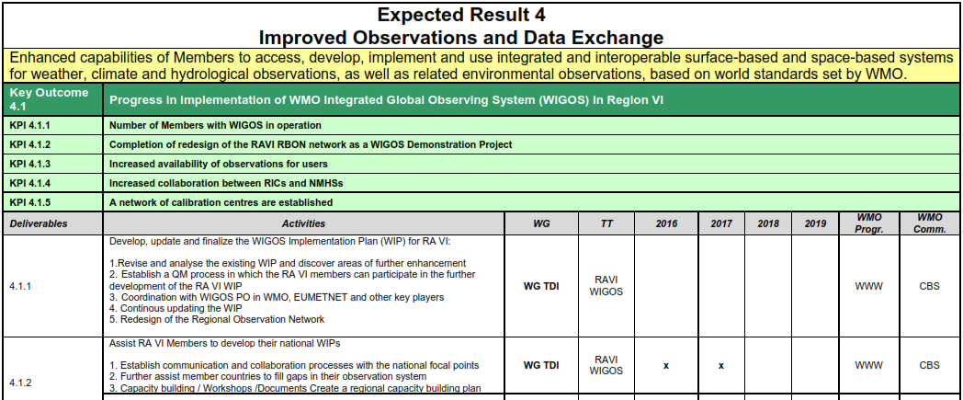
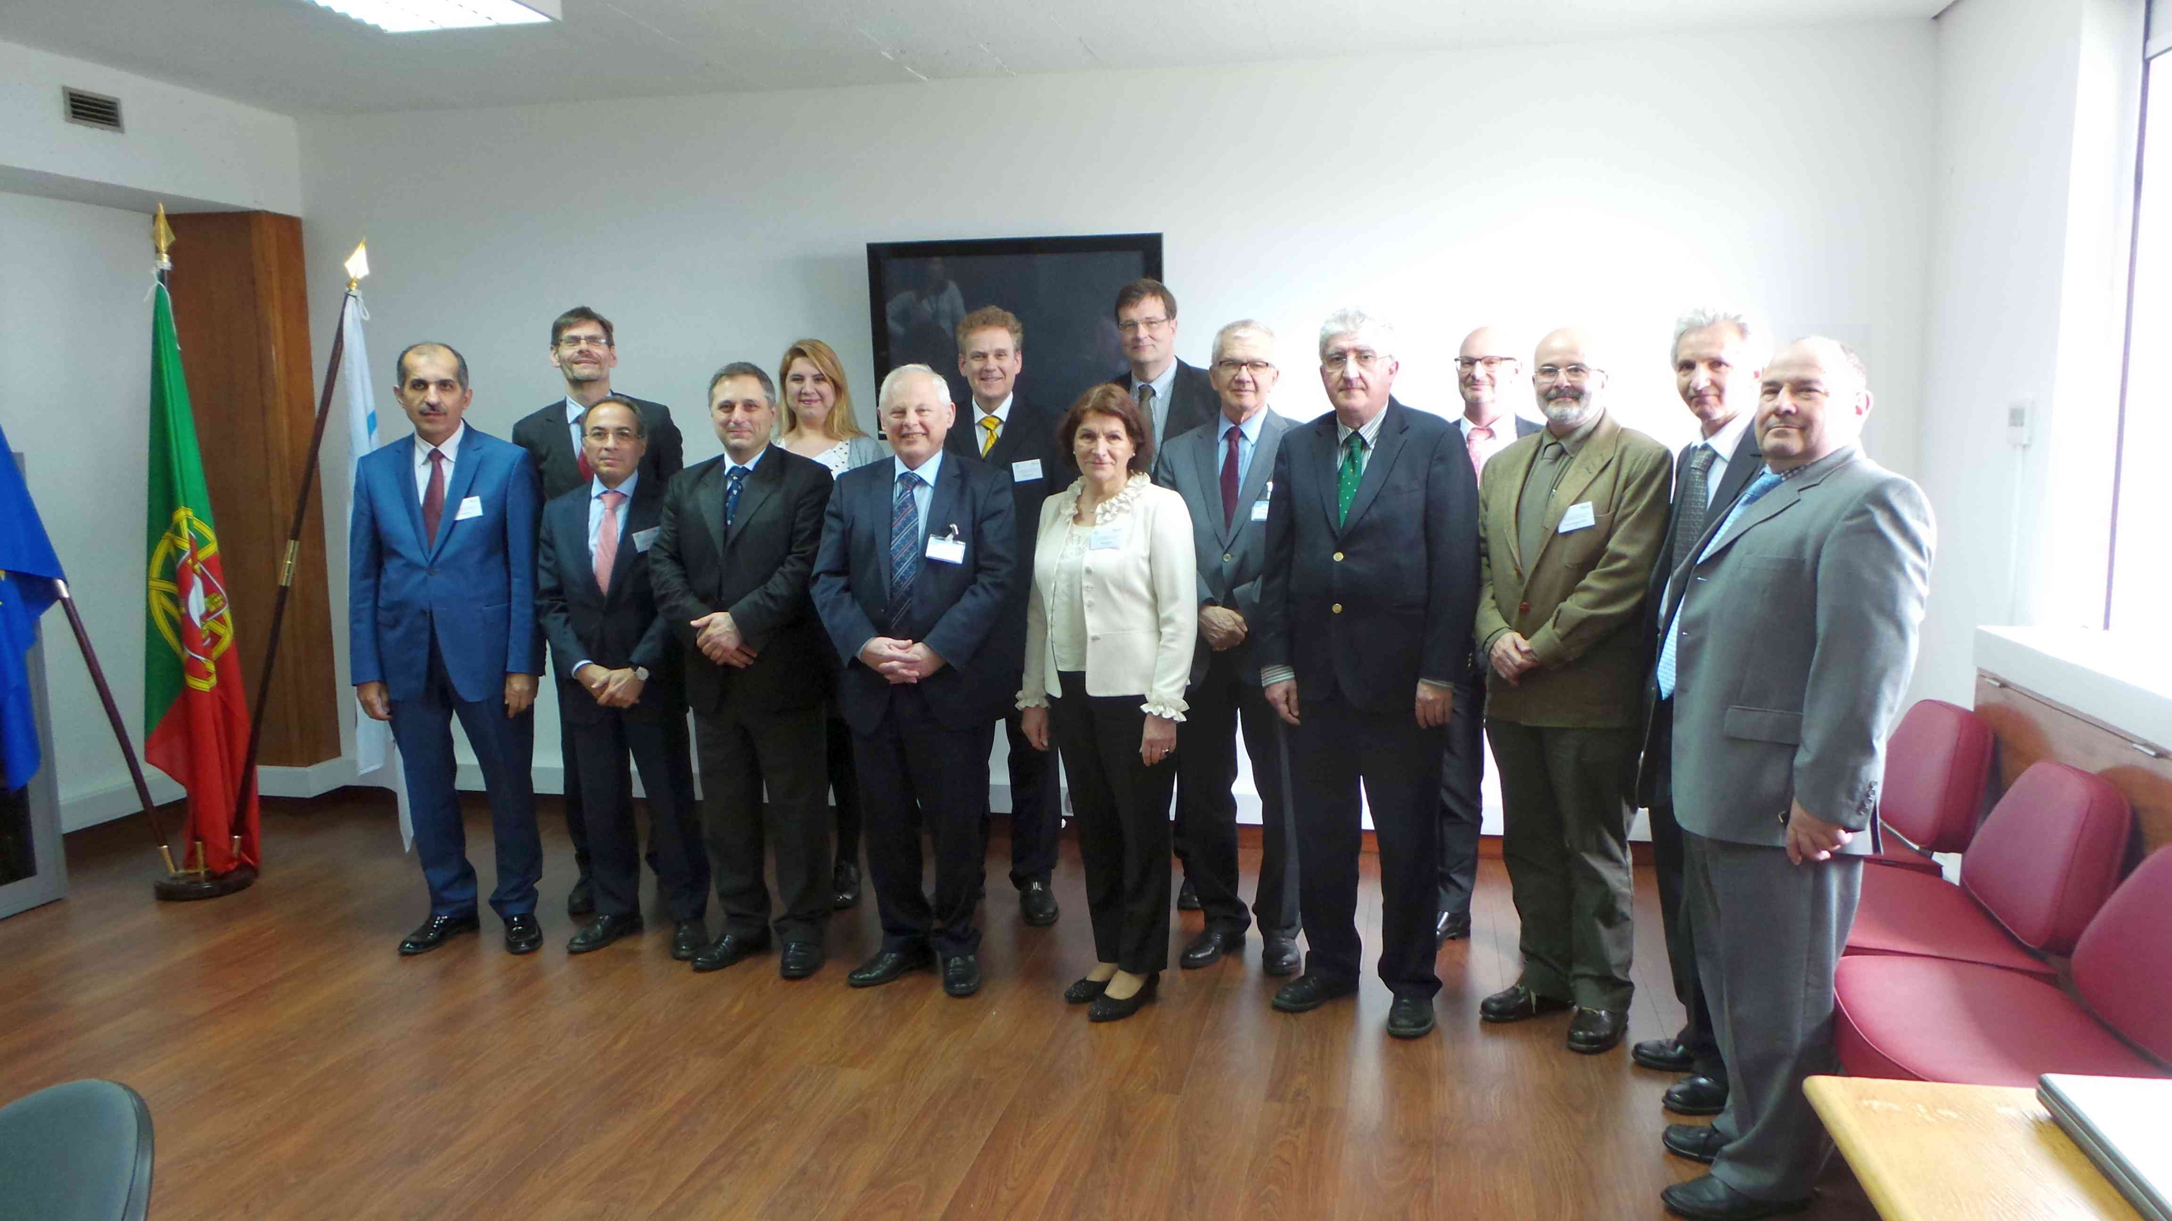
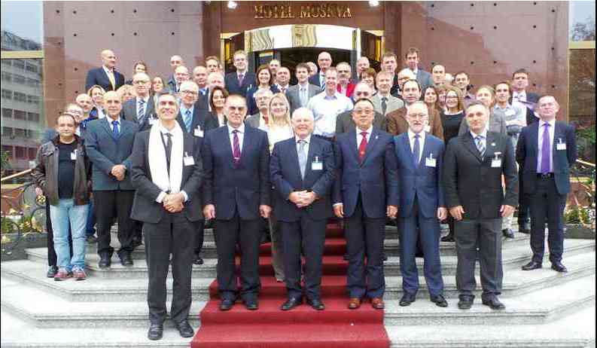
Implementation Gaps
Support WIGOS Implementation Plan
“WMO RA VI WIGOS Workshop for RA VI (Europe) Members”, Belgrade, Serbia 24 - 27 November 2015
Decision of the 4th RA VI MG Meeting, Lisbon, Portugal, 21 – 22 April 2016
RA VI Regional WIGOS Centers (RWC) should be established as a network of contributing NMHSs (virtual center structure)
- Draft Concept document on RWC-Network, including the Terms of Reference
for the modules of RWC Network
Establish a “proof of concept” phase in setting-up of RWC-Network
- assign the roles of virtual RWC that will start to work as a “nut shell RWC”
- initiate assignment process after the RA VI Session in 2017

Slide 4
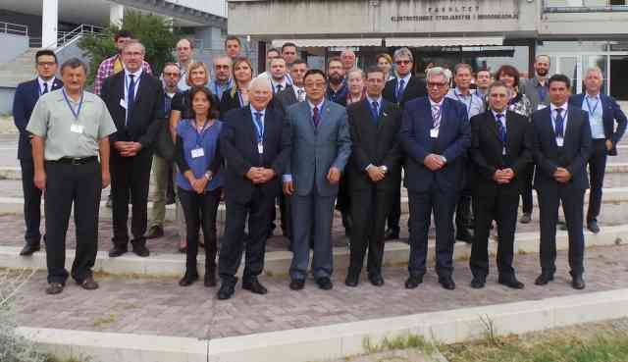
Implementation Gaps
Support WIGOS Implementation Plan
“WMO RA VI WIGOS Workshop with focus on marine observations”, Split, Croatia, 5-7 September 2016
The RA VI WIGOS / Marine - Ocean workshop recommendations
Establish a RWC for the Adriatic Sea area as a virtual centre and refine the functionalities of this centre. The proposed RWC will complement existing WIS DCPC for the Adriatic Sea area; Croatia will be leading in this regard.
Explore possibilities to establish an WMO-IOC Regional Marine Instrument Centre (RMIC) for the Adriatic Sea as a distributed centre where service for instruments and measurements would provide
oceanographic institute(s) - for oceanografic part
NMHS(s) – for marine meteorological part

Slide 5
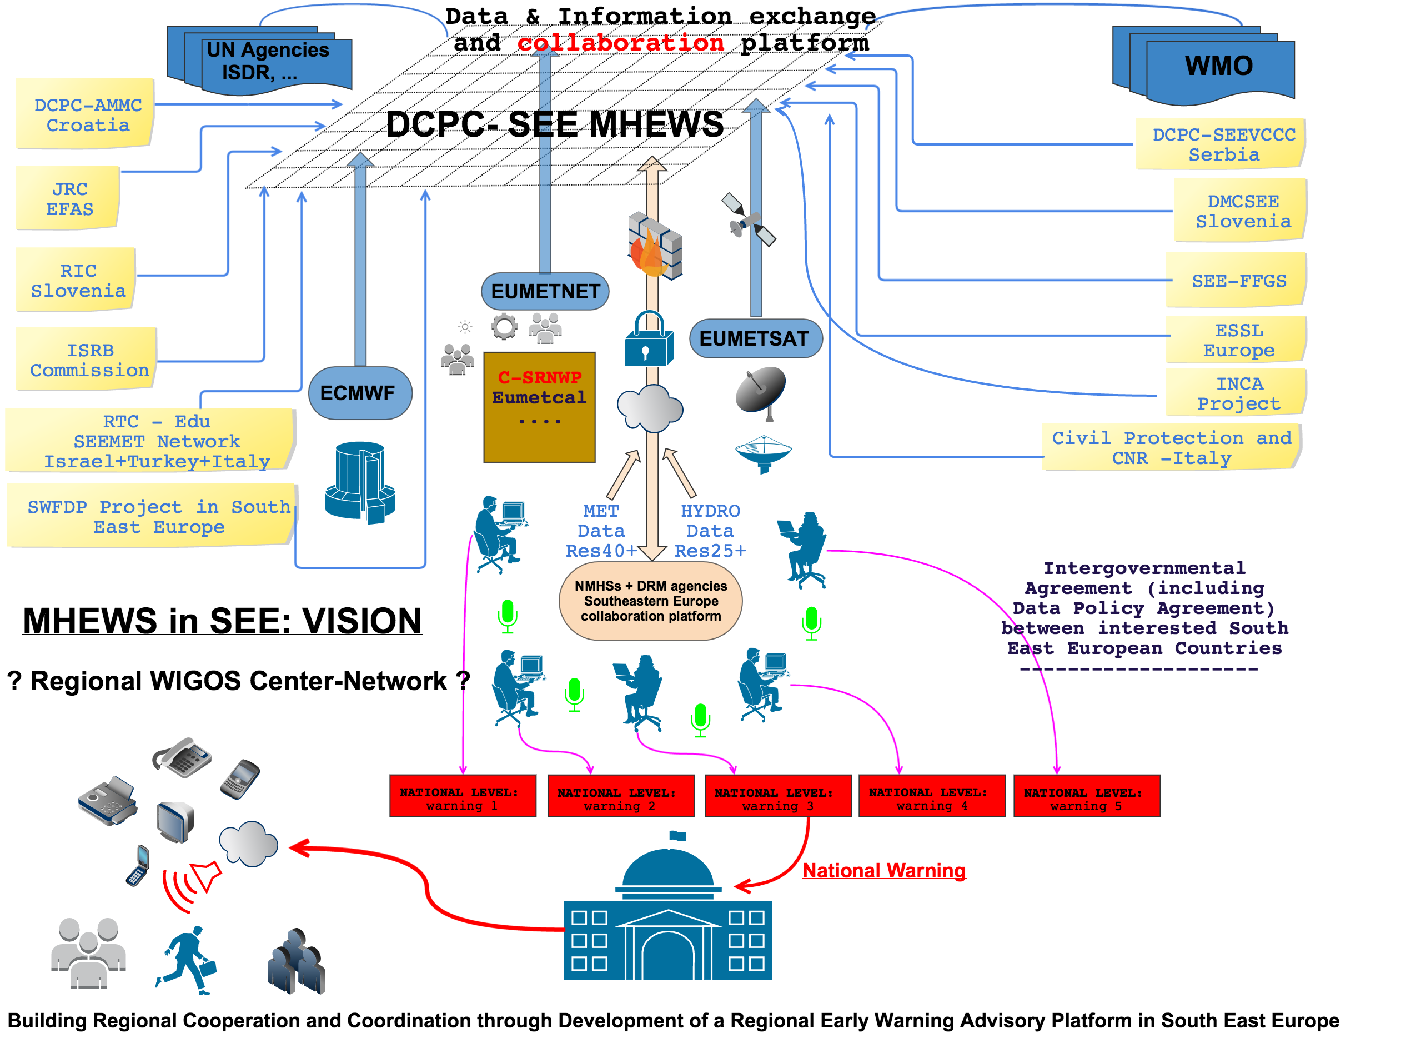
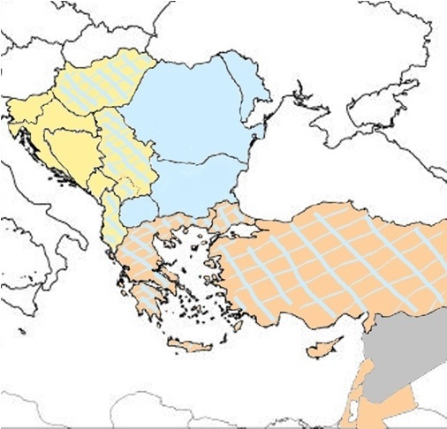
Implementation Gaps
EC WG DRR recommendation on developing new projects such as a South-East European Multi-Hazard Early Warning Advisory System project with a perspective to collaborate with other regional projects
Project has perspective to build up
common technical platform including a virtual
Regional WIGOS Center in SEE to ensure data
and products availability for MHEWS in line
with the DRM requirements
common organizational platform
to ensure cros-boarder collaboration / SOP
trough distributed structure
SEE Consortium of Collaboration
3 Clusters of Collaboration
Ad-Hoc Claster / Clusters of Collaboration
what could serve as a template

Slide 6
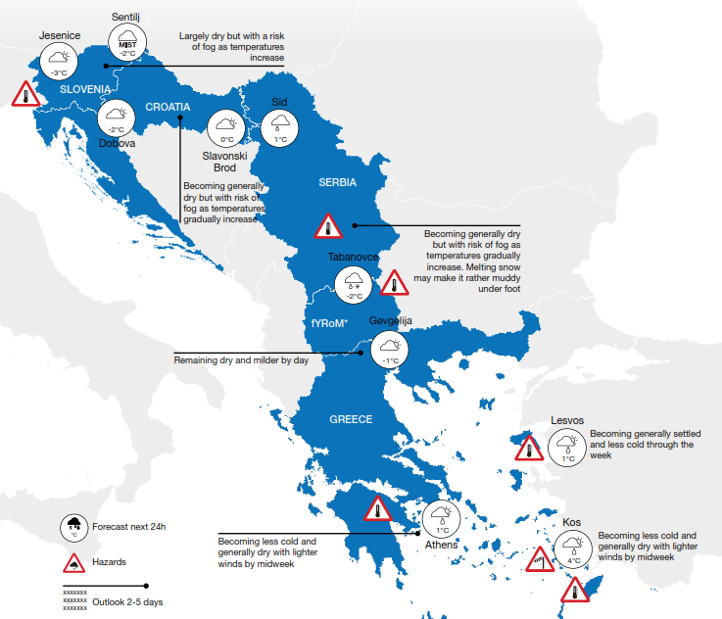
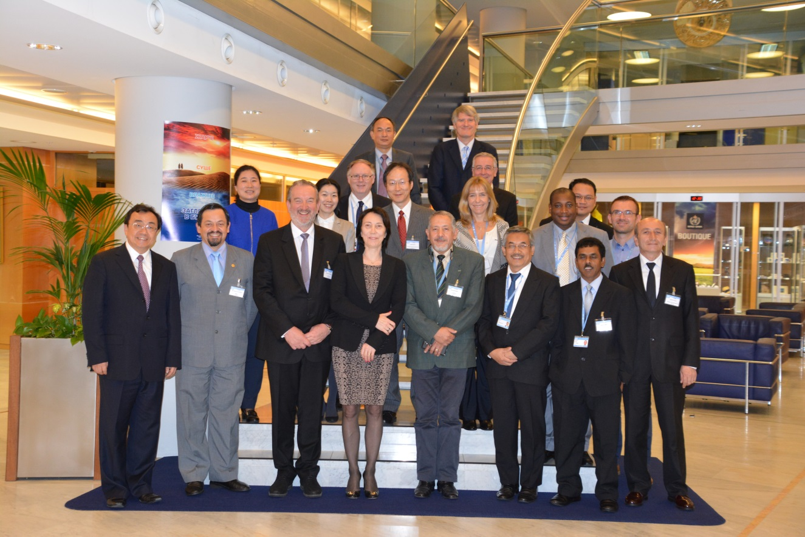
Implementation Gaps
The idea of common tecnical and organizational platform
was strongly advocated by the achievement of a
good practice after provision of meteorological support
following the UNHCR request to the WMO
during the refugee crisis in Europe
EC WG DRR supported milestones achieved in the
implementation of the Strategy through the activities of the PWS Programme
A regional event is also planned (Tirana, Albania)
for developing Members’ capacities in
service delivery in Southern and Eastern Europe
It is envisaged that - as more Members undertake
the implementation of
the Strategy for Service Delivery - the experience gained will further refine and guide the work of the Secretariat in assisting other Members in improving their levels of service delivery to their stakeholders

Slide 7
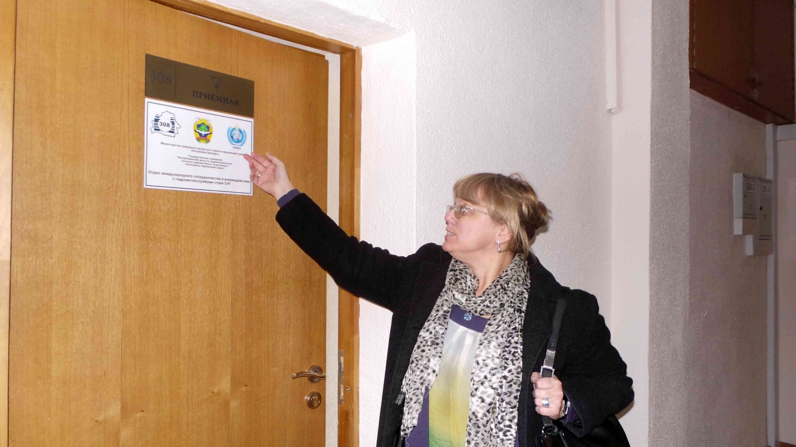
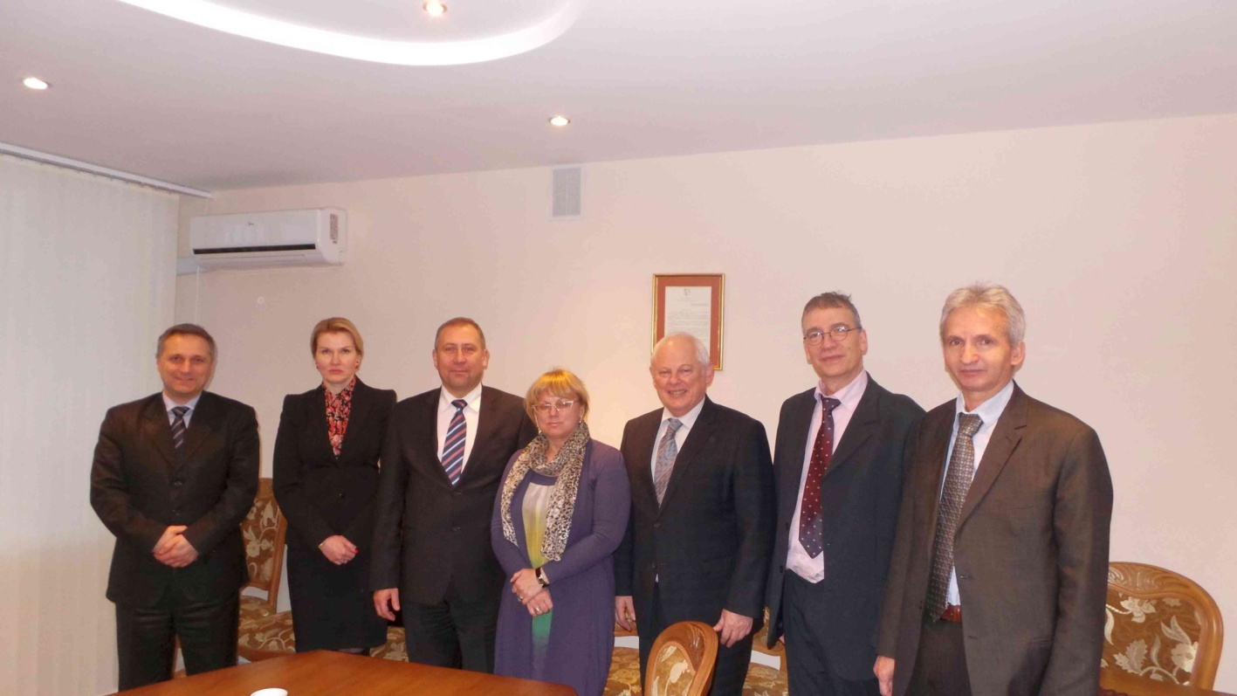
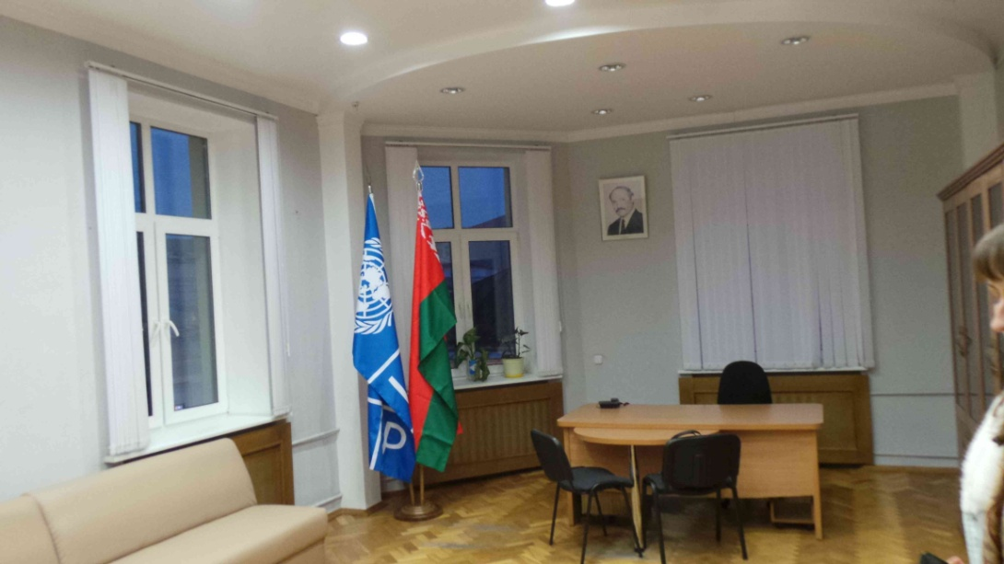
Implementation Gaps
Harmonization of service quality in pan-European level and enhancement of interregional cooperation and partnership (in particular with RA I and RA II)
Special effort has been performed towards establishment of WMO Eurasian Office in Minsk, Belarus (following Cg-17 Decision)
High potential for extension of EMI towards RA VI Meteorological Infrastructure, if possible starting with some EUMETNET programmes ( e.g. Opera, Ema)
Response to technological and institutional gaps between the developed and developing NMHSs in RA VI towards harmonized services

Slide 8
Thank you

