Slide 1

Implementation of Cg-17 Resolution 9 – Links to international agreements
Alasdair Hainsworth, Chief
Disaster Risk Reduction Division

Slide 2
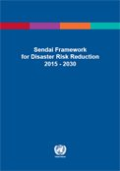
Sendai Framework for Disaster Risk Reduction 2015-2030
The Sendai Framework for Disaster Risk Reduction 2015-2030 outlines seven clear targets and four priorities for action to prevent new and reduce existing disaster risks:
  Understanding disaster risk;
  Strengthening disaster risk governance to manage disaster risk;
  Investing in disaster reduction for resilience and;
  Enhancing disaster preparedness for effective response, and to "Build Back Better" in recovery, rehabilitation and reconstruction.
It aims to achieve the substantial reduction of disaster risk and losses in lives, livelihoods and health and in the economic, physical, social, cultural and environmental assets of persons, businesses, communities and countries over the next 15 years.
The Framework was adopted at the Third UN World Conference on Disaster Risk Reduction in Sendai, Japan, on March 18, 2015.

Slide 3
Sendai Framework for Disaster Risk Reduction 2015-2030
To support assessment of global progress in achieving outcomes and goal of present Framework, seven global targets have been agreed. These targets will be measured at global level and complemented by work to develop appropriate indicators. National targets and indicators will contribute to achievement of outcome and goal of the present Framework. The seven global targets are:
(a) Substantially reduce global disaster mortality by 2030, aiming to lower the average per 100,000 global mortality rate in the decade 2020–2030 compared to the period 2005 – 2015;
(b) Substantially reduce the number of affected people globally by 2030, aiming to lower the average global figure per 100,000 in the decade 2020–2030 compared to the period 2005–2015
(c) Reduce direct disaster economic loss in relation to global gross domestic product (GDP) by 2030;

Slide 4
Sendai Framework for Disaster Risk Reduction 2015-2030
(d) Substantially reduce disaster damage to critical infrastructure and disruption of basic services, among them health and educational facilities, including through developing their resilience by 2030;
(e) Substantially increase the number of countries with national and local disaster risk reduction strategies by 2020;
(f) Substantially enhance international cooperation to developing countries through adequate and sustainable support to complement their national actions for implementation of the present Framework by 2030;
(g) Substantially increase the availability of and access to multi-hazard early warning systems and disaster risk information and assessments to people by 2030.

Slide 5
Sendai Framework provisions especially relevant to WMO
Call of States to enhance and strengthen MHEWS (par 14, 25), develop and invest in regional multi-hazard early warning mechanisms (par 34-c), and achieve the global target for MHEWS (par 18-g).
Calls for support to strengthen and implement global mechanisms on hydrometeorological issues, in order to raise awareness and improve understanding of water-related disaster risks (par 43-e)
Importance of international cooperation for DRR (par 39), and requests enhanced coordination of DRR strategies of UN and international and regional organizations and institutions (par 48-a).
To promote real time access to reliable data, make use of space and in situ information, including geographic information systems (GIS) ; and use information and communications technology innovations to enhance measurement tools and the collection, analysis and dissemination of data

Slide 6

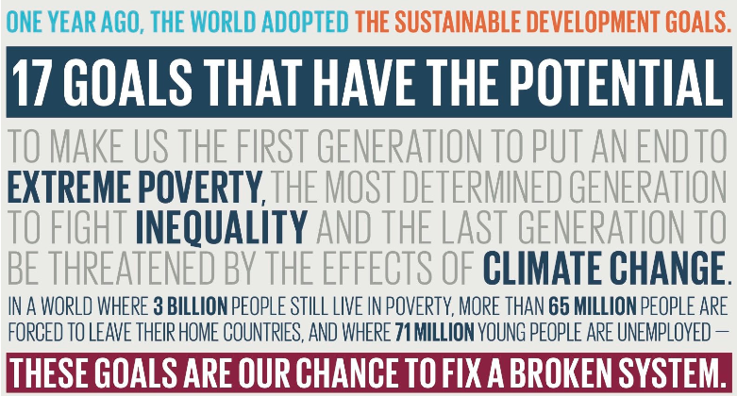

Slide 7
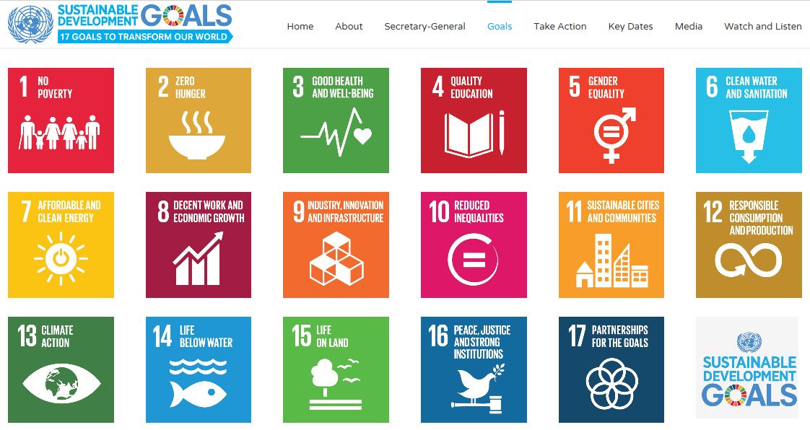

Slide 8
Targets for Goal 13
Strengthen resilience and adaptive capacity to climate-related hazards and natural disasters in all countries
Integrate climate change measures into national policies, strategies and planning
Improve education, awareness-raising and human and institutional capacity on climate change mitigation, adaptation, impact reduction and early warning
Implement the commitment undertaken by developed-country parties to the United Nations Framework Convention on Climate Change to a goal of mobilizing jointly $100 billion annually by 2020 from all sources to address the needs of developing countries in the context of meaningful mitigation actions and transparency on implementation and fully operationalize the Green Climate Fund through its capitalization as soon as possible
Promote mechanisms for raising capacity for effective climate change-related planning and management in least developed countries and small island developing States, including focusing on women, youth and local and marginalized communities

Slide 9
(Relevant) Targets for Goal 11
By 2030, significantly reduce the number of deaths and the number of people affected and substantially decrease the direct economic losses relative to global gross domestic product caused by disasters, including water-related disasters, with a focus on protecting the poor and people in vulnerable situations
By 2030, reduce the adverse per capita environmental impact of cities, including by paying special attention to air quality and municipal and other waste management
By 2020, substantially increase the number of cities and human settlements adopting and implementing integrated policies and plans towards inclusion, resource efficiency, mitigation and adaptation to climate change, resilience to disasters, and develop and implement, in line with the Sendai Framework for Disaster Risk Reduction 2015-2030, holistic disaster risk management at all levels

Slide 10
Measuring targets
Resolution 9 will assist in identifying the key elements we need to measure in order that the loss/damage community can link to our data and link losses to climatic and synoptic events
We will need to show that we are relevant and that over time, we are improving

Slide 11
International Network for Multi-Hazard
Early Warning Systems (IN-MHEWS)
Proposed by a number of UN organizations and their partners/stakeholders at WCDRR’s Working Session on Early Warning as joint effort to assist and advise States in sustaining and improving their national DRR and CCA strategies through multi-hazard early warning services.
Builds on the experience, good practice, and achievements of States and the international community within participating partners organizational mandates
Based on “hazard clusters” which address cascading impacts of related hazards and to identifies relevant stakeholders groups at different levels
Focused on a “1+2” approach: Seamless MHEWS based on Standard Operating Procedures (SOPs) plus Impact-based Forecasting and Risk-based Warnings (IBF&RBW)

Slide 12
Key objectives of IN-MHEWS:
Identify effective strategies and actions to promote and strengthen MHEWS in support of the implementation of the Sendai Framework (e.g. Words into Action guides), the UN Plan of Action on DRR for Resilience, GFCS, etc.;
Facilitate sharing of good practices and making available to governments and key stakeholders policy-relevant guidance to enhance MHEWS and related services, as an integral component of their national strategies for DRR, climate change adaptation, and resilience/sustainable development strategies;
Promote synergies and partnerships between and among stakeholders at national, regional and international levels and those in charge of MHEWS at national and local levels and strengthening of user-interface platforms
Advocate usefulness of MHEWS in regional and international platforms and among key stakeholders, including donors and across all sectors.
→ focus is on integration and crosscutting activities and provision of coordination and advisory mechanism that brings stakeholders and experts from different sectors and hazard clusters together

Slide 13
International Conference on MHEWS
(IC-MHEWS) May 22-23 Cancun prior to Global Platform
  Identify effective strategies and actions needed to promote and strengthen MHEWS in alignment with the Sendai Framework
The IC-MEWS will:
  Build on the outcomes of the three International Conferences on EW
  Address the call for enhancing and strengthening MHEWS by the Sendai Framework.
  Review and take stock of good practices in MHEWS such as stakeholder partnerships, communication strategies, risk informed warnings, impact based forecasting, governance mechanisms, capacity building and education as well as disaster management
  Publish a set of recommendations addressed to different MHEWS stakeholders for strengthening of their MHEWS.

Slide 14
International Conference on MHEWS (IC-MHEWS)
IC-MEWS is currently supported by: WMO, UNISDR, WHO, UNDP, UNESCO‐IOC, UNESCAP, UNOOSA / UN‐SPIDER, IFRC, ITU, Mexican Government, China, Ecuador, France, Germany (DKKV), India, Indonesia, Italy, Philippines (11+8). Others are in discussion such as CREWS, IAEA, UNOCHA, IMO, IHO, ICAO.
Organizational arrangements
  Internal coordination: WDS, supported by Steering Committee on Disaster Reduction
  International Organizing Committee: High-level (representatives from Countries, practitioners, and science), Working level → support from IN-MHEWS partners
date: 22-23 May 2017
venue: Cancun, Mexico – preliminary meeting to Global Platform

Slide 15
Merci - Thanks!
Alasdair Hainsworth
C/DRR
WMO

