Slide 1
Integrated Flood Management: Associated Programme on Flood Management (APFM)

Slide 2
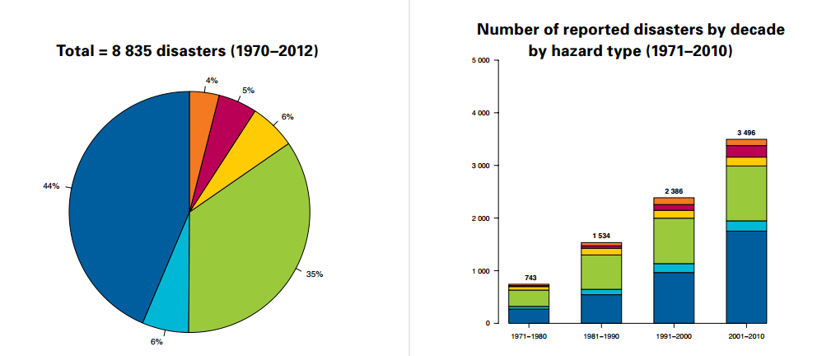
Why is IFM necessary?
Source: WMO-No. 11.23 (2014)
Notes:
Floods are the most common natural disaster with the largest impacts on society. Flood impact records show that the number of flood fatalities is gradually decreasing, thanks to among others better early warning, although incidental devastating (coastal) floods may distort this trend. Flood damages, however, appear to be increasing because of insufficient attention to prevention, economic growth and lack of flood sensitive land-use planning.

Slide 3
Impacts of hydrometeorological and climatological hazards (1955–2014)
Human losses by decade (millions)
Economic losses by decade (billions of US$ adjusted to 2013)
Epidemics and insect infestations are not included
Reduction of the number of victims thanks to greater effectiveness of early warning systems and prevention measures
Notes:
2005-2014: cyclone Nargis in Myanmar in 2008 (~140.000 deaths).
1965-1974: drought in India in 1965 (~1.500.000 deaths).
1955-1964: floods in China in 1959 (~2.000.000 deaths)

Slide 4
Why is the WMO involved in IFM?
National Hydrological Services are responsible for:
Providing services in support of national needs including
Protecting of life and property
Safeguarding the environment
Contributing to sustainable development
Promoting capacity-building
Active involvement in the planning, development and management of water resources projects
WMO has a mandate to:
Advocate for the widespread adoption of IFM at the basin, national and international levels (Resolution 20 (Cg-XV))
Assist Members in flood management policy, strategy development, and capacity building
Notes:
Point 1: Per WMO Convention
Point 2: Per Technical Regulations
Point 3: Under Resolution 20 (Cg-XV) WMO Congress decided “That WMO should continue its advocacy for a widespread adoption of an Integrated Flood Management approach at the basin, national and international levels”
Point 4: Under Res. 4 (CHy-XIII) the Hydrology Commission decided “To assist setting up of a HelpDesk for Integrated Flood Management for the benefit of Members in the areas of flood management policy and strategy, and capacity building in support thereof.”

Slide 5


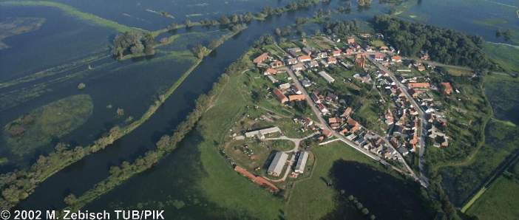
Associated Programme on Flood Management (APFM)
Joint Initiative
Technical Support Unit embedded in the WMO Hydrology and Water Resources Branch
Founded in 2001
Contributors FOEN (Switzerland), MAE (France), CONAGUA (Mexico) and USAID (in the past: Japan, the Netherlands, Germany and Italy)
Mission
To support Members/countries in implementing Integrated Flood Management
Notes:
WMO and GWP launched in 2001 the APFM. The program is based on extrabudgetary resources, mainly coming from donors such as (in the past) the Governments of the Netherlands, Japan, Germany and Italy, and currently Switzerland (through FOEN) and USAID.
Purpose of the programme is to support countries in the integrated management of floods within the overall framework of IWRM

Slide 6




End-to-end (E2E) Flood Forecasting and Early Warning Initiative
!
REAL-TIME DATA COLLECTION
MODELLING & FORECASTING
EARLY WARNING DISSEMINATION
DECISION SUPPORT
RESPONSE TO WARNING
Global Hydrometry Service Facility (GHSF)
Meteorological, Climatological and Hydrological (MCH) Database Management System
Flash Flood Guidance System (FFGS)
Coastal Inundation Forecasting Demonstration Project (CIFDP)
Severe Weather Forecasting Demonstration Project (SWFDP)
(APFM) Associated Programme on Flood Management
DEWETRA Platform
Preparing for Extreme And Rare events in coastaL regions (PEARL)
In support of the functions of National Meteorological and Hydrological Services
Notes:
The Flood Forecasting Initiative, steered by an Advisory Group, aims at promoting the E2E FFEW concept, while at the same time serving as an umbrella for finding and coordinating synergies between different WMO activities sharing a common disaster risk reduction objective. WMO’s activities support NHSs in their functions, as specified in the WMO Technical Regulations, in particular:
Collecting, transmitting, processing, archiving and maintaining quality control of data and the data collection process
Making data and products accessible to users, when, where and in the form they require (e.g. hydrological forecasts and warnings)
Assembling water-related data and hydrological information and ensuring their accessibility for the use of non-governmental, international and private sector organizations
Coordinating with agencies which are responsible for using water-related data and hydrological information
Informing potential users of available information and resources, and assisting them to make the best use of it
Participating in the planning, development and management of water resources projects

Slide 7
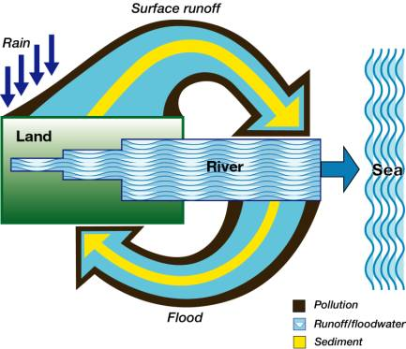
Need to consider the water cycle as a whole and interaction with people
A river basin is a dynamic system with many interactions/fluxes between land, water bodies and the atmosphere
Flood and drought management
Effective use of waters
Ground water and surface water interaction in flood plains
Flood Management is water management that is strongly linked to land management and people
Notes:
Integrated Flood Management (IFM) refers to the integration of land and water management in a river basin using a combination of measures that focus on coping with floods within a framework of IWRM and adopting risk management principles while recognizing that floods have beneficial impacts and can never be fully controlled.

Slide 8




IFM is interdisciplinary, flexible and participatory
International
National
Basin
Local
SPACE
TIME
Hydrometeorology
Engineering
Social Sciences
Law
Economics
SCIENTIFIC
DOMAINS
Planning
Protection/Prevention
Emergency Response
Reconstruction and Rehabilitation
Developers, Drainage authorities, Water/sewerage service providers, Insurers, Emergency Services, Local authorities, Strategic industries, Dam/reservoir operators, Irrigators, Farmers/Forestry, Environmental Regulators
STAKEHOLDERS
Notes:
IFM integrates and mixes strategies
- Structural and Non-structural
Short-term and Long-term
Local and basin-level measures
Balances development needs and environmental concerns
Addresses all aspects of Flood Management
- Scientific and Engineering
Social Aspects
Environmental Aspects
Economic Aspects
Legal and Institutional Aspects
Adaptive Management
The effectiveness of an IFM approach also depends largely on mobilizing and rallying for greater stakeholder participation from the start. Greater participation of all stakeholders in flood policy development is considered vital since it enables inhabitants of flood-prone regions to choose the level of risks they are ready to take.
- Ensure implementation of basin flood management plans with full public support
Ensure sustainability of plans and associated decisions
Build consensus and public support on the flood management options
Build stakeholders commitment
- Build resilience of flood-prone communities
- Provide all stakeholders, including the public, with full opportunities to share their views and influence the outcome

Slide 9




Flood Risk Mitigation: from theory to practice
Lack of information and preparedness
DISASTER
Elevated exposure due to uneffective (or absent) land use planning
Warnings, civil defence planning, awareness raising and education to risk
DISASTER
Structural measures (and maintenance), land use planning, basin management
Residual risk
Hazard
Risk sharing
Flood forecasting, flood mapping

Slide 10
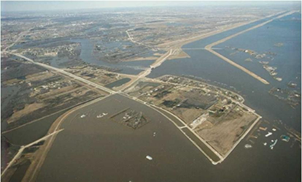
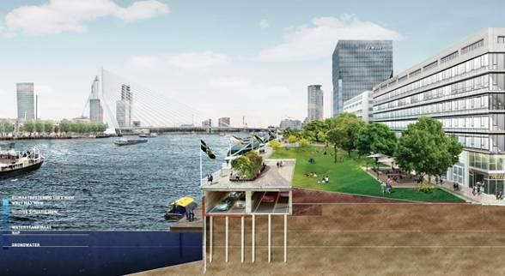
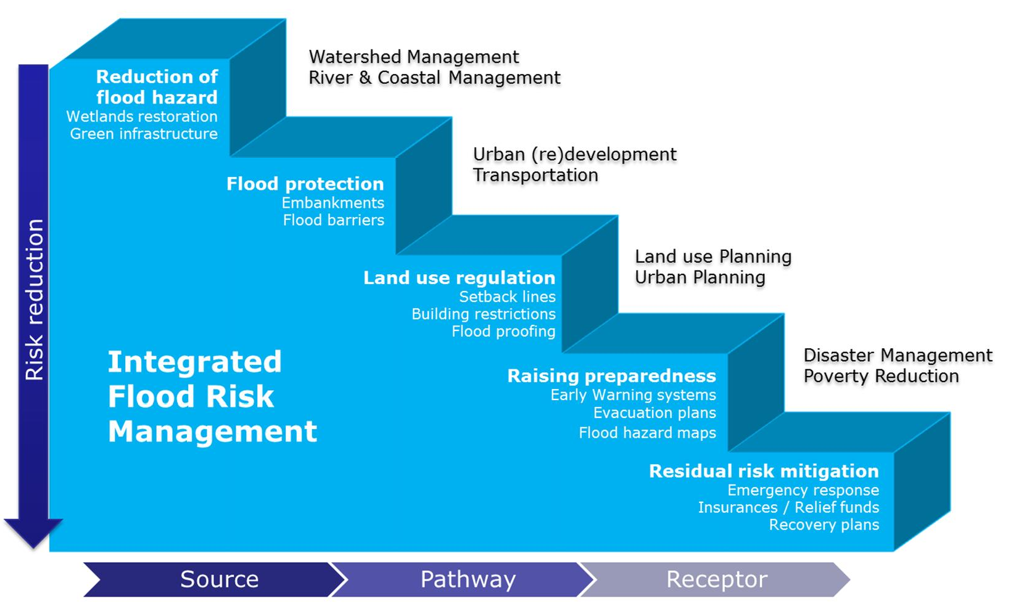
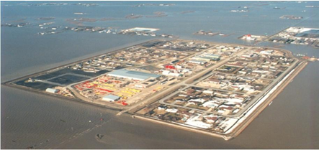
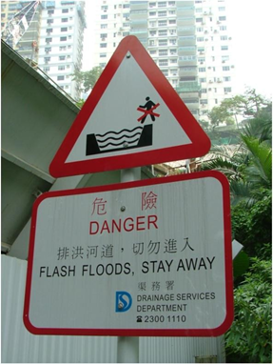
Notes:
Images:
Red River Floodway at Winnipeg (Canada)
Dike improvement at urban waterfront (Netherlands)
Ring dike at Red River (Canada)
Flash flood warning (Hong Kong)

Slide 11
How can APFM help?
Promoting IFM to prevent the disaster from repeating itself
Reducing risk exposure (flood risk management)
Build back better
End-to-end early warning systems
Advice on flood management through a HelpDesk
Training , capacity building, and advocacy material
Building a network of institutions supporting a multi-disciplinary approach
Hands on assistance to Members
Project proposal preparation
Flood risk management project implementation
Notes:
The activities of the APFM can be grouped in these three main categories:
Compilation of guidance material publications, manuals and tools on specific aspects of flood management (all available for download from our websites)
Capacity building implementing advocacy or specific trainings on IFM at the national or regional level.
Strategic advice through the HelpDesk on IFM, a user-friendly platform where users can access relevant information and request our assistance in finding the right resources and know-how, or to get capacity building training workshops, or to get assistance in developing flood management strategies at the national level
We will see more in detail these three categories in the following slides

Slide 12

Integrated Flood Management HelpDesk
MEMBERS/COUNTRIES
Request for assistance, preparation of project proposals, advice and supervision on implementation
Technical expertise
SUPPORT BASE
http://www.apfm.info/ifm-helpdesk

Slide 13































30 Support Base Partners
Specialized institutes in various disciplines relevant for IFM
Notes:
These are the 30 Support Base Partners who have signed a mutual letter of engagement for the support of the HelpDesk.
THE SBP NETWORK IS NOT CLOSED; OTHER INSTITUTIONS ARE WELCOME TO JOIN AND SHARE THEIR KNOW-HOW FOR THE BENEFIT OF THE HELPDESK USERS

Slide 14
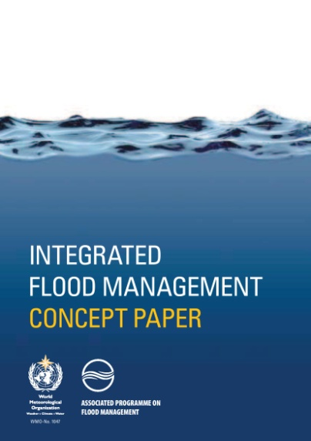
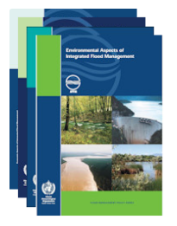
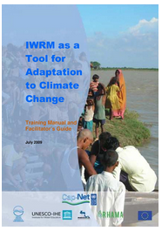
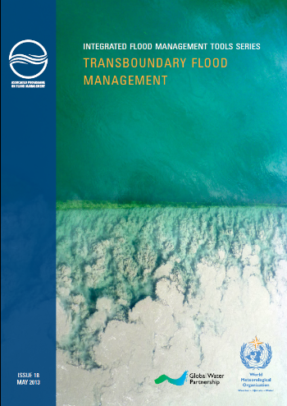
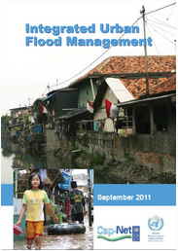
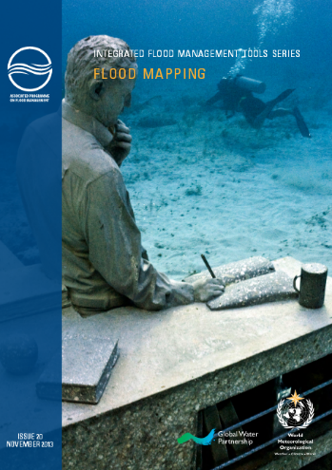
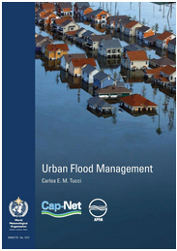
Guidance Materials
Integrated Flood Management Concept Paper
Flood Management Policy Series
IFM Tool Series
Training Manuals
Plus 22 Case Studies from Africa, Asia, Central & North America, Europe, South America and the South-West Pacific http://www.apfm.info/publication
Notes:
The „pillars“ of the program (and of the HelpDesk) are constituted by the IFM concept paper and the four policy series, each one covering a specific aspect of flood managment, namely:
Environmental aspects
Economic Aspects
Social Aspects
Legal and institutional aspects
Moreover, APFM also develops on a regular basis a series of IFM Tools (see next slide) and specific training manuals on IFM issues

Slide 15
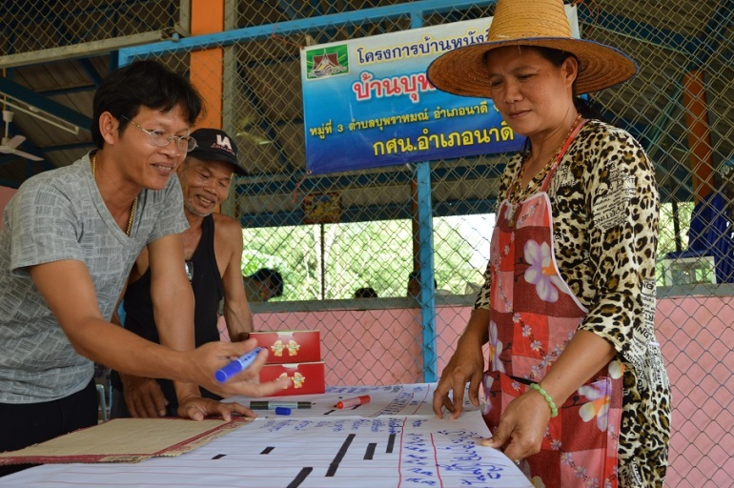
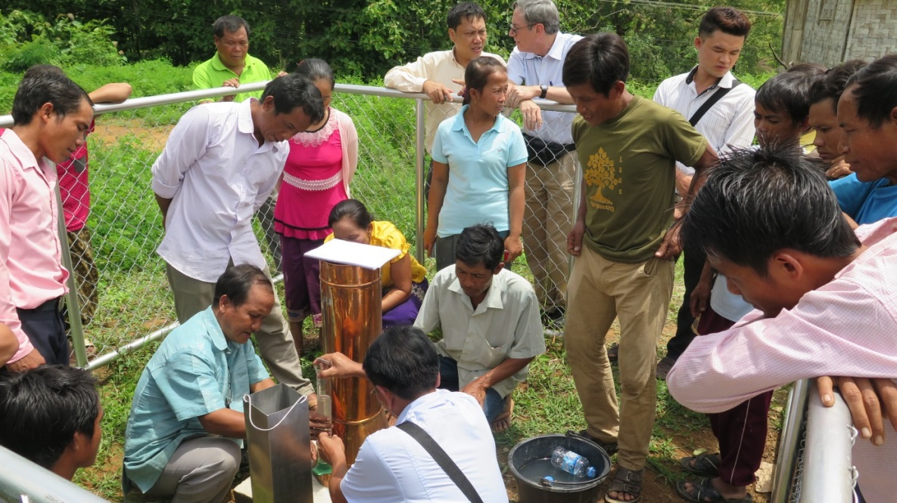
Capacity building & training
APFM Provides:
What is needed? Identification of problems and gaps
What is possible? Presenting existing capacities and opportunities
Vocational training (short training and workshops for different target groups)
Material on specific topics and contact with experts :
Integrated flood management
Urban flood management
E2E EWS - Floods (under development)
Community-based approaches
Development of National Strategies applying the IFM concept
IFM for flood hazard mapping, Japan
Participatory risk assessment at Ban Buprham, Thailand
Measuring rain water from standard equipment installed at Ban Keomany, Lao PDR
National strategy on IFM, Lao PDR
Notes:
Training modules have been developed in order to meet the needs of the requesting parties. These modules go from one-day vocational workshops outlining the general concept and the main components of IFM, to 5-days training workshop on specific topics related to IFM. The expertise to deliver such workshops, depending from the topic and the language, is ensured through a network of trainers established in the past. Training courses can be delivered in English, French and Spanish.

Slide 16
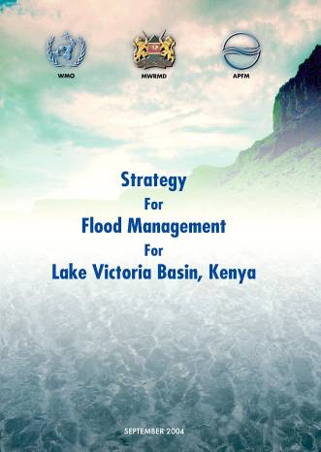
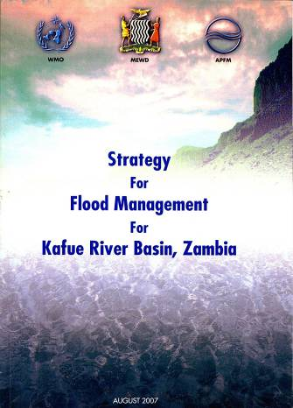
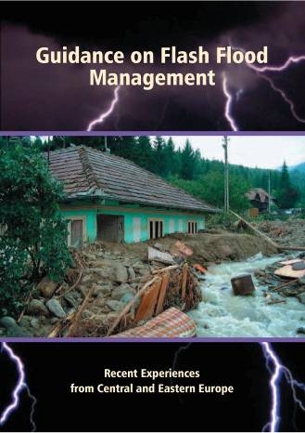
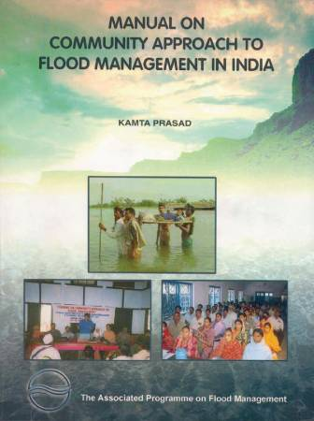
Regional pilot projects
Pilot projects have been undertaken in:
South Asia (community-based approaches)
Africa (flood management strategies)
Central and Eastern Europe (flash floods)
Available through the HelpDesk:
Assistance in development of proposals
Support in securing funding from donors
Technical supervision
Aim of pilot projects:
Develop and implement IFM concept and its application through demonstration (with third party funding)
Notes:
To demonstrate in a first phase the implementability of IFM concepts, specific pilot projects were developed in South Asia, Africa, and Central and Eastern Europe, based on external resources.
Currently through the HelpDesk is possible to seek assistance in developing project proposals, as well as in securing funding through third party donors

Slide 17
Success indicators
Launched in 2009
Around 221 requests received from more than 40 countries
Used by:
NGOs and private sector
Academic institutions
Governmental agencies
International Organizations
Notes:
Launched in 2009 at the Global platform on DRR, the HelpDesk has received aroud 221 requests from more than 40 countries up to September 2016 (the count is done for reporting to its Management Committee).
In terms of geographical distributio, requests have been received mainly from RA I, RA VI, and RA II.
Of these requests, more than one third were received from academia, almost half from NGOs or private sector companies, and only 17% from governmental agencies, proving that the HelpDesk is still somehow missing the target of NMHSs…

Slide 18
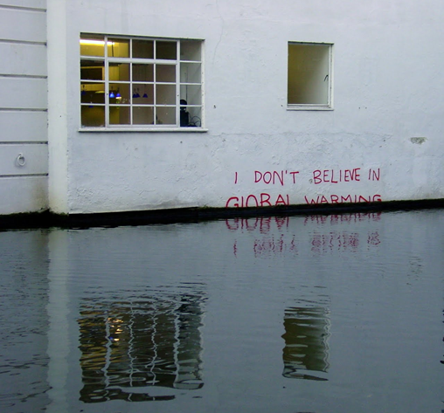
For more details: www.floodmanagement.info
Thank you for your attention

