Slide 1


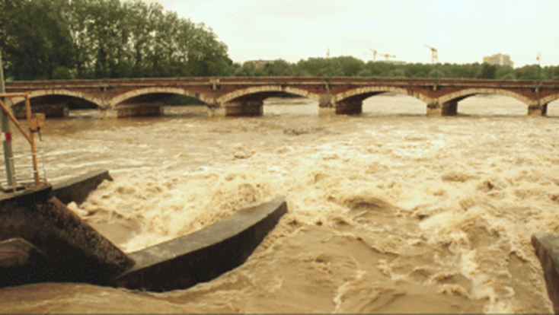
Republic of Turkey
Ministry of Forestry and Water Works
Turkish State Meteorological Service
Black Sea and Middle East Flash Flood Guidance System
Yusuf ULUPINAR
Turkish State Meteorological Service
yulupinar@mgm.gov.tr

Slide 2
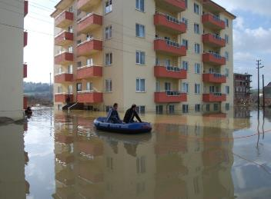
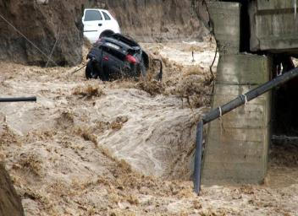
Objectives
Climate change has caused an increase in the number of severe weather events in many countries, and it has led to an increase in violence.
85% and 15% of the floods are characterized as flash floods and river floods, respectively.
Flash floods cause more than 5000 fatalities per year all over the world.

Slide 3
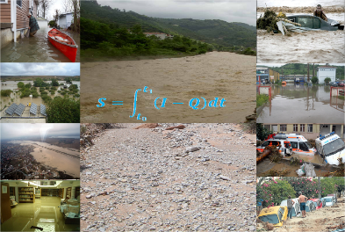
Objectives
to provide real time flash flood warnings with high hit rate,
to reduce the loss of life and property damages that may occur in the flash flood prone areas all over the world.

Slide 4
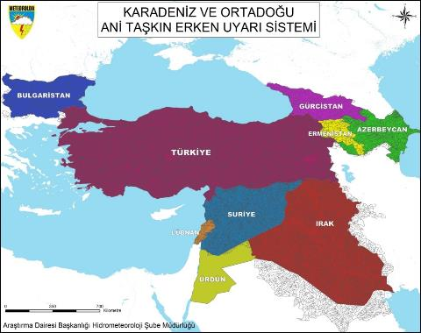
Black Sea and Middle East
Flash Flood Guidance System
In 2007, WMO decided to establish 22 Regional Centers worldwide, and it has created 7 regional centers by now.
The initial meeting of Black Sea and Middle East Flash Flood Guidance System was held in İstanbul on 29-31 March 2010, and Turkey has been elected as the regional center.

Slide 5
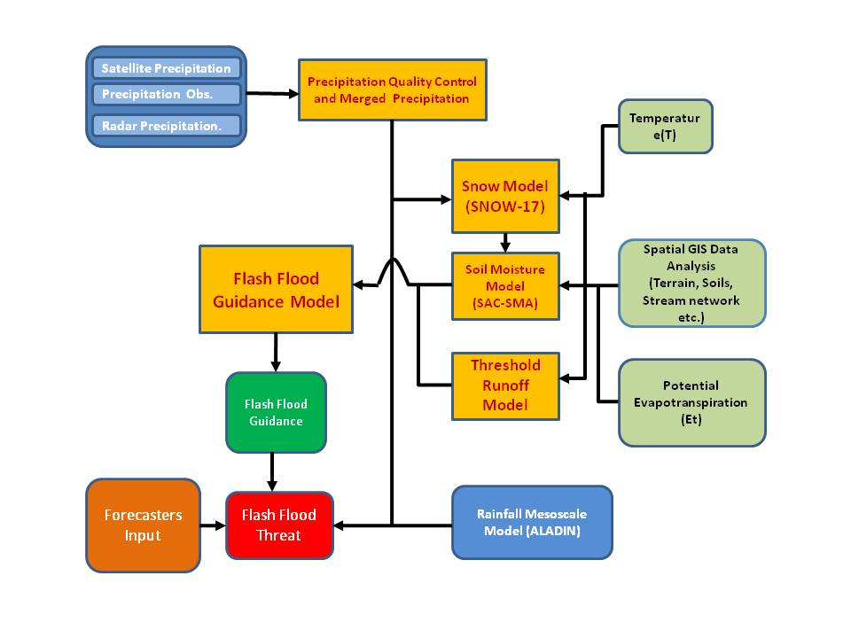

Flash Flood Guidance Model Concept

Slide 6
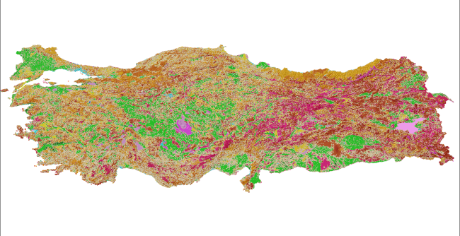
Land Cover
Land Cover
Source: Republic of Turkey Ministry of Forestry and Water Works
1/100.000
Scale: 1/100.000
“Corine” land classification
5 basic classes; agricultural areas, forests, wetlands, artificial zones and water bodies are given.

Slide 7
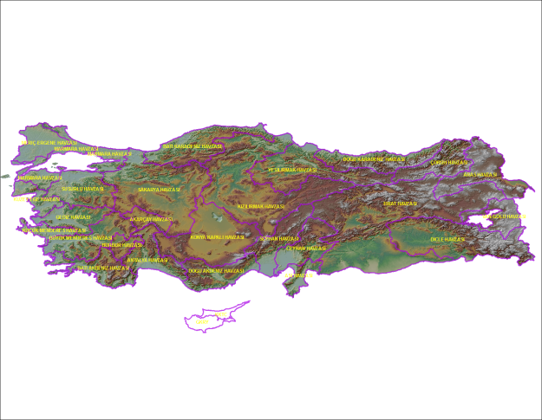
Topography
Source: USGS http://srtm.csi.cgiar.org
90 meters resolution DEM (Digital elevation Model) data from USGS has been applied. When the model has been obtained for Turkey, the model parameters have been improved to 30 meter resolution data.

Slide 8
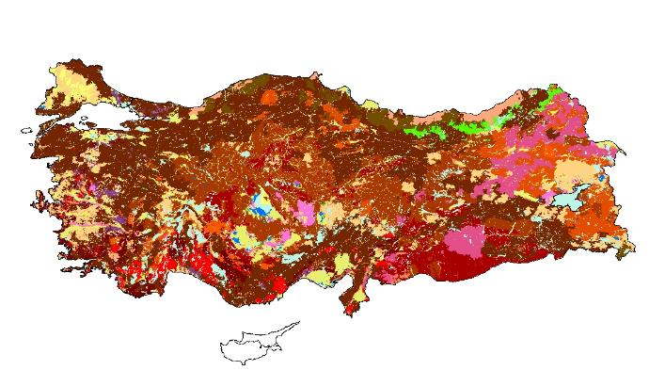
Soil Classification
Soil Data
Source: REPUBLIC OF TURKEY MINISTRY OF FOOD, AGRICULTURE AND LIVESTOCK
1/25.000
Prepared based on the USDA soil classification
There are 26 different soil groups in Turkey, e.g., alluvial soil, beach sand, brown soil etc.
Scale: 1/25.000

Slide 9
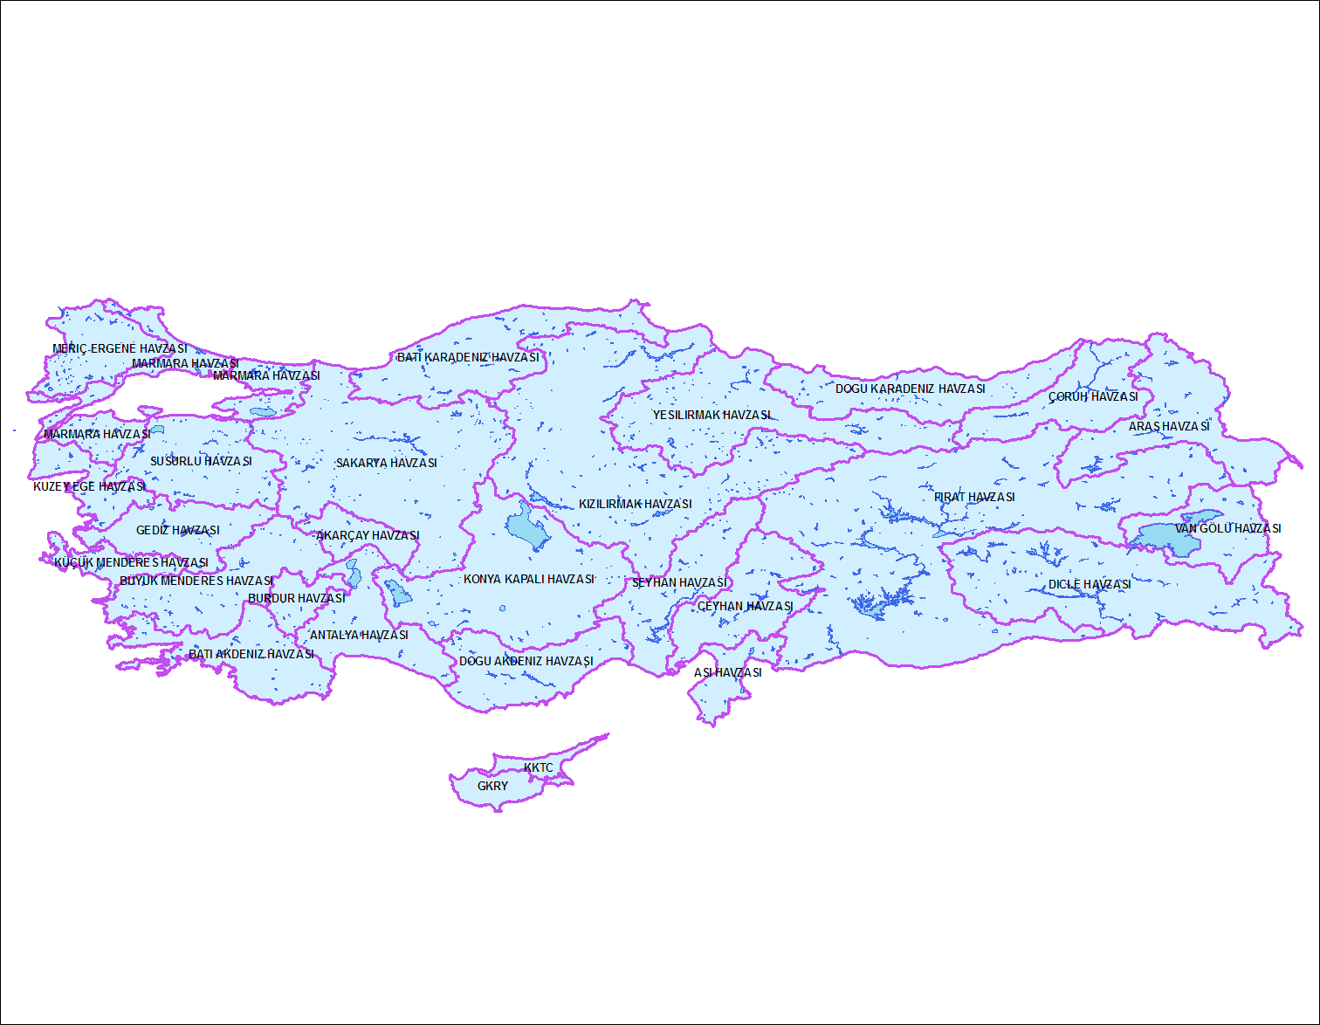
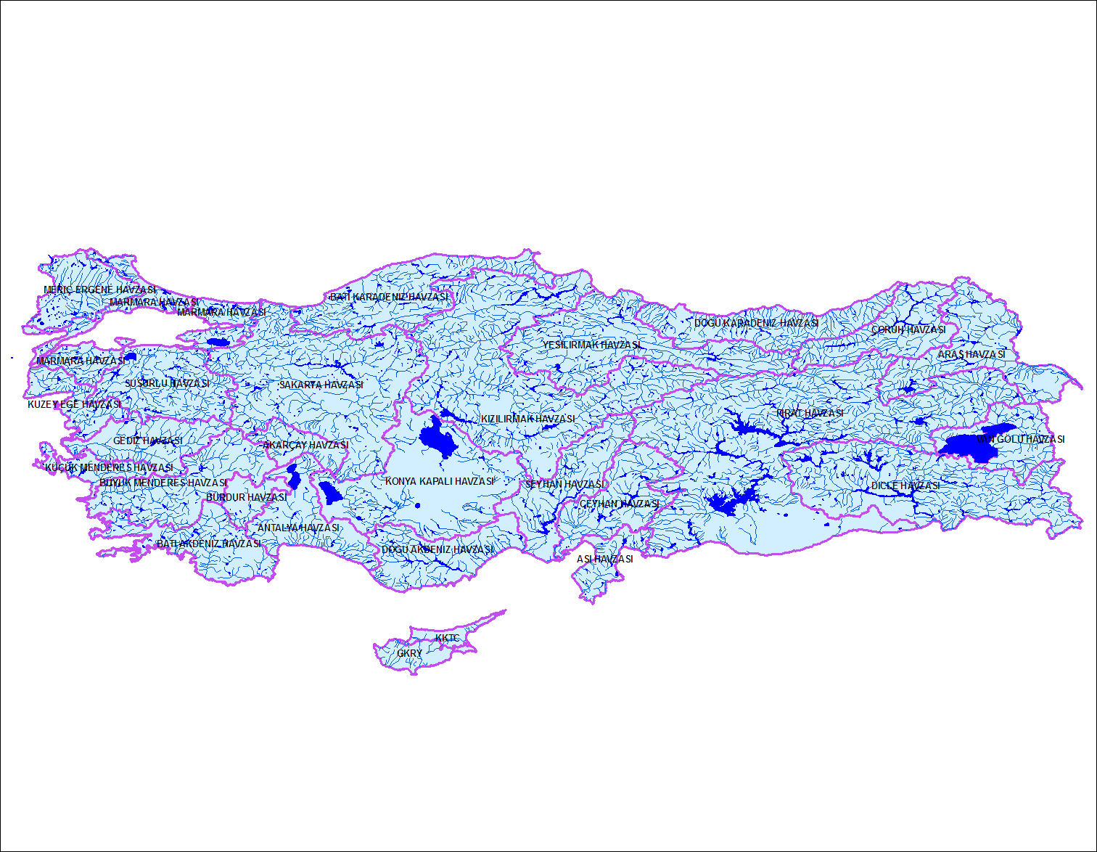
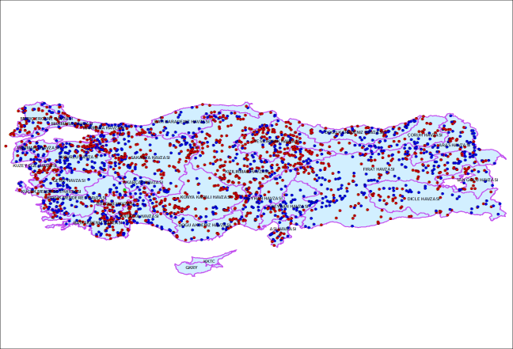
Hydrological Parameters
Dams and Ponds
Rivers
Scale: 1/250.000
Scale: 1/250.000
The data for rivers, dams, ponds, and gauging stations are obtained from the State Hydraulic Works to use as inputs in the system.
There are 1478 State Hydraulic Works stations in Turkey.
19 station data, where flash flood events occurred in the past, are applied for the model calibration.
State Hydrolic Work Stations
Source: DSİ

Slide 10
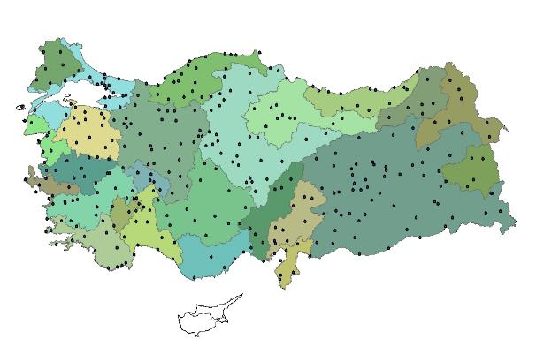
Meteorological Parameters
30 Year Historical Meteorological Data
Rain,
Temparature,
Sunshine duration,
Evaporation,
Soil moisture,
Wind.
Source: TSMS
30-year historical data are used to calibrate the model and determine the parameters.

Slide 11
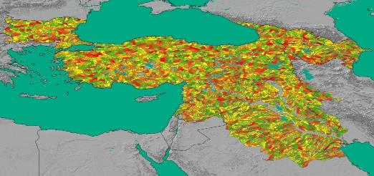
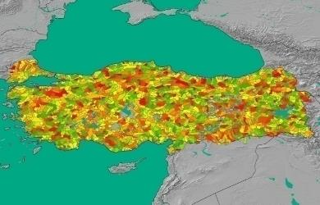
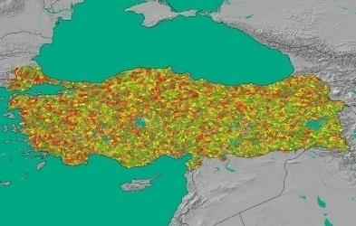
The formation of Sub-basin
At the regional level, more than 16.800 sub-basins with an average area of 200 km were generated .
For Turkey, 2.900 sub-basins were generated (before).
More than 11.000 sub-basins with high resolution delineation for Turkey (current).

Slide 12
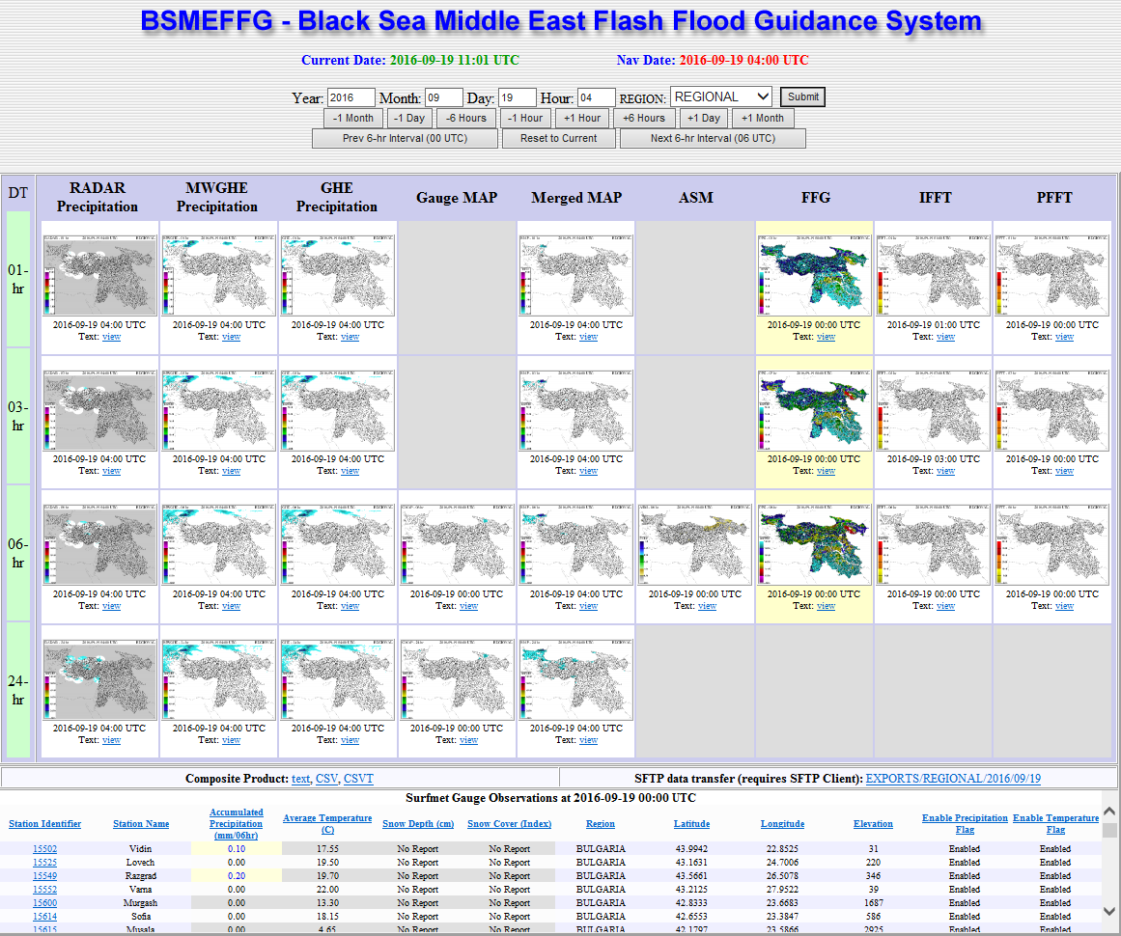
Main Product Console
Surface Observation Data
Imminent
Flash
Flood
Threat
Persistent
Flash
Flood
Threat
Radar
Precipitation
Microvawe
Satellite
Infrared
Satellite
Surface
Observation
Soil
Moisture
Merged Precipitation
FFG

Slide 13
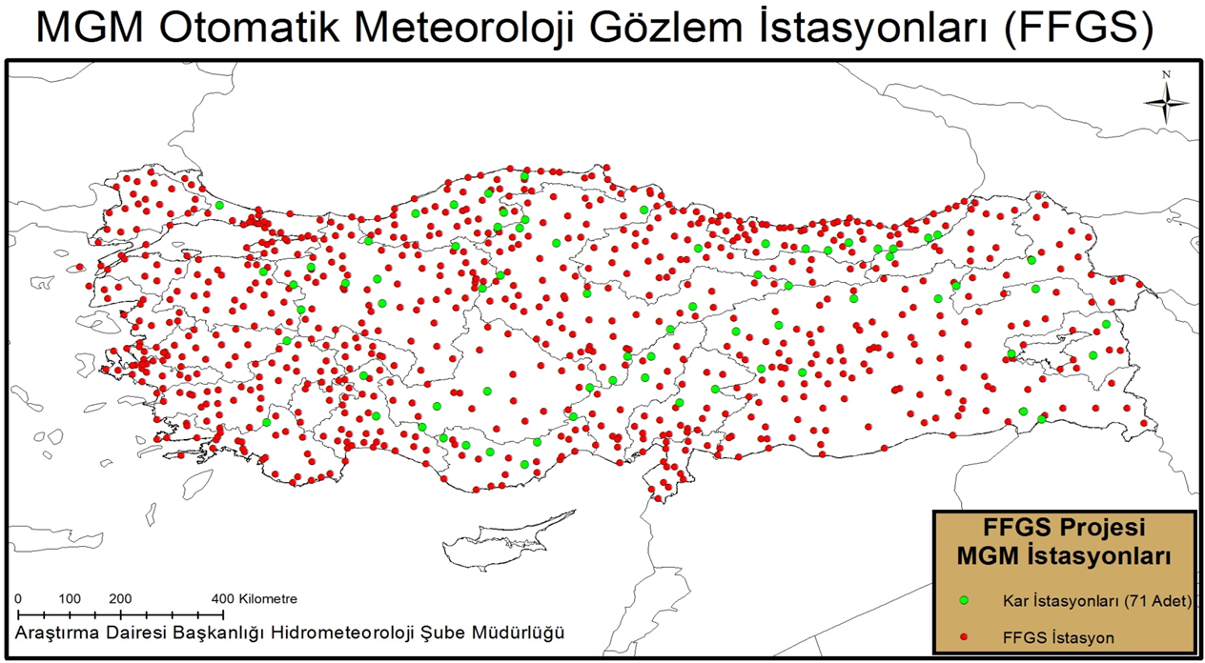
Surface Observation
The number of automatic meteorology observation station has increased to 850 from 138 because of the importance of hydrological studies, thereby the model has operated more accurate. Measured precipitation, temperature, snow, and evaporation data are entered into the model in real time.

Slide 14
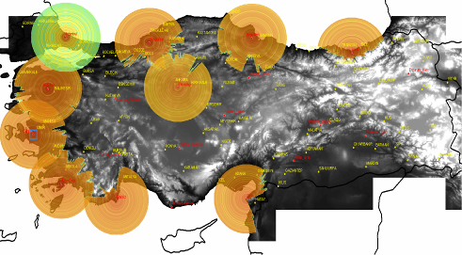
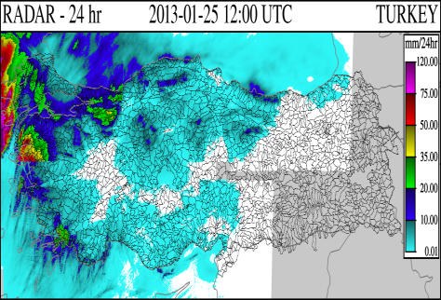
Radar Precipitation Data
After the bug fixes, hourly precipitation data obtained from 10 radars of TSMS are entered into the model with 450 x 720 m grid resolution. Radar precipitation products are updated in every 6 minutes.

Slide 15
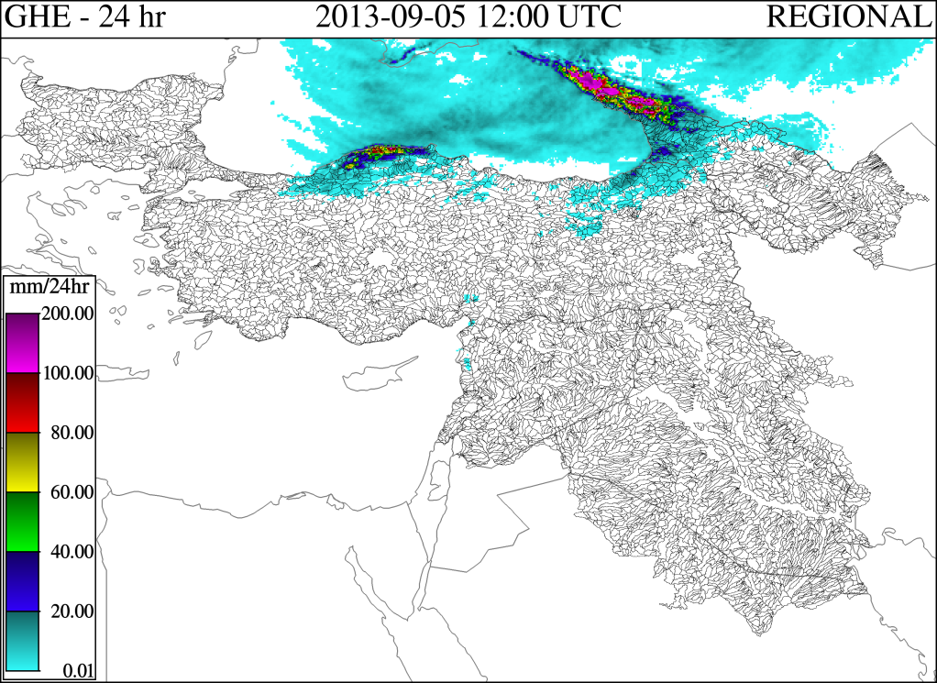
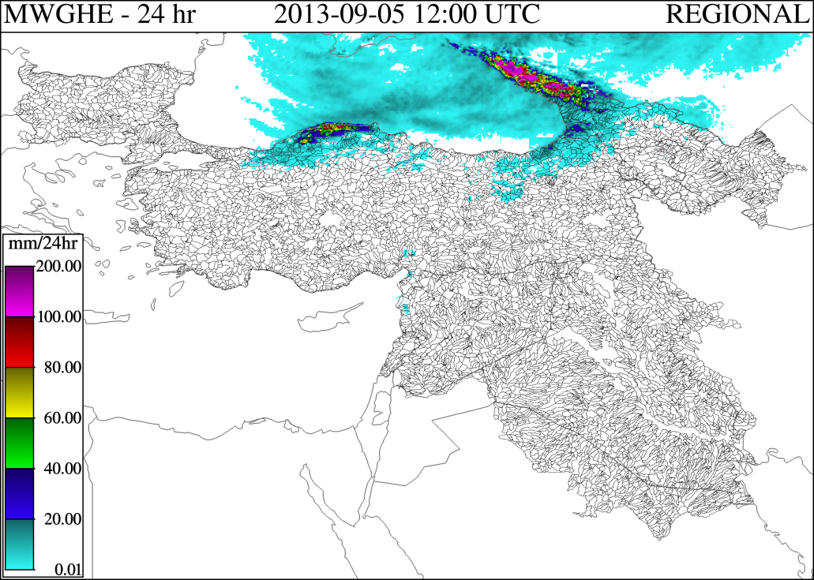
Satellite Precipitation Data
Global Hydro Estimator (GHE) is generated by NOAA-NESDIS by using IR window channels of NOAA and EUMETSAT geostationary satellites.
Microwave bias adjusted Global Hydro Estimator (MWGHE) is generated by NOAA-NESDIS by adjusting GHE precipitation with microwave precipitation retrievals from polar orbiting satellites.

Slide 16

Satellite Precipitation Data
Infrared (10.5 µm)
Microwave
15.000 m
T_{b}
T_{b}
10.000 m
5.000 m
3.000 m
1.500 m
Precipitation data are calculated by using infrared sensors based on cloud-top height.
Microwave precipitation data are calculated by using the radiation that coming inside of the cloud.
Therefore, the microwave precipitation data are more accurate.

Slide 17
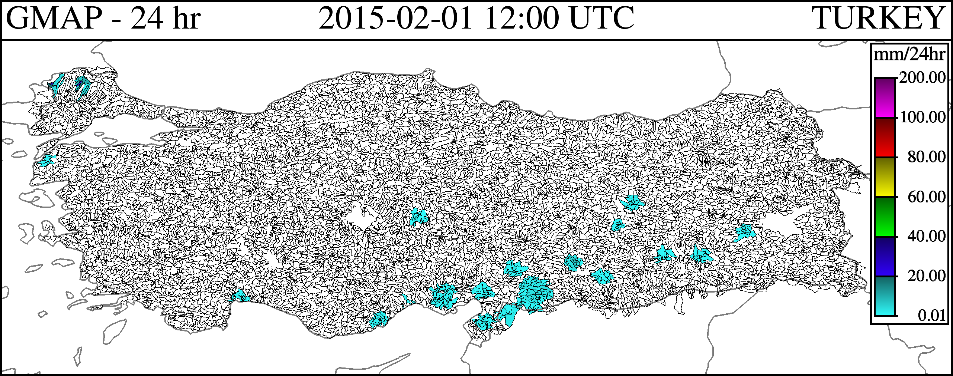
Surface Observations
The measured areal precipitation data are entered into the model in real time and shown at the sub-basin scale.

Slide 18
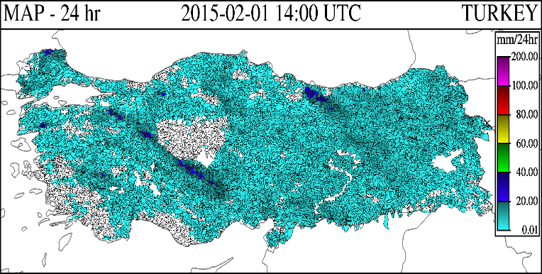
Merged Satellite Data
This product is derived for each basin based on the best available mean areal precipitation estimates from bias-adjusted RADAR or bias-adjusted MWGHE or bias-adjusted GHE or the gauge-interpolations. The Merged MAP data products are updated every hour and reflect accumulations of basin-average precipitation of a given duration ending on the current navigation hour.

Slide 19
Soil Moisture Model (SAC-SMA)
Soil moisture, run-off and infiltration products are generated by using the Sacramento SAC-SMA model.

Slide 20
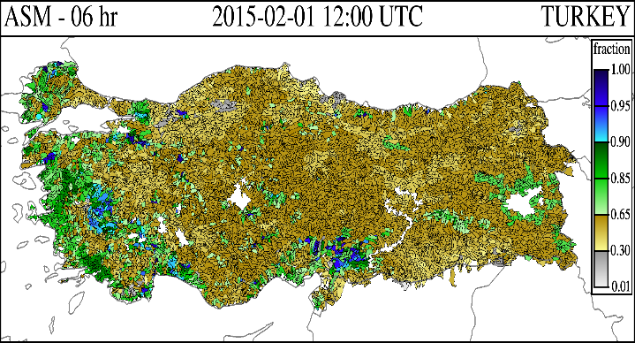
Soil Moisture Model (SAC-SMA) Outputs
Average Soil Moisture (ASM) product shows the fraction of soil moisture deficit of the upper soil (20-30 cm) for which upper zone tension and free water contents are estimated by using Sacramento Soil Moisture Accounting Model (SC-SMA).

Slide 21
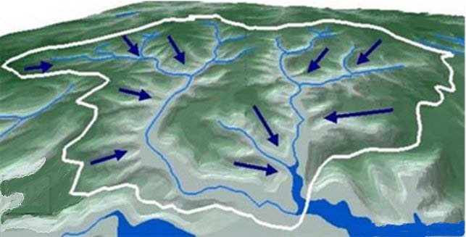
Surface Runoff Threshold Model
Surface Runoff and Infiltration
FFT (Flash Flood Threat)= excessive precipitation after filled creek channel (precipitation-FFG) (mm).
Flow (Q) Account in the outlet of sub-basin
h=Water Level
FFG= rainfall needed to fill creek channel (mm).

Slide 22
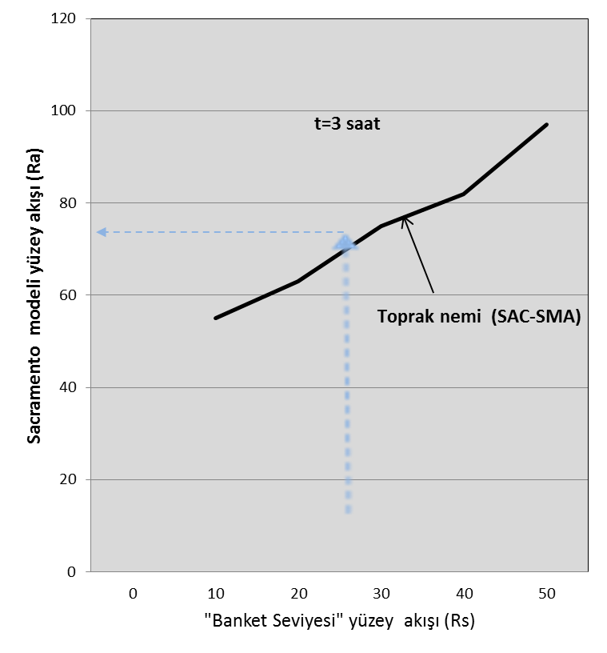
Surface Runoff Threshold Model
Soil water holding capacity and runoff are calculated based on precipitation and soil types by the Sacramento Soil Moisture Model.
FFG products are generated by the soil moisture and surface runoff data (Banket Level ve Sacramento Model).

Slide 23
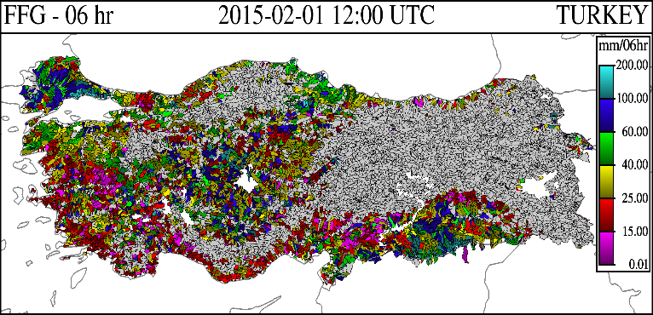
Flash Flood Guidance Model (FFG)
Flash Flood Guidance is defined as the amount of actual rainfall that causes bankfull flow at the end of the catchment for a given duration, e.g., 1-, 3-, and 6- hour. The main inputs of the FFG model are threshold runoff which is calculated with the geomorphologic unit hydrograph, drainage channel and catchment characteristics, and soil moisture deficit that is estimated from SAC-SMA model.

Slide 24
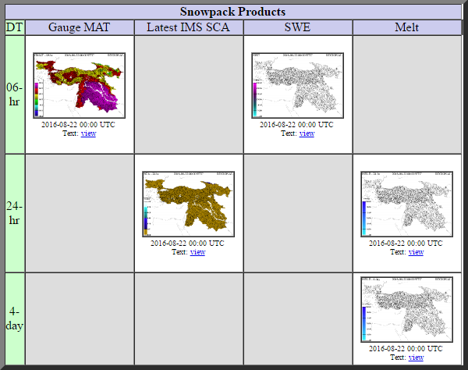
Snow Products
Mean
Areal
Temperature
Snow
Cover
Area
Snow-Water Equivalent
Snow
Melt

Slide 25
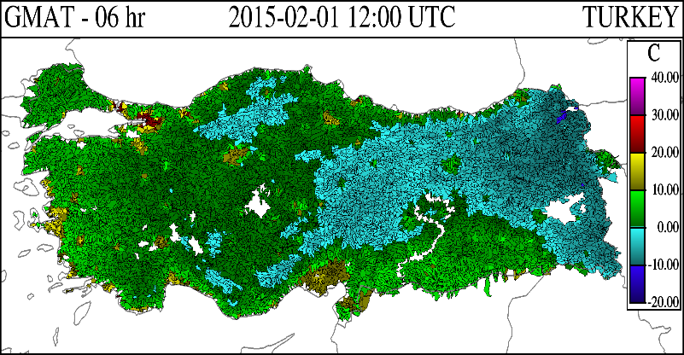
Temperature
Gauge mean areal temperature (GMAT) is generated by the synoptic observations that are disseminated through WMO Global Telecommunication System (GTS).

Slide 26
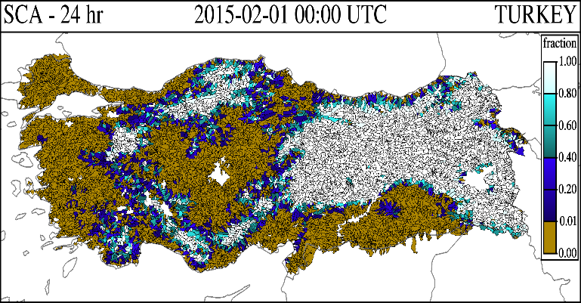
Snow Cover Areas
24-hour snow cover area map is obtained from the satellite.

Slide 27
Structure of the Snow Model
Precipitation and Temperature
Y
Rain or Snow?
K
Snowpack
Energy change between Snow-Atmosphere
Snow Cover Area
Rain
Energy
Deficit
Deficit=0.0
Water
Storage
Transmission of excess water
Ground Melt
Rain and Melting
Snow Melt
SNOW-17 model gets two parameters which are GMAT and merged MAP, and it produces a number of products including SWE and MELT by the thermodynamic equations.

Slide 28
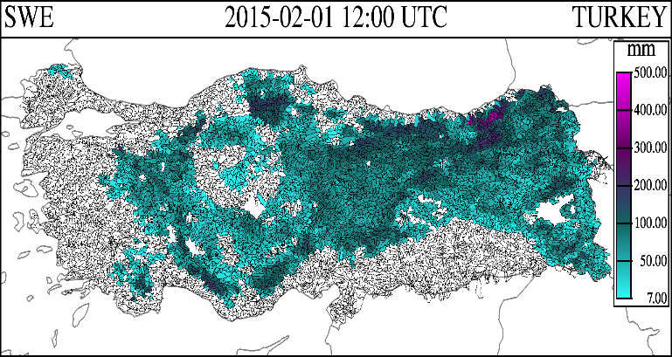
Snow Model Output
Snow Water Equivalent product is the direct output of SNOW-17 accumulation and estimated at 00, 06,12 and 18 UTC.

Slide 29
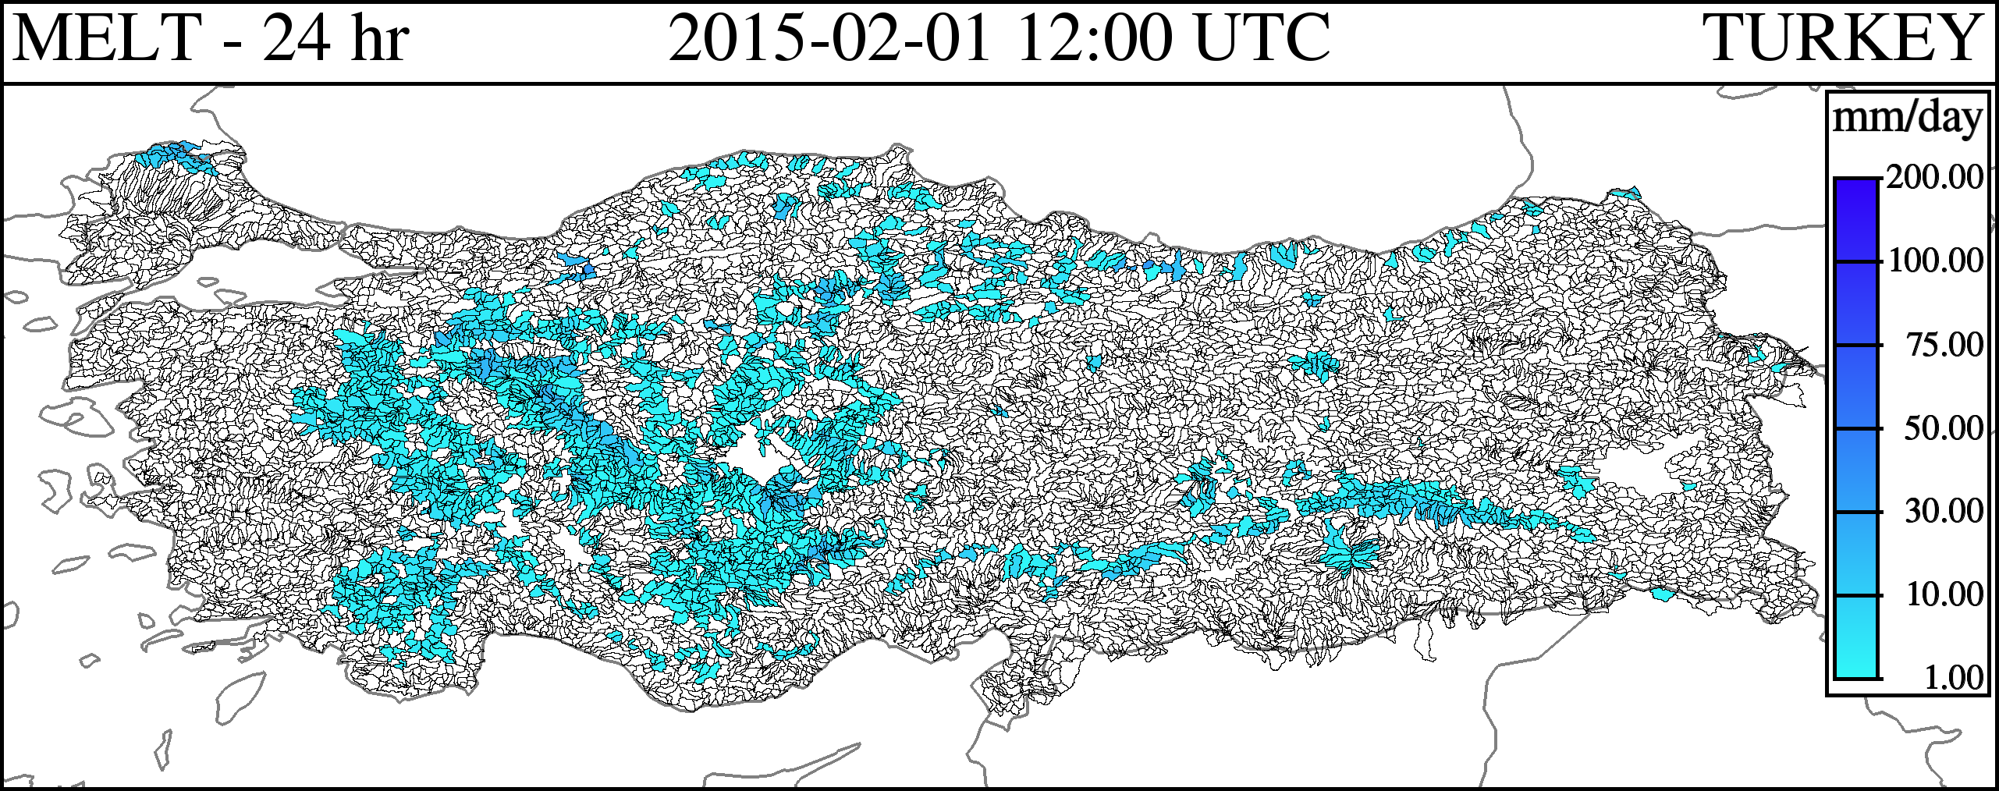
Snow Model Output
The amount of snow melt products is obtained for 1 and 4 days for each sub-basin.

Slide 30
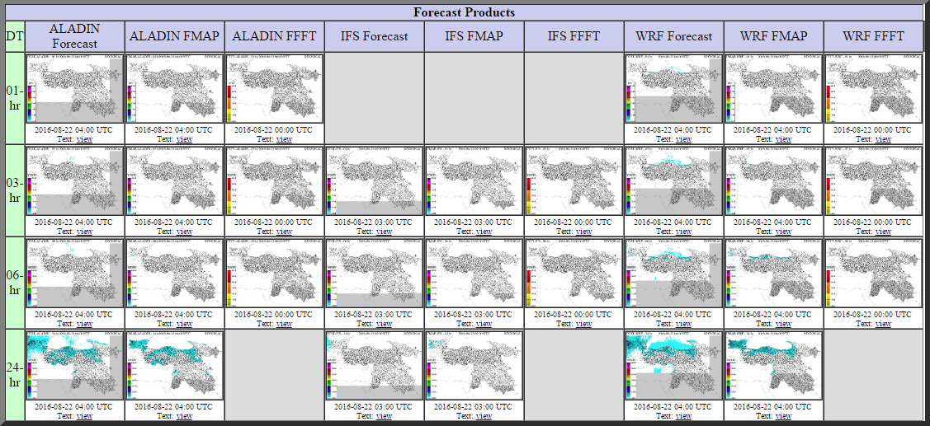
Forecast Products
ALARO
Model
Output
ALARO
Forecast
Mean Areal Pre.
ALARO
Forecast
Flash Flood Threat
ECMWF
Model
Output
ECMWF
Forecast
Mean Areal Pre.
ECMWF
Forecast
Flash Flood Threat
WRF
Model
Output
WRF
Forecast
Mean Areal Pre.
WRF
Forecast
Flash Flood Threat
ALARO Numerical Forecast Model was the only model used in the project until this time. However, BSMEFFG system started to use 3 different numerical models as ALARO, WRF and ECMWF since 18th August 2016.

Slide 31
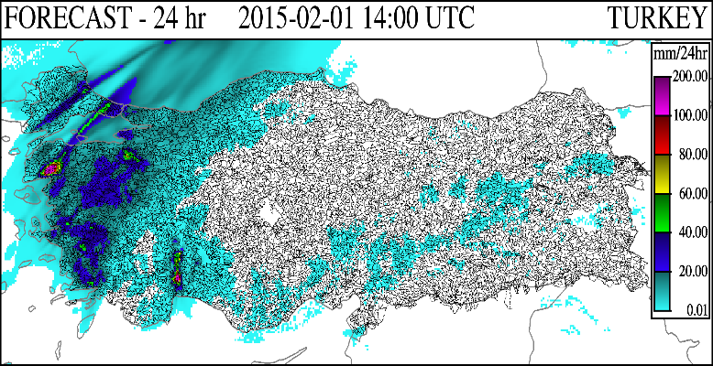
Numerical Weather Prediction Models
ALADIN was the only numerical forecast model which has the highest resolution used in our country. Precipitation products that are updated in every 6 hours with 4.5 x 4.5 km resolution are entered into the model.

Slide 32
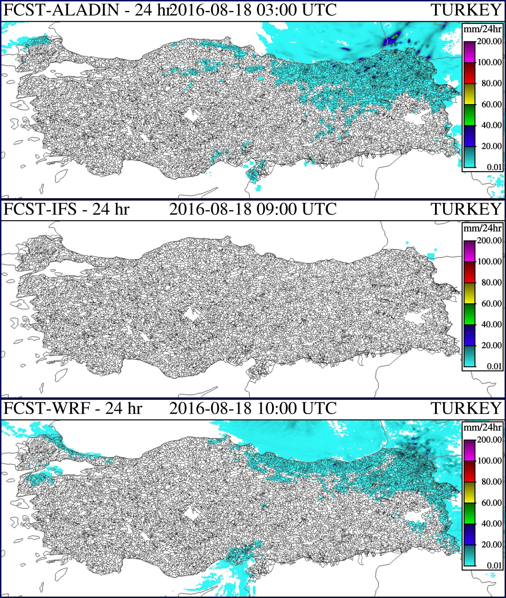
Numerical Weather Prediction Models
Generated forecast precipitation products by using ALARO, ECMWF and WRF Numerical Weather Prediction Models are demonstrated in the figures, respectively.

Slide 33
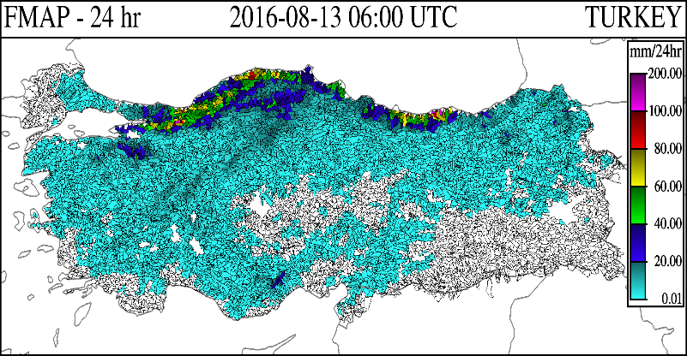
Forecast Mean Areal Precipitation
1-, 3-, 6-, and 24-hour accumulations of mean areal precipitation (mm) for each sub-basin are produced by using the numerical forecasts from the ALADIN, ECMWF and WRF models.

Slide 34
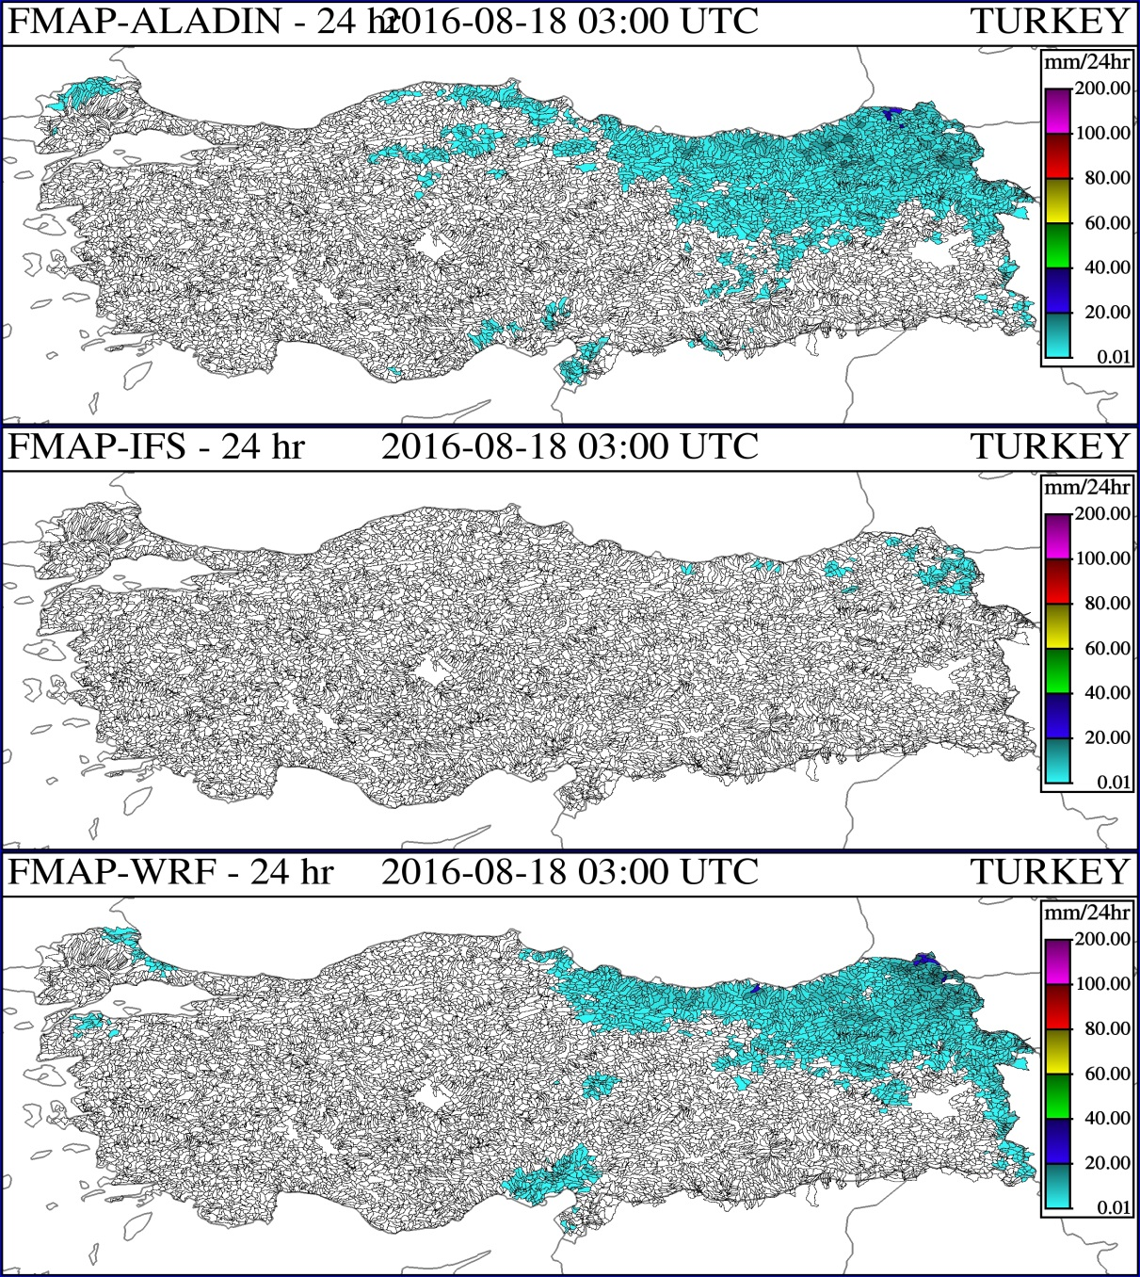
Forecast Mean Areal Precipitation
Generated areal forecast precipitation products by using ALARO, ECMWF and WRF Numerical Weather Prediction Models are illustrated in the figures, respectively.

Slide 35
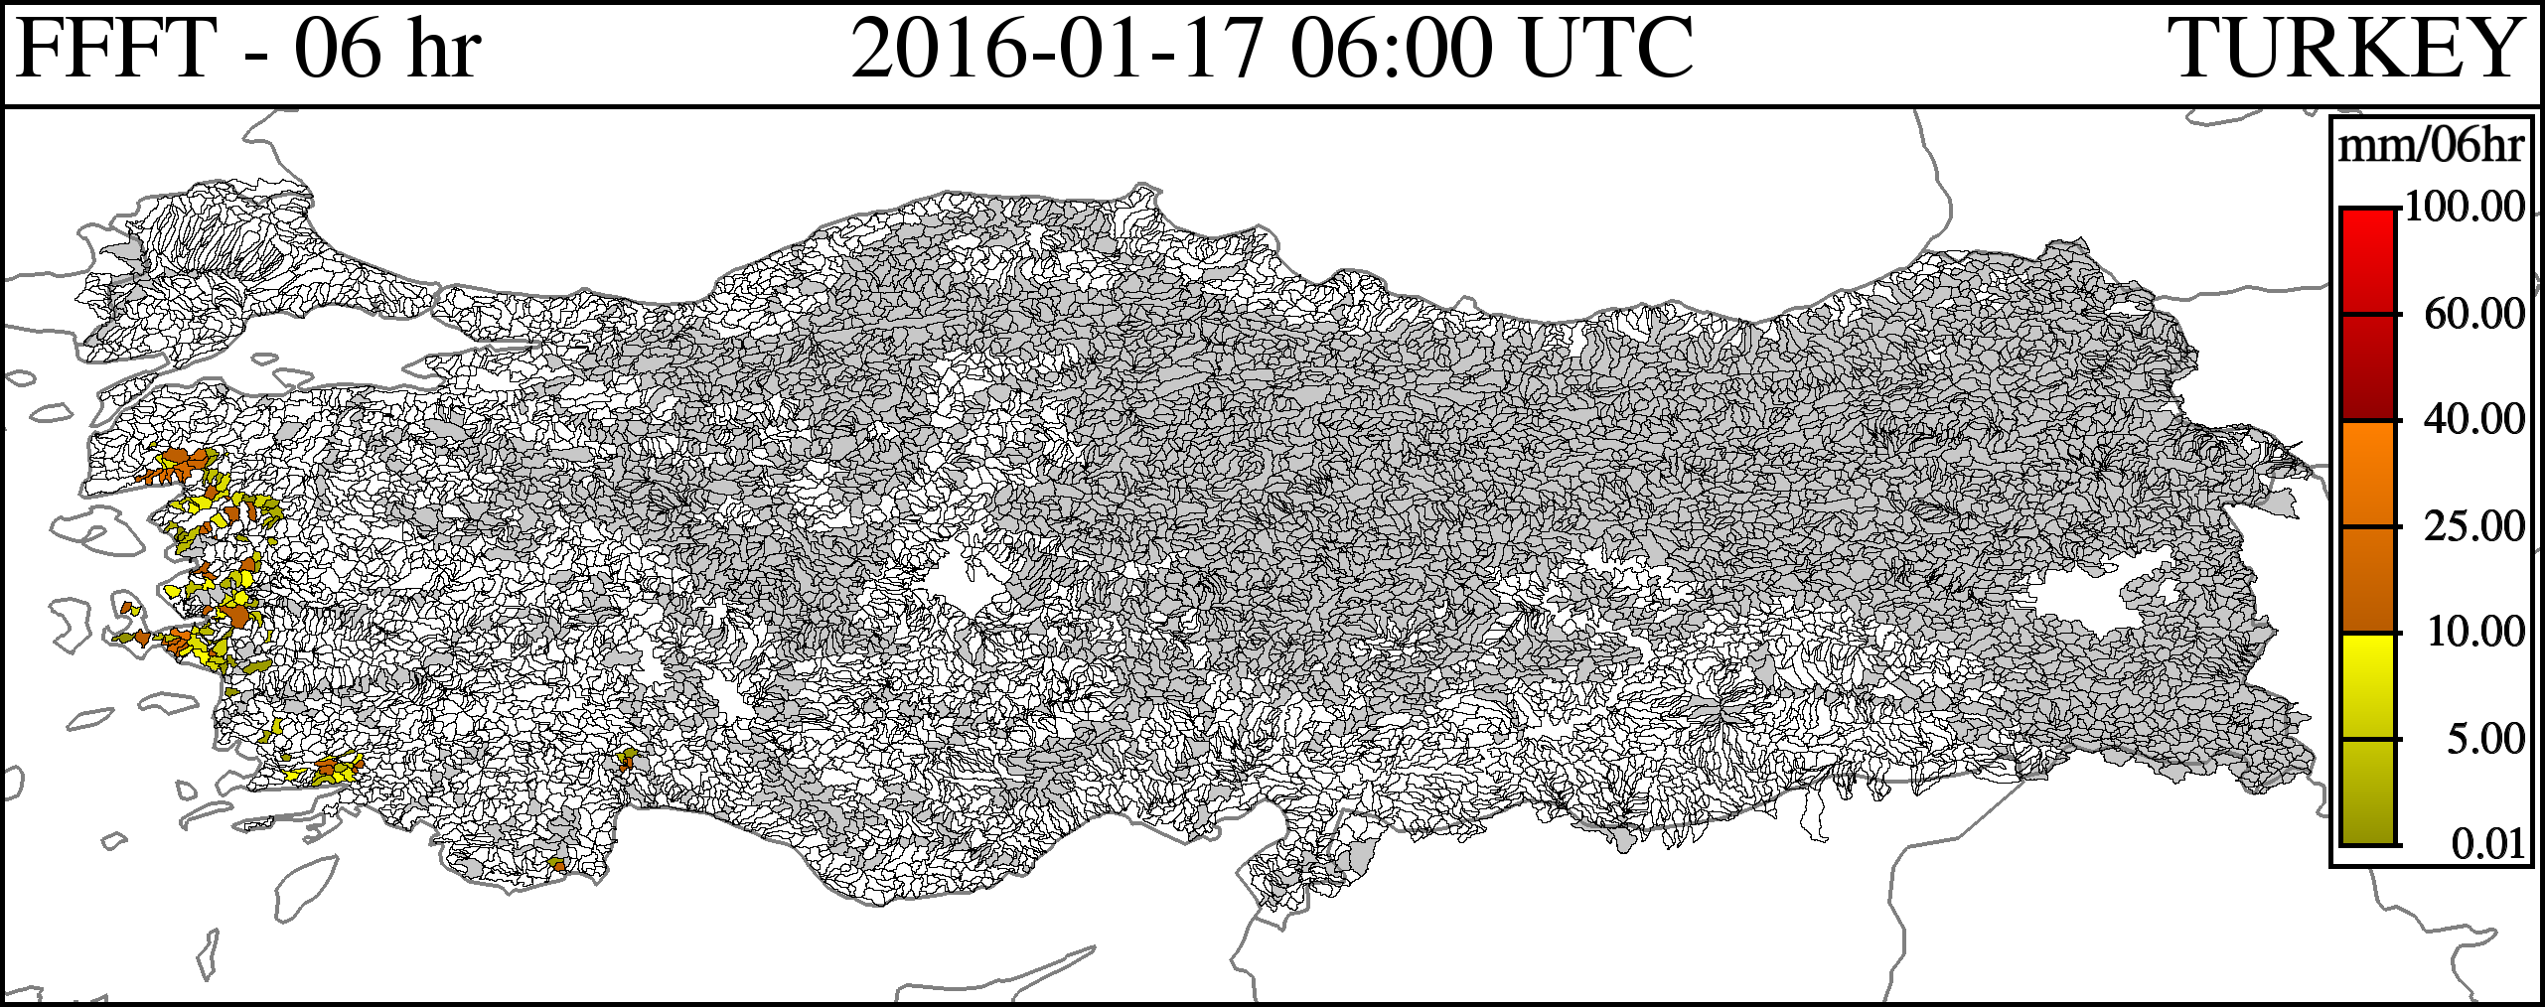
Forecast Flash Flood Threat
FFFT (06 UTC) = FMAP (06 UTC) - FFG (06 UTC)
FFT is the difference between forecast mean areal precipitation (FMAP) and FFG, and it is created at the model runtimes of 00, 06, 12 and 18 UTC. 1-hour, 3-hour, and 6-hour FFFTs are estimated at the model runtimes.

Slide 36
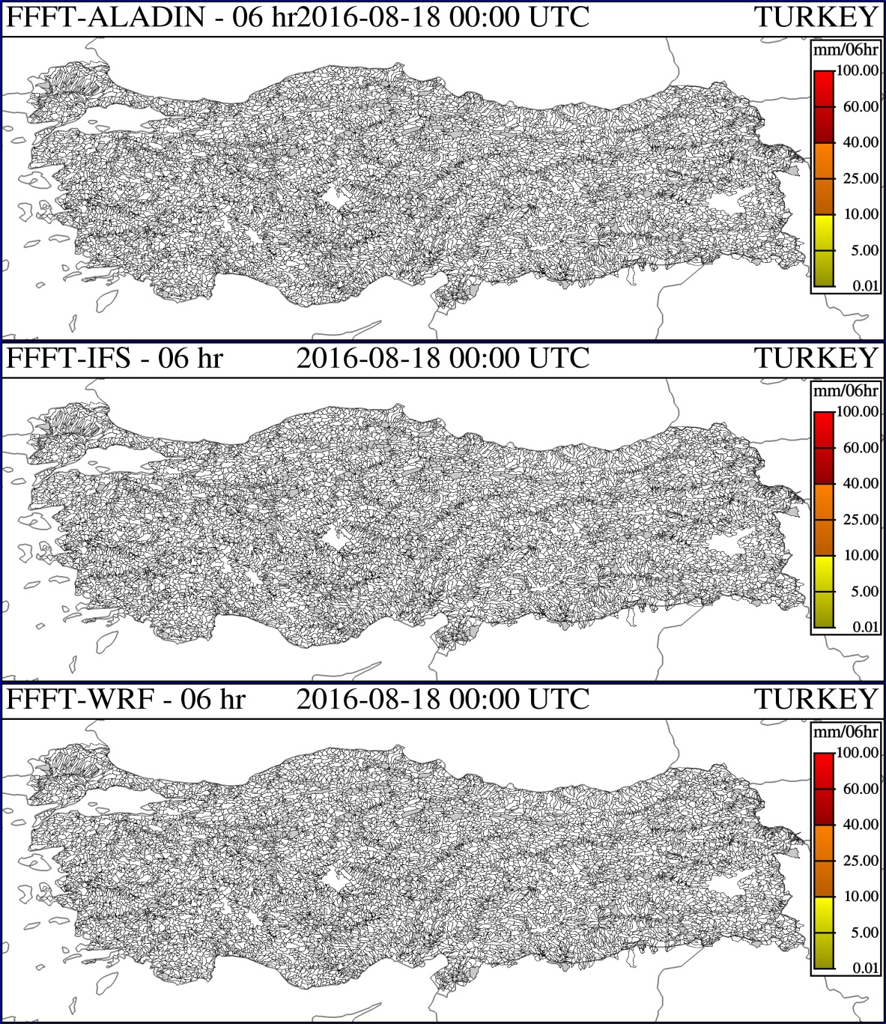
Forecast Flash Flood Threat
Generated forecast flash flood threat products by using ALARO, ECMWF and WRF Numerical Weather Prediction Models are shown in the figures, respectively

Slide 37
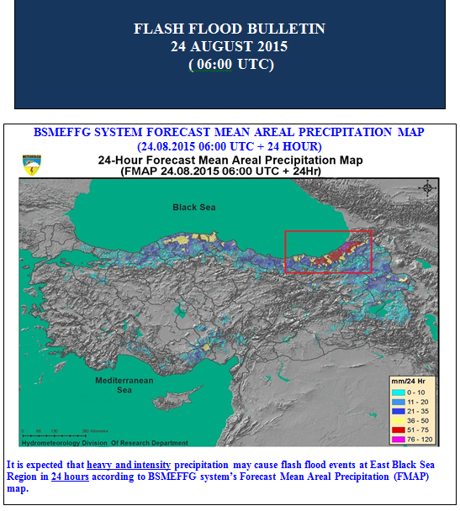
Flash Flood Risk Areas Bulletin
Flash flood risk areas bulletins are prepared 6 hours in advance with the purpose of verification by means of BSMEFFG when there is potential risk of flash flood.

Slide 38
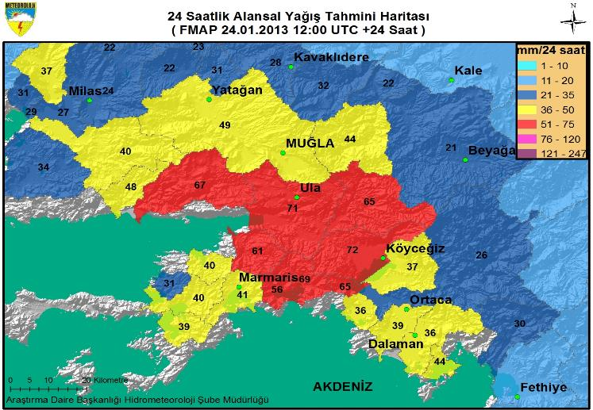
24-Hour Forecast Mean Areal
Precipitation (FMAP)
Forecast precipitation maps are prepared by using the FMAP data in the GIS software.

Slide 39
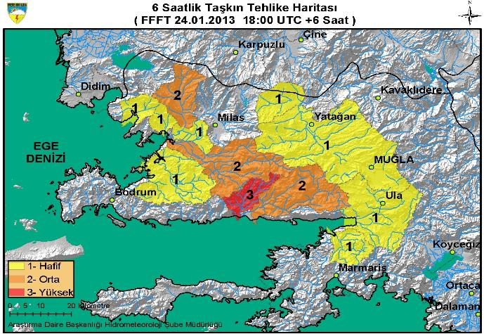
Flash Flood Risk Areas
Early warning maps are prepared with the FFFT data in the GIS software.

Slide 40
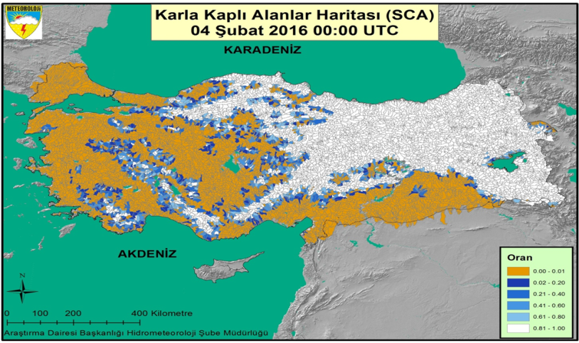
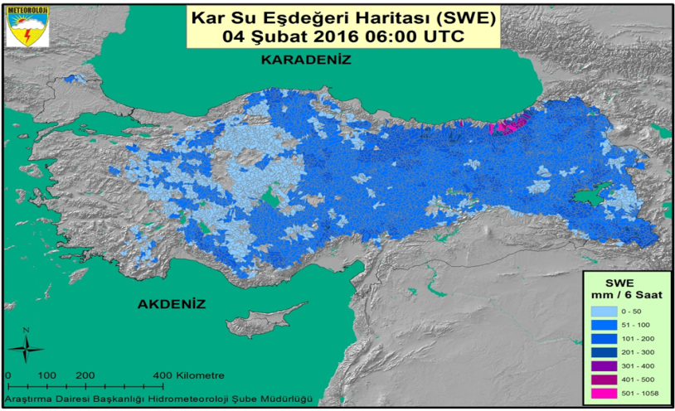
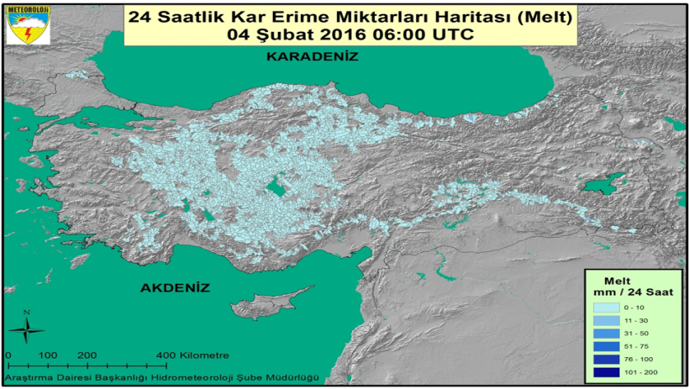
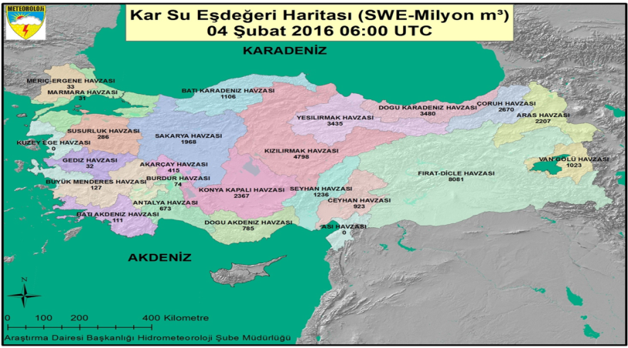
Snow Water Equivalent and Analysis Bulletin
SNOW 17 SNOW COVERED AREAS
SNOW 17 SNOW WATER EQUIVALENT
SNOW-17 THE AMOUNT OF SNOW MELT MAP
SNOW-WATER POTENTİAL MAP (25 BASIN)
By the Flash Flood Guidance Model, snow water potential and snow melt maps are prepared at basin scale for 1 and 4 days. Furthermore, these bulletins are shared with affiliated institutions.

Slide 41
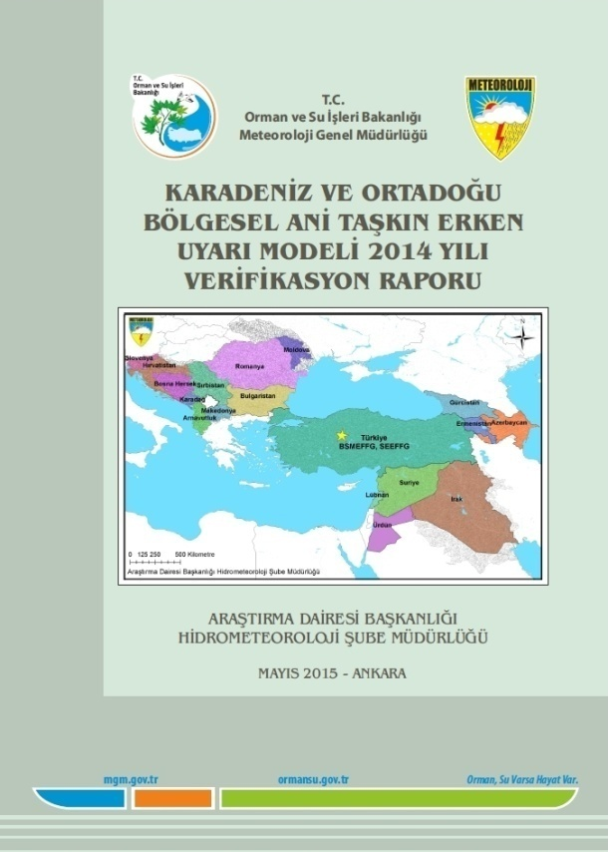
Verification
 | Flash Flood Obs.(TSMS, DSİ, Press)
BULLETINS 2014 |  | YES | NO | TOTAL
 | YES | 57 (a) | 10 (b) | 67
 | NO | 48 (c) (DSİ + TSMS+ Press) | 250 (d) | 298
 | TOTAL | 105 | 260 | 365
                Verification reports are performed periodically by using FFGS bulletins. For instance, 67 Flash Flood Warning Bulletins were prepared throughout 2014. Flash flood events occurred in the areas that early warning was given in the 57 bulletins while there were no any recorded incidents for the other 10 bulletins.

Slide 42
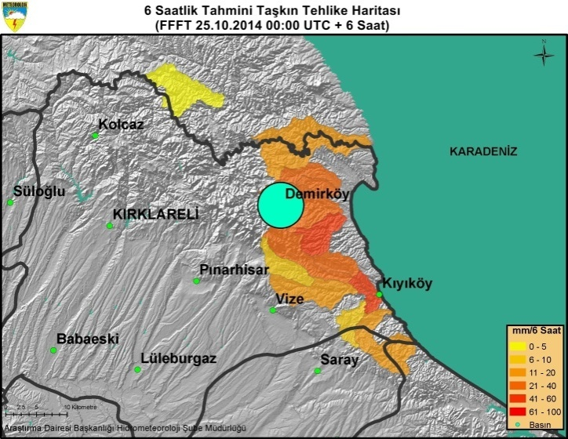
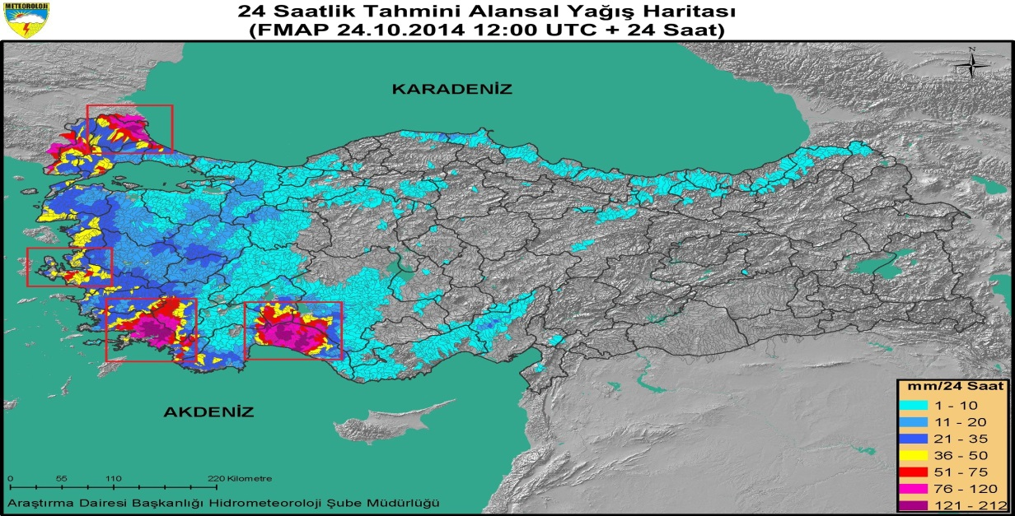



Verification Methods
                TSMS Fevk Obs., DSİ Flood reports, and flash flood news from press are the verification sources for the reports.

Slide 43

Flash Flood events compared with Flash Flood Bulletins in 2014
                F.F. Bulletins, State Hydraulic Works flood reports, TSMS fevk obs., and flash flood news from press are indicated with the colors of purple, yellow, green, and blue, respectively.

Slide 44



Training and Documentations
55 forecasters from 15 regional forecasting offices were trained about BSMEFFG products and how to use them in daily forecasting. It was held in Ankara at WMO RTC on 30 October-1 November 2013.
BSMEFFG user guide has been prepared both in Turkish and English.

Slide 45



Meeting and Workshops
BSMEFFG regional workshop was held in Alanya WMO RTC, Turkey on 3-5 December 2013. As well as Turkey, Bulgaria, Georgia, Azerbaijan and Armenia, HRC and WMO representatives also participated in the meeting.
FFG products and case studies were covered in the workshop.

Slide 46



Training for the Regional Countries
BSMEFFG forecasters training was held at the Armenian , Azerbaijan and Georgia Hydrometeorological Services on 19-23 May , 26-29 May, and 21-25 July 2014 respectively.
Participants in the BSMEFFG Training at Armenian Hydrometeorological Service
Participants in the BSMEFFG Training at Azerbaijan Hydrometeorological Service
Participants in the BSMEFFG Training at Georgia Hydrometeorological Service

Slide 47


Training for the Regional Countries
Lebanon and Jordan Hydrometeorological Services were trained about BSMEFFG on May 16-27, 2016 in TSMS.
BSMEFFG forecasters training coordinated by WMO was held for 8 regional countries at the Georgia Hydrometeorological Service on 28-30 June 2016.

Slide 48


SEEFFG Project
SEEFFG initial meeting was held in Ankara on January 22-24, 2013. Bosnia Herzegovina, Romania, Serbia, Croatia, Montenegro, Moldova, Slovenia, Macedonia, and Albania representatives attended to the meeting. Turkey was elected as the regional center of the SEEFFG project during the meeting.

Slide 49

Central Asian Countries
Flash Flood Guidance Project
CAFFG initial meeting was held in Ankara on May 5-7, 2015. As well as World Meteorological Organization (WMO), Hydrology Research Center (HRC) and TSMS representatives, Kazakhstan, Turkmenistan, Uzbekistan, Tajikistan, and Kyrgyzstan representatives also attended to the meeting. Kazakhstan was elected as the regional center of the CAFFG project in the meeting.

Slide 50

BSMEFFG Project
BSMEFFG Project was ended on December 31st, 2015. However, studies still continue to enhance the project.

Slide 51
Representation of the Model Products
The studies of GIS-based, two- and three-dimensional views of the Flash Flood model products will be performed.

Slide 52
FOR DETAILED INFORMATION:
PLEASE CONTACT WITH
MR. YUSUF ULUPINAR (yulupinar@mgm.gov.tr)

