Slide 1



Republic Hydro-Meteorological Service of Republika Srpska (one of two entity hidrometeorological services in Bosnia and Herzegovina)
ICSEED 15th Session , Zagreb 6-7 Oct. 2016. Croatia
INFORMAL
CONFERENCE
OF SOUTH-EAST
EUROPE
DIRECTORS
Hosted by National
Meteorological and
Hydrological Service
of Croatia
(DHMZ)
Activities between two meetings and present actions
rhmz@teol.net Republic Hydro-Meteorological Service of Republika Srpska, B&H www.rhmzrs.com

Slide 2
ICSEED 15th Session , Zagreb 6-7 Oct. 2016. Croatia
FOCUS ON whole institution
DOCUMENTS:
new and additional legislative acts: adopted systematization of workplaces
-this opens up opportunities for employment experts from all
fields of activity
-negative circumstance is small and restrictive budget
92% (salaries); 8% (all other coasts)
-Preparation of new Water Low or amandmens on old one
ACTION:
renovation the old building of weather station in Banja Luka, which is used as office building, where they are located sectors: climatology, hydrology and ecology
Project: preservation of archives (storage, guidance, publishing and data security
cooperation with hail suppression public company on Project:
The establishment of technical meteorological service and modernization of
the hail protection of the Republic of Srpska
rhmz@teol.net Republic Hydro-Meteorological Service of Republika Srpska, B&H www.rhmzrs.com

Slide 3
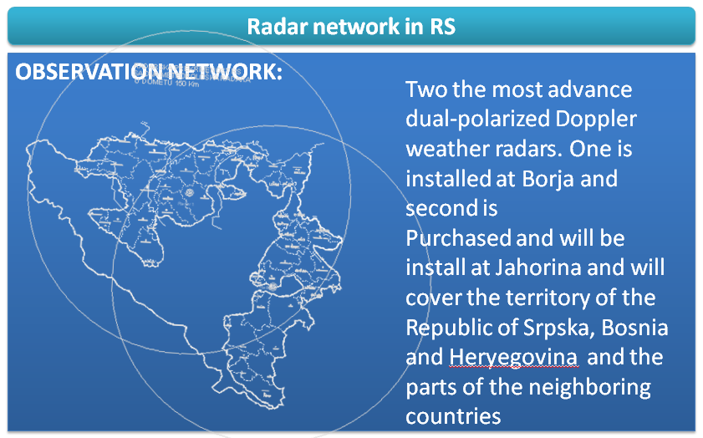
ICSEED 15th Session , Zagreb 6-7 Oct. 2016. Croatia
Borje
Jahorina
rhmz@teol.net Republic Hydro-Meteorological Service of Republika Srpska, B&H www.rhmzrs.com

Slide 4

ICSEED 15th Session , Zagreb 6-7 Oct. 2016. Croatia
FOCUS ON action within BiH through Miistry of Civil Protection
INITIATIVE:
Bosnia and Herzegovina Co-operation Agreement with
"for eventual accession to the Convention".
at the end of 2015 (17.dec.) B & H (Ministry of Civil Protection) sent a letter to Dr Florens Rabier, General-Director ,of interest to establish broken communication with ECMWF for the purpose of cooperation and accession to the Convention.
RHMS RS and FHMI FB&H, obtain the consent of the entity Governments, to enter into the negotiation process.
Two entity meteorological services have drawn up an agreement on a joint approach with equal rights, where RHMS RS is Focal Point
for the Ministry of Civil Affairs, it was necessary to continue talks and negotiations with the ECMWF
rhmz@teol.net Republic Hydro-Meteorological Service of Republika Srpska, B&H www.rhmzrs.com

Slide 5
ICSEED 15th Session , Zagreb 6-7 Oct. 2016. Croatia
FOCUS ON METEOROLOGY AND HYDROLOGY
STRENGTHENING OBSERVATION AND FORECASTING SYSTEM
Last year in B&H was a year of start-up and implementation of a number of projects related to reconstruction the damages, on protection facilities and watercourses caused by the floods, erosions and torrents in 2014
In field of our activities it was year of preparation and realization the Projects related to Establishing a appropriate monitoring system and Hydrological Forecasting System in B&H as a key activity in the domain of prevention and early warning system from the flood.
PROJECTS
Add to own measure have to provide sub-measures:
building the network of meteorological, precipitation and hydrological stations,
establishing the procedures for exchange of meteorological and hydrological data between the competent hydro-meteorological services in BiH and neighboring countries, as well as with other international organizations (Sava Commission, ICPDR, WMO and the like).
rhmz@teol.net Republic Hydro-Meteorological Service of Republika Srpska, B&H www.rhmzrs.com

Slide 6
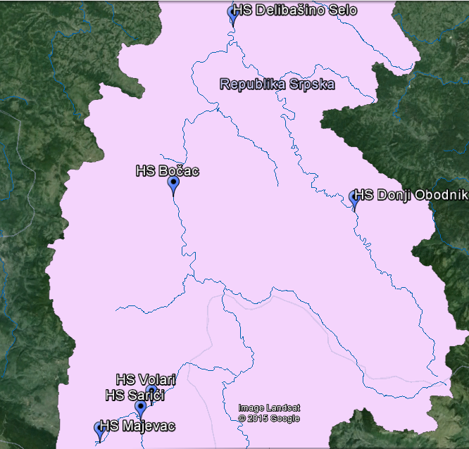
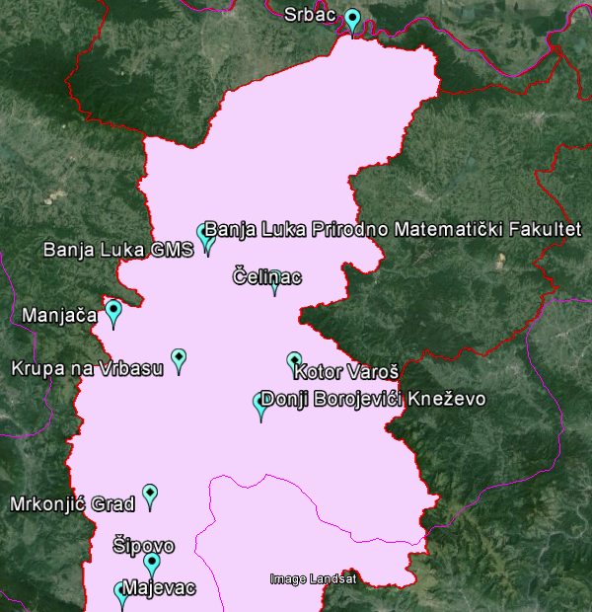
ICSEED 15th Session , Zagreb 6-7 Oct. 2016. Croatia
FOCUS ON Vrbas river UNDP GEF SCCF "Integrating climate change and reducing the risk of flooding in the Vrbas River basin"
"A key advantage is: it would be first time on the territory of B&H, integrating climate change in water management, regarding flood protection
. The project would have a very strong infrastructure component, with development of a hydrological model for the Vrbas River basin, which includes climate change. '
10 automatic precipitation station
1. Majevac
2. Šipovo
3. Mrkonjić Grad
4. Krupa na Vrbasu
5. Manjača
6. PMF-BanjaLuka
7. Donji Borojevići-Kneževo
8. Kotor Varoš
9. Čelinac
10. Srbac i
1 AWS at MS Banja Luka
Vrbas river UNDP GEF SCCF (Global Enviromental Found Special Climate Change Found)
Through this Project is renew and modernize hydrometeorological monitoring network in Vrbas river basin
6 automatic hydrological stations
1. Majevac-Pliva
2. Volari-Pliva
3. Sarići-Janj
4. Bočac-Vrbas
5. Donji Obodnik-Vrbanja
6. Delibašino selo- Vrbas
rhmz@teol.net Republic Hydro-Meteorological Service of Republika Srpska, B&H www.rhmzrs.com

Slide 7
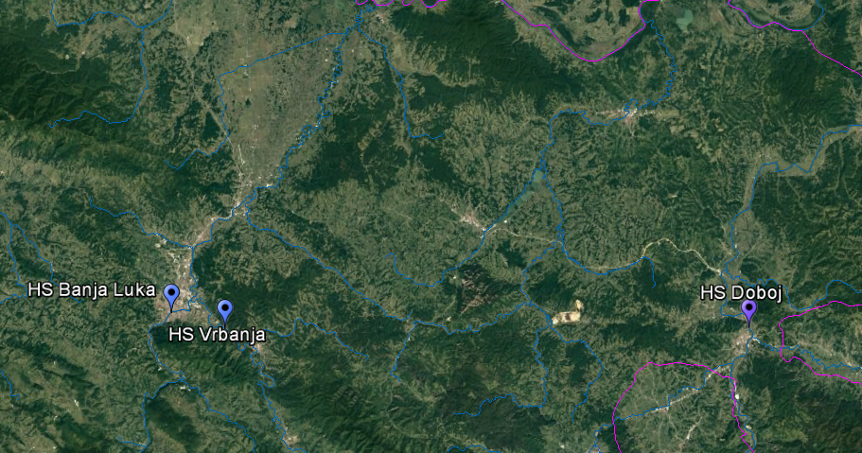
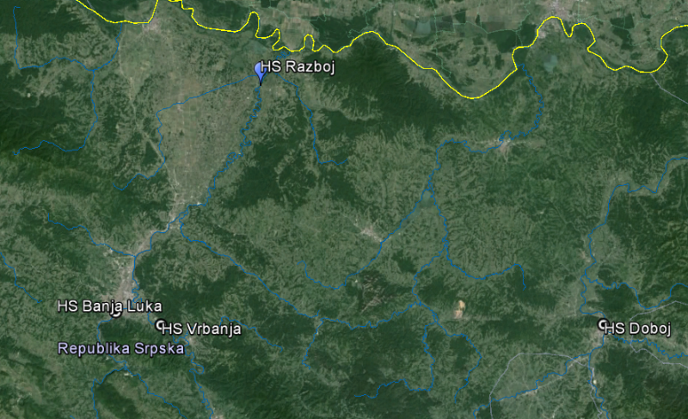
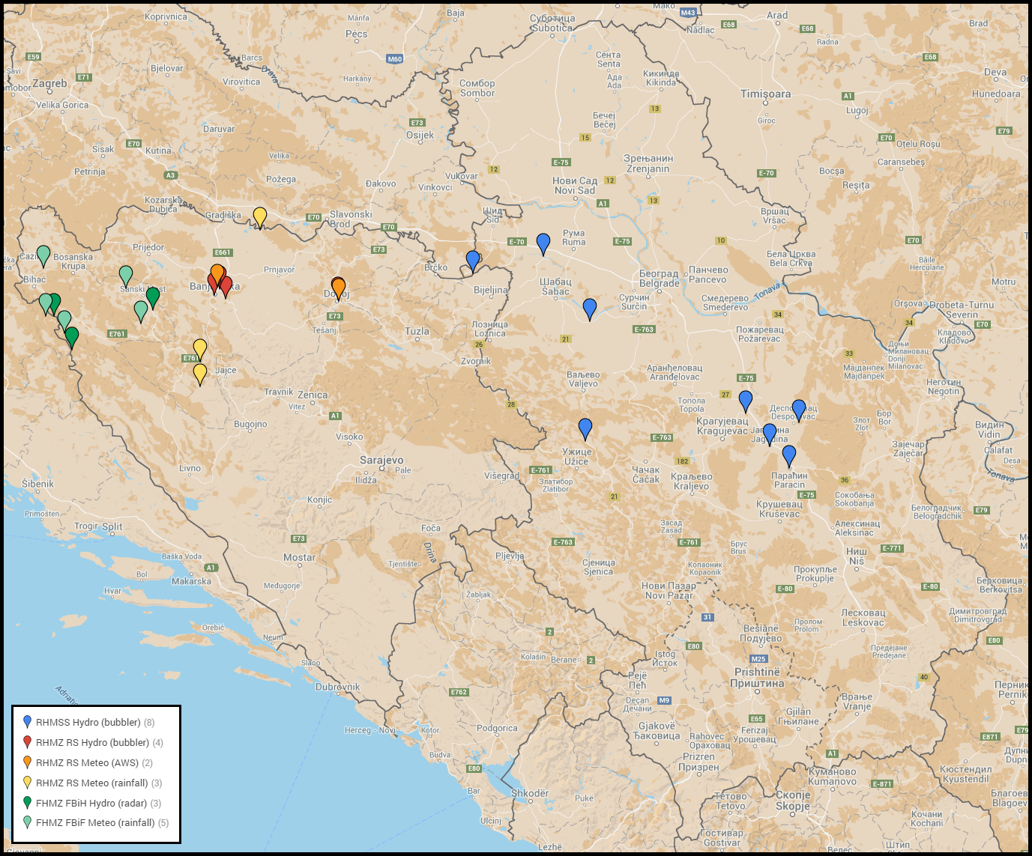
ICSEED 15th Session , Zagreb 6-7 Oct. 2016. Croatia
FOCUS ON Finnish donation:
Rehabilitation and Modernization of the Hydrological and Meteorological Observing Network and Data Exchange Procedures in Serbia and Bosnia and Herzegovina
3 AWS
Doboj
Ribnik
Kalinovik
2 Automatic precipitation station
Krupa na Uni and Mlječanica
Hydrological station installed:
Banja Luka
Vrbanja
Doboj
rhmz@teol.net Republic Hydro-Meteorological Service of Republika Srpska, B&H www.rhmzrs.com

Slide 8
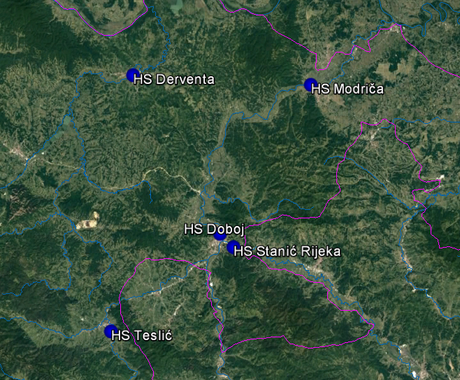
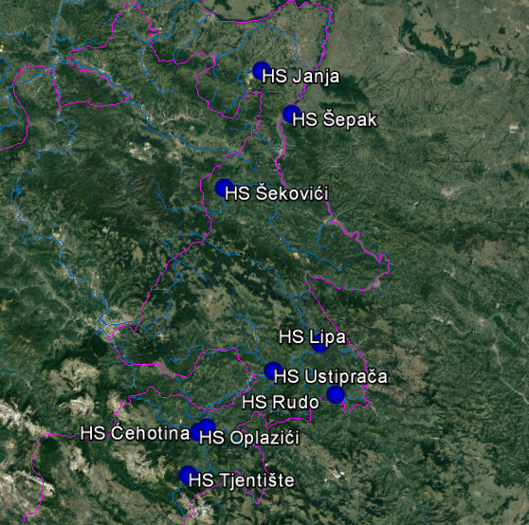
ICSEED 15th Session , Zagreb 6-7 Oct. 2016. Croatia
FOCUS ON Bosna and Drina river:
Bosna river IPA 2015-2020
A Project Title "Support to Flood Protection and Water Management"
GEF/SCCF WBDRBM Global Environmental Facility Special climate change found Drina River Basin Management
rhmz@teol.net Republic Hydro-Meteorological Service of Republika Srpska, B&H www.rhmzrs.com

Slide 9
ICSEED 15th Session , Zagreb 6-7 Oct. 2016. Croatia
FOCUS ON Development of prognostic model for the basin of the Una and Sana:
Public Institution Water Srpska during 2016 joined the project together with the Croatian Water and MHS launched AVP Sava and FHMZ
RHMS RS is also a participant in the project.
Held the first of three training software MIKE 11
Delivered a historic series of hydrological and meteorological data for the development of hydrological models.
Through this project will be automated hydrological stations of Prijedor, upstream and downstream of Novi Grad
FLOOD FORECASTING AND WARNING SYSTEM IN SAVA RIVER BASIN
Active participation in the project
Representatives of members of the working groups of the project
Data exchange via the Sava HIS portal
rhmz@teol.net Republic Hydro-Meteorological Service of Republika Srpska, B&H www.rhmzrs.com

Slide 10

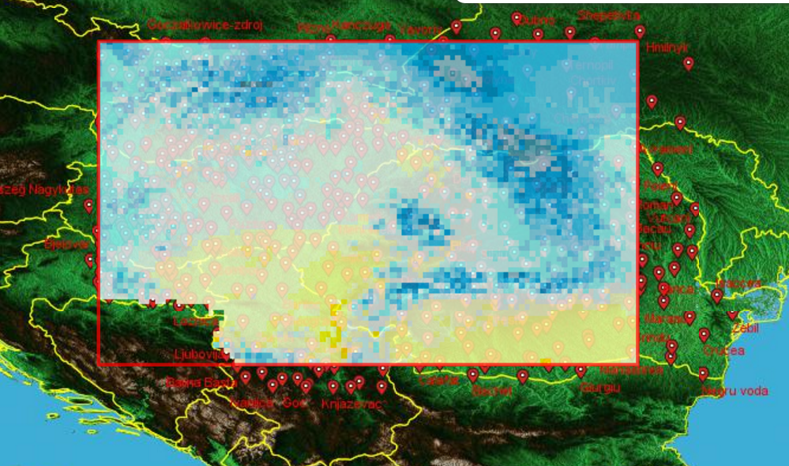
ICSEED 15th Session , Zagreb 6-7 Oct. 2016. Croatia
FOCUS ON ONGOING PROJECTS
The CARPATCLIM 2. Project : creation of a gridded Climate Atlas of the Carpathian Region for 1961-2010
Module 1: Data rescue, quality control, and datahomogenisation by the use of MASH. (Leader: SHMU)
Module 2: Data harmonisation and gridded datasets by the use of MISH. (Leader: OMSZ)
Module 3: Climate Atlas, publicly accessible dedicated web site, gridded climatological datasets and searchable metadata catalogue (Leader: RHMSS)
rhmz@teol.net Republic Hydro-Meteorological Service of Republika Srpska, B&H www.rhmzrs.com

Slide 11
ICSEED 15th Session , Zagreb 6-7 Oct. 2016. Croatia
FOCUS ON ONGOING PROJECTS
ECRAN – finished
Position Paper of Republic of Srpska
Models and projections used for the long-term climate change vulnerability and impacts assessment in the Initial and Second National communication have shown that the following sectors are the most vulnerable to climate change in Bosnia and Herzegovina: agriculture, water resources, human health, forestry and biodiversity, and vulnerable ecosystems.
FOCUS ON Department of environmental protection
Responsibilities
(2 automatic stations: Banja Luka, Prijedor of 12 total planned). Stations established within GEF project "Capacity Development For The Integration Of Global Environmental Commitments Into National Policies And Development Decision Making in Bosnia and Herzegovina"
rhmz@teol.net Republic Hydro-Meteorological Service of Republika Srpska, B&H www.rhmzrs.com

Slide 12
ICSEED 15th Session , Zagreb 6-7 Oct. 2016. Croatia
FOCUS ON Department of environmental protection
RESPONSIBILITIES PROJECTS
GHG Inventory (UNFCCC)
PRTR
In process of establishing
Air quality Inventory (LRTAP)
In process of establishing
Air quality Information system
In process of establishing
Capacity Development For The Integration Of Global Environmental Commitments Into National Policies And Development Decision Making in Bosnia and Herzegovina“ (GEF)
RER 1/015 “Apportioning Air Pollution Sources on a Regional Scale” (IAEA)
TNC and SBUR (GEF)
West Balkan E-reporting (EEA)
rhmz@teol.net Republic Hydro-Meteorological Service of Republika Srpska, B&H www.rhmzrs.com

Slide 13
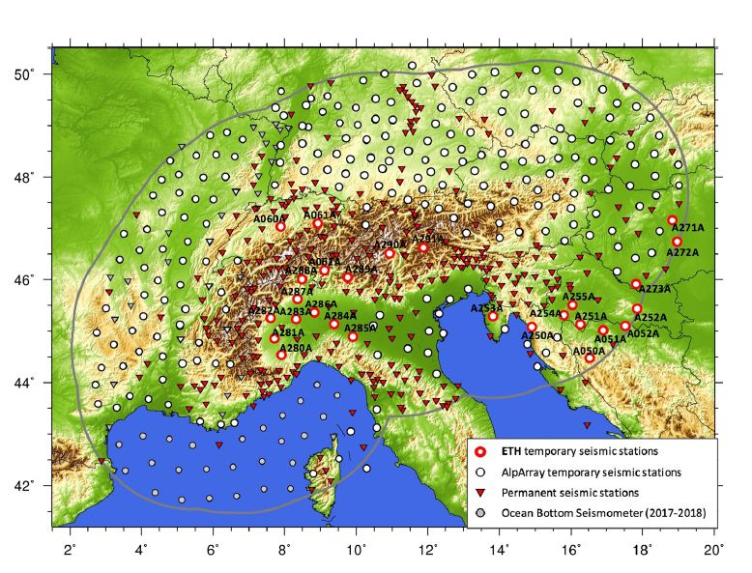
ICSEED 15th Session , Zagreb 6-7 Oct. 2016. Croatia
FOCUS ON Sector for Seismology AlpArray Project
that is a large collaborative seismological project in Europe that includes more than 50 research institutes and seismological observatories.
At the heart of the project is the collection of top-quality seismological data from a dense network of broadband temporary seismic stations, in compliment to the existing permanent networks, that ensures a homogeneous station coverage of the greater Alpine region.
This Alp Array Seismic Network (AASN) began operation in January 2016 and will have a duration of at least 2 years.
rhmz@teol.net Republic Hydro-Meteorological Service of Republika Srpska, B&H www.rhmzrs.com

Slide 14
ICSEED 15th Session , Zagreb 6-7 Oct. 2016. Croatia
FOCUS ON MAIN GOALS OF THE RHMS REPUBLIC OF SRPSKA
Summary:
STRONGER REGIONAL COOPERATION
The biggest problem remains finance, and how to convince the Government that it is necessary to extract more funds, since taking over many responsibilities and as it is to spread hydrological and meteorological observation network being necessary resources
RHMS RS sought for 2017 additional EUR 120,000.00 in order to fulfill its function.
NEXT YEAR RHMS RS CELEBRATE 25 YEARS SINCE INCEPTION
Our institution plan to issue a Monograph of institution and to organize a Conference at Mministerial level with stakeholders about system of early warning of dangerous natural disasters in Republic of Srpska and B&H, that we face in our work
rhmz@teol.net Republic Hydro-Meteorological Service of Republika Srpska, B&H www.rhmzrs.com

Slide 15
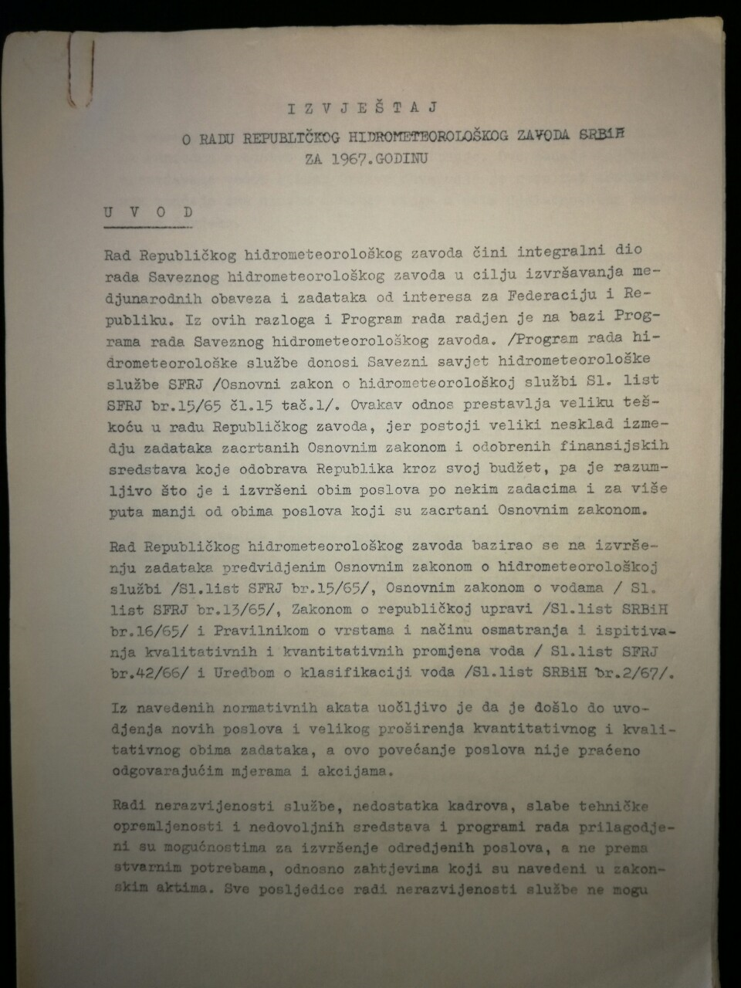
ICSEED 15th Session , Zagreb 6-7 Oct. 2016. Croatia
Report of Director Dr. Zdravko Mićević of RHMS B & H for 1967. about activities of Institution in that year
In order of underdevelopment services, lack of experts end employments, poor technical equipment and insufficient funding , work programs are adapted to the possibilities for the execution of tasks, and not according to the actual needs, and obligations regarding legislation.
rhmz@teol.net Republic Hydro-Meteorological Service of Republika Srpska, B&H www.rhmzrs.com

Slide 16
Republic Hydro-Meteorological Service of Republika Srpska (one of two entity hidrometeorological services in Bosnia and Herzegovina)
ICSEED 15th Session , Zagreb 6-7 Oct. 2016. Croatia
INFORMAL
CONFERENCE
OF SOUTH-EAST
EUROPE
DIRECTORS
Hosted by National
Meteorological and
Hydrological Service
of Croatia
(DHMZ)
warmest thanks for your attention
rhmz@teol.net Republic Hydro-Meteorological Service of Republika Srpska, B&H www.rhmzrs.com

