Slide 1
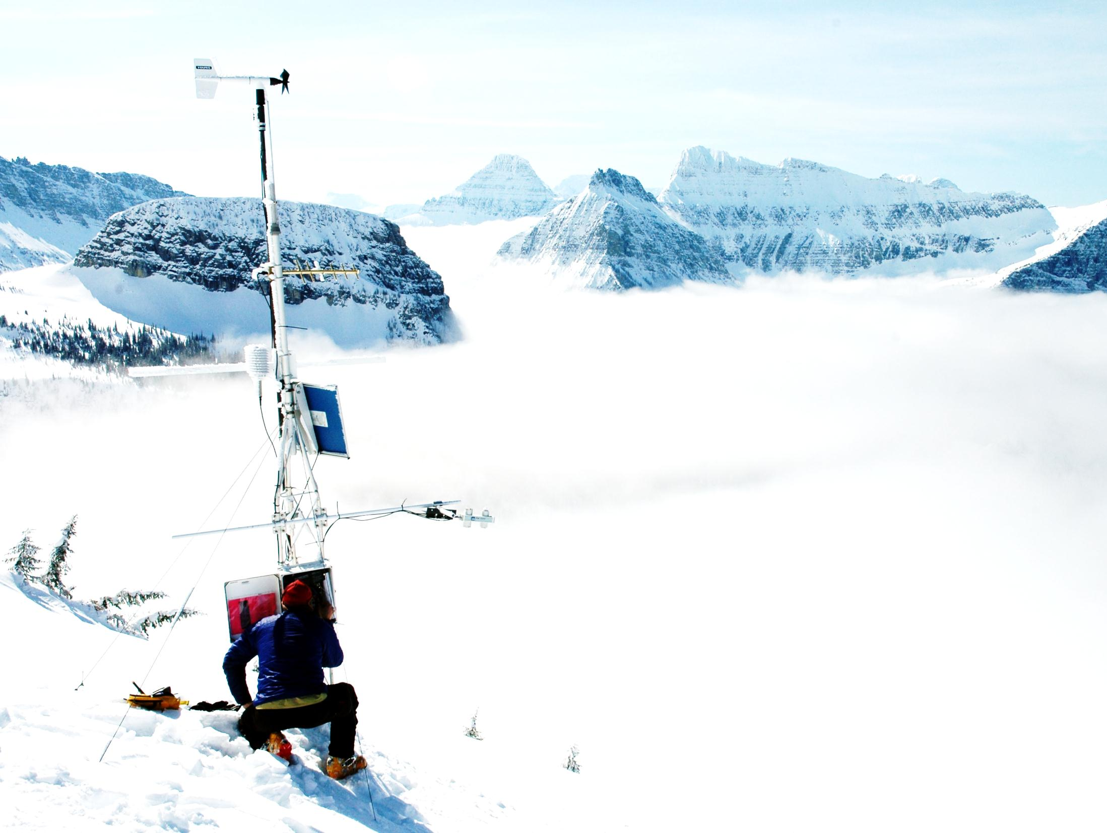


Activities of the World Bank Group in Europe and Central Asia
Relevant
Daniel Kull
Senior Disaster Risk Management Specialist
Photo : U.S. Geological Survey

Slide 2
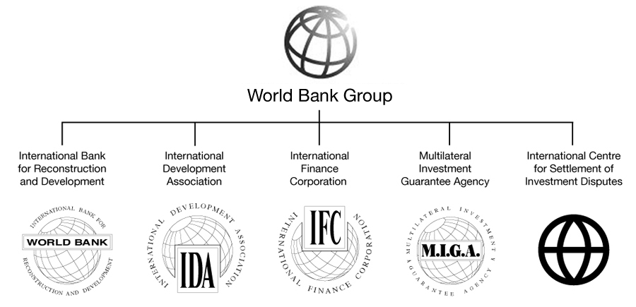
WORLD BANK GROUP OVERVIEW
“Twin goals” – end extreme poverty and promote shared prosperity
Source of financial and technical assistance to developing countries

Slide 3


CLIENTS IN EUROPE AND CENTRAL ASIA
IDA – Credits & Grants
Blend
IBRD - Loans
Kosovo
Kyrgyz Republic
Tajikistan
Moldova
Uzbekistan
Albania
Armenia
Azerbaijan
Belarus
Bosnia and Herzegovina
Bulgaria
Croatia
Georgia
Kazakhstan
FYR of Macedonia
Montenegro
Poland
Romania
Russian Federation
Serbia
Turkey
Turkmenistan
Ukraine
Trust fund grants available to all, also to (sub)regions
Reimbursable Advisory Services (RAS) available to all including high income countries

Slide 4

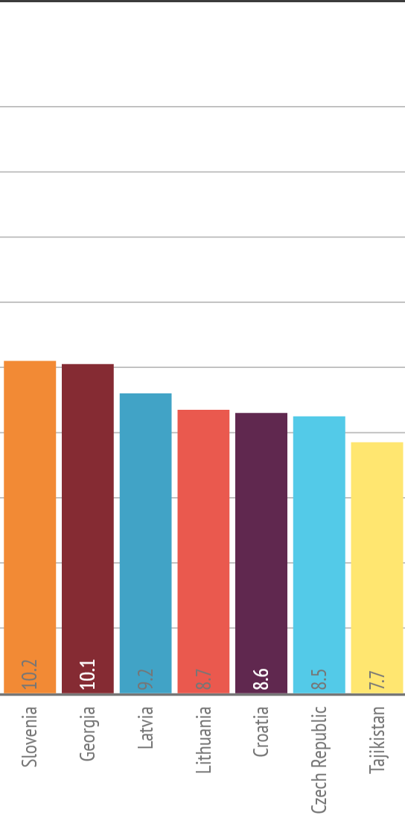
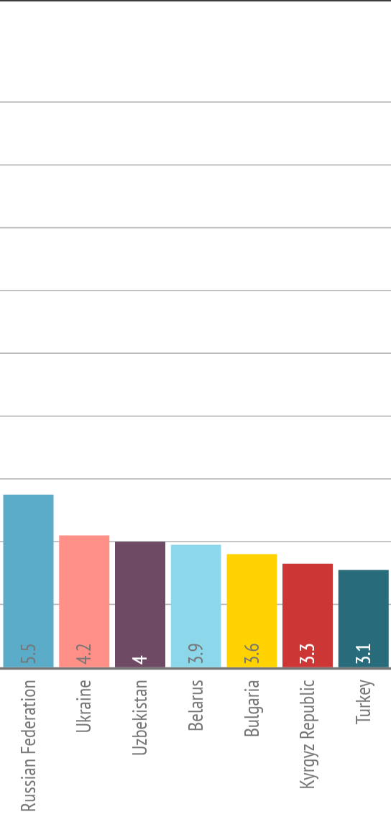
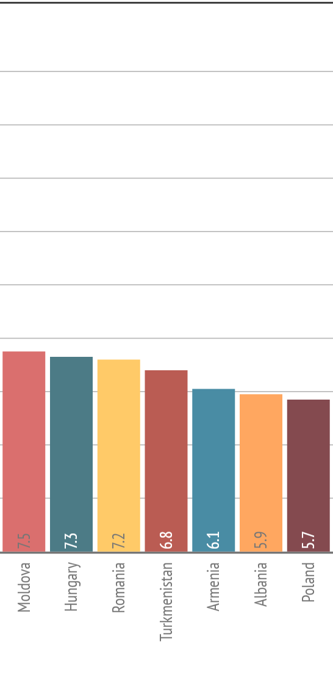
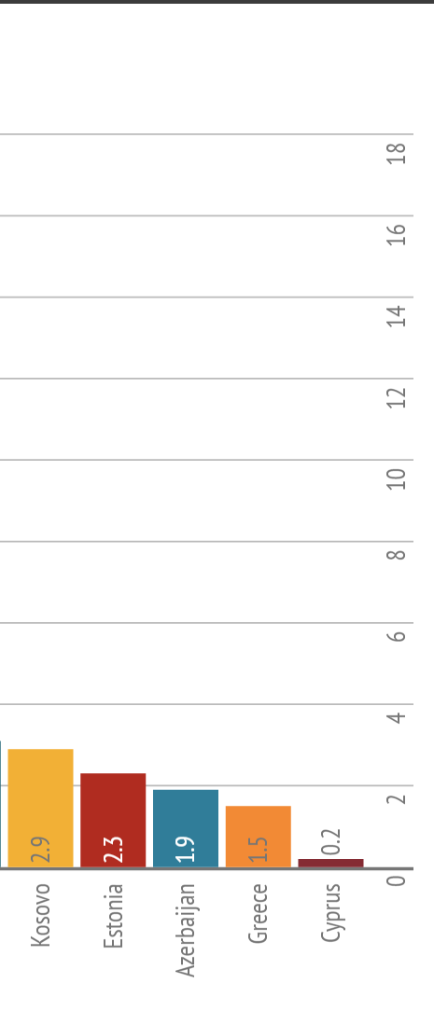
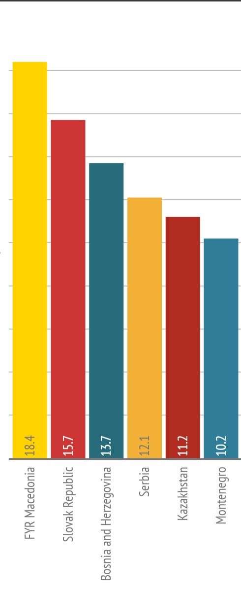
Potential loss of a 100 year return period flood relative to % of GDP (2015)
Average = 7.1% of GDP
Notes:
The average growth during 2014 in the region was 2.3. The average loss for a 100 yr is 7.1

Slide 5


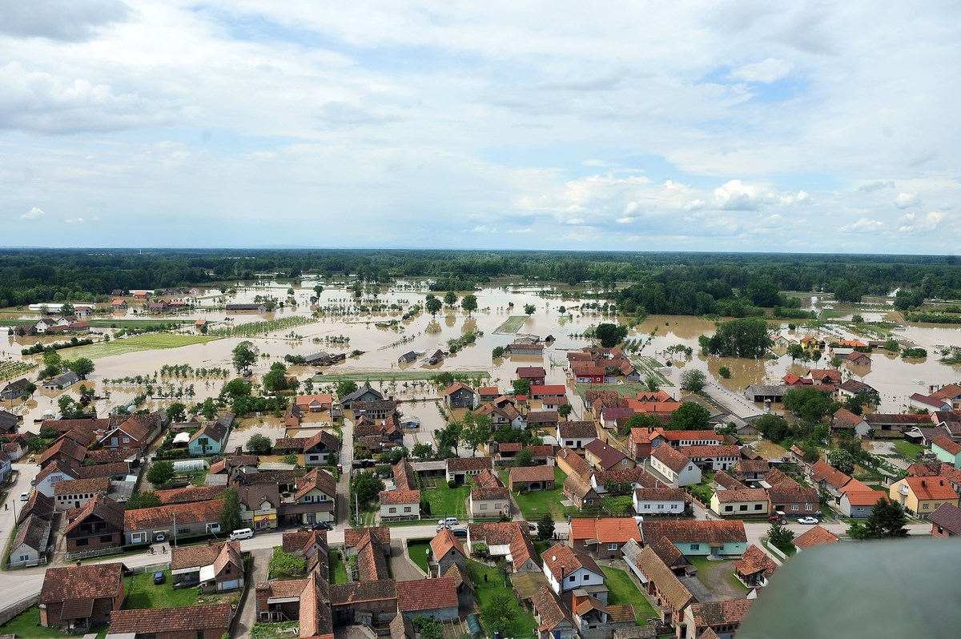
Flood risks in ECA: focus on Balkans 2014 floods
Bosnia and Herzegovina (2014)
2014 floods cost ~15% of BiH’s GDP
$2.7 billion of damages
1 million pop. affected (25%)
Serbia (2014)
Cost? ~5% of Serbia’s GDP
1.5M pop. impacted (20%)
125,000 pop. pushed into poverty
Serbia’s economy: ↓ by 0.4% (in contrast to ↑0.5% projection made prior to floods)
Notes:
We have seen how disasters can cause poverty and sorrow in our region.
Source of picture: http://www.huffingtonpost.co.uk/2014/05/19/balkans-floods_n_5350349.html
The recent 2014 floods pushed the Serbian economy into a recession and will increase the government deficit by an additional 1.0 percent of GDP. The incremental impact of the floods on economic growth is estimated at -0.9 percentage points, i.e. the Serbian economy will contract by 0.4 percent in 2014, rather than growing by 0.5 percent as projected before the floods.
More WBG info on Serbia: http://www.worldbank.org/en/news/feature/2014/10/06/after-the-rain-helping-serbia-rebound-from-disaster
More info on BiH: http://www.ebrd.com/news/2014/the-economic-cost-of-the-floods-in-serbia-and-bosnia.html
http://www.ansamed.info/nuova_europa/en/news/sections/business/2015/01/21/floods-have-cost-bosnia-15-of-gdp-world-bank-report-shows_76b9d72e-79b3-4e61-a312-e6015ab0110e.html

Slide 6
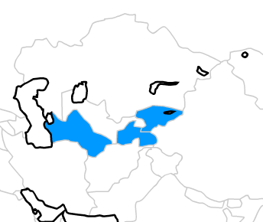
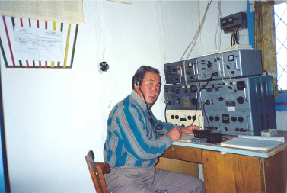
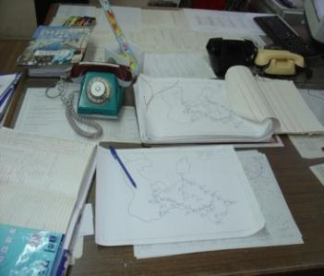
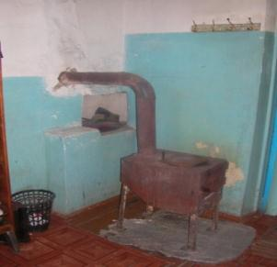
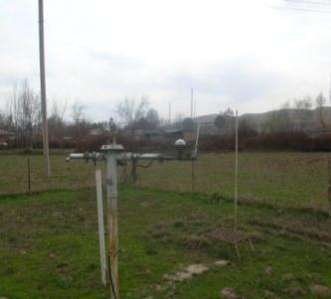
CAPACITY ISSUES
NMHSs’ capacity in many regions is not adequate and considerably degraded in some countries during the last 25-30 years
% reduction in hydromet observation networks between 1985-2008
Kyrgyzstan
54%
Tajikistan
38%
Turkmenistan
42%
Notes:
Weather, climate and hydrological information is essential for disaster reduction, agriculture, water resources, transport, energy particularly renewables and public health
Importance of weather, climate and hydrological information is growing
To serve ever more elaborate societal needs
To minimize growing economic losses from hydromet disasters
To better adapt to climate change and variability
Weather, climate and hydrological services at national, regional and global levels complement each other and constitute a unique global enterprise guided by the World Meteorological Organization
Public sector - National Meteorological and Hydrological Services (NMHSs) - is a backbone of the system
Annual public funding globally exceeds USD15-20 billion
National funding of NMHSs is usually 0.01-0.05% of GDP

Slide 7
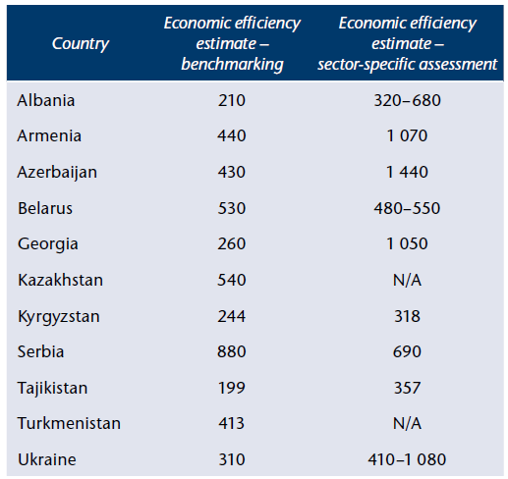
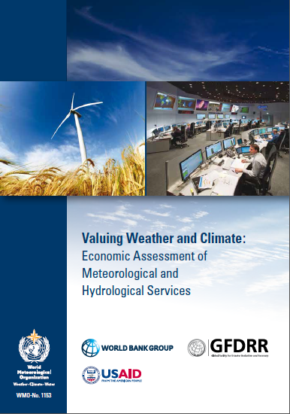
IT STILL MAKES ECONOMIC SENSE TO INVEST
% economic returns for hydromet modernization investment over 7 years (2008):

Slide 8
HYDROMET INVESTMENT APPROACH
Modernization investment must be substantial to achieve transformation, across three complementary areas:
Institutional strengthening, capacity building and implementation support
Modernization of observation infrastructure and forecasting, including leveraging global and regional opportunities
Enhancement of the service delivery system
1
2
3

Slide 9
CURRENT NMHS MODERNIZATION EFFORTS IN ECA
Standalone modernization projects: Central Asia, Russia
Post Disaster Needs Assessments for floods (PDNAs): Bosnia & Herzegovina, Serbia, Macedonia
Modernization components in flood recovery projects: Bosnia & Herzegovina, Serbia
Modernization components in flood risk management projects: South Eastern Europe and Balkans, Poland
Modernization components in climate change or sectoral projects: Central Asia, Moldova, Danube Basin, probably more…
Soon to be explored: Belarus, SEE-MHEWS-A
Working with WMO is critical for success

Slide 10
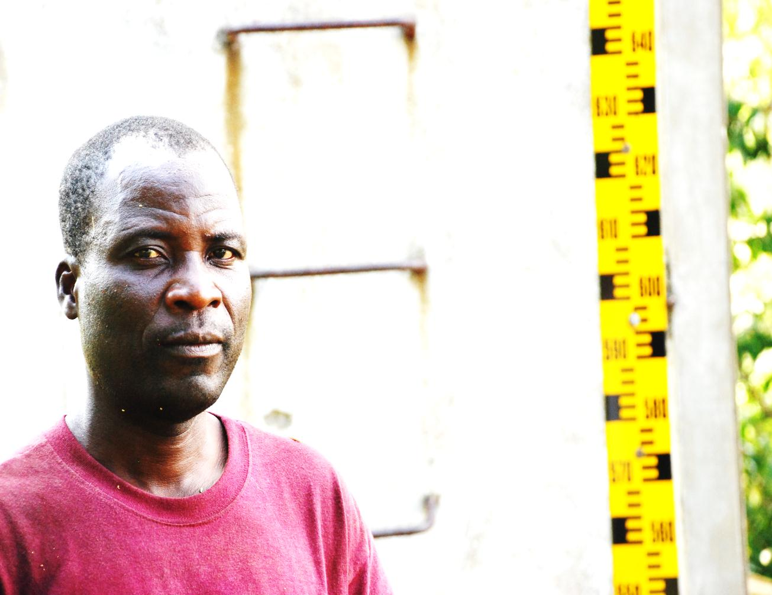
SOCIO-ECONOMICS DOES MATTER
Sustainable operations and financing requires:
Clear demonstration of the importance of observational and data processing infrastructure
Rigorous and widely understood demonstration of the socio-economic benefits, both public and private
Systematic basis for prioritizing the use of available funding for infrastructure and service development and improvement
Economic evidence for additional investment in climate services infrastructure necessary to support national commitments

Slide 11

LESSONS LEARNED
Invest in capacity, from management to technical
Ensure long-term operations and maintenance (O&M) commitment
Strong user interface leads to better and more sustainable services
User capacity as important as provider capacity
Prioritize public services – open data approach best
Consider sensitivities, challenges and opportunities of public-private partnership
Approach fee-based services with great caution
Leverage international and regional systems
Leverage and coordinate international and domestic partners
Need strong and innovative leadership

Slide 12
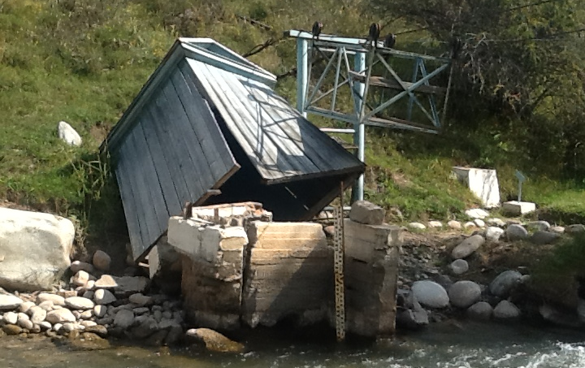
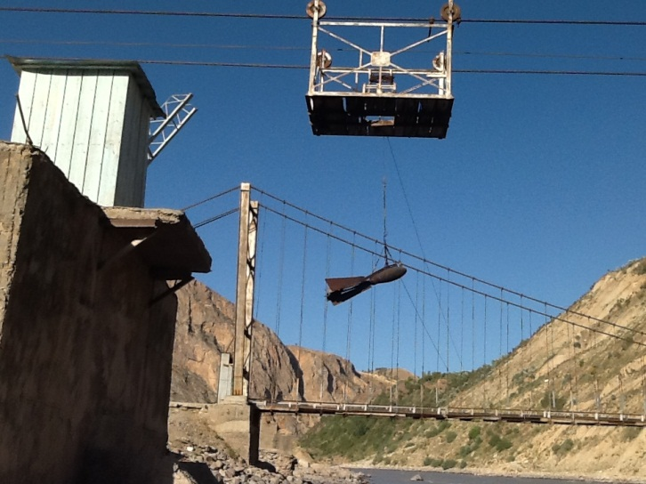
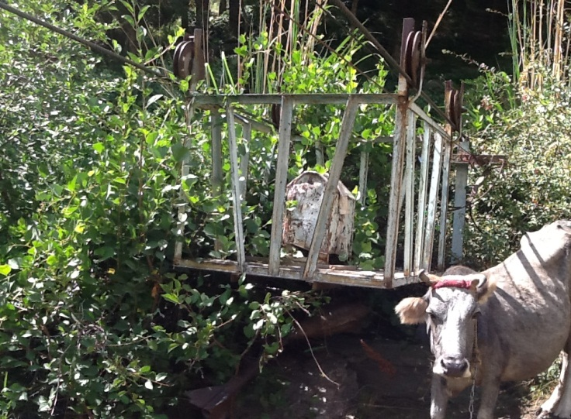
TECHNICAL LESSONS LEARNED
Ensure appropriate technical support:
Everyone talks about the weather, floods and disasters, this does not mean they are experts
Partnership must prioritize client/public needs, especially when working with private companies
Operational verses “soft” expertise
Innovation verses reliability, scale and sustainability
Procurement – getting the right stuff to do the right thing for the right people at the right cost
Photos: Canadian Environmental Assistance

Slide 13

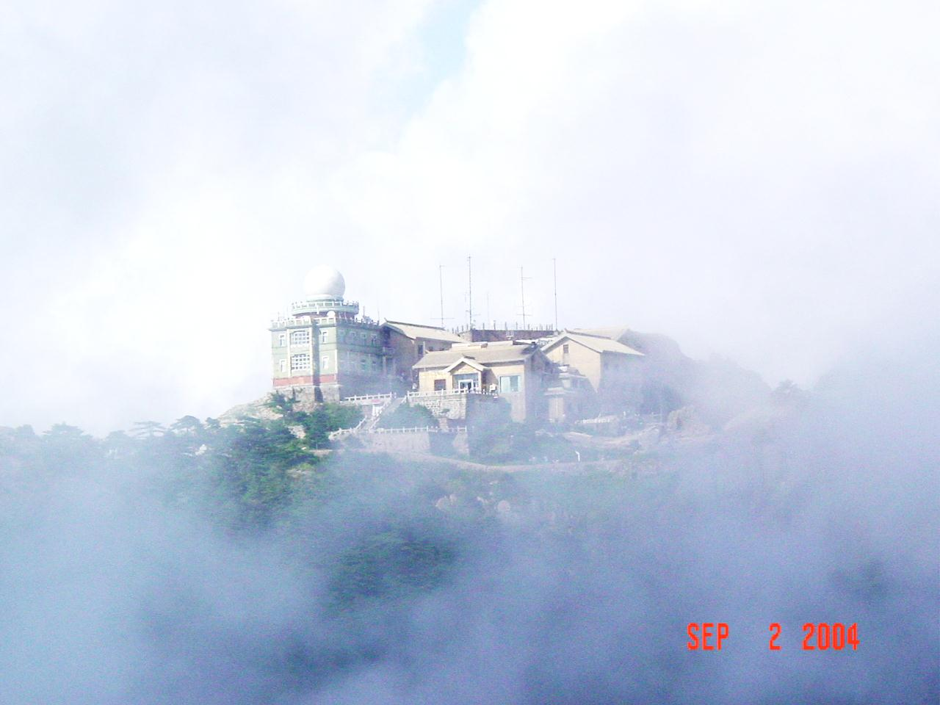
DANIEL KULL
Senior Disaster Risk Management Specialist
Europe and Central Asia Region (ECA)
and
Global Facility for Disaster Reduction and Recovery (GFDRR)
World Bank Group
Email: dkull@worldbankgroup.org
Telephone: +41 22 748 1015
Photo: Sim Li under Creative Commons License

