Slide 1
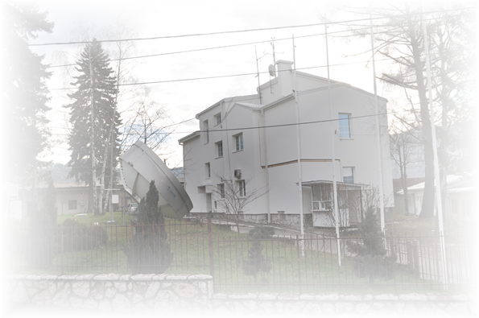
ICSEED-15 - 15th Session of the Informal Conference of SEE NMHS Directors
Federal Hydrometeorological Institute
Director:
Almir Bijedić
Zagreb, 05 - 07 October 2016.

Slide 2
ICSEED-15 - 15th Session of the Informal Conference of SEE NMHS Directors
The scope of work of the
Federal Hydrometeorological Institute:
Federal Hydrometeorological Institute performs professional and other activities within the competence of the Federation referring to:
- development and functioning of meteorological, hydrological, seismic activities and environmental quality;
- exploration of atmosphere, water resources, environmental quality (air, water and soil) and seismological processes;
- collecting, processing and publishing data from the scope of interest for the Federation BH and other tasks in the field of meteorology, hydrology, environmental quality and seismology.
(The Law on Federal Ministries and other bodies of the Federal Administration)
- conducting operations of FHMI stipulated in accordance with applicable laws and regulations of the Federation and in accordance with the standards and guidelines of the World Meteorological Organisation, the European Environment Agency and other professional international organizations.
Rulebook on Air Quality Monitoring ("Off. Gazette of F BiH, 12/05"), FHMI is authorized institution for:
establishment, organization and management of the air quality monitoring system in the FBiH, as part of the monitoring in Bosnia and Herzegovina,
establishment an information system for air quality in FBiH
Rulebook on the method of air quality monitoring and defining the types of pollutants, limit values and other air quality standards (Off. Gazette F BiH, No. 1/12)
Federal Environmental Protection Strategy 2008 -2018.
The Federal government decision Nr 341/2013 ("Off. Gazette of F BiH" no. 41/13) - FHMI is declared as Federal reference center for air. With this decision, the Institute has become the authority for air quality and air emission data verification in FBiH.

Slide 3
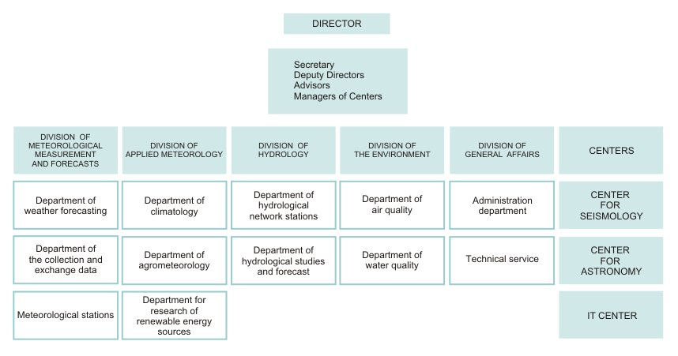
ICSEED-15 - 15th Session of the Informal Conference of SEE NMHS Directors
Zagreb, 05 - 07 October 2016.

Slide 4
Meetings, workshops
ICSEED-15 - 15th Session of the Informal Conference of SEE NMHS Directors
2 th Pannex workshop on the climate system of the Pannonian basin | 1.-3.june 2016 | Budapest
Climatology foundation for climate service | 30.May-10. June | Tolouse
Follow Up Operations Workshop South East Europe Flash Flood Guidance System (SEEFFGS) | 9-13.May 2016 | Zagreb
Basic of calibration | 2.-8. October 2016 | Ankara
RA VI TT WIGOS Implementation | 6.-7. july | Beograd
WIGOS OCEAN Workshop for RA VI | 5.-7. September 2016 | Split
Aplication with neweast multy spectral environmental Satellite | 12. -16.September | Thessaloniki
Capacity devepopment for flood risk management with IFAS | 4.-29. July | Tsukuba
SEE VCCC-SRNWP | 27.June 2016 | Beograd
Regional Conference on South-East European Multi-Hazard Early Warning Systems | 5-6. October | Zagreb
Zagreb, 05 - 07 October 2016.

Slide 5
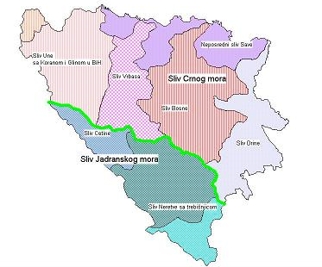
Ongoing projects
ICSEED-15 - 15th Session of the Informal Conference of SEE NMHS Directors
RIVER UNA
Rehabilitation and Modernization of the Hydrological and Meteorological Observing Network and Data Exchange Procedures in Serbia and Bosnia and Herzegovina - Finnish Foreign Aid Programme of the Ministry for Foreign Affairs of Finland
Hydrological forecasting model established by the Water Agency of the Sava River Basin in cooperation with the Federal Hydro-Meteorological Institute, Hydrometeorological Institute of Croatian and Croatian waters.
RIVER VRBAS
Integrating climate change and reducing the risk of flooding in the Vrbas River basin – WB, UNDP
RIVER BOSNA
Hydrological forecasting system for Sava River Basin in Bosnia and Herzegovina (Phase 1. Bosnia River)- Component 1. of IPA II BiH project
RIVER DRINA
Support to Water Resources Management in Drina River Basin – WBIF WB
Drina River Basin Management Project – Regional GEF SCCF
RIVER SAVA
Improvement of Joint Action in Flood Management in the Sava river Basin – WBIF WB Project – Sava Commission – WBIF WB
Project "Sava Supermodel" of Croatian waters and DHMZ
OTHER PROJECTS
JICA Japanese non-project grant aid to the Government of Bosnia and Herzegovina
Aid the government of the Czech Republic to Bosnia and Herzegovina

Slide 6
Rainfall stations: 3 Meteorological stations: 1 Hydrological stations: 2 PROJECT STATUS: - Hydrological stations in use. - Meteorological stations in the mounting phase
ICSEED-15 - 15th Session of the Informal Conference of SEE NMHS Directors
Projects for the Una River Basin
1. Rehabilitation and Modernization of the Hydrological and Meteorological Observing Network and Data Exchange Procedures in Serbia and Bosnia and Herzegovina - Finnish Foreign Aid Programme of the Ministry for Foreign Affairs of Finland
VS Vrhpolje/Sana
Hydrological forecasting model
VS Martin Brod/Una
2. Hydrological forecasting model established by the Water Agency of the Sava River Basin in cooperation with the Federal Hydrometeorological Institute, Hydrometeorological Institute of Croatian and Croatian waters.
Zagreb, 05 - 07 October 2016.

Slide 7
Equipment and softwer: - Rainfall stations: 10 - Meteorological stations: 1 - Monitoring network management software „OTT Hydras“ - Hydrological forecast model PROJECT STATUS: Procurement of equipment - Completed Procurement software - Ongoing Hydrological forecast model - Ongoing
ICSEED-15 - 15th Session of the Informal Conference of SEE NMHS Directors
Project for the Vrbas River Basin
1. Integrating climate change and reducing the risk of flooding in the Vrbas River basin – WB, UNDP
Hydrological forecasting model
Zagreb, 05 - 07 October 2016.

Slide 8
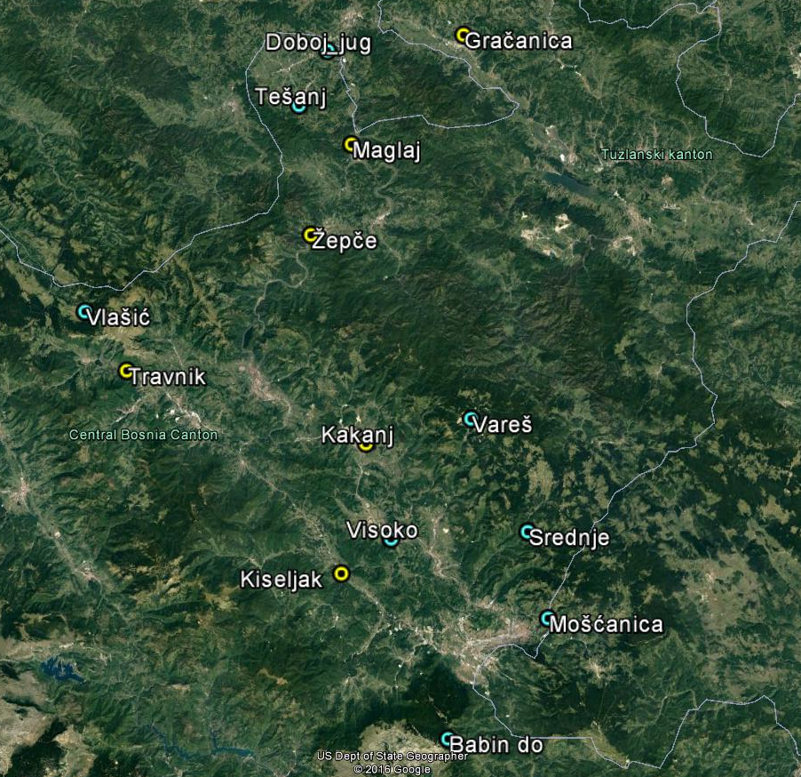
Equipment and softwer: - Rainfall stations: 6 - Meteorological stations: 7 - Hydrological stations: 6 - Groundwater hydrological stations 2 - Car, trailer, boat with engine - Power generator - IT equipment - ADCP device for flow measurement - hydrometric wing - Wisky – hydrological softwer - Hydrological forecast model PROJECT STATUS: - Preparation of tender documents
ICSEED-15 - 15th Session of the Informal Conference of SEE NMHS Directors
Project for the Bosna River Basin
Hydrological forecasting system for Sava River Basin in Bosnia and Herzegovina (Phase 1. Bosnia River)- Component 1. of IPA II BH project
Hydrological forecasting model
Zagreb, 05 - 07 October 2016.

Slide 9
ICSEED-15 - 15th Session of the Informal Conference of SEE NMHS Directors
Project for the Drina River Basin
1. Support to Water Resources Management in Drina River Basin – WBIF WB
2. Drina River Basin Management Project – Regional GEF SCCF
Equipment:
Rainfall stations: 6
Meteorological stations: 1 (agro)
ADCP for measuring the flow of small water
PROJECT STATUS: As a regional project, in the course of
preparation of an agreement on cooperation
Wather menagement in Drina river basin
Zagreb, 05 - 07 October 2016.

Slide 10
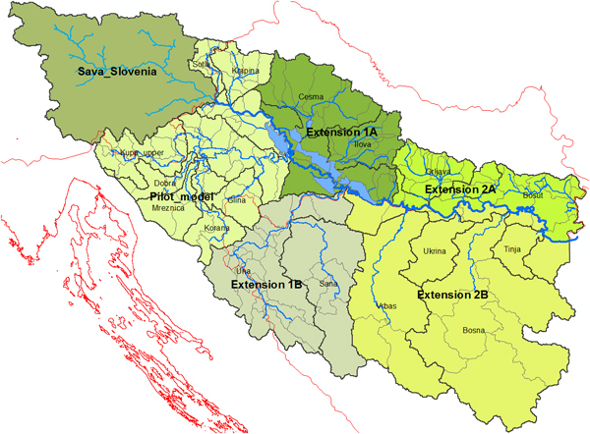
Sava Super model (SSM)
ICSEED-15 - 15th Session of the Informal Conference of SEE NMHS Directors
In the project "Sava Supermodel" of Croatian waters and DHMZ, Federal Hydrometeorological Institute has contributed to the development and will be one of the beneficiaries of results model.
Zagreb, 05 - 07 October 2016.

Slide 11
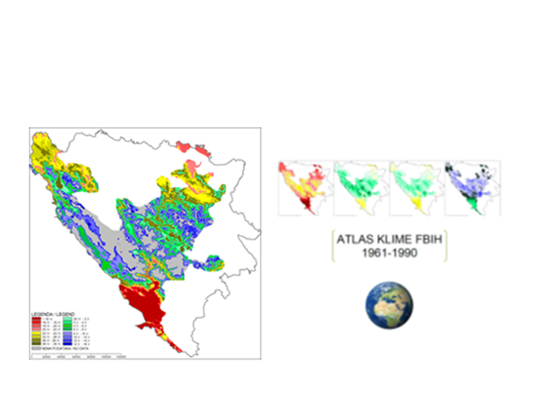
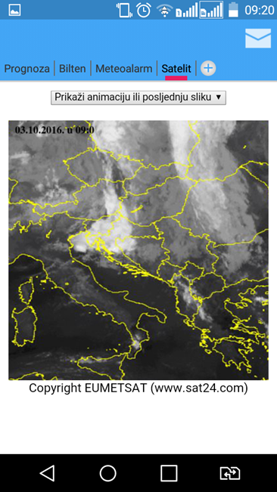
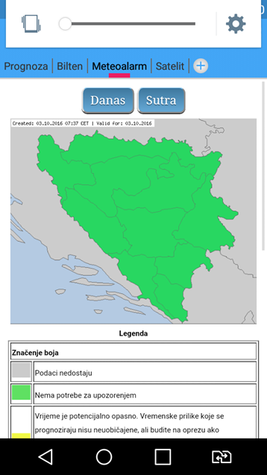
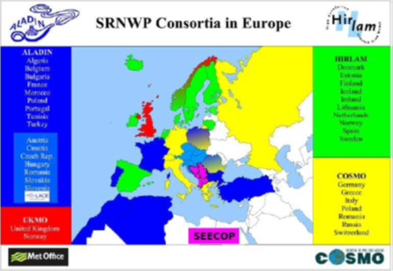
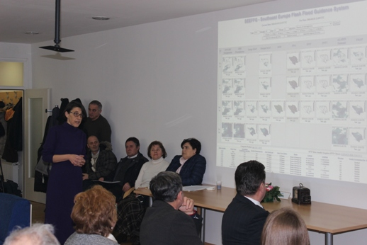
29. 7. 2016. - Predstavljanje dovršenog cjelovitog hidrološko-hidrauličkog modela za sliv rijeke Save nazvanog Sava Super model (SSM).
Institucije uključene u ovaj projekat su: Agencija za vodno područje rijeke Save i Federalni hidrometeorološki zavod BiH iz Sarajeva,
Javna ustanova Vode Srpske iz Bijeljine te Republički hidrometeorološkog zavod Republike Srpske iz Banja Luke..
.
ICSEED-15 - 15th Session of the Informal Conference of SEE NMHS Directors
Other activities
Climate Atlas of FBIH
Andriod Weather application for weather forecast
South-East European Consortium for Operational weather Prediction (SEECOP)
https://www.androidcreator.com/app131556"
Flash flood guidance
ECRAN
Environment and Climate
Regional Accession Network
Quality Management System
preparation for accreditation
BAS 9001 & BAS 17025
Zagreb, 05 - 07 October 2016.

Slide 12
ICSEED-15 - 15th Session of the Informal Conference of SEE NMHS Directors
Environmental department activities
Air Quality monitoring – station network
Establishment of laboratory for PM10 and rainwater chemical analisys
Sarajevo, Bjelave
Measurement range expansion
Repair of existing equipment:
Atomic spectrofotometer (AAS),
Microwave digestion owen ,
Ivan Sedlo
Zenica
Sarajevo, Bjelave
PM10 Sampler
PM10 Analyser
Jajce
New equipment:
Conductometer
PH- analyser
Analitical balance ,
Ultra pure water destilator
Goražde
Station networks –other operaters
Project documentation: “Laboratory space adaptation and modernisation”
Zagreb, 05 - 07 October 2016.

Slide 13
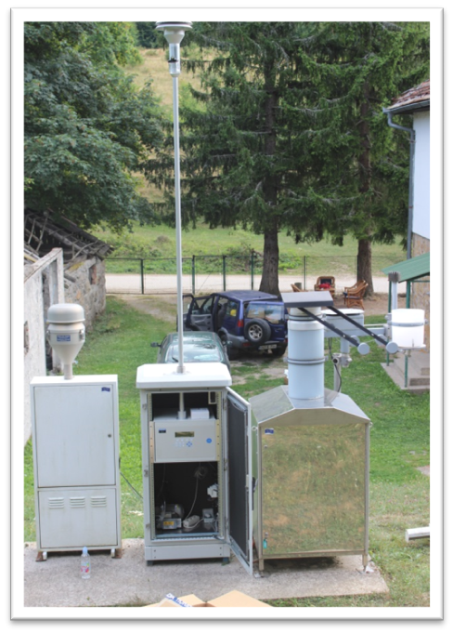
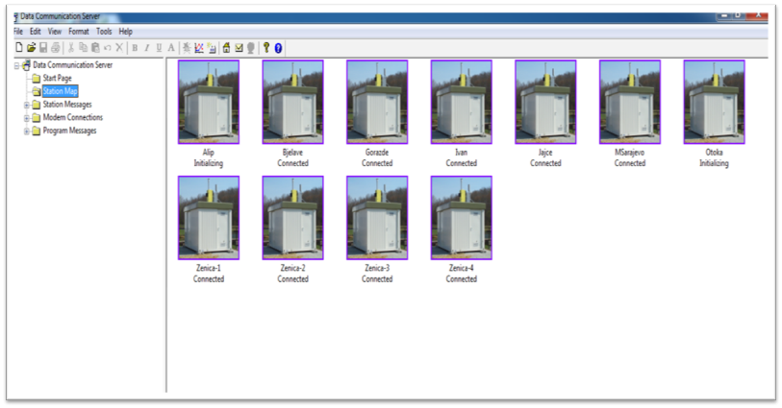
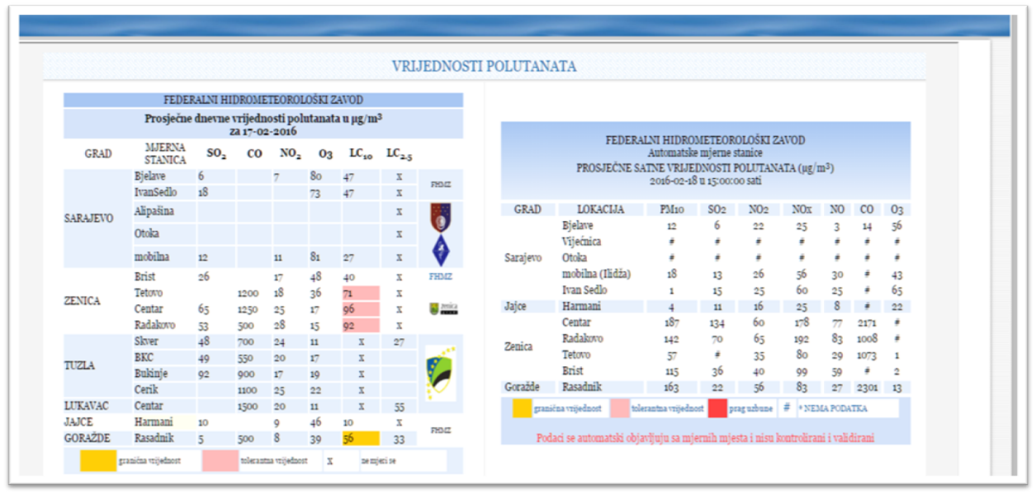
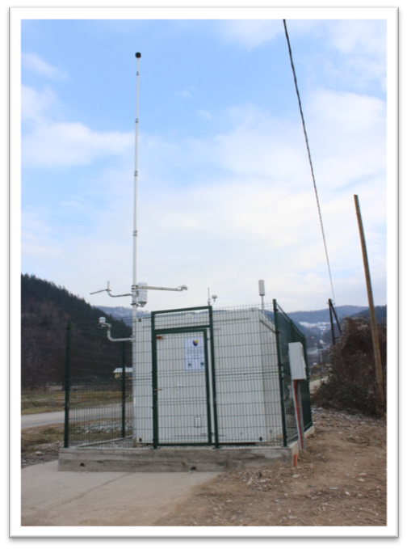
ICSEED-15 - 15th Session of the Informal Conference of SEE NMHS Directors
Air quality monitoring station Ivan Sedlo
Data collection softwer display for airquality monitoring station networks
Air quality monitoring station Goražde
WEB display of daily and real-time measured data
Zagreb, 05 - 07 October 2016.

Slide 14
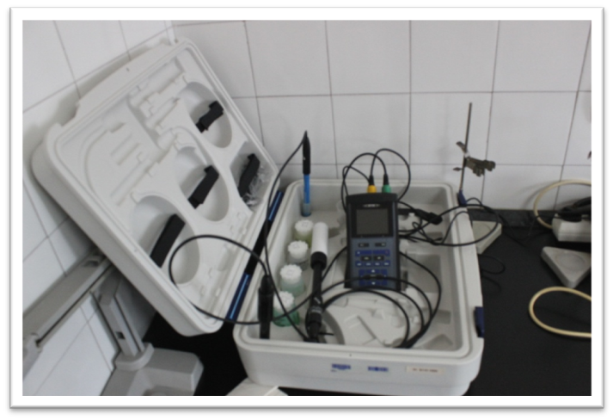
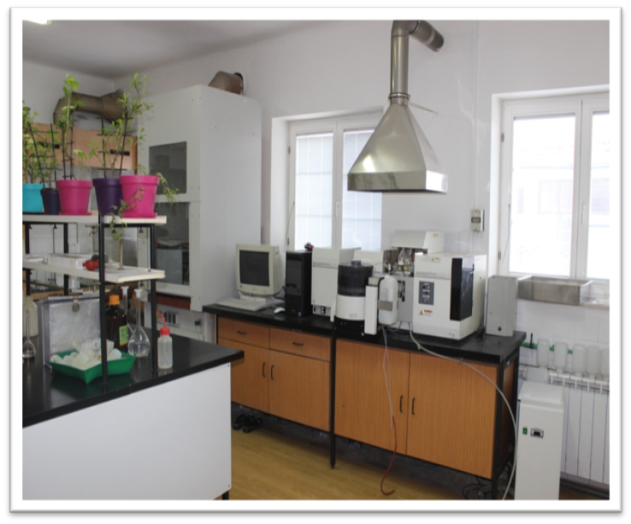
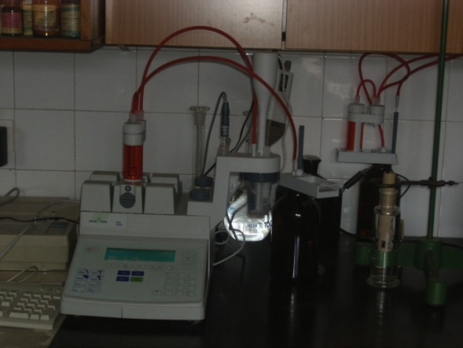
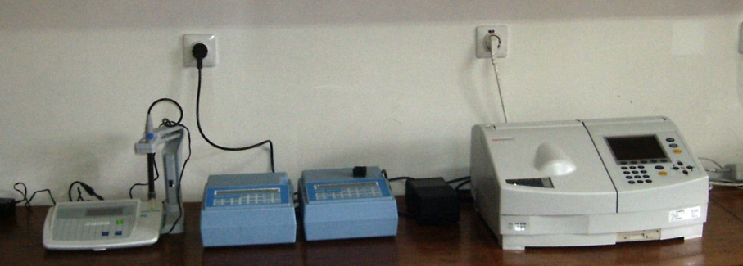
ICSEED-15 - 15th Session of the Informal Conference of SEE NMHS Directors
Laboratory for PM10 and rainwater chemical analisys
Atomic absorption spectrofotometer (AAS)
pH – analiser and conductometer
Automatic digital titrator
Spectrophotometer
Zagreb, 05 - 07 October 2016.

Slide 15
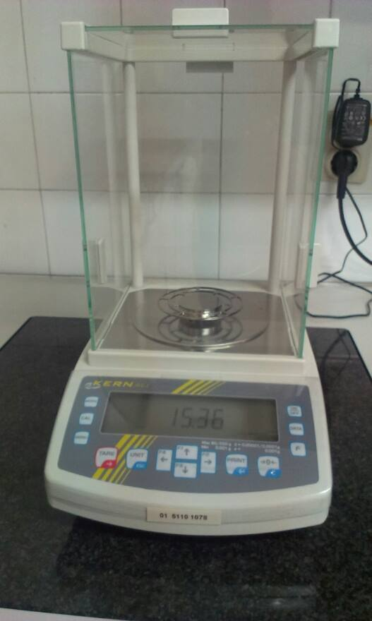
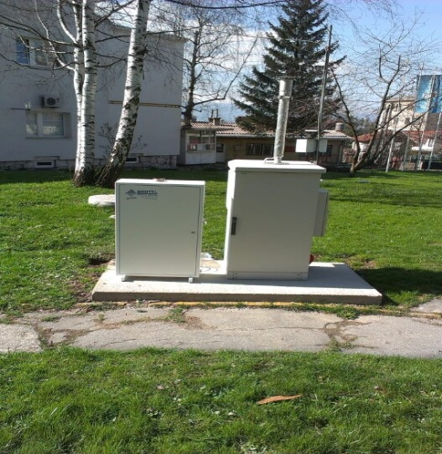
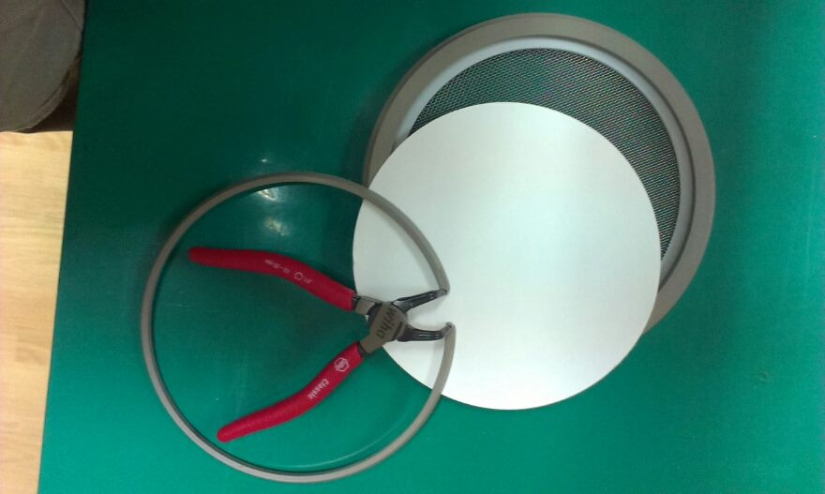
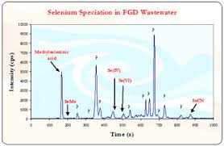
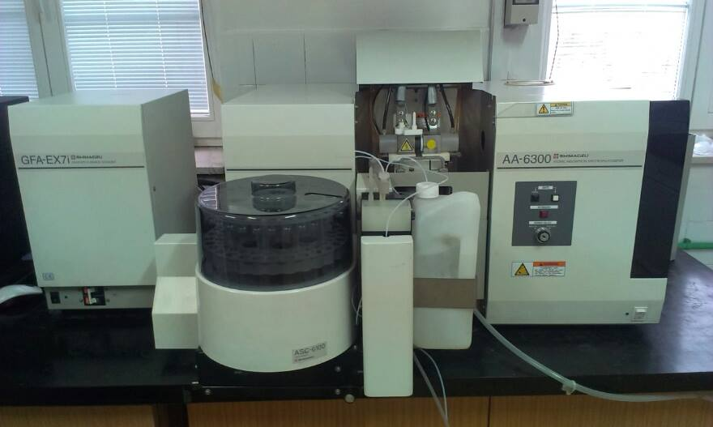
ICSEED-15 - 15th Session of the Informal Conference of SEE NMHS Directors
PM10 sampling, gravimetry and analisys – step by step
3. Sampling
2.Filter Weighing
4. Filter weighing
1. Filter preparing
5. Microwave sample digestion
7. Results
6. AAS analisys

Slide 16
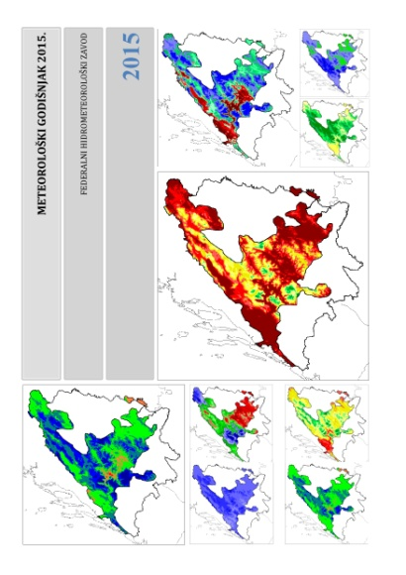
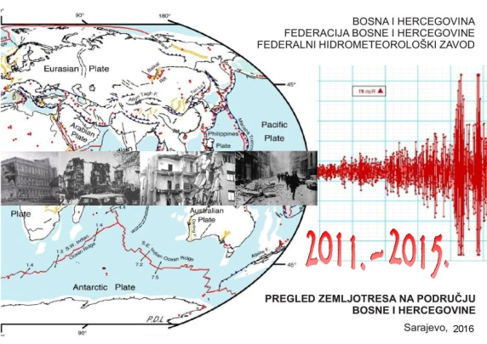
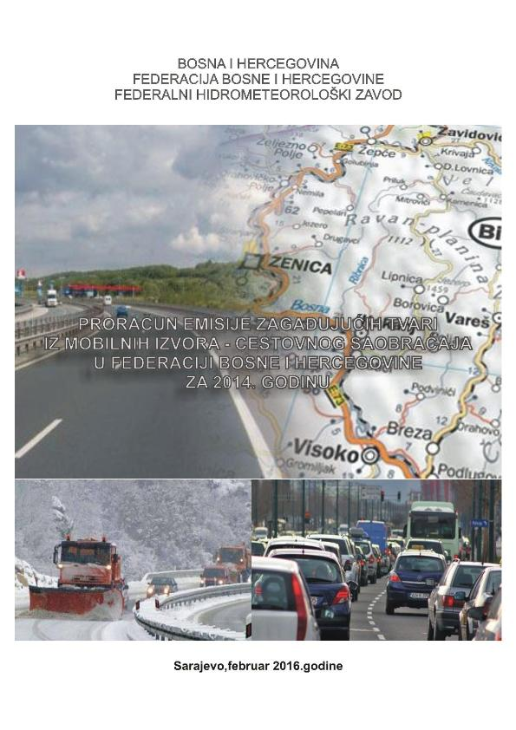
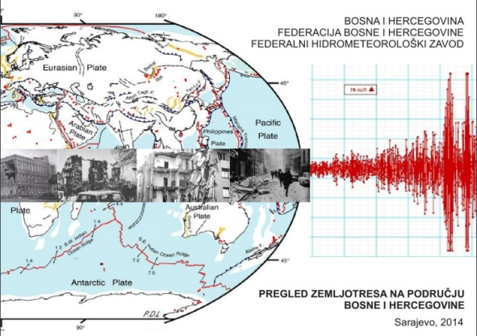
ICSEED-15 - 15th Session of the Informal Conference of SEE NMHS Directors
Publications of FHMI
Catalogue of Earthquaces for period 2011. - 2015.
Hydrological annual
Meteorological annual
Phenological annual
Air quality monitoring in BiH 1955-1992, historical data transmitted in a digital format
Report of air pollutant emission from mobile sources in FBiH in 2014.
Annual air quality report in FBiH 2015.
Catalog of Earthquakes for period
-510 BC to 1900 A.D.
Zagreb, 05 - 07 October 2016.

Slide 17
ICSEED-15 - 15th Session of the Informal Conference of SEE NMHS Directors
Planned activities
Membership BH in „ECMWF“ (ongoing activities)
Collaboration in the field of operational numerical weather prediction - SEECOP
Modernisation, automatisation i upgrading network of rainfall, meteorological, hydrological and air quality stations
Unification stations of different operators.
Establishing of Quality Management System BAS 9001 & BAS 17025
Establishing the laboratory for calibration of meteorlogical instruments
Establishment of laboratories for calibration of instruments of air quality.
Establishing dispersion model for air quality
Zagreb, 05 - 07 October 2016.

Slide 18
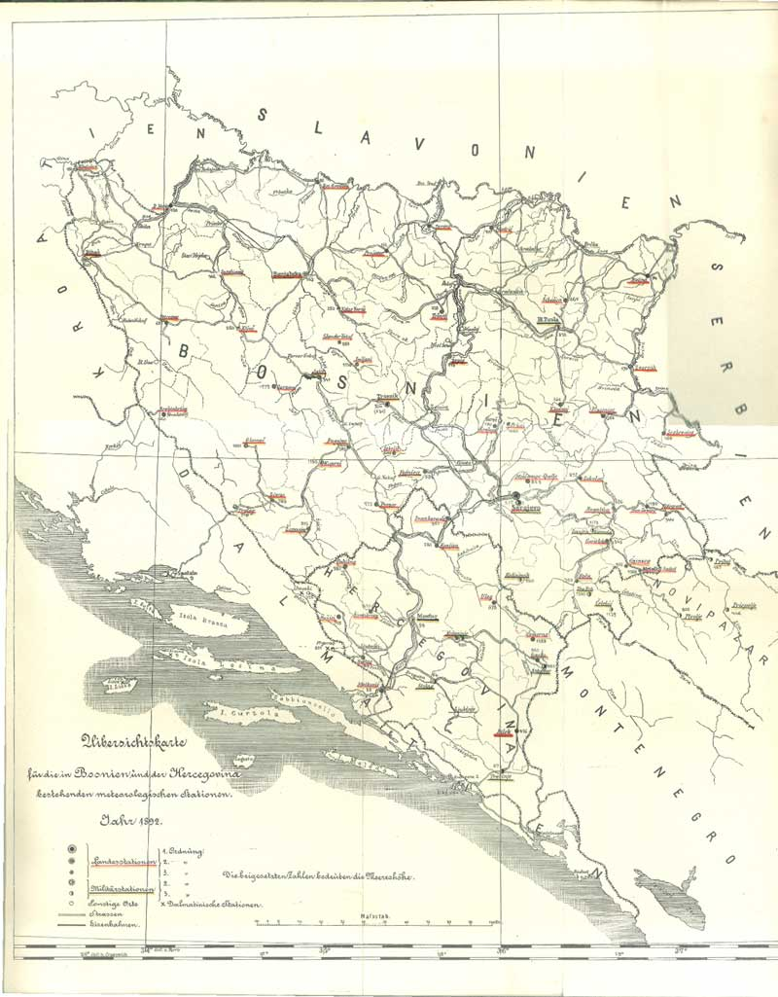
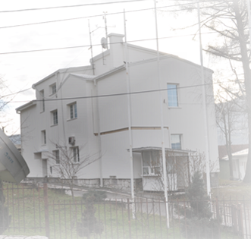
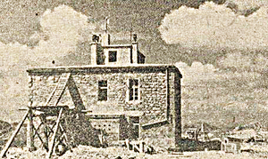
next year 125 years meteorology in BiH
2017
1892

Slide 19
Thank you for attention
ICSEED-15 - 15th Session of the Informal Conference of SEE NMHS Directors
Zagreb, 05 - 07 October 2016.

