Slide 1
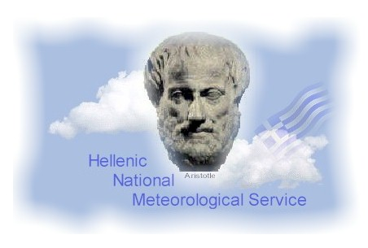

Hellenic National Meteorological Service
(HNMS)
Angeliki Marinaki
Head of forecasting Section
HNMS

Slide 2
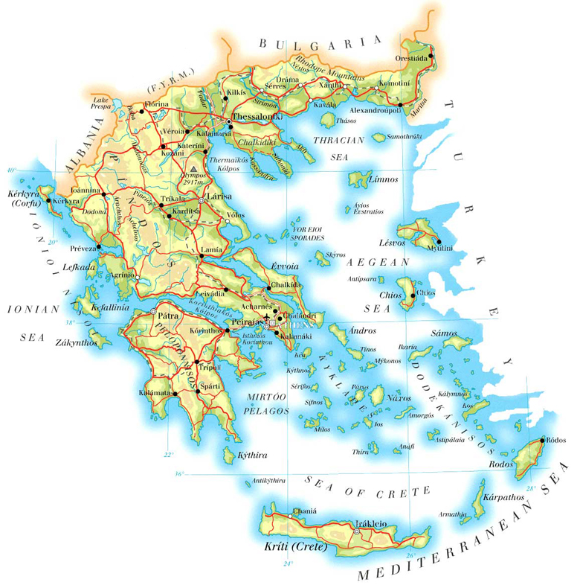
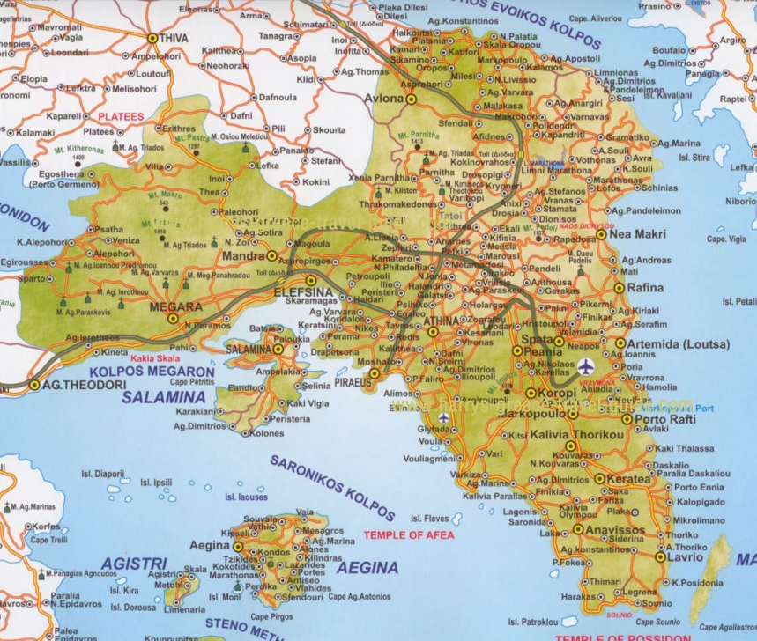
Εθνική Μετεωρολογική Υπηρεσία
Location
HNMS
Notes:
2

Slide 3
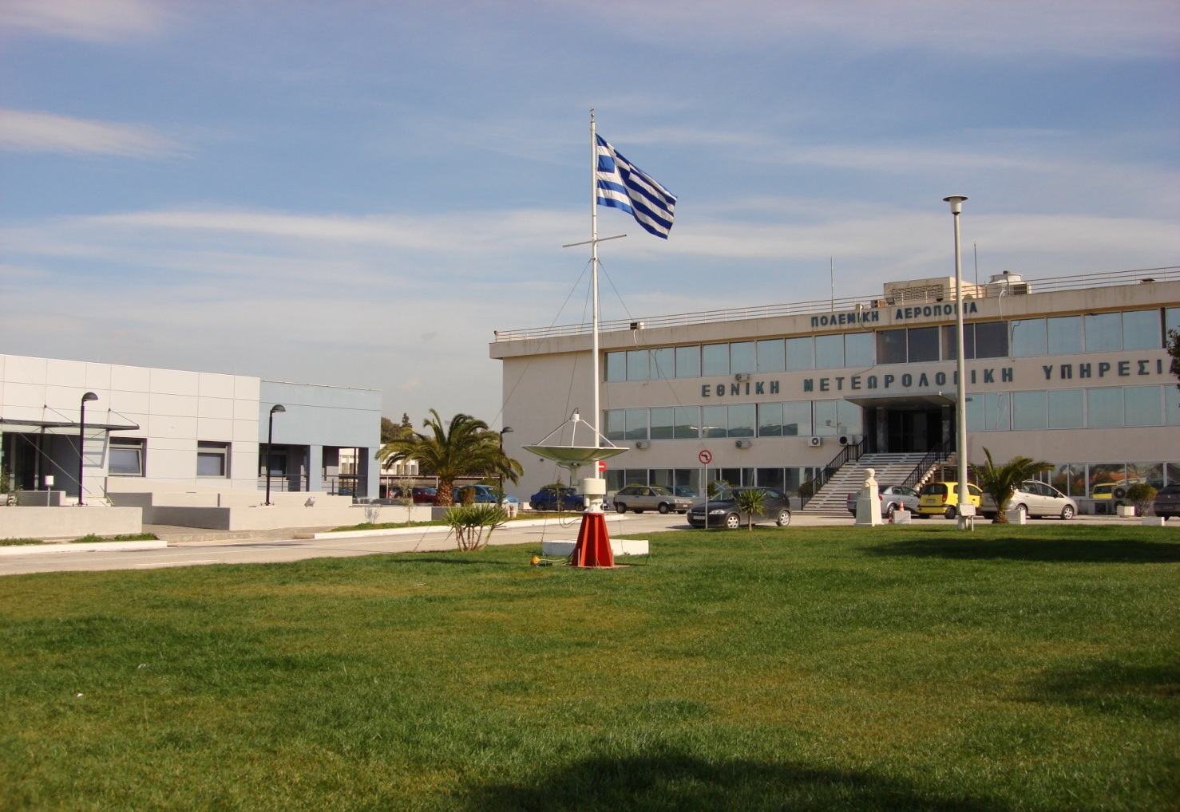
Εθνική Μετεωρολογική Υπηρεσία
Location
Headquarters
Helliniko, Athens
HNMS

Slide 4
Εθνική Μετεωρολογική Υπηρεσία
General information
Hellenic National Meteorological Service
  The national meteorological agency
  Founded in 1931
  Operates under the auspices of the Hellenic Ministry of Defence/Air Force General Staff (military / civilians personnel)
Mission
  To provide meteorological support for:
    National Defence
    National Economy
    The safety of life and property
HNMS
Notes:
HNMS

Slide 5
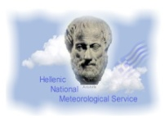
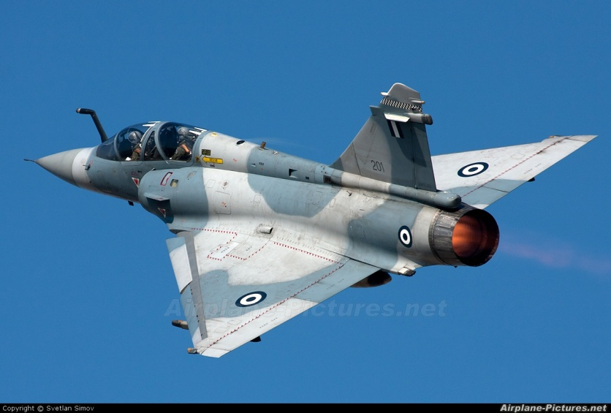

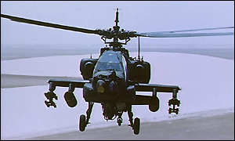
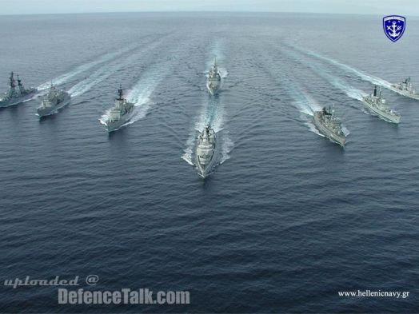
Mission
HELLENIC AIRFORCE
HELLENIC ARMY
HELLENIC NAVY
Notes:
5
HNMS gives information about weather conditions to Hellenic Air force, to Hellenic Army and Hellenic Navy. The knowledge of the weather is of great importance when planning the operations of the Army in General.

Slide 6
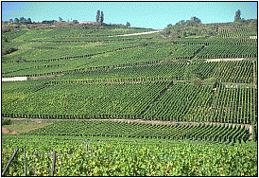
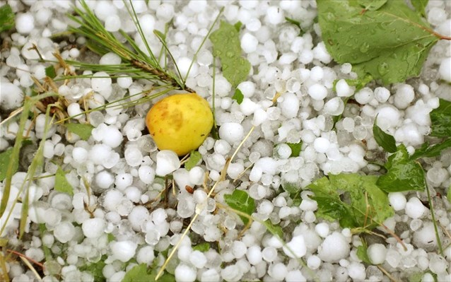
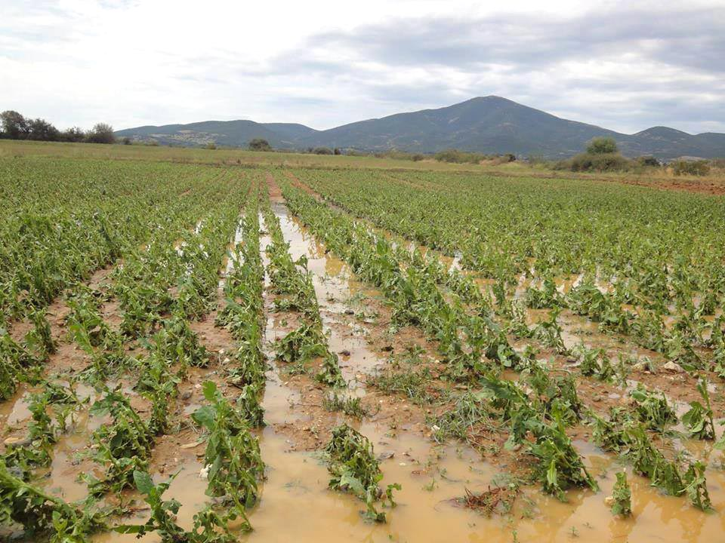
AGRICULTURE
Mission
Notes:
6
Weather conditions and their forecasts are useful to the agriculture too. HNMS gives information for precipitation, probability of hail, and cases of drought.

Slide 7
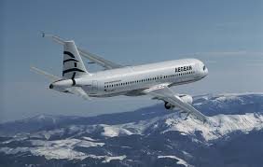
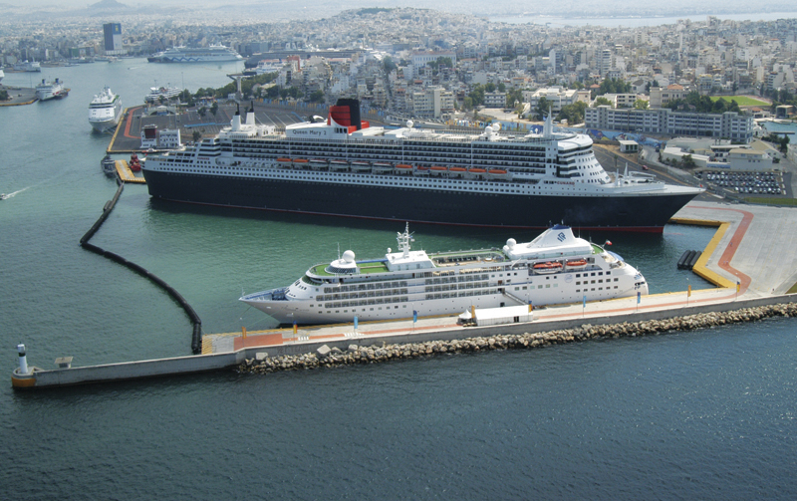
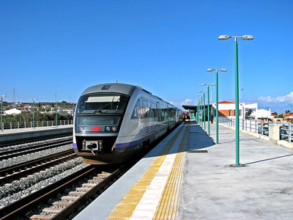
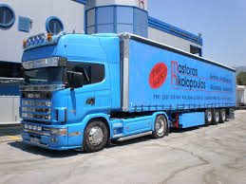
TRANSPORT
Mission
Notes:
7
HNMS gives information about weather conditions for the safety of transports. Cases of frost, strong winds, thunderstorms are forecasted in order to avoid accidents.

Slide 8
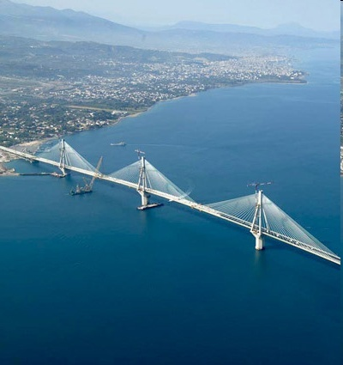
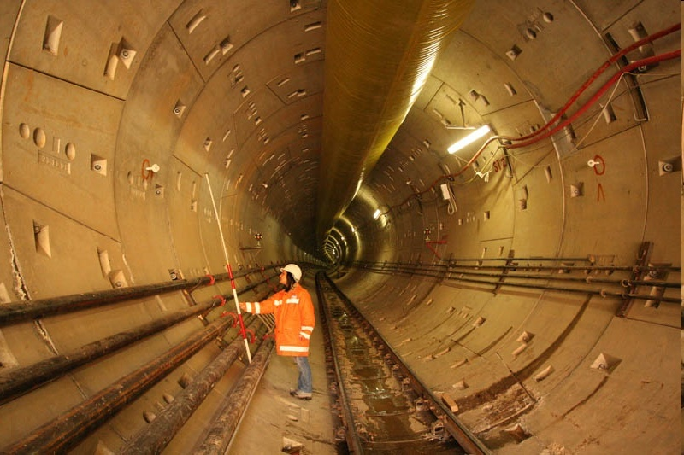
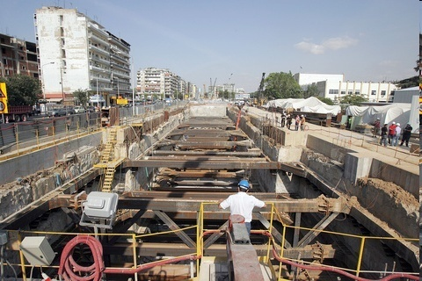

CONSTRUCTION & PUBLIC WORKS
Mission
Notes:
8
a construction or a public work takes place, it is HNMS that gives all the information needed for weather conditions. So, HNMS has it’s clients and produces special forecasts for them.

Slide 9
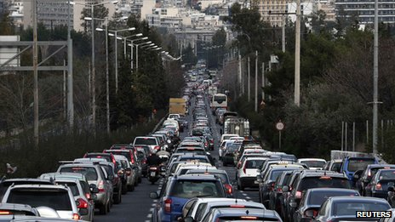
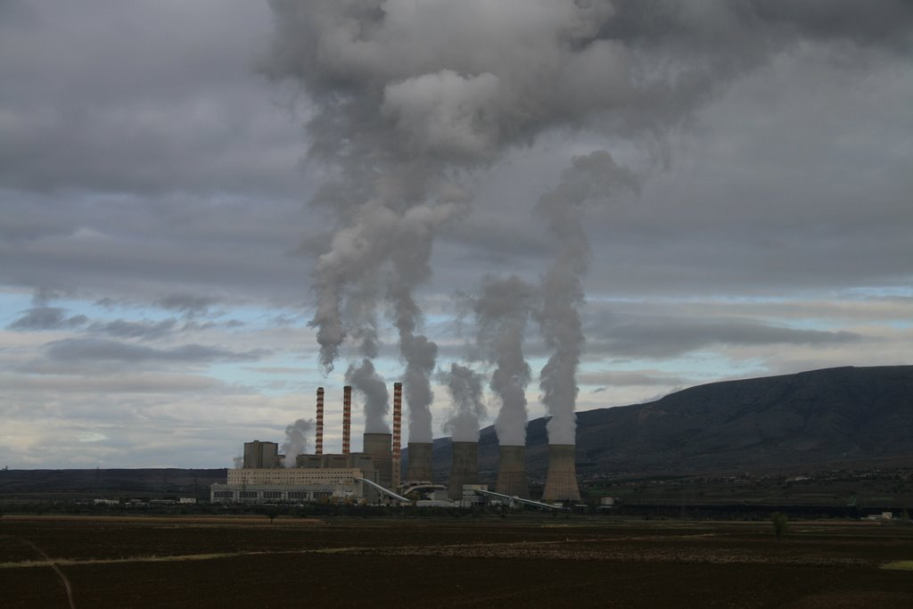
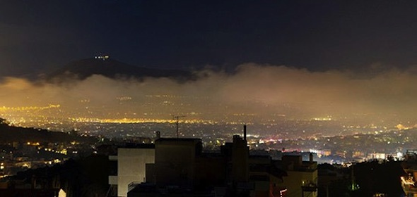
Mission
AIR POLLUTION
Notes:
9
HNMS cooperates with the Ministry of Environment and gives information about temperature and wind conditions so that conclusions for air pollution can be made.

Slide 10
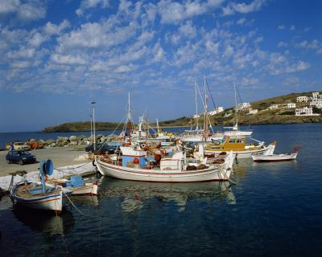

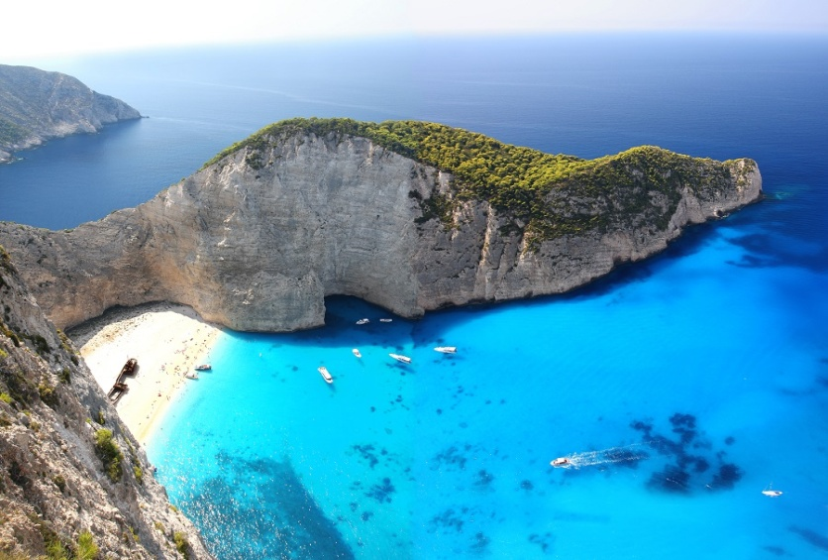
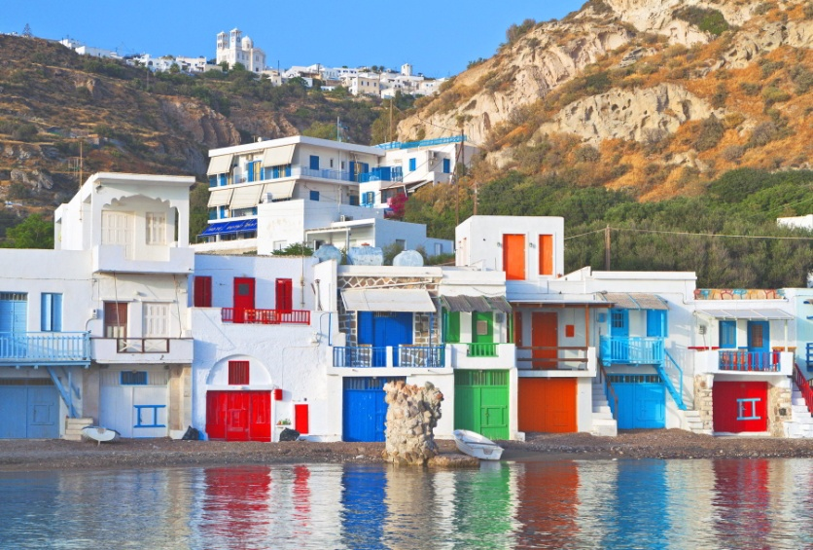
TOURISM & RECREATION
Mission
Notes:
10
Supporting Tourism and Recreation is one of HNMS’s goals. Except from forecasts for weather phenomena HNMS gives climate information about all Greek areas.

Slide 11
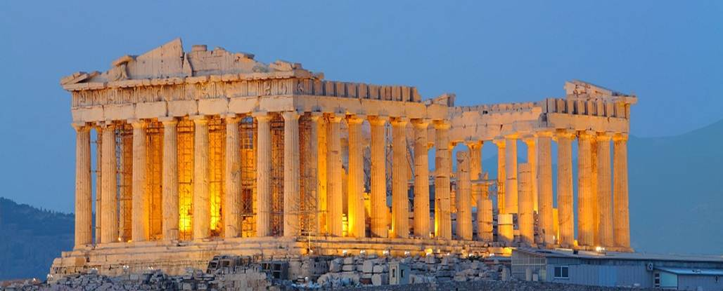
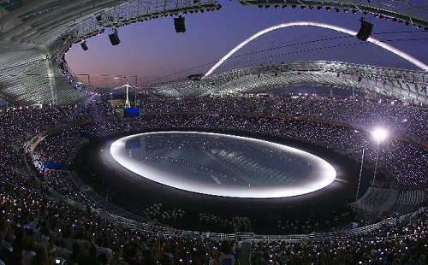
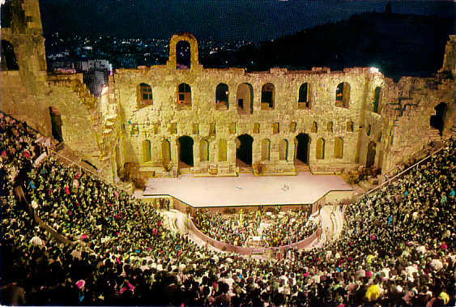
CULTURAL EVENTS
Mission
Notes:
11
HNMS gives also information whenever cultural events take place.

Slide 12
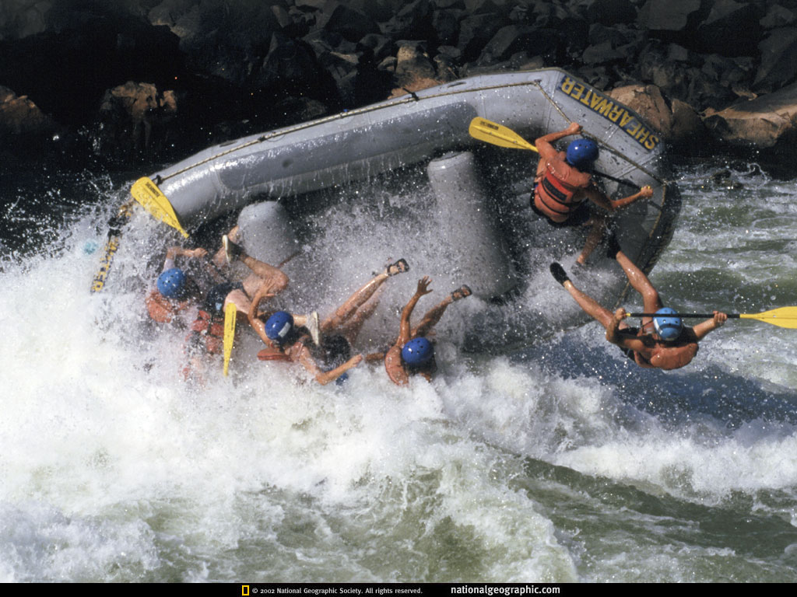

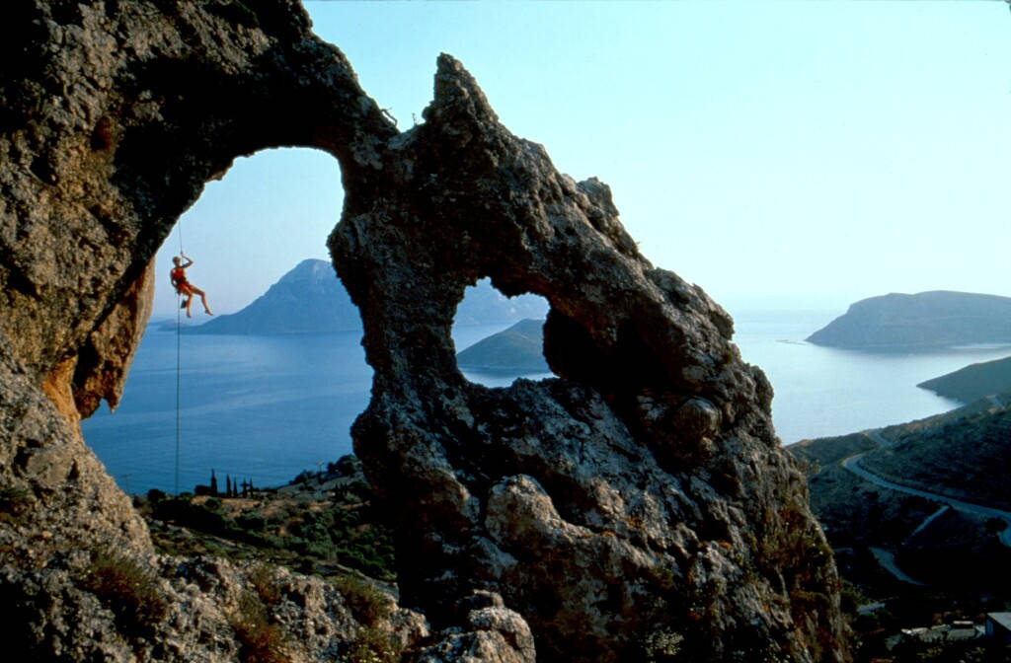
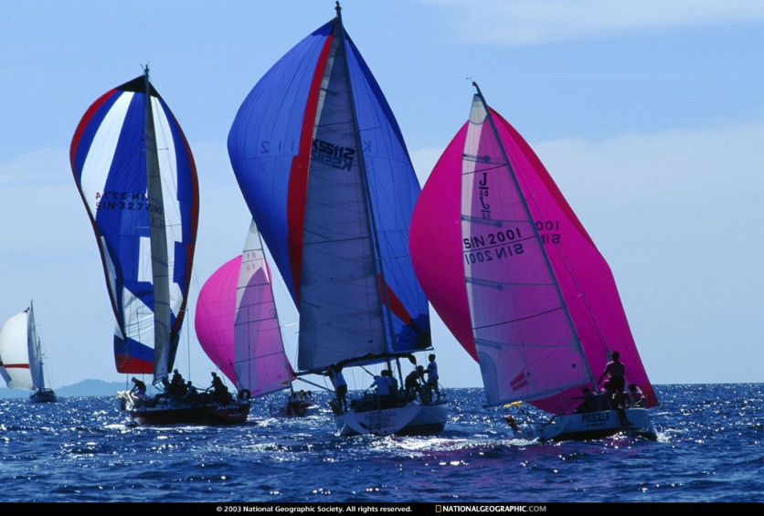
SPORTS
Mission
Notes:
12
Whenever sports are being planed HNMS has to support these events with efficient meteorological information.

Slide 13


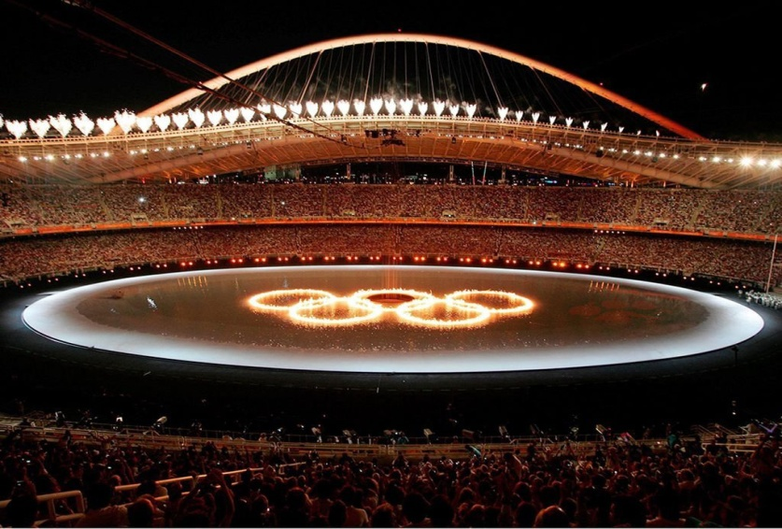

2004 OLYMPIC GAMES
Mission
Notes:
13
Whenever sports are being planed HNMS has to support these events with efficient meteorological information.

Slide 14
Divisions
DIRECTOR
DIRECTOR OFFICE
SECTION OF INSPECTION
LEGAL ADVISOR’S OFFICE
SECTION OF INTERNATIONAL
RELATIONS AND ORGANIZATIONS
SECRETARIATE
NATIONAL MET CENTRE
MET SCHOOL
MARINE MET CENTRE
LOGISTICS
MET OFFICES AIRPORT/PORT
MET STATIONS NETWORK
DEPUTY DIRECTOR
Operational
Support
Meteorological
Observations
Research &
Forecasting
Climatological
Applications
Communications
Informatics
Service Provision
Support
HNMS
Notes:
Director

Slide 15
Εθνική Μετεωρολογική Υπηρεσία
Infrastructure
Description | Total
Regional Meteorological Centers | 2
Meteorological Offices | 21
Meteorological Stations (Manned) | 62 (12 cities+ 50 airports (28 CAA, 22 HAF))
Meteorological Stations (At-Semi) | 82 (49 at + 33 semi)
Upper Air Stations | 3
Network of Meteorological RADARS | 8 (4 active)
Lightning Detection Network | 8
Supercomputer System | 1
HNMS
Notes:
HNMS

Slide 16
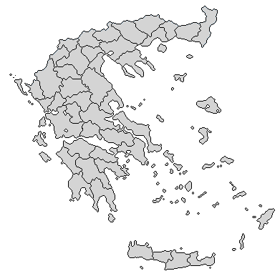
Infrastructure
Regional Meteorological Offices (2)
Thessaloniki
Larissa
HNMS Headquarters
HNMS
Notes:
HNMS
16

Slide 17
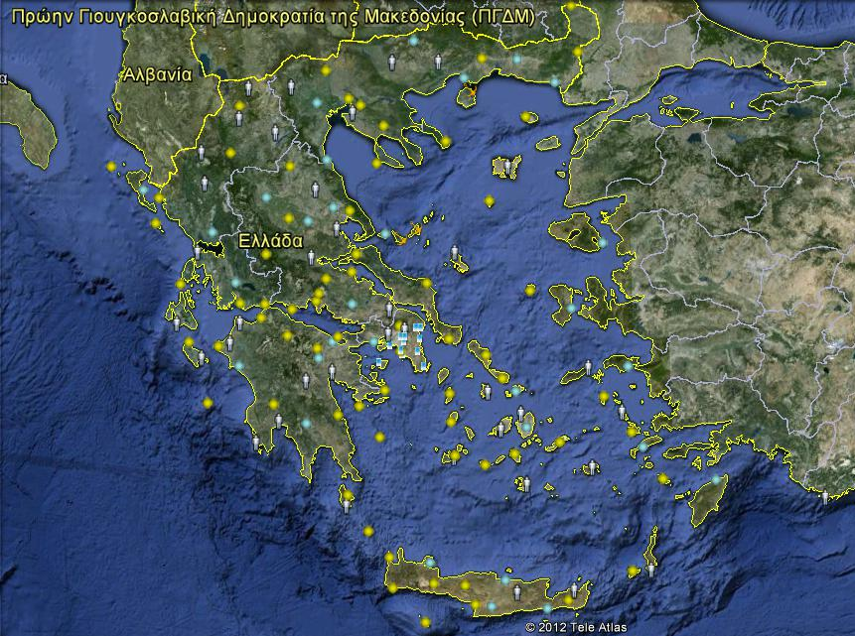

Εθνική Μετεωρολογική Υπηρεσία
Infrastructure
MS Network Monitoring (119)
Manned
At - Semi
National Strategic Reference
Framework (NSRF)
HNMS
Notes:
HNMS

Slide 18
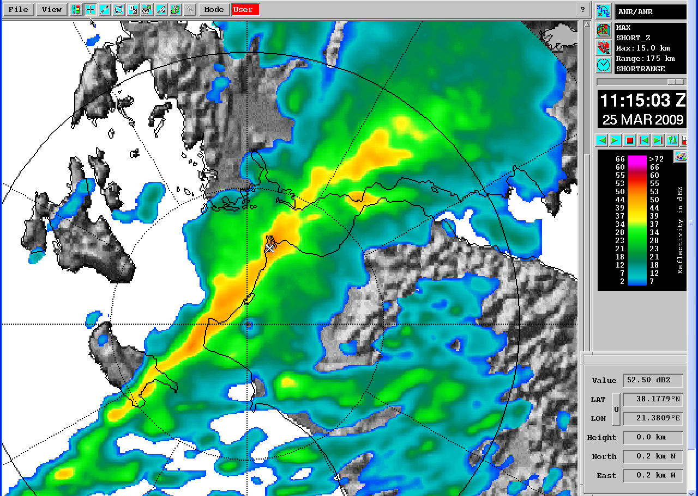
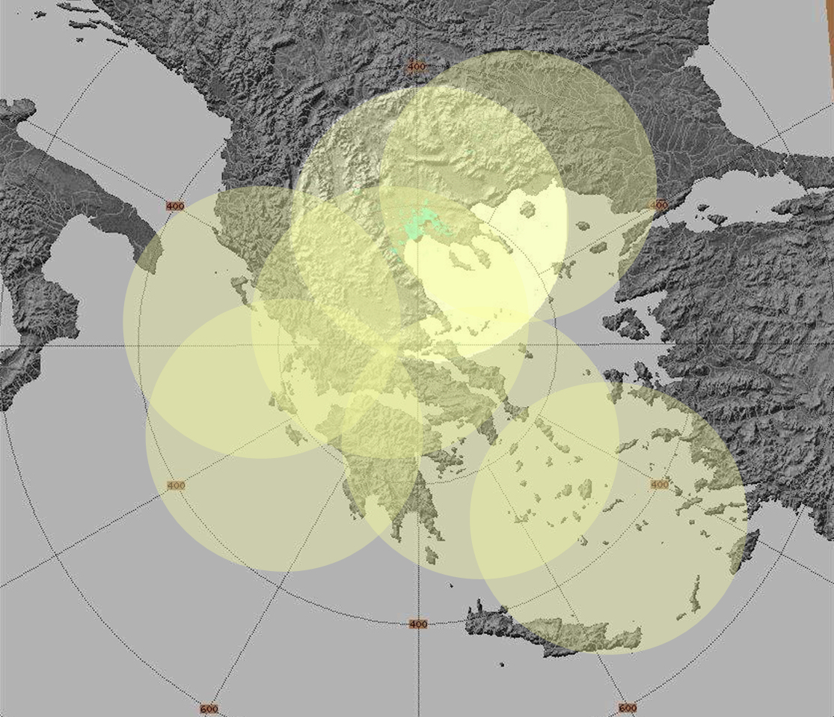
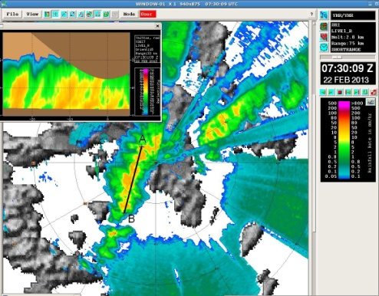
Infrastructure
Weather Radar Network
Network Operational Coverage (150km)
150km
HNMS
Notes:
HNMS

Slide 19
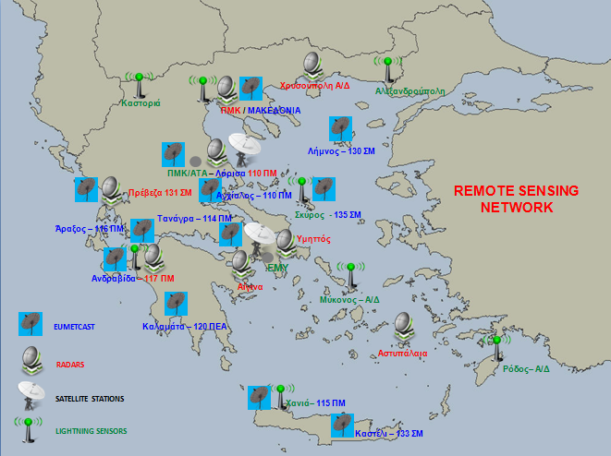
Εθνική Μετεωρολογική Υπηρεσία
Infrastructure
Remote Sensing Network
HNMS
Notes:
HNMS

Slide 20
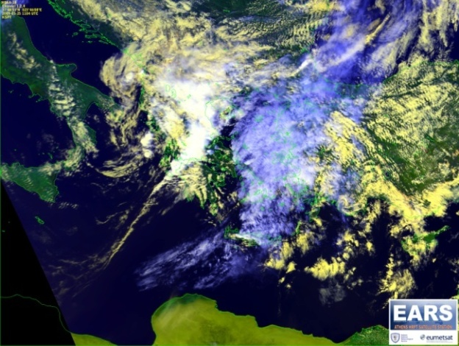
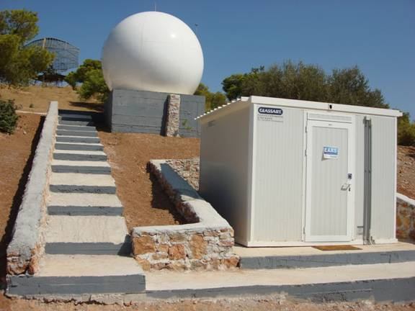
Εθνική Μετεωρολογική Υπηρεσία
Infrastructure
Satellite Receiving Systems
EUMETCast (METEOSAT 7, 8, 9) 12-Channels
Polar orbiting
High Resolution Picture Transmission (NOAA 15-19, FY)
EUMETSAT ADVANCED RETRANSMISSION SERVICE
EARS
Athens
DVB Broadcast
EUROBIRD-9
Others…
Weather Satellites
EUMETSAT
EUMETSAT DVB Uplink
Clients-Users
HNMS
Notes:
he Regional Data Service is provided by the EUMETSAT Advanced Retransmission Service (EARS), a network of Advanced High Resolution Picture Transmission (AHRPT) reception stations.

Slide 21
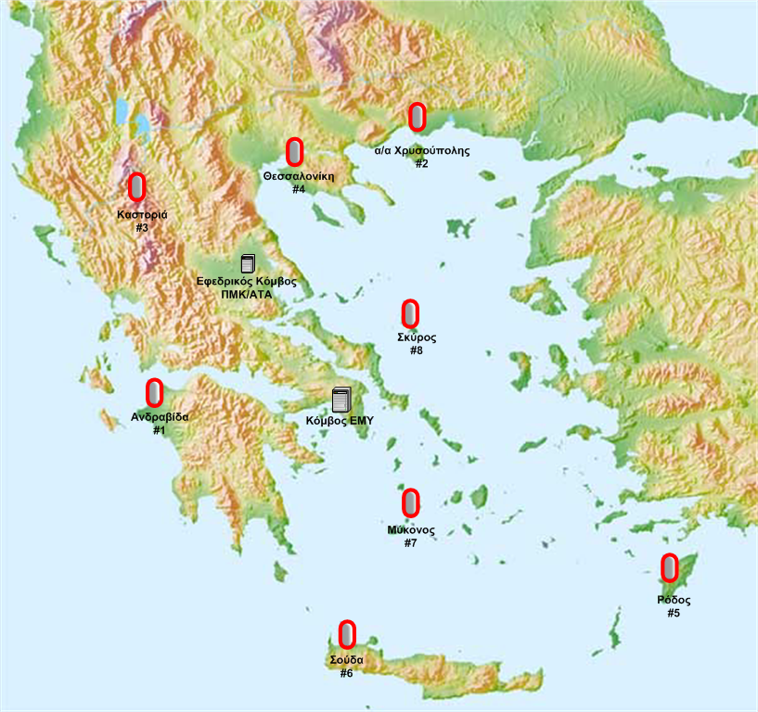
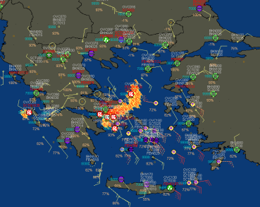
Εθνική Μετεωρολογική Υπηρεσία
Infrastructure
Lightning Detection Network
MTSHELL INTEGRATION SYSTEM
Base Stations
HNMS Headquarters & Larissa
HNMS
Notes:
HNMS

Slide 22
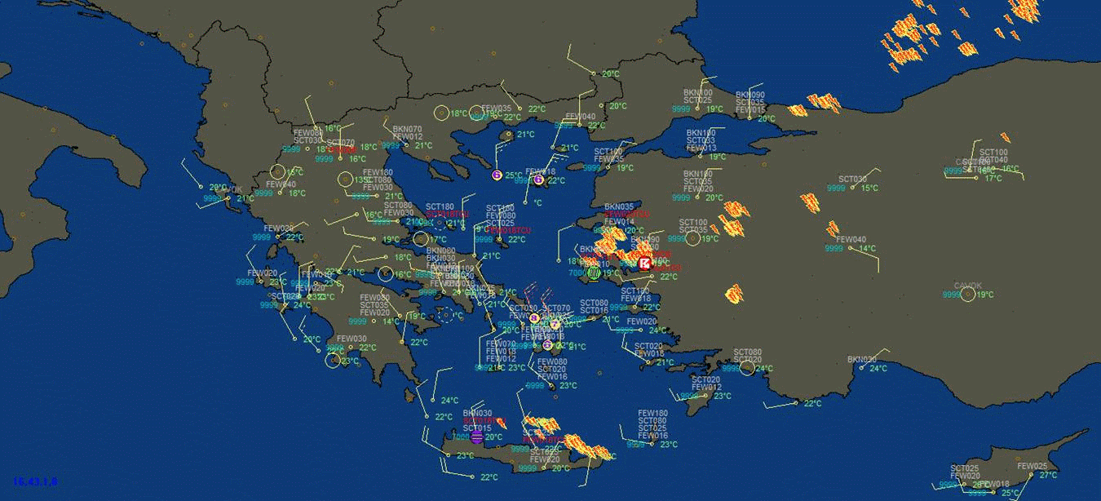
Εθνική Μετεωρολογική Υπηρεσία
Start: 18/6/2015 – 1100 UTC End: 19/6/2015 – 0600 UTC
Infrastructure
HNMS
Notes:
22

Slide 23
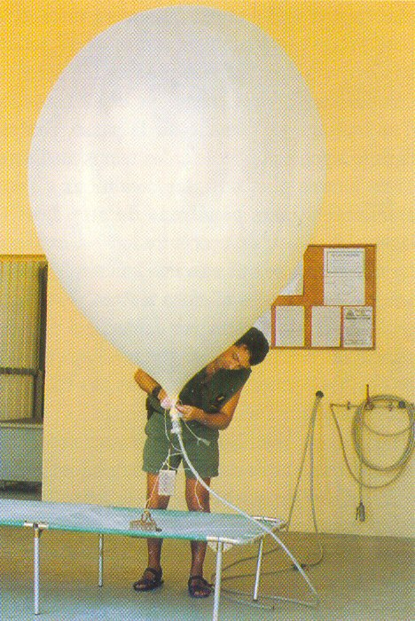
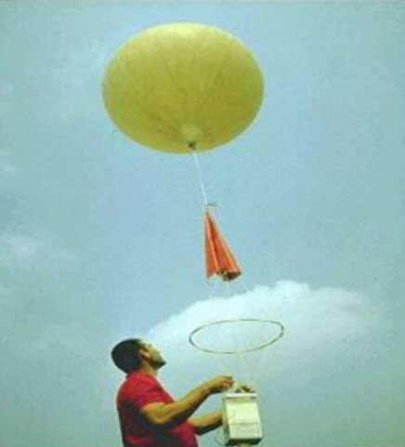
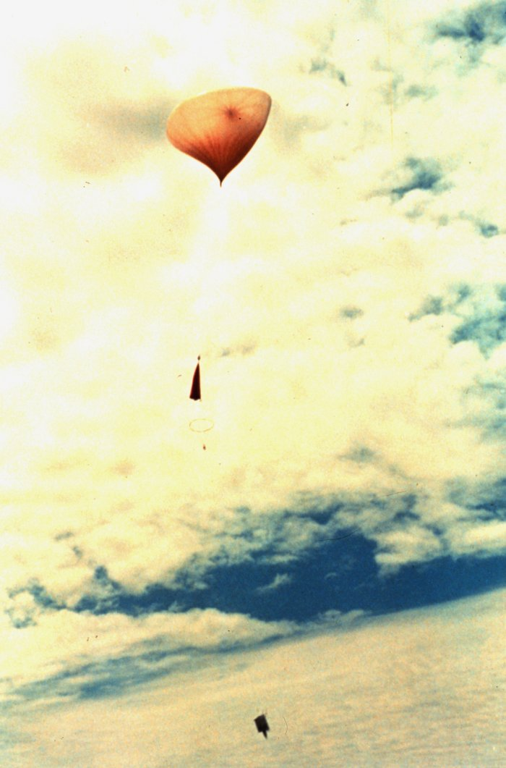
Infrastructure
Upper air stations(3)
Thessaloniki
HNMS Headquarters
Heraklion
Notes:
The need to have information about meteorological parameters all over the atmosphere led HNMS to have 3 Upper air stations.

Slide 24
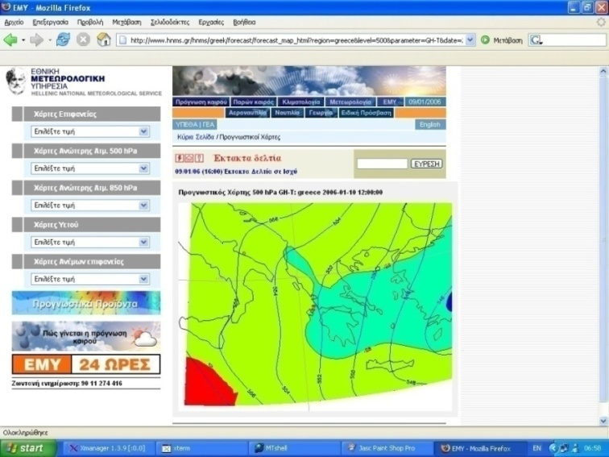
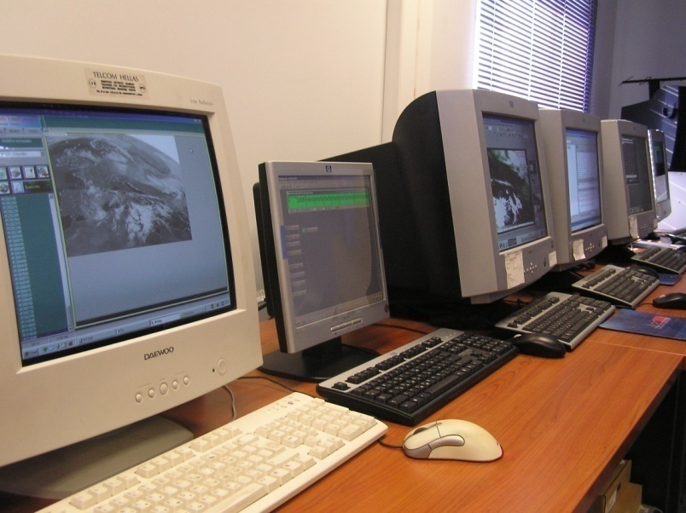
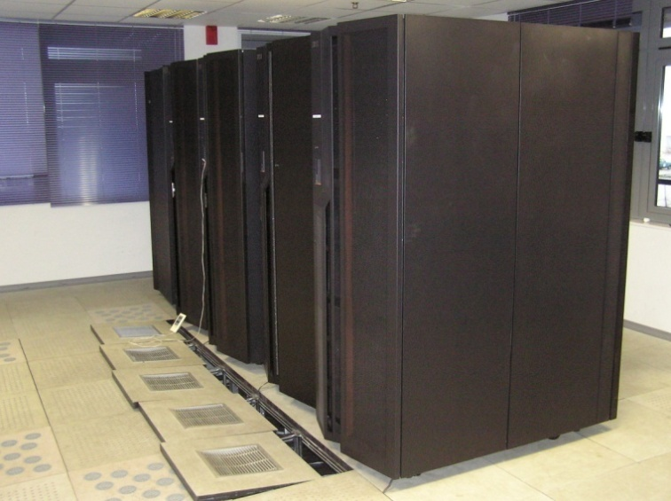
Εθνική Μετεωρολογική Υπηρεσία
Infrastructure
Computer Systems
  Communication system
  Central Data Base
  Meteorological Support System
  Computer Centre
  Operational Support System
HNMS
Notes:
HNMS

Slide 25

OPERATIONAL MODELS
1. ECMWF
2. Local Area Model COSMO
- Resolution 7km & 2.8km
- Forecast 0…72 h
3. WAM –Hellenic wave model
- Resolution 4km
- Forecast 0…60

Slide 26
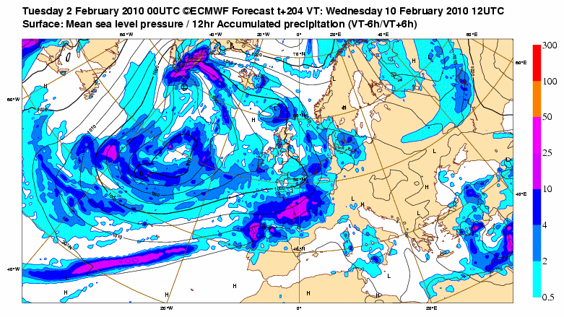
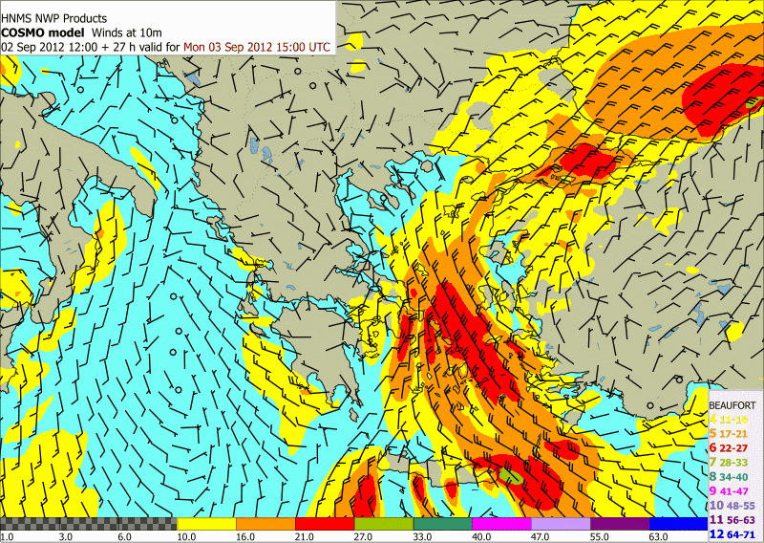

NWP tools
MODEL’s PRODUCTS
ECMWF
WAM
COSMO
Notes:
The products of these numerical models are charts like these. Studying these charts the meteorologist can give information about wind force and direction, precipitation, clouds, sea state, extreme weather phenomena and many other meteorological parameters.

Slide 27

Weather
Forecasting
HNMS website: www.hnms.gr
Operational Activities
HNMS
Notes:
27

Slide 28
PRODUCTS
AERONAUTICAL FORECASTS (TAFs, TREND, WARNINGs, SWC, AIREP,SIGMET …)
MARINE FORECAST (SEA BULLETINS FOR METAREA 3, GALE WARNINGS, SEA ROUTES FORECAST )
GENERAL AND SPECIFIC FORECASTS
EXTREME WEATHER PHENOMENA FORECASTS
FORECASTING MAPS OF FOREST FIRES RISK
METEOALARM
FORECAST FOR WMO
FORECAST FOR AIR POLLUTION CONDITIONS

Slide 29



Εθνική Μετεωρολογική Υπηρεσία
Operational Activities
  Gale Warnings
Maritime Bulletins for East Mediterranean Sea
HNMS
Notes:
29

Slide 30


Operational Activities
  Fire Risk Assessment Forecast Map (Civil Protection Secretariat product)
  Wind – Max Temperature Forecast Map (HNMS product)
HNMS
Notes:
30

Slide 31


Εθνική Μετεωρολογική Υπηρεσία
Operational Activities
  Warning Alerts for Extreme Weather
HNMS
Notes:
31

Slide 32

Warning Alerts for Extreme Weather (strong winds, High or Low Temperatures, Thunderstorms, severe rainfall, fog)
ATHENS FEBRUARY 2013

Slide 33
Operational Activities
  HNMS’s ISO CERTIFICATION
  Exclusive Provision of Meteorological Support to Aviation (EN ISO 9001: 2008)
  Provision of Marine Meteorological Services (ΕΝ ISO 9001: 2008)

Slide 34


Research activities
Development of Information Applications
Development of Numerical Weather Prediction Models
(LM-COSMO)
Database Management Applications
Applications for Climatology
Software Development for usage of Meteorological Products
Development of Data Processing Applications
HNMS
Notes:
HNMS

Slide 35
Εθνική Μετεωρολογική Υπηρεσία
Organizations
  International Organizations
      WMO
      ICAO
      ΝΑΤΟ
  European Organizations
      ECMWF
      EUMETSAT
      EIG - EUMETNET
      ECOMET
      EUROCONTROL
HNMS
Notes:
HNMS

Slide 36

Εθνική Μετεωρολογική Υπηρεσία
Contents
EUMETNET PROGRAM
  EMMA- Meteoalarm
  Eumetcal
Member EFAS
Collaborations
  Research Centers (NCSR “D”, NOA, HCMR, ATHINA, et. al.)
  Universities (Domestic/European)
  Horizon 2020 EURO Funded Research Project “EU-CIRCLE”
HNMS
Notes:
36

Slide 37
Εθνική Μετεωρολογική Υπηρεσία
Collaborations - Projects
On going interest (NSRF Project)
  Provision of Meteorological and Environmental Information through information technology & communication (Re-invitation for bid)
  Creation of a Detection and Short Term Forecasting System for severe weather prediction (Planning phase)
  Qualitative and quantitative surveying, digital processing and online provision of observations and weather forecasts ( Planning phase)
  Creation of a weather information system and short term forecasts for the benefit of transport safety, with emphasis on marine, islands and roads network (Planning phase)
  SEE MHEWS project ?
HNMS
Notes:
Hellenic center for marine research

Slide 38
Εθνική Μετεωρολογική Υπηρεσία
Thank you very much for your attention!!
ευχαριστώ
HNMS
Notes:
HNMS

