Slide 1
Research and Trainings at the European Severe Storms Laboratory
Münchener Str. 20 ▪ 82234 Wessling ▪ Germany ▪ www.essl.org
Pieter Groenemeijer
with contributions of several ESSL colleagues
15th session of the Informal Conference of South-East European NHMS Directors ICSEED-15
Zagreb, 6-7 Oct 2016

Slide 2
This presentation
European Severe Weather Database:
uses of this data
European Storm Forecast Support
ESSL Trainings
ESSL Membership

Slide 3
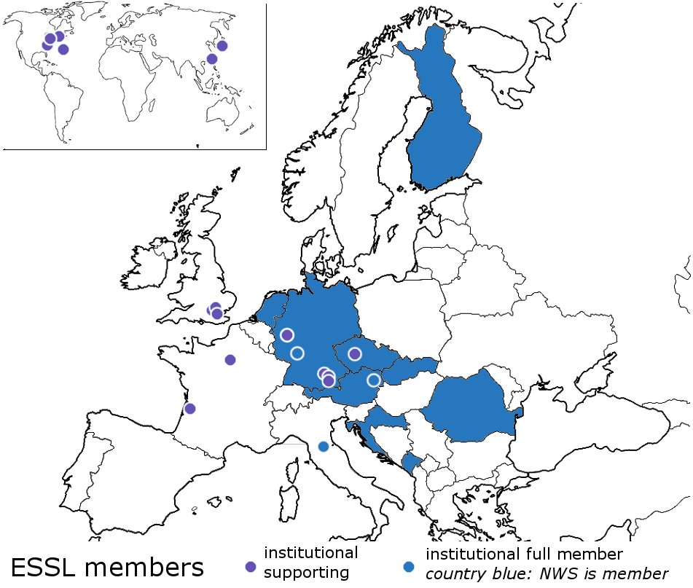
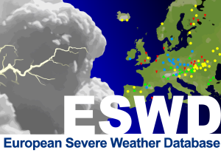
The ESSL
non-profit organization
association with members
NHMS, EUMETSAT, research institutes, individual scientists, (re-)insurance sector
statutory purposes:
Perform and support severe weather research at a European level
Management and development of the European Severe Weather Database ESWD
Organization or support of the European Conference on Severe Storms

Slide 4
ESSL Facts
ESSL has these primary sources of income:
Membership fees
supporting members
full members
Projects funded by third parties
European Commission
National and regional governments
Partner research organizations
Fees for ESSL programmes
ECSS – European Conference on Severe Storms
ESSL Testbed
Trainings, Seminars, Workshops

Slide 5
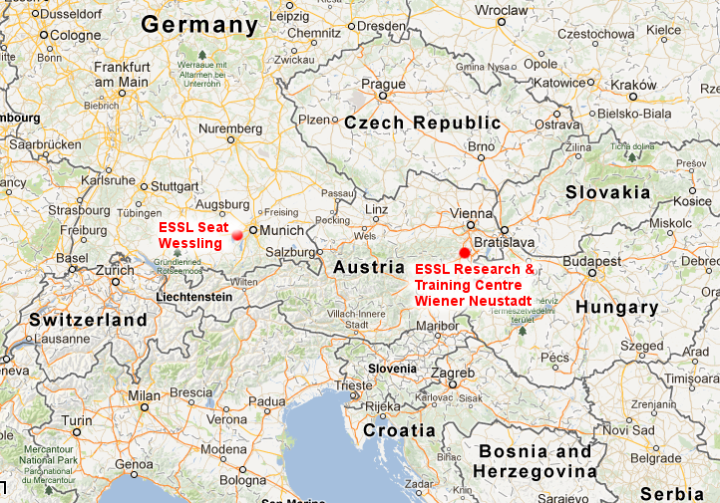
ESSL Facts
ESSL is seated in Wessling, Germany, on the premises of DLR
Subsidiary (non-profit) ESSL – Science and Training in Wiener Neustadt, Austria:
Location of forecaster trainings,
seminars, workshops and

Slide 6
We are a small organization

Slide 7
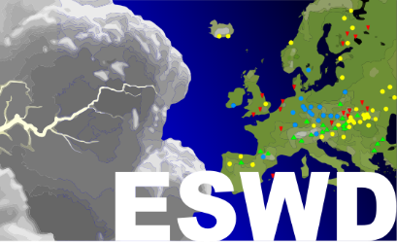
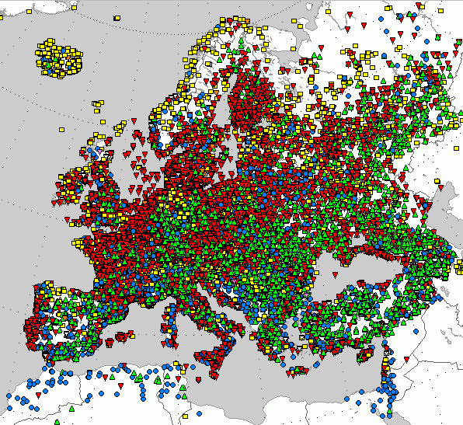
European Severe Weather Database
Tornadoes
Severe wind gusts
Large hail
Extreme rainfall
pan-European database of severe weather reports
contains 102 000 observations as of 1 Oct 2016
data collected in cooperation with networks of storm spotters, NHMS, and individuals
www.eswd.eu

Slide 8
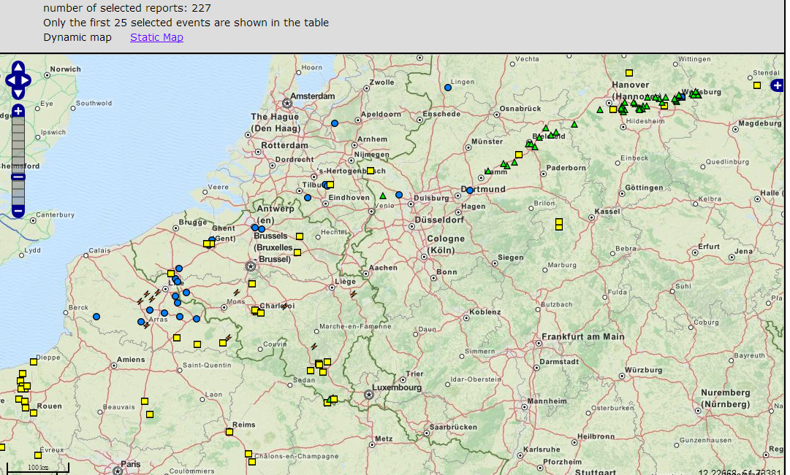
European Severe Weather Database
ESWD web interface showing reports of 28 July 2013
www.eswd.eu

Slide 9
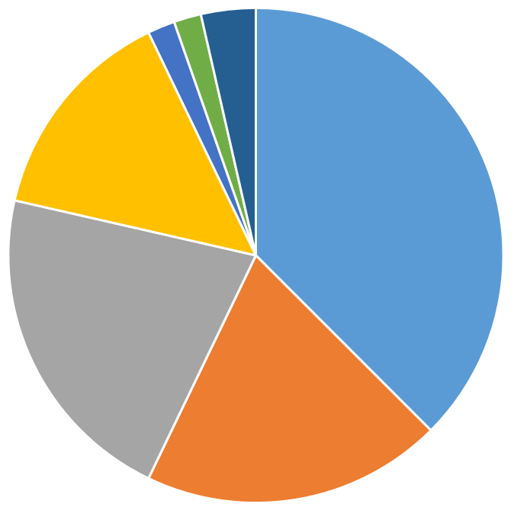
European Severe Weather Database
pan-European database of severe weather reports
contains 102 000 observations as of 1 Oct 2016
data collected in cooperation with networks of storm spotters, NHMS, and individuals
ESWD data has been used in 66 peer-reviewed publications
Satellite and radar studies
Climatologies &
Risk assessments
Case studies
Identification of severe weather environments

Slide 10
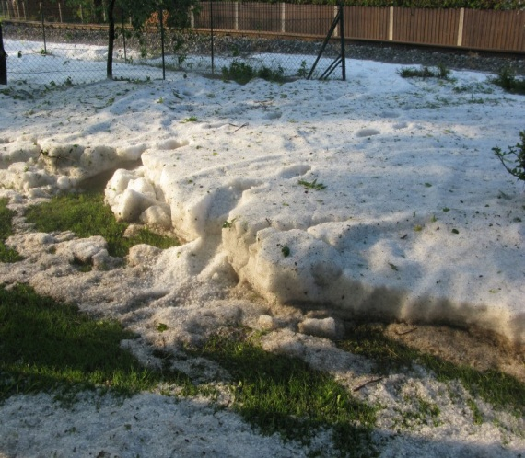
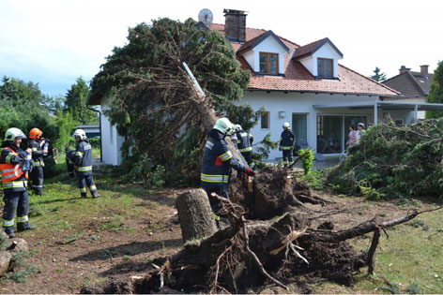
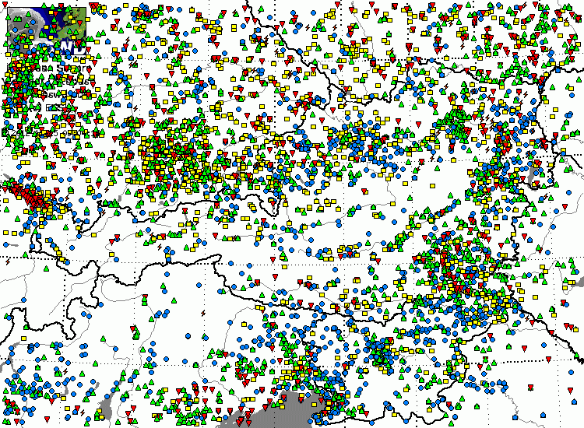
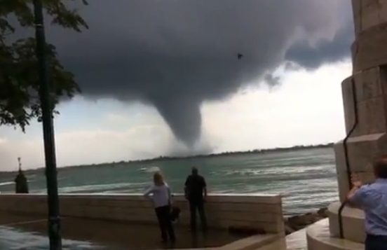
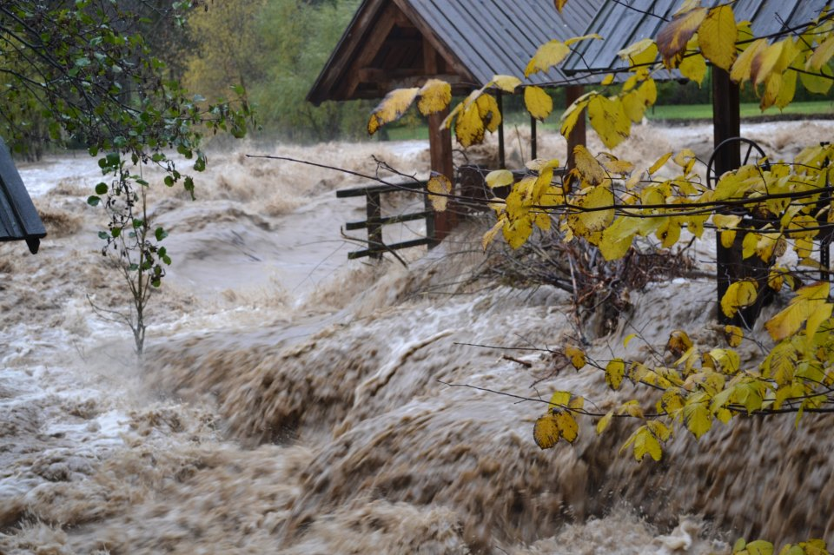
Tornadoes
Severe wind gusts
Large hail
Extreme rainfall
near Wiener Neustadt 3 Juni 2012 Images: Skywarn.at / ORF
Venice (I), 11 June 2012
Slovenia, 4 November 2012

Slide 11
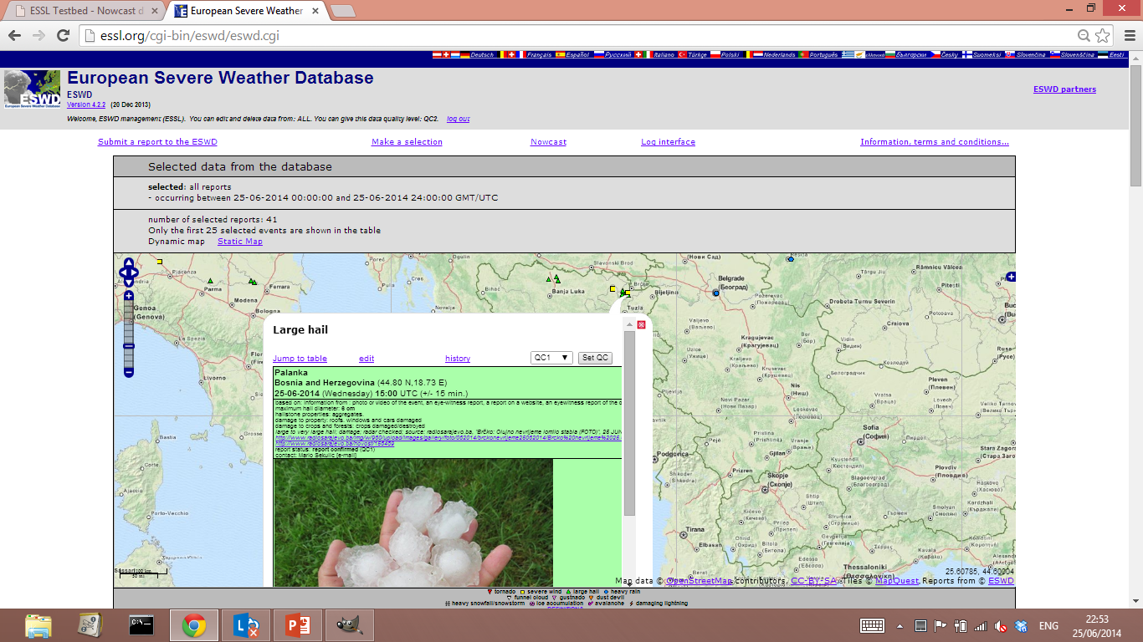
ESWD Web interface

Slide 12
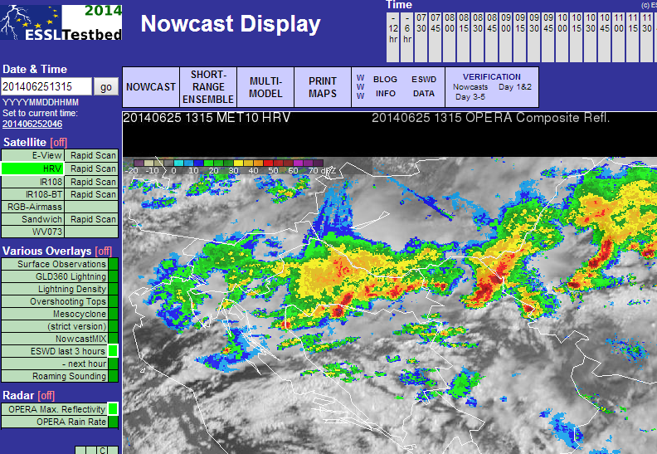
ESWD use in forecast verification

Slide 13
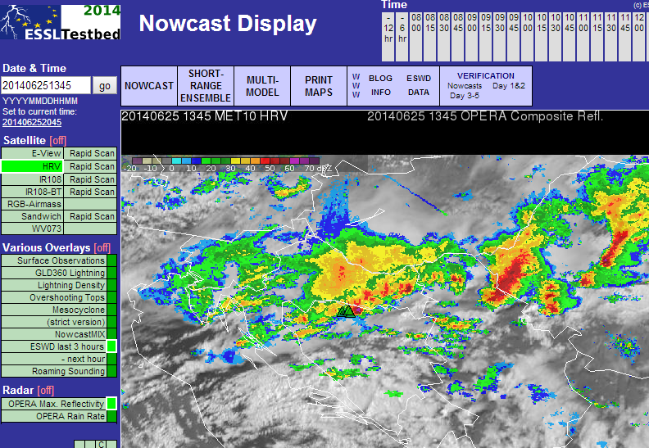
ESWD use in forecast verification
HAIL 4 cm diameter

Slide 14
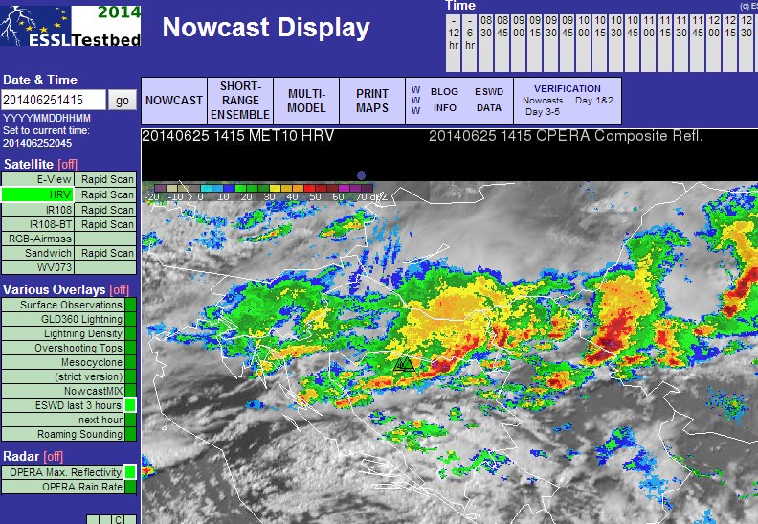
ESWD use in forecast verification

Slide 15
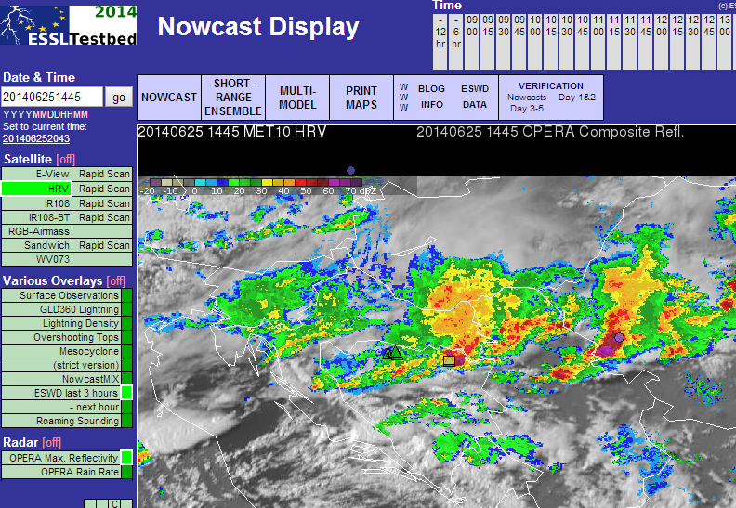
ESWD use in forecast verification
more HAIL
and WIND damage

Slide 16
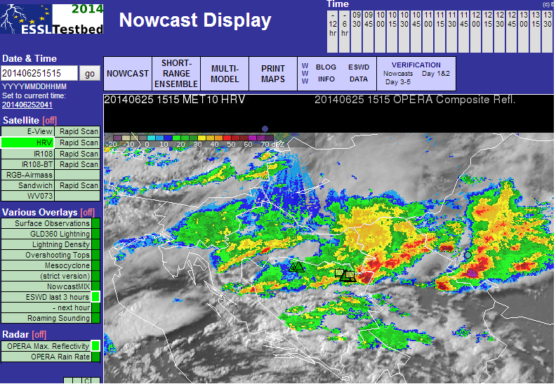
ESWD use in forecast verification
HAIL 7 cm diameter

Slide 17
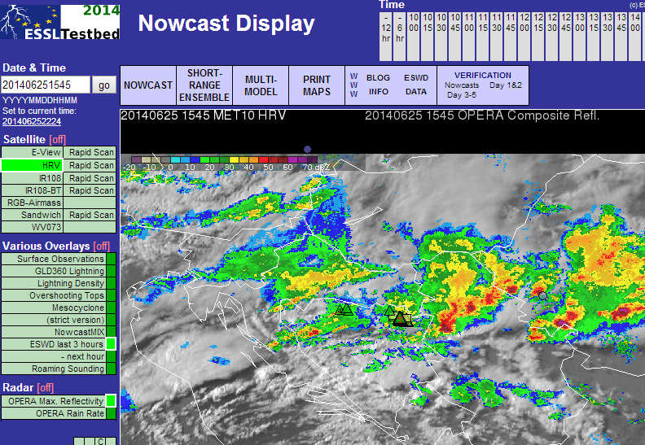
ESWD use in forecast verification
HAIL 7 cm diameter

Slide 18
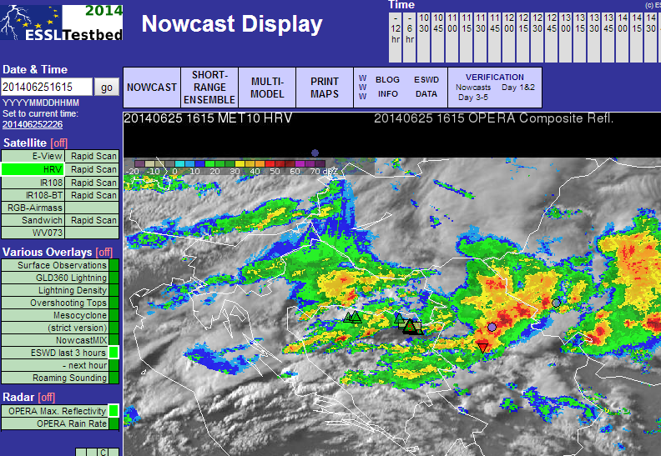
ESWD use in forecast verification
HAIL 7 cm diameter
and a TORNADO

Slide 19
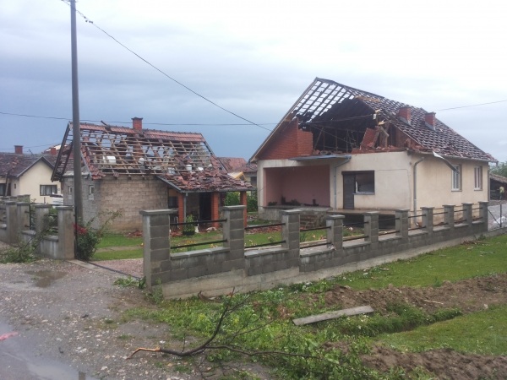
ESWD use in forecast verification
HAIL 7 cm diameter
and a TORNADO

Slide 20
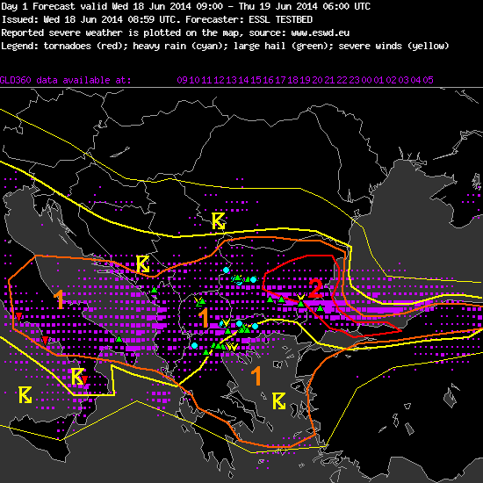
Forecast verification at the ESSL Testbed
Experimental forecast showing:
forecast areas of thunderstorms (yellow lines)
increasing levels of severe weather risk (the orange, red lines and numbers)
and a posteriori verification data:
violet squares (observed lightning)
severe weather reports:
hail (green)
wind (yellow)
flash flooding (blue)
(Valid Tuesday 24 June 2014),
FORECAST VALID TUESDAY 18 JUNE ISSUED THAT MORNING
Large hail

Slide 21
Quality control
by ESSL quality control
(within a few days)
by ESSL quality control,
VON or NHMS
by NHMS or
ESSL quality control
QC0
as received
QC0+
plausibility
checked
QC1
confirmed by reliable source
QC2
scientific case study
general
public
VON, NHMS,
ESSL
VON, NHMS,
ESSL
NHMS,
ESSL (rarely)
* reliable sources include:
conclusive photo and/or video material, with accurate time & location
certified storm spotter reports
VON = Voluntary Observer Network NHMS = National Hydro-Meteorological Service

Slide 22
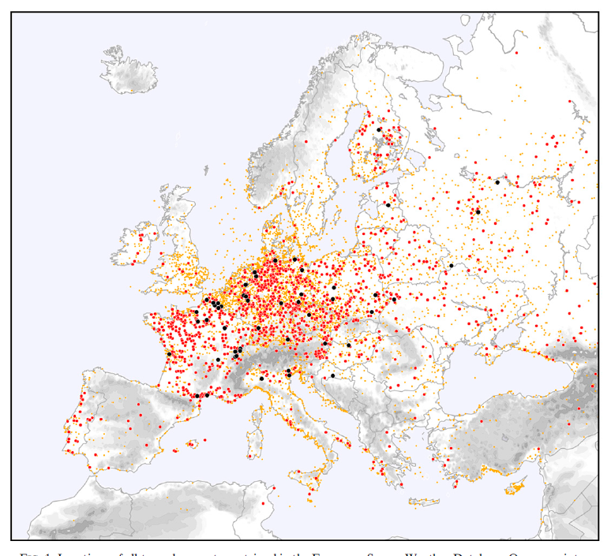
ESWD based severe weather climatology
Map of all tornadoes recorded in Europe⁺
Tornado rating:
F4, F5
F2, F3
F0, F1 and unrated
missing
data
From:
Groenemeijer and Kühne 2014;
Monthly Weather Review

Slide 23
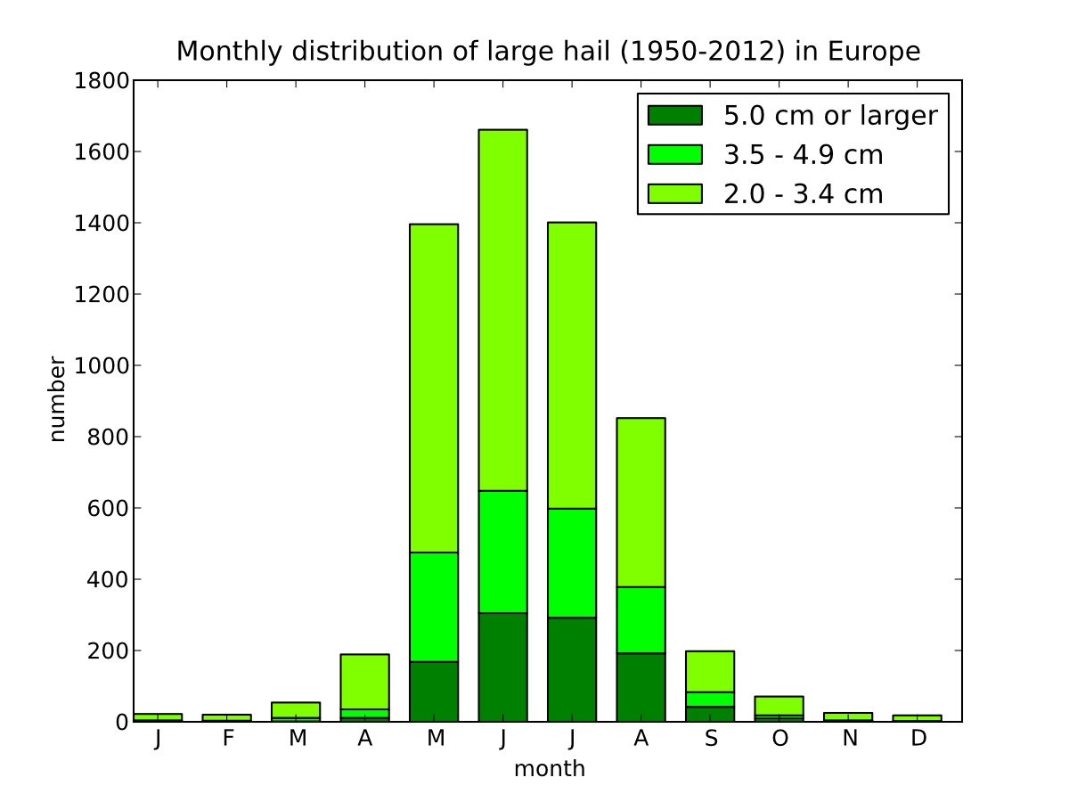
Some characteristics of the data set
Annual cycle

Slide 24
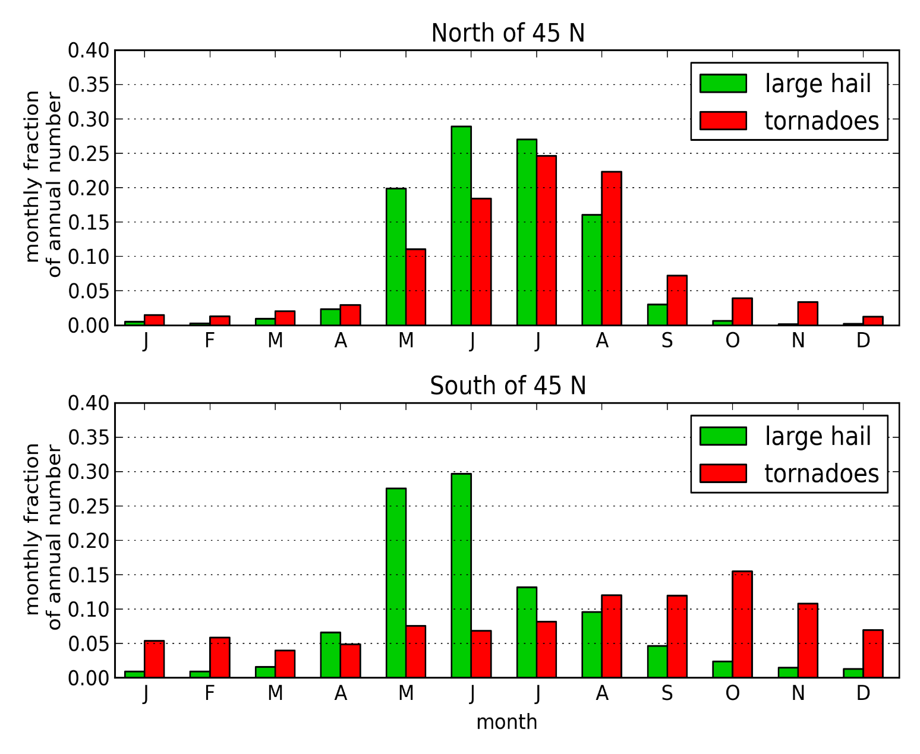
Some characteristics of the data set
Regional annual cycle

Slide 25
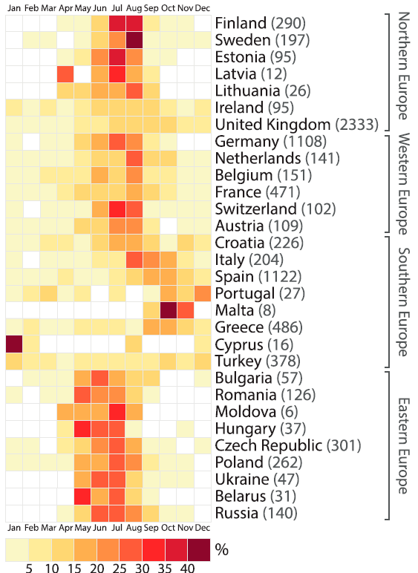
Some characteristics of the data set
Annual cycle of tornadoes per country
From:
Antonescu et al 2016;
Monthly Weather Review

Slide 26
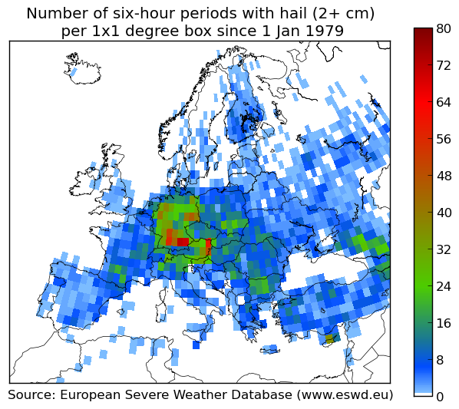
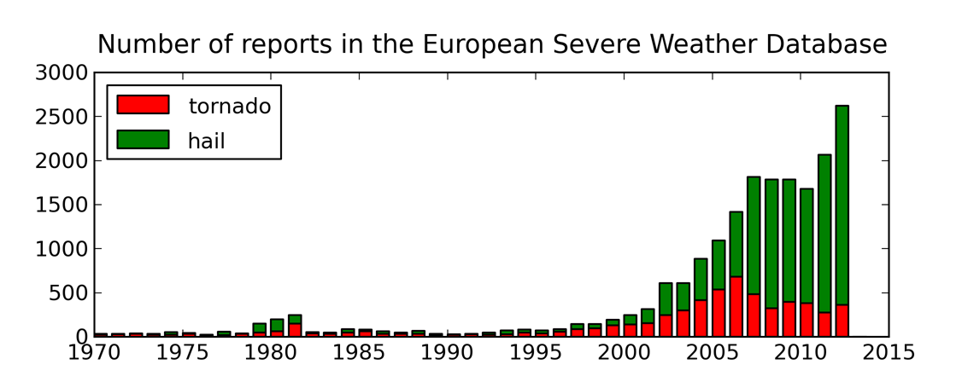
ESWD data and
climatology
Is this the true distribution of events? Probably not.
The data set is inhomogeneous in time and space
One cannot directly derive trends from the data

Slide 27
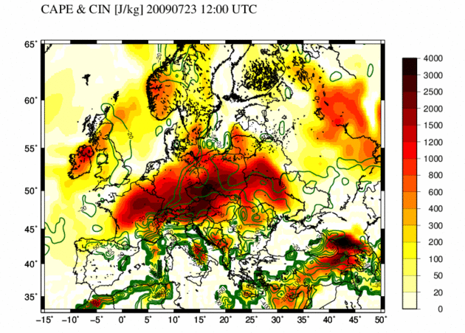
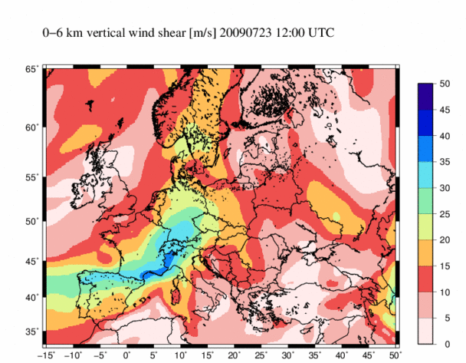
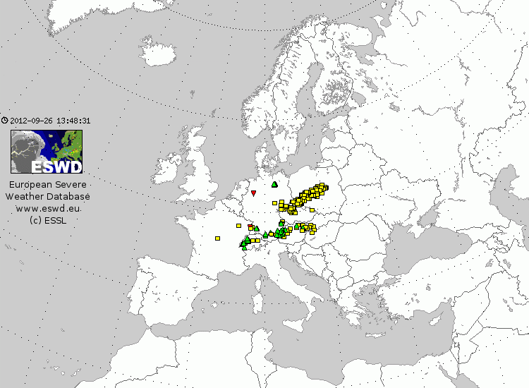
ESWD data and climatology
One can use ESWD data to find out under which atmospheric conditions severe weather occurs
High latent instability (CAPE, J/kg)
Strong 0 – 6 km wind shear
ESWD Reports at this (23 July 2009 1200 UTC)
Yellow: wind, Green: large hail, Red: tornado

Slide 28
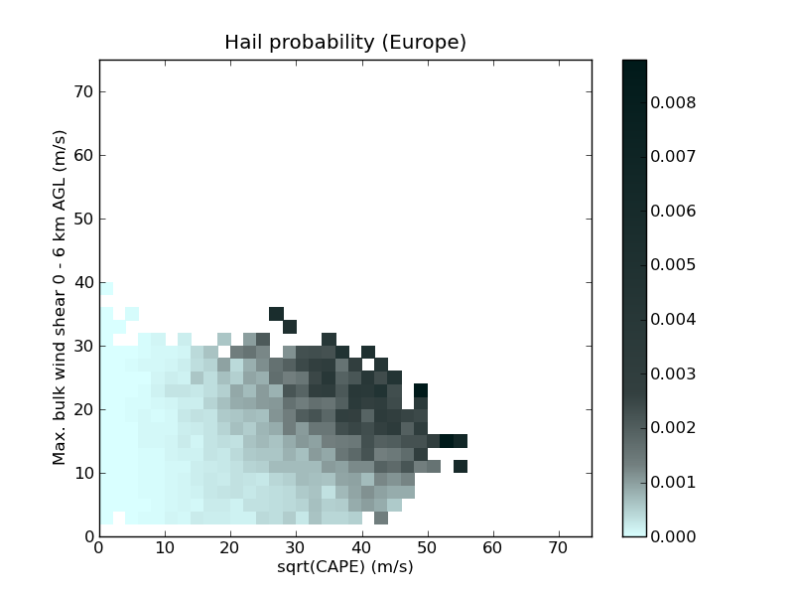
ESWD data and climatology
Project STEPCLIM
Hagel tritt am häufigsten auf bei großer CAPE und starker Windscherung
Probability of large hail (2+ cm) as a function of two parameters, √CAPE and 0 – 6 km AGL wind shear.
Data sources: ECMWF (ERA-Interim 1979-2011) and ESWD

Slide 29
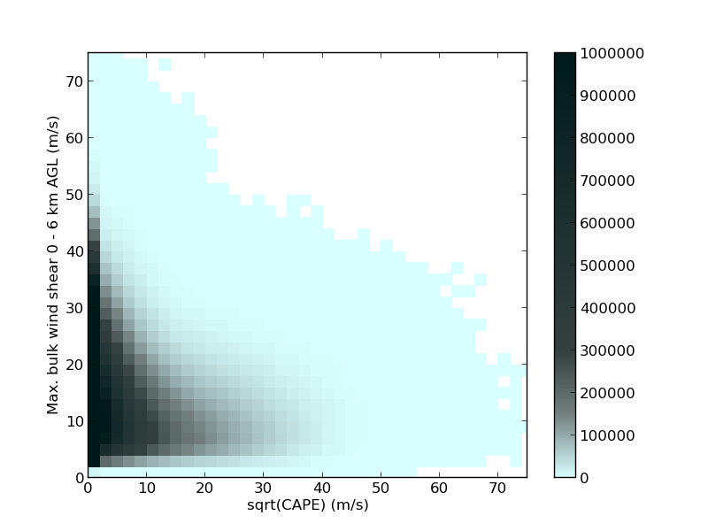
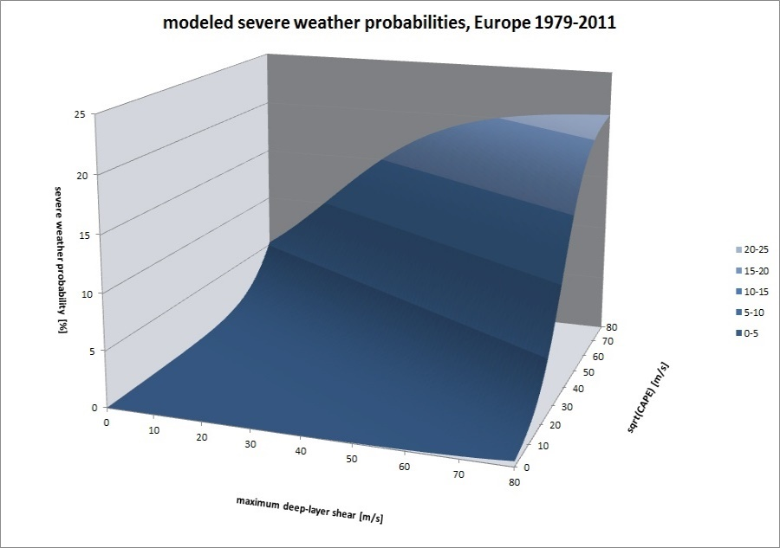
STEPCLIM: Modelling Severe Weather Hazards
f : how frequently does the atmosphere visit a particular area of parameter space?
P_{event} : the probability that severe weather occurrs given that the atmosphere is in a given region of paramater space?
P_event
while the conditional probability P_event remains constant
climatic changes mean this distribution will change
x2 (e.g. shear)
x1 (e.g. CAPE)
(number of severe weather events)
Notes:
29

Slide 30
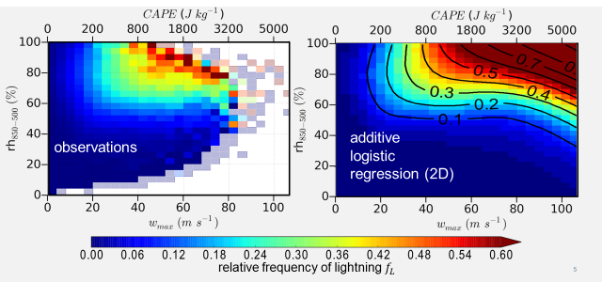
Modelling of conditions leading to lightning or severe weather
From: Anja Westermayer. Project ARCS in collaboration with Munich Re.
Funded by Munich Re and the German Ministry of Education and Research.
30
Large hail (Germany)
Notes:
30

Slide 31
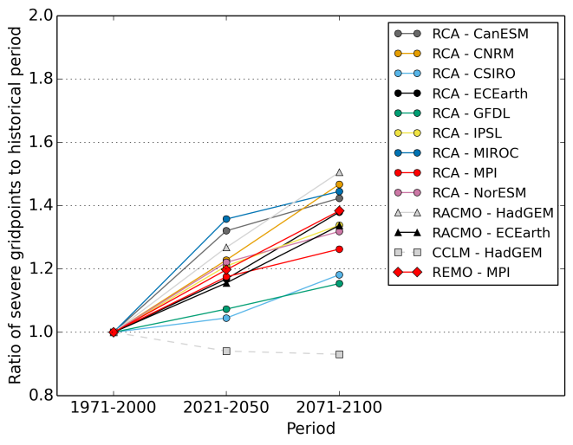
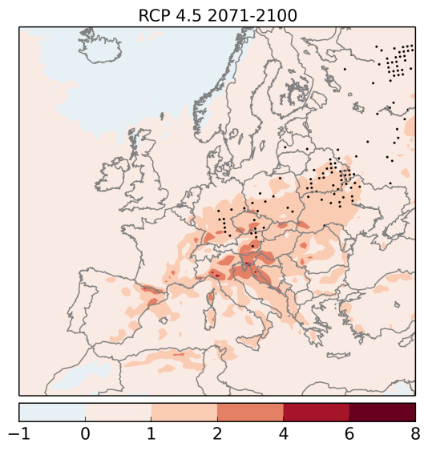
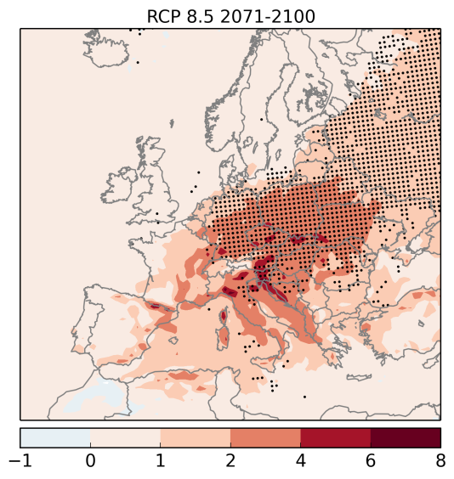
ESSL Research
scenario RCP4.5
Climate research
Number of grid points with strong instability (LI < -2), wind shear (> 15 m/s), and modelled precipitation relative to 1970-2000.
From: Púčik et al (in preparation)

Slide 32
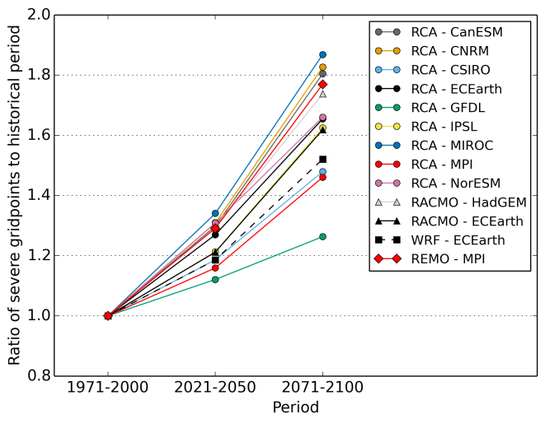
ESSL Research
scenario: RCP4.5
scenario RCP8.5
Climate research
Number of grid points with strong instability (LI < -2), wind shear (> 15 m/s), and modelled precipitation relative to 1970-2000.
From: Púčik et al (in preparation)

Slide 33
ESSL Research
7 Jul 2015 1200 – 1800 UTC EC IFS 00 UTC + 30 h
Forecasting research
Probability of lightning
Probability of wind gust ≥ 25 m/s;
ESWD observations
Probability of hail ≥ 2 cm; ESWD observations
Courtesy Lars Tijssen & Anja Rädler

Slide 34
Uses of the ESWD
Forecast verification
e.g. at weather services, at the Testbed
Monitoring of extreme event occurence
nationally, at weather services
RCC Node-CM RA-VI Regional Climate Centre Offenbach Node on Climate Monitoring
validation of nowcast and forecast methods
satellite, radar, NWP
Risk modelling studies

Slide 35
Part 2: European Storm Forecast Support

Slide 36
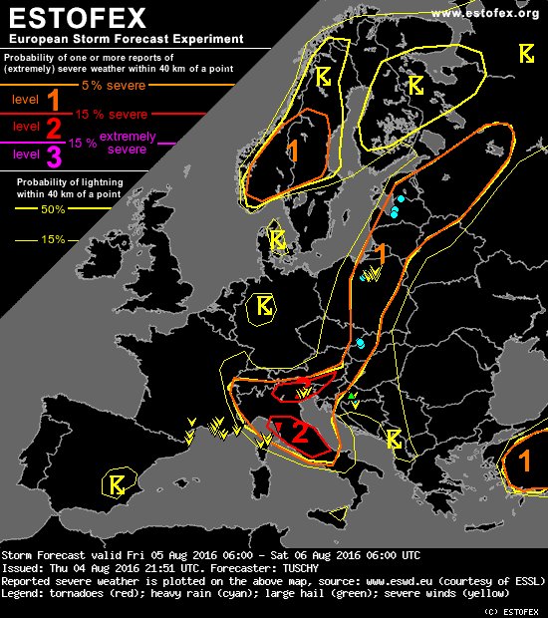
Who knows the European Storm Forecast Experiment?
group of volunteers consisting of Forecasters and researchers provide convective forecasts online since 2002
used as additional information by forecasters of virtually all European NHMS
Example of an ESTOFEX forecast map without the accompanying discussion text.

Slide 37
ESFS – European Storm Forecast Support
Working Group that aims to set up an international effort in improving severe storms forecasting across Europe
EWorking Group
Christoph Gatzen (chair) | PhD student at the University of Cologne
Dr. Harold Brooks | Researcher at National Severe Storms Laboratory, Norman, OK, USA
Helge Tuschy | Forecaster at Deutscher Wetterdienst
Tomáš Púčik | Researcher at European Severe Storms Laboratory, Former forecaster at the Czech and Slovak HydroMeteorological Institutes
Alois M. Holzer (ex officio) | Director of Operations at European Severe Storms Laboratory
Dr. Johannes Dahl | Assistant Professor at Texas Tech University, Lubbock, TX, USA
Marcus Beyer | Forecaster at Deutscher Wetterdienst
Dr. Pieter Groenemeijer (ex officio) | Director at European Severe Storms Laboratory
Dr. Oscar van der Velde | Researcher at Technical University of Catalonia
Example of an ESTOFEX forecast map without the accompanying discussion text.

Slide 38
ESFS – European Storm Forecast Support
Goals:
to produce daily convective forecasts for Europe, similar to ESTOFEX
to develop a framework for the verification of these forecasts
to accommodate communication between ESFS forecasters by periodic teleconferences and a virtual platform for discussion
to compile a document on best practices and other training material in forecasting severe convection
Example of an ESTOFEX forecast map without the accompanying discussion text.

Slide 39
ESFS – European Storm Forecast Support
Benefits:
Availability of a daily forecast of severe storm risk across Europe
to support national forecasts and warnings
Rapid acquisition of experience and skills in forecasting severe convection
through interaction with expert colleagues from other NHMS and ESSL
Example of an ESTOFEX forecast map without the accompanying discussion text.

Slide 40
ESFS – European Storm Forecast Support
Means:
dedicated shifts of forecasters of participating services
online teleconferences
occasional trainings
use of existing ESSL Testbed data display; coordination by ESSL
Example of an ESTOFEX forecast map without the accompanying discussion text.

Slide 41
ESFS – European Storm Forecast Support
Current stage:
building of critical mass of interested weather services
first expressions of interest from: MeteoSwiss, FMI, SHMI, IMGW
contact me to receive the document describing initiative
Example of an ESTOFEX forecast map without the accompanying discussion text.

Slide 42
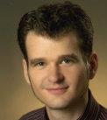
ESSL Training activities
ESSL Research and Training Centre
Wiener Neustadt, Austria
Seminars:
Forecasting Severe Convection I
by Tomas Pucik (ESSL) – 12 - 16 June 2017
Forecasting Severe Convection II
by Prof. Johannes Dahl (Texas Tech University) 2 - 6 October 2017
Introduction to ingredients-based Forecasting of Severe Convection
by Dr. Charles Doswell III 23 Sep. 2017, side event of ECSS conference in Pula, Croatia
ESSL Summer school on severe convection
several speakers, 28 – 1 Sep 2017

Slide 43
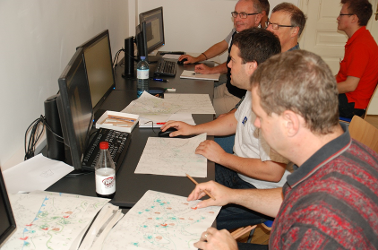
ESSL Testbed
Testbed partners:
Goals:
Train Europe’s forecasters with regard to severe convective weather forecasting
Evaluate new forecast-supporting products

Slide 44
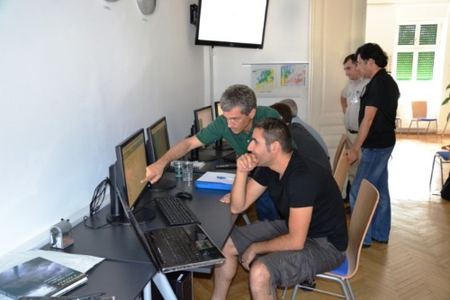
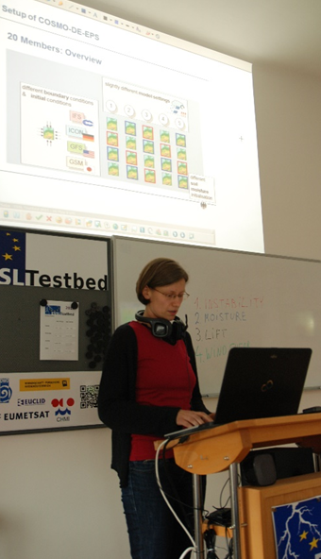
ESSL Testbed
Next edition:
5 June – 7 July 2017
Wiener Neustadt, Austria

Slide 45
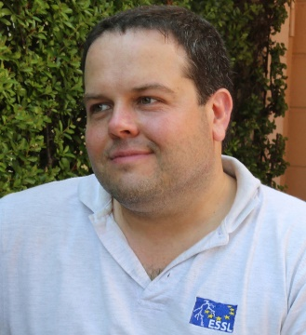
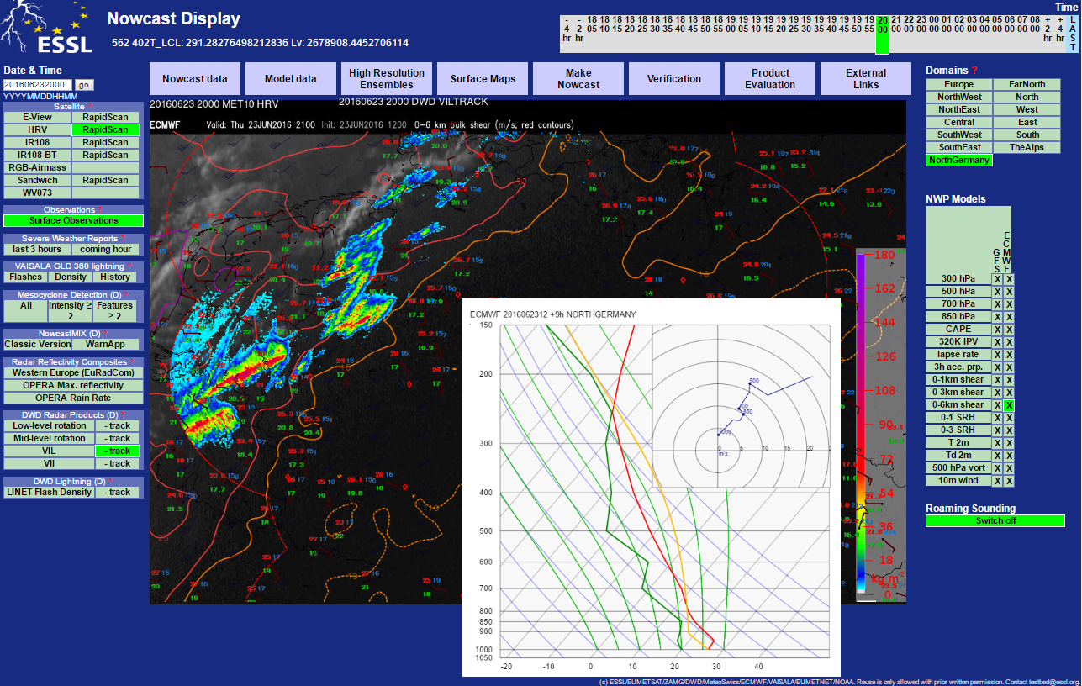
ESSL Trainings on-site
In response to numerous requests...
ESSL will offer trainings at NHMS locations starting in 2017, using the Testbed web-interface
ESSL trainers:
Alois M. Holzer Tomáš Púčik

Slide 46
ESSL Membership
ESSL would welcome additional NHMS members
Benefits:
full access to ESWD database; right to perform quality control
ESSL General Assembly
reduced participation fees for workshops, seminars, testbed and ECSS conference
regular updates on ESSL projects
Fee: depending on nominal GDP per capita, size of organization (€ 100 – 1200 per year for SEE NHMS)

Slide 47
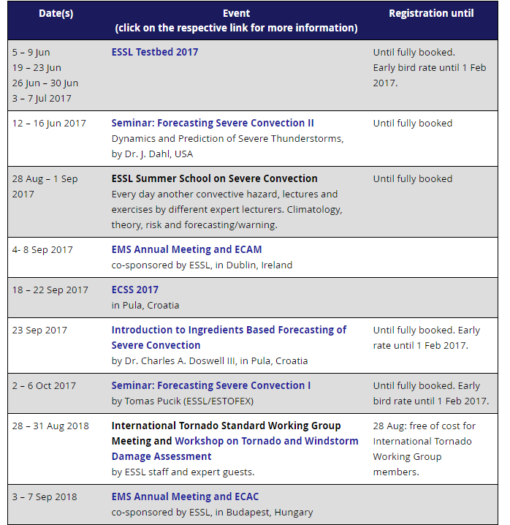
www.essl.org
information on membership
upcoming event calendar
latest news
link to ESWD

Slide 48
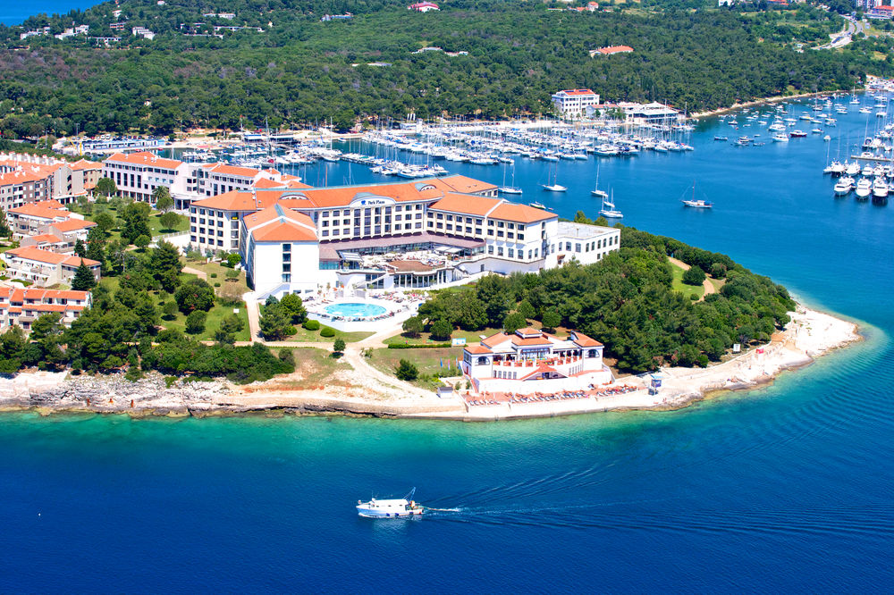
ECSS2017 European Conference on Severe Storms 18-22 September 2017 in Pula, Croatia
Topics include:
forecasting
nowcasting
radar
satellite
impacts
climate studies
storm dynamics
flash floods
in cooperation with:
Meteorological and Hydrological Service of Croatia
For questions about ESSL, ESWD, trainings, or the conference contact me at: inflow@essl.org

Slide 49
Extra slides

Slide 50
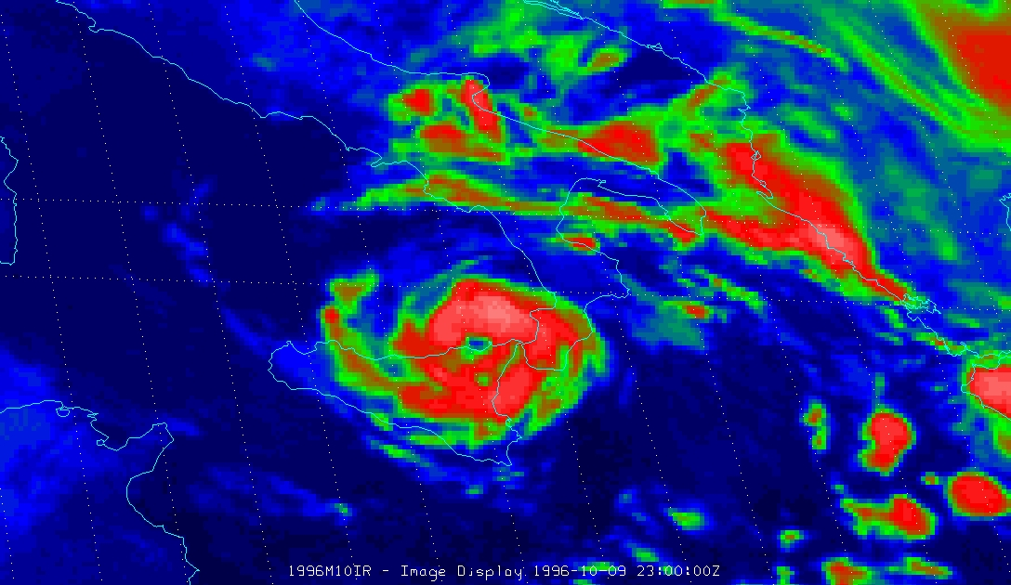
(Sub-)tropical cyclones near Europe
Hurricane-like systems occur occasionally over the Mediterranean and Black Sea, and the eastern Atlantic.
Maximal Potential Intensity (Emanuel 1998)
SST
outflow T
central pressure
To (° C)
“Enhanced” IR image
10 Oct 1996 00 UTC (EUMETSAT)
18 16
14 987 hPa

Slide 51
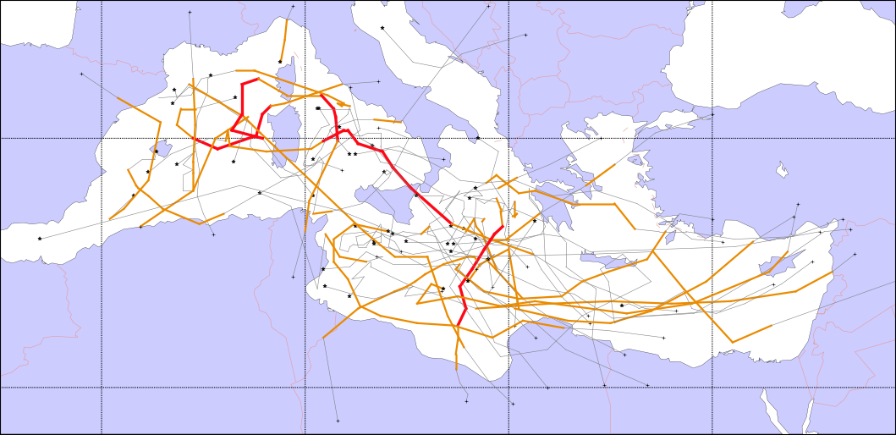
(Sub-)tropical cyclones near Europe
ESSL has established the first systematic study to derive a climatology using METEOSAT-Data from 1982 – 2006.
All tropical and subtropical cyclones 1982 – 2006 across the Mediterranean Sea:
16 (Sub-)tropical depressions 27 (Sub-) tropical storms 4 Hurricanes

Slide 52
Assessment of an historical tornado
Historical
Tornado cases in Europe
Pforzheim (D), 10. Juli 1968
Palluel (F), 24. Juni 1967
ESSL studied this case in detail
Wiener Neustadt (A), 10 July 1916, F4, 35 fatalities, fourth-deadliest in EU
Wiener Neustadt (A), 10. Juli 1916
Neede (NL), 1. Juni 1927
Large hail (Germany)
Notes:
52

Slide 53
Procedure
Training by Researchers & Devlopers and by forecasting experts from Europe and overseas (e.g. NOAA Storm Prediction Center, National Severe Storms Laboratory)
Participants jointly make forecasts and nowcasts
Forecasts are verified against observations
Products are evaluated
Discussion
Testbed Blog
Questionnaires
Notes:
53

Slide 54
Procedure
Participants jointly make forecasts and nowcasts
Forecasts are verified against observations
Products are evaluated
Discussion
Testbed Blog
Questionnaires
Forecast for the next day (coloured lines) with verification data (symbols reflect severe weather reports, magenta = lightning).
Notes:
54

Slide 55
ESSL Testbed
We work with new experimental and operational NWP-, radar-, satellite- and remote sensing products
Notes:
55

Slide 56
ESSL Testbed
We work with new experimental and operational NWP-, radar-, satellite- and remote sensing products
Notes:
56

Slide 57
ESSL Testbed
We work with new experimental and operational NWP-, radar-, satellite- and remote sensing products
Notes:
57

Slide 58
ESSL Testbed
We work with new experimental and operational NWP-, radar-, satellite- and remote sensing products
Notes:
58

Slide 59
ESSL Testbed
We work with new experimental and operational NWP-, radar-, satellite- and remote sensing products
Notes:
59

Slide 60
ESSL Testbed
5 editions since 2016
over 200 unique participants from 29 countries
average grade on a 0-10 scale: 9.1
Number of participants per country
(2012-2015)
Notes:
60

Slide 61
ESSL Trainings on-site
ESSL plans to offer trainings at NHMS locations starting in 2017, using the testbed web-interface
ESSL trainers:
Alois M. Holzer Tomáš Púčik

