Slide 1
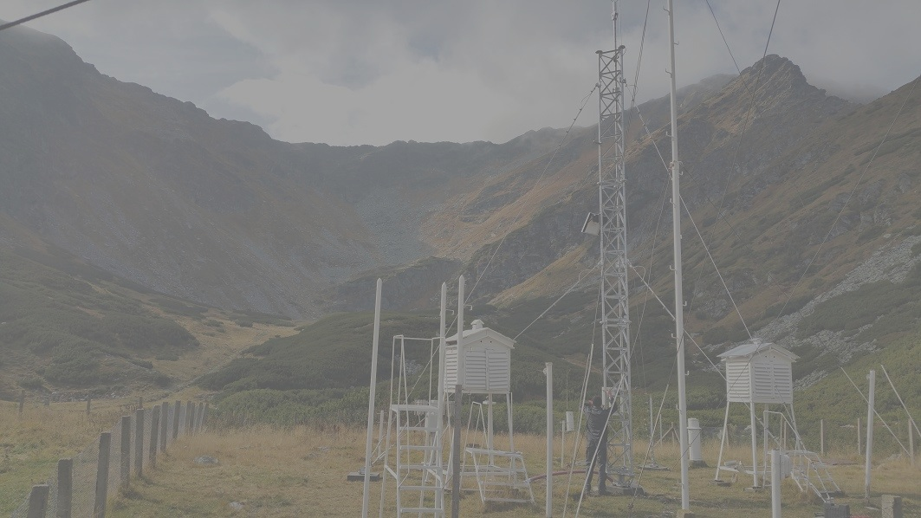
INFORMAL CONFERENCE
OF SOUTH-EAST
EUROPE
DIRECTORS
ICSEED principles

Slide 2
Art 1. ICSEED is acting as a sub-regional informal body/assembly with the main purpose to enhance cooperation and contacts in the field of meteorology, hydrology and related disciplines;
Art 2. ICSEED is established on voluntary and mutual basis by the south east European NMSs / NMHSs Directors;
Art 3. ICSEED aims at facilitating, promoting and strengthening professional sub-regional relationships, capacity building, expertise and technology transfers;

Slide 3
Art 4. ICSEED is an instrument of common progress and integration to the European structures;
Art 5. ICSEED cooperates in order to minimize individual NMSs / NMHSs effort and optimize common progress;
Art 6. ICSEED is considering the principle of equality, mutual support while respecting individual member decisions;
Art 7. ICSEED is guided according to the WMO regulations and acting under each of the partners national laws;

Slide 4
Art 8. ICSEED should maintain permanent contact with WMO sub-regional Office for Europe;
Art 9. ICSEED principally operates its activities by its own resources including WMO and other technical and financial support when appropriate;
Art 10. ICSEED meetings are, in principle, taking place once a year and are organized in turn by each member. The meeting place and time should be established by consensus. The meeting agenda and other documentation should be prepared by the host country taking into account the other countries’ proposals;

Slide 5
Art 11. ICSEED is open to meet other countries which share the program for development of meteorological and hydrological activities;
Art 12. ICSEED can establish Ad Hoc Groups for the common activities and projects;
Art 13. ICSEED meeting is chairing by the host country NMSs / NMHSs Director appointed by the ICSEED members at the beginning of meeting;
Art 14. ICSEED Chairman is also taking care of the completion of the ICSEED decisions between the two ICSEED meetings. In addition, the Chairman is preparing and presenting the results at the following ICSEED meeting.

