Slide 1
LOOKING AHEAD NEXT TEN YEAR STRATEGY FOR ECMWF
Prof. Florian Pappenberger
Director of Forecasts

Slide 2
THE STRENGTH OF A COMMON GOAL
ECMWF’s purpose is to develop a capability for medium-range weather forecasting and to provide such weather forecasts to the Member and Co-operating States
ECMWF is complementary to the National Meteorological Services and works with them in research, numerical weather predictions, supercomputing and training.

Slide 3
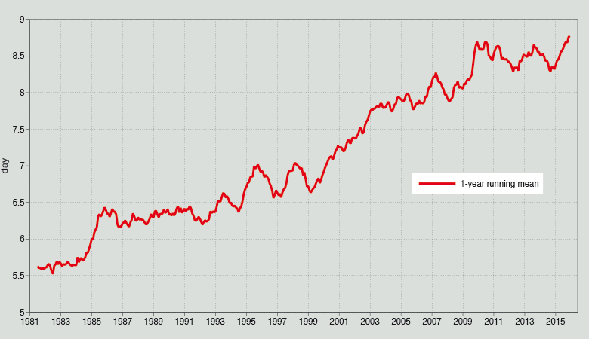
ECMWF forecast quality improvement Day when NH 500 hPa anomaly correlation drops below 60%

Slide 4
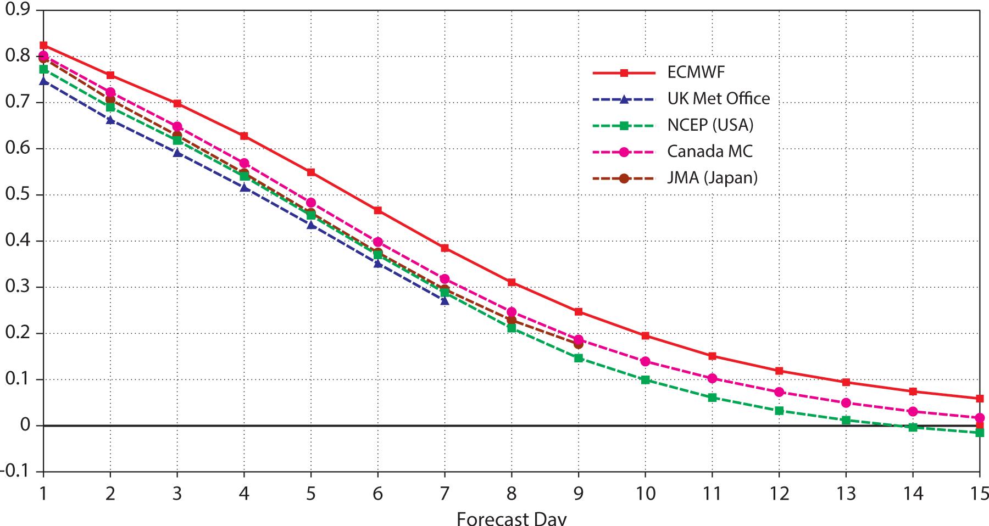
THE STRENGTH OF A COMMON GOAL
Verification of the Ensemble prediction skill
Verification of the Ensemble prediction skill over the past twelve months illustrating ECMWF’s performance against other global centres. Higher values mean better skill, with 1 representing perfect forecasts.
It is worth noting that not all centres produce their ensemble forecast to two weeks.

Slide 5
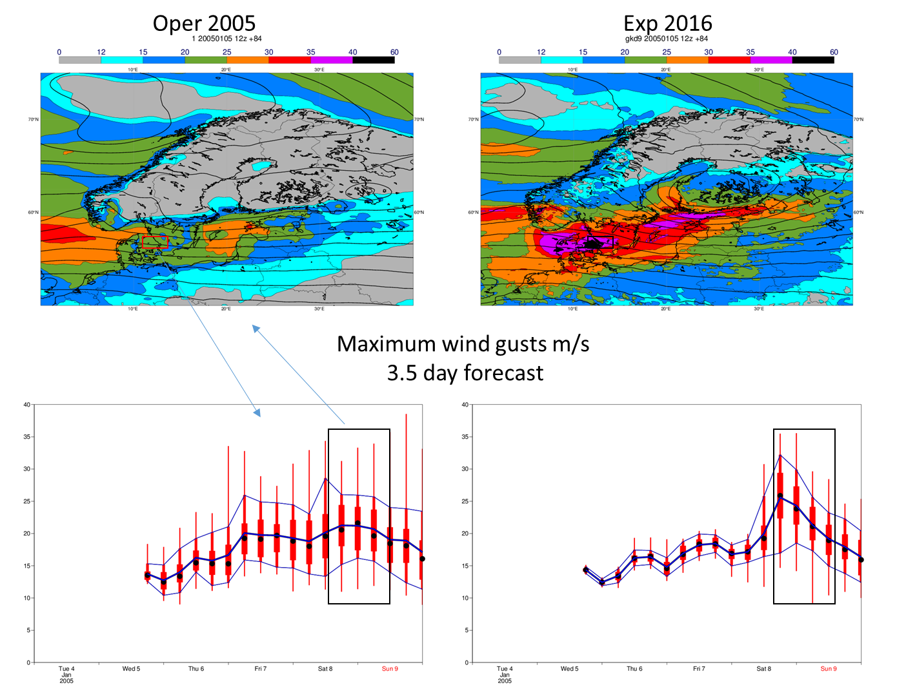
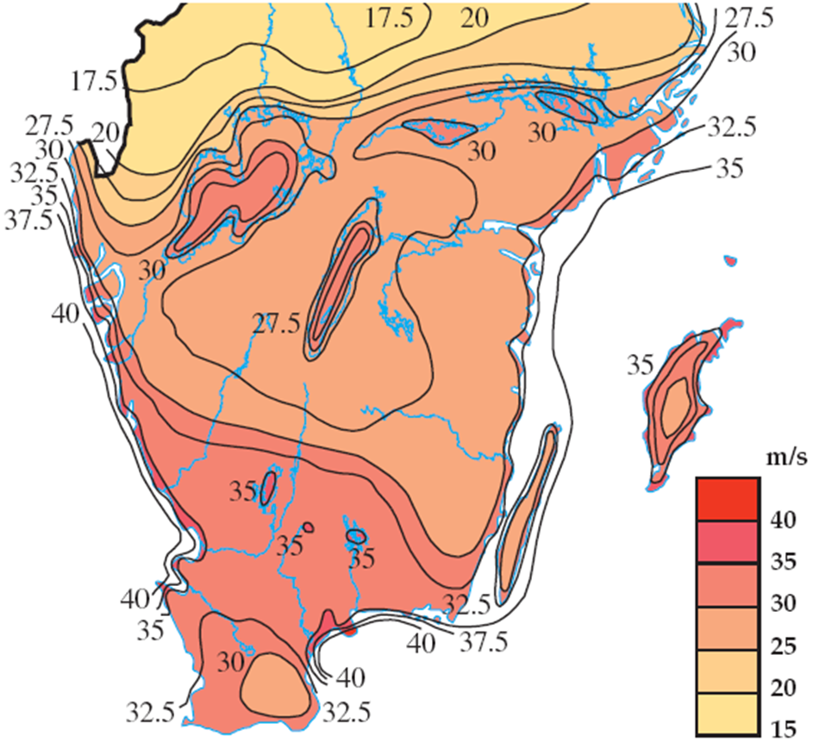
Gudrun storm – example from 9 January 2005
Wind gusts from SMHI observations

Slide 6
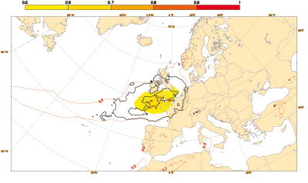
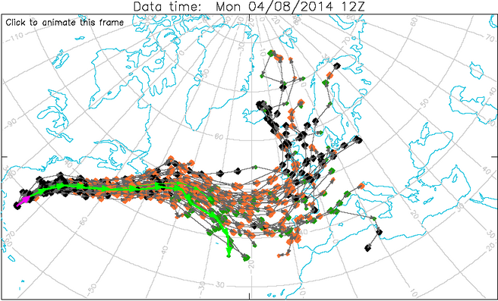
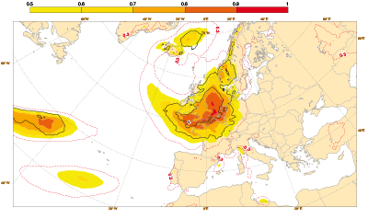
THE STRENGTH OF A COMMON GOAL
The size of the challenge # 1
The difficulty: Sharp ensembles two weeks ahead
Severe weather: Hurricane Bertha
6-9 days
2-5 days

Slide 7
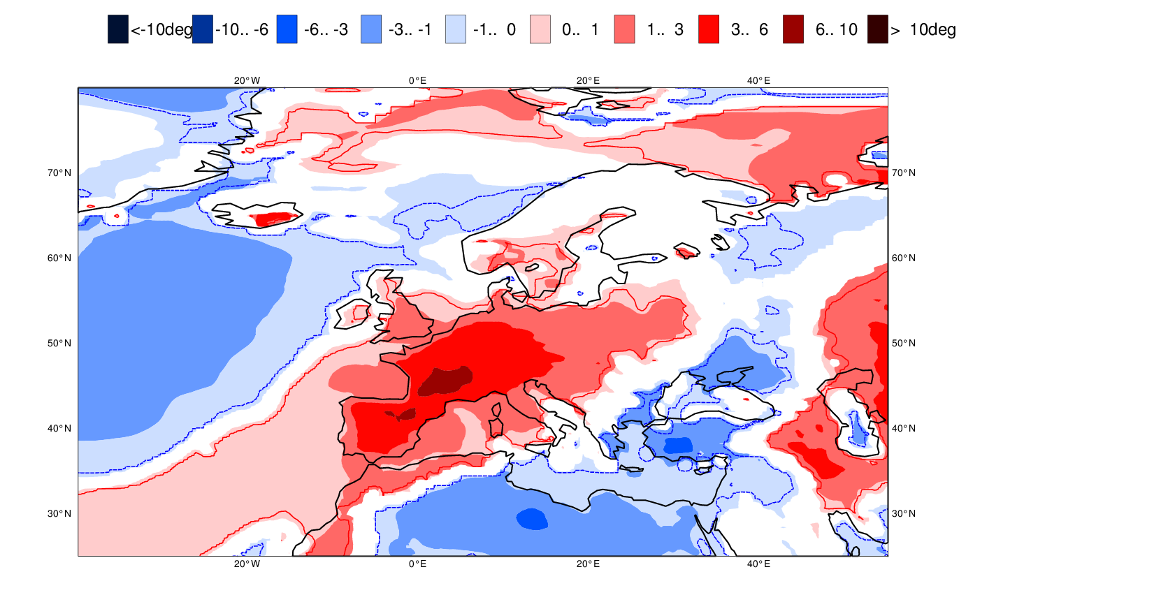
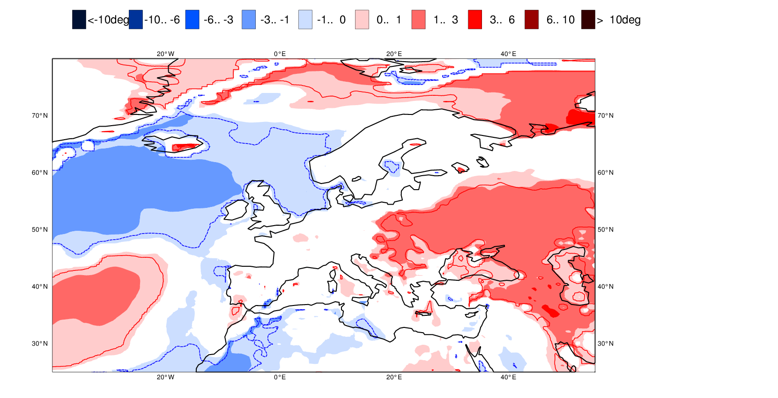
THE STRENGTH OF A COMMON GOAL
The size of the challenge # 2
Forecast week 1.5
European heat wave
29 June – 5 July 2015
Forecast week 2.5

Slide 8
THE STRENGTH OF A COMMON GOAL
Forecast targets by 2025
Ensemble predictions of high impact weather up to two weeks ahead
Seamless approach, aiming towards predictions of large scale patterns and regime transitions up to four weeks ahead and global-scale anomalies up to a year ahead

Slide 9
THE STRENGTH OF A COMMON GOAL
Goals
Research at frontiers of knowledge
Ensemble-based analyses and predictions that raise the international bar for quality and operational reliability

Slide 10
THE STRENGTH OF A COMMON GOAL
How do we achieve these goals?
Observations
High resolution ensemble
Earth-system
Scalability
Funding
People

Slide 11
THE STRENGTH OF A COMMON GOAL
Collaboration
Partnering with universities and research institutes –OpenIFS
Strategic partnerships in Earth observation
Pooling expertise to improve scalability of data assimilation
Providing collaborative data bases
Regional modelling co-operation

Slide 12
THE STRENGTH OF A COMMON GOAL
ECMWF will continue to provide:
Dedicated HPC, software, and data resources for Member States
Environmental information
Advanced training

Slide 13
THE STRENGTH OF A COMMON GOAL
In summary
Operational forecasts AND Research
High-impact weather, regime transitions and global-scale anomalies
Integrated ensemble at high resolution
Earth-System model at all time-ranges
Scalable computation
Environmental information services: Copernicus

