Slide 1


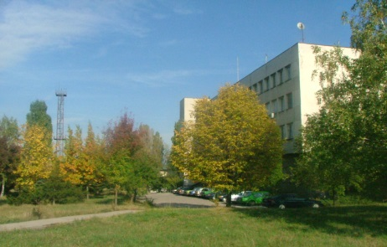
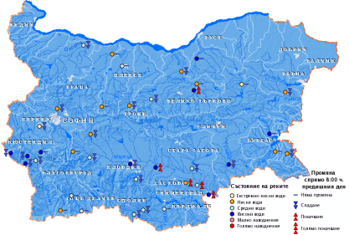
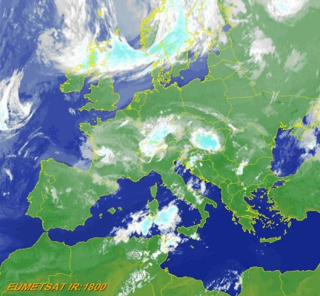

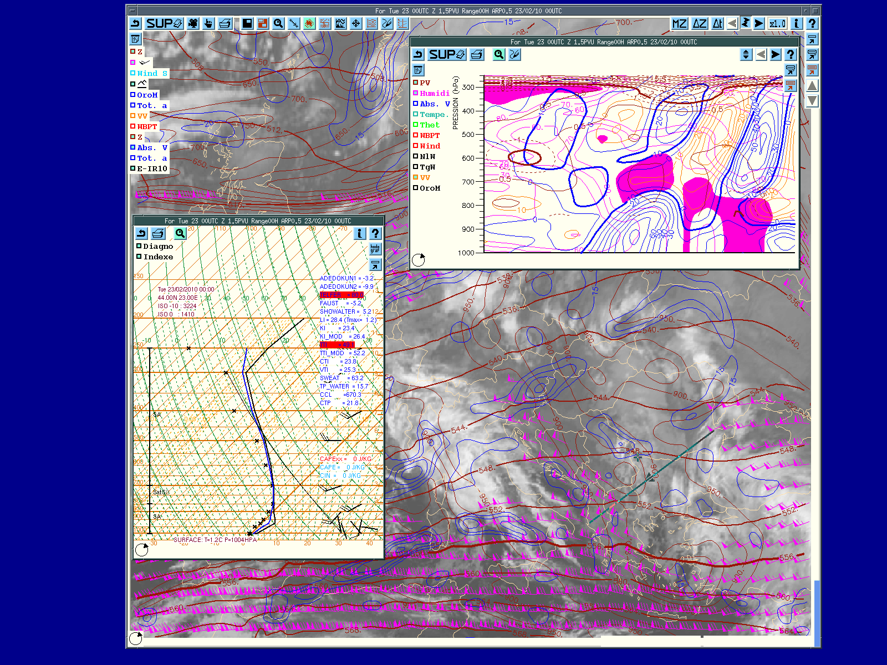
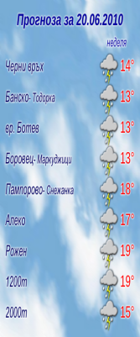
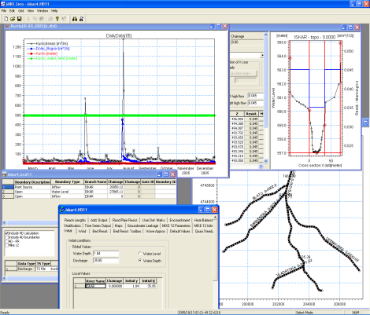
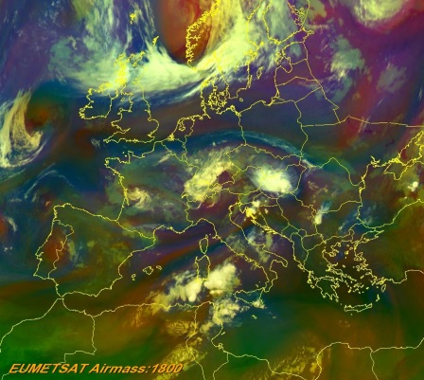
National Institute of Meteorology and Hydrology
Bulgarian Academy of Sciences
Structure and Activities of the National Institute of Meteorology and Hydrology of Bulgaria
15th Session of the Informal Conference of South-East European NMHSs Directors (ICSEED), 6-7 October 2016, Zagreb, Croatia

Slide 2
National Institute of Meteorology and Hydrology – BAS
HISTORY IN DATES
1860 First instrumental meteorological measurements started in the city of Ruse;
1870 First hydrological station on the Danube River near Ruse began to work for the purposes of navigation;
1887 The first meteorological station (MS) in Sofia started regular meteorological observations;
20 Feb 1890 MS in Sofia became the Central MS (birthday of the Bulgarian Meteorological Service);
1894 Direction of Meteorology at the Ministry of Enlightenment was established;
1934 The Direction of Meteorology was renamed to Central Meteorological Institute;
1920 Organized hydrological observations began in Bulgaria carried out by the Service of Water at the Ministry of Agriculture and State Property;
1950 Hydrological and meteorological (HM) activities were merged into a single HM Service at the Bulgarian Council of Ministers (CM);
1954 Research Institute of Hydrology and Meteorology (RIHM) was created to provide scientific background of this important national institution;
1962 Administration of Hydrology and Meteorology (AHM) together with RIHM transferred to BAS. AHM became Main AHM (MAHM) on 07/01/1977;
1989 MAHM and RIHM united forming the Institute of Meteorology and Hydrology (IMH) with a resolution of the Council of Ministers (CM);
1991 IMH was renamed to National Institute of Meteorology and Hydrology (NIMH) at BAS again with a resolution from the CM.
15th Session of the Informal Conference of South-East European NMHSs Directors (ICSEED), 6-7 October 2016, Zagreb, Croatia

Slide 3
National Institute of Meteorology and Hydrology – BAS
The National Institute of Meteorology and Hydrology at the Bulgarian Academy of Sciences (NIMH-BAS) conducts scientific and applied research and operational activities in the field of meteorology, agrometeorology, hydrology, management and use of water resources.
NIMH-BAS has the obligations of the National Hydrometeorological Service of the Republic of Bulgaria.
NIMH-BAS represents the Republic of Bulgaria in the World Meteorological Organization, UNESCO and in other international organizations in accordance with intergovernmental agreements.

Slide 4
National Institute of Meteorology and Hydrology – BAS
Departments
Governing Body
Sectors
Meteorology
- Climatology
- Agrometeorology
- Meteorological Database
- Applied Meteorology
- Modeling of Atmospheric Pollution
Director
Deputy Director
Director of Operational Activities
Scientific Secretary
Director of Financial, Economic and Administrative Activities
Measurements, Metrology and Information Technologies
Financial and Accounting Sector
Hydrology
- Surface and Groundwater
- Water resources research
- Hydraulics of Water Systems
- Sediments and morphology of rivers
- Operational Analysis and Development
- Technical Support of hydrological
facilities and monitoring stations
- Hydrological Database
NIMH-BAS Branches
NIMH-BAS
Branch Varna
Collective Management Bodies
NIMH-BAS
Branch Kyustendil
Forecasts and Information Services
- Meteorological Forecasts
- Hydrological Forecasts
- Remote Sensing
- Marine Forecasts
- Numerical Modeling
- HM Information Services
General Assembly of Scientists
NIMH-BAS
Branch Pleven
Scientific Council
NIMH-BAS – Branch Plovdiv

Slide 5
Main priorities of NIMH-BAS
Validation and optimization of the observation networks, development and optimization of the equipment and methods for observation, data processing and interpretation, data transmission.
Assessment of the hydrometeorological (climatic, agroclimatic and water) resources, their variability over the territory of the country and their utilization in different sectors of the national economy.
Improvement of the methods for short and medium range forecasts of hydrometeorological processes with application of modern tools such as satellite and radar observations, local numerical forecasts and their wider use in the preparation of specialized forecasts in cases of natural disasters and industrial accidents.

Slide 6
Main priorities of NIMH-BAS
Atmospheric processes and climate variability, development of methods for long range weather forecasting.
Cloud physics and aerological studies.
Composition and changes of natural and anthropogenic origin in the atmosphere and hydrosphere at different scales, study and modeling of the pollutant transport processes.
Management and planning of water resources utilization, methods and tools for their protection as a part of the environment.
Utilization and management of water in river basins.
Management of water resource systems; hydraulic and hydrophysical problems of water systems.

Slide 7
The National observing system of NIMH-BAS is part of the WMO Integrated Global Observing System (WIGOS)
Ground stations
Synoptic (37), climatological (86), precipitation (253)
Agrometeorological (28)
Hydrometric (198) и hydrogeological (337 wells and 109 sprigs)
Monitoring of precipitation chemistry (34)
Measuring of solar radiation components (4)
automatic meteorological and hydrological (over 150)
Coastal boundary layer station (Acoustic remote measurements/ SODAR) - (1)
Aerological measurements
Daily measurement of vertical profiles of meteorological elements up to a height of 25 km by radiosondes.

Slide 8
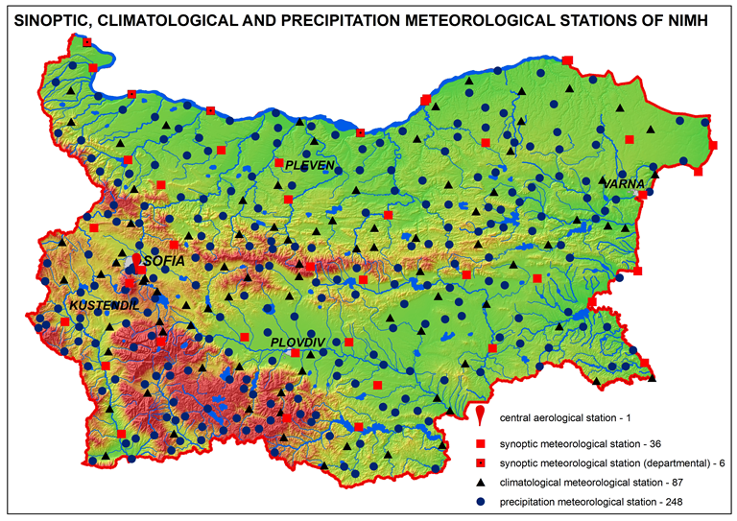
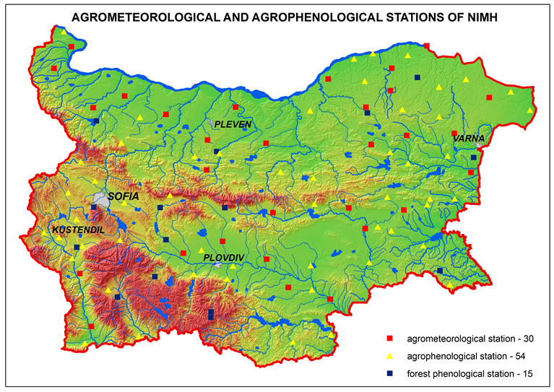
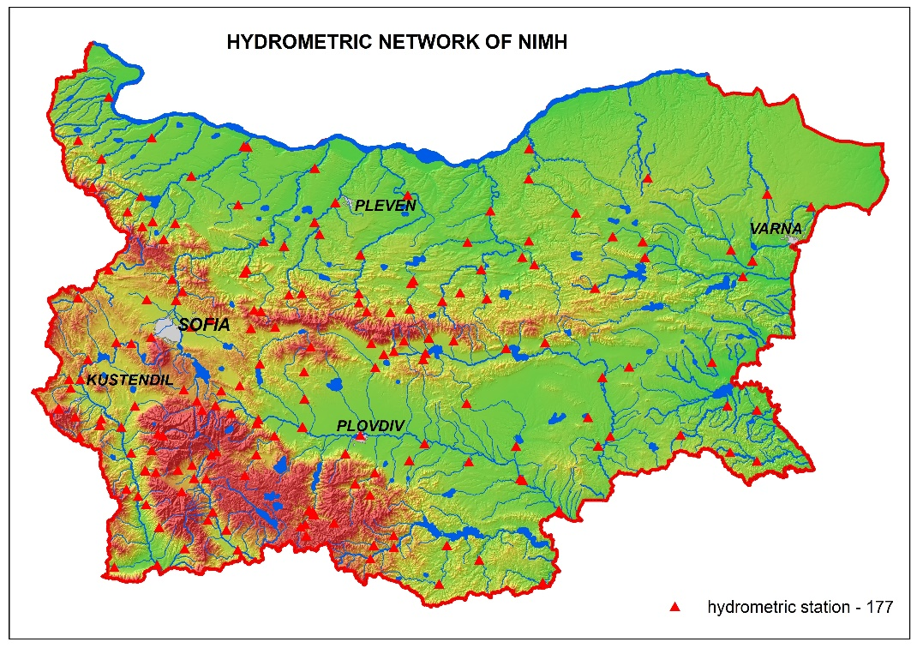
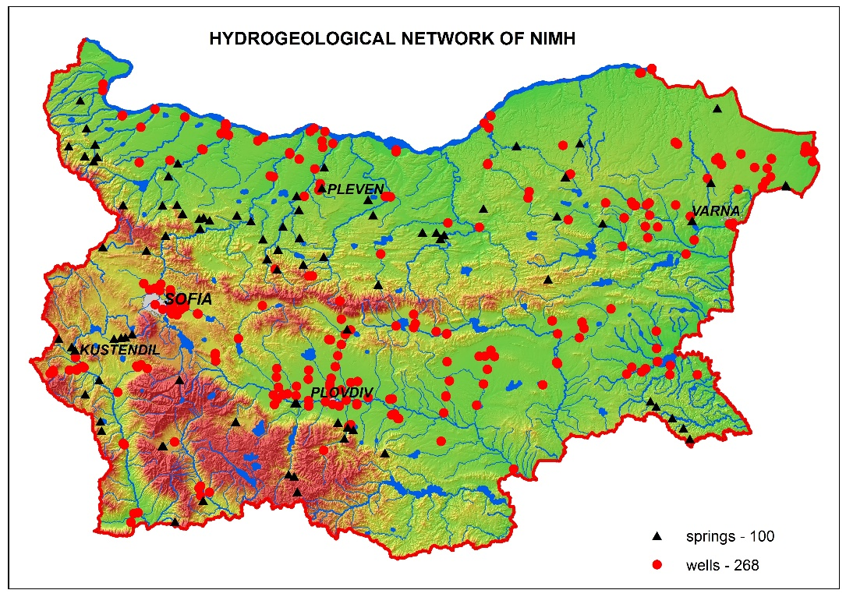

Slide 9
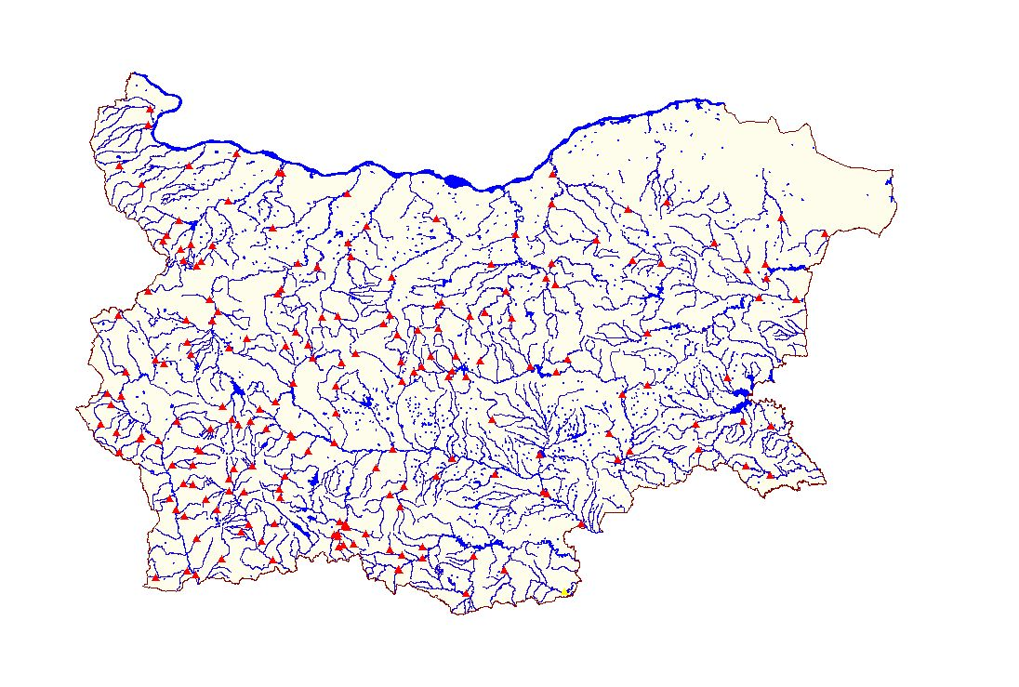
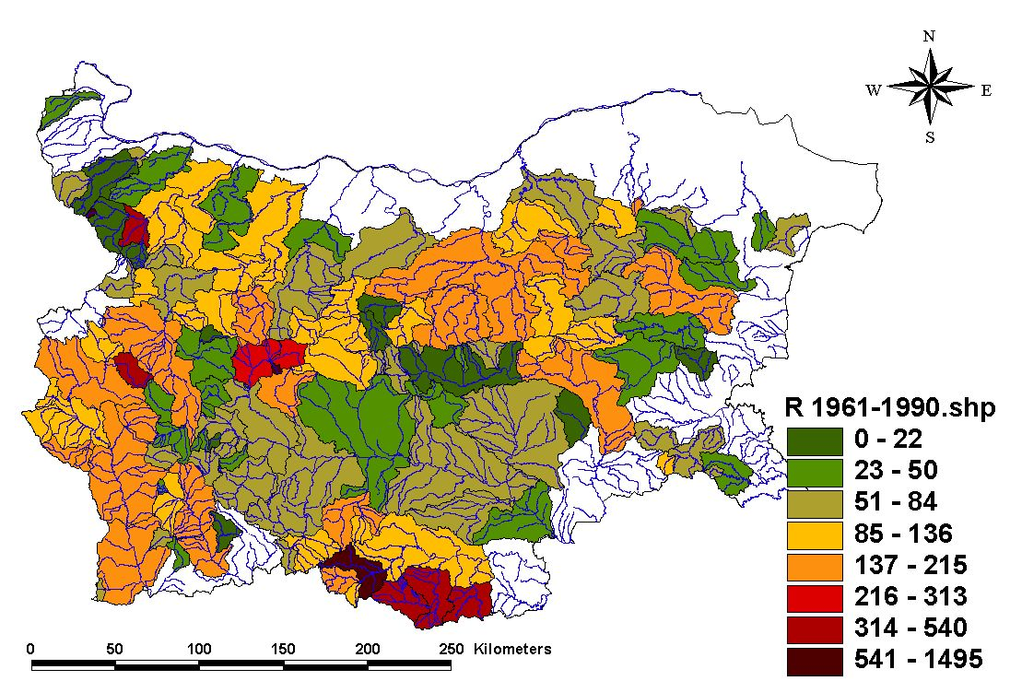
Suspended sediment network and specific sediment runoff

Slide 10
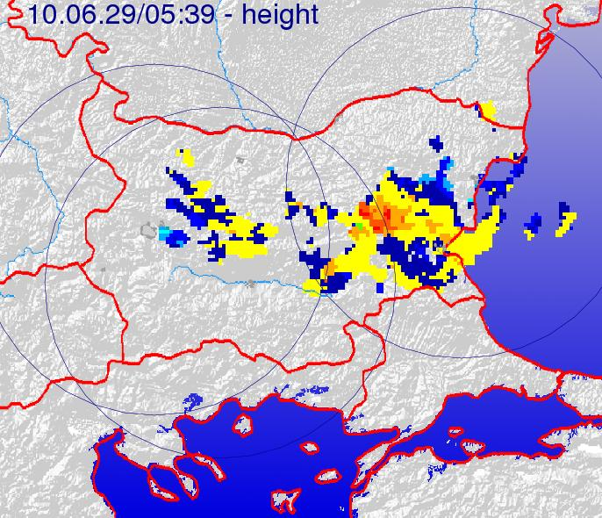
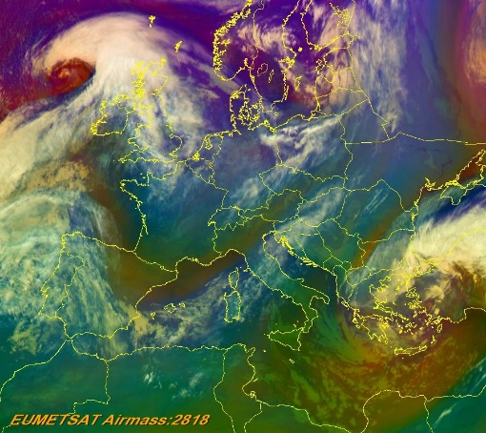
Satellite information
The "real time" information is obtained from meteorological satellites of EUMETSAT, used in operative activities of the short-term weather forecast and the condition of the ground surface for warnings about hazardous weather phenomena and dangerous events.
Radar measurements
Radar network with five meteorological radars (managed by the Bulgarian Air Traffic Services Authority and Hail protection services)
Coverage of radar network

Slide 11
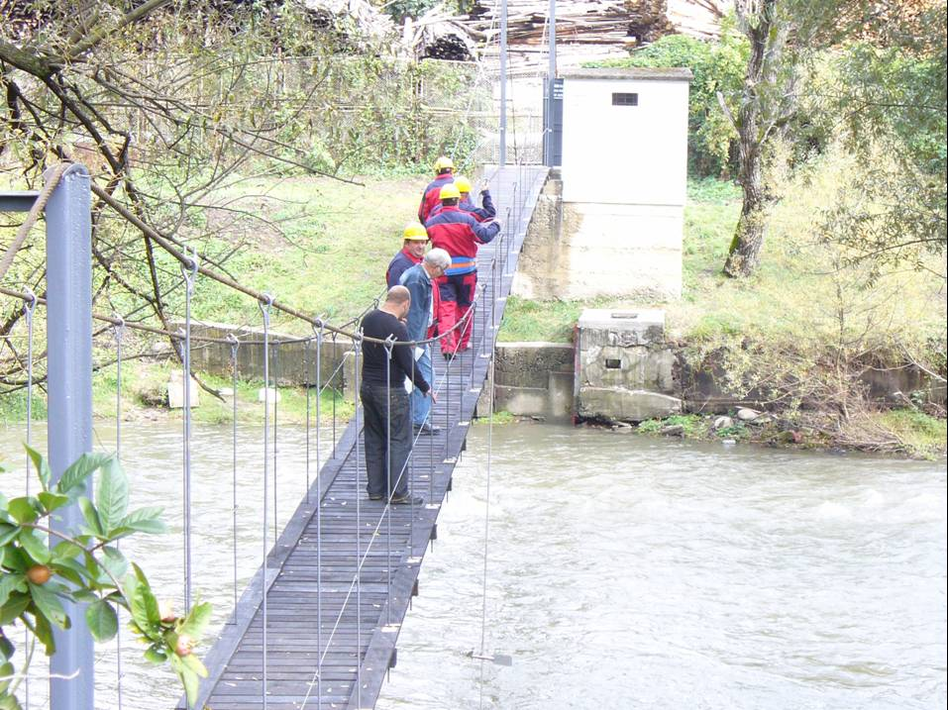
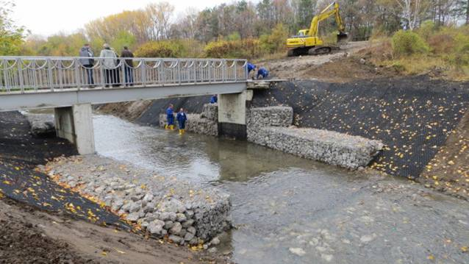
Properly set the places of the stations
Then the monitoring sites should be properly chosen and equipped with the necessary monitoring devices.

Slide 12
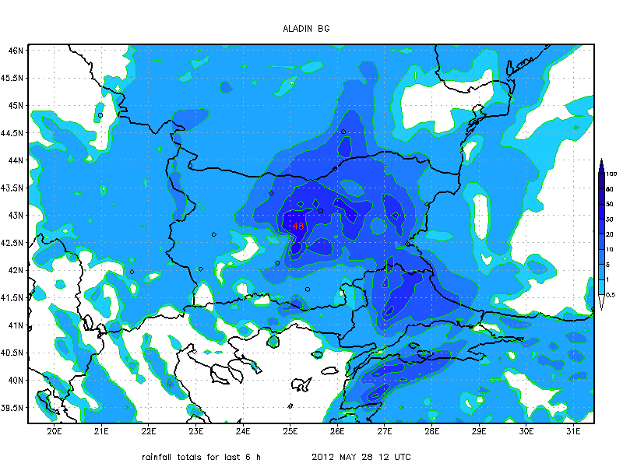
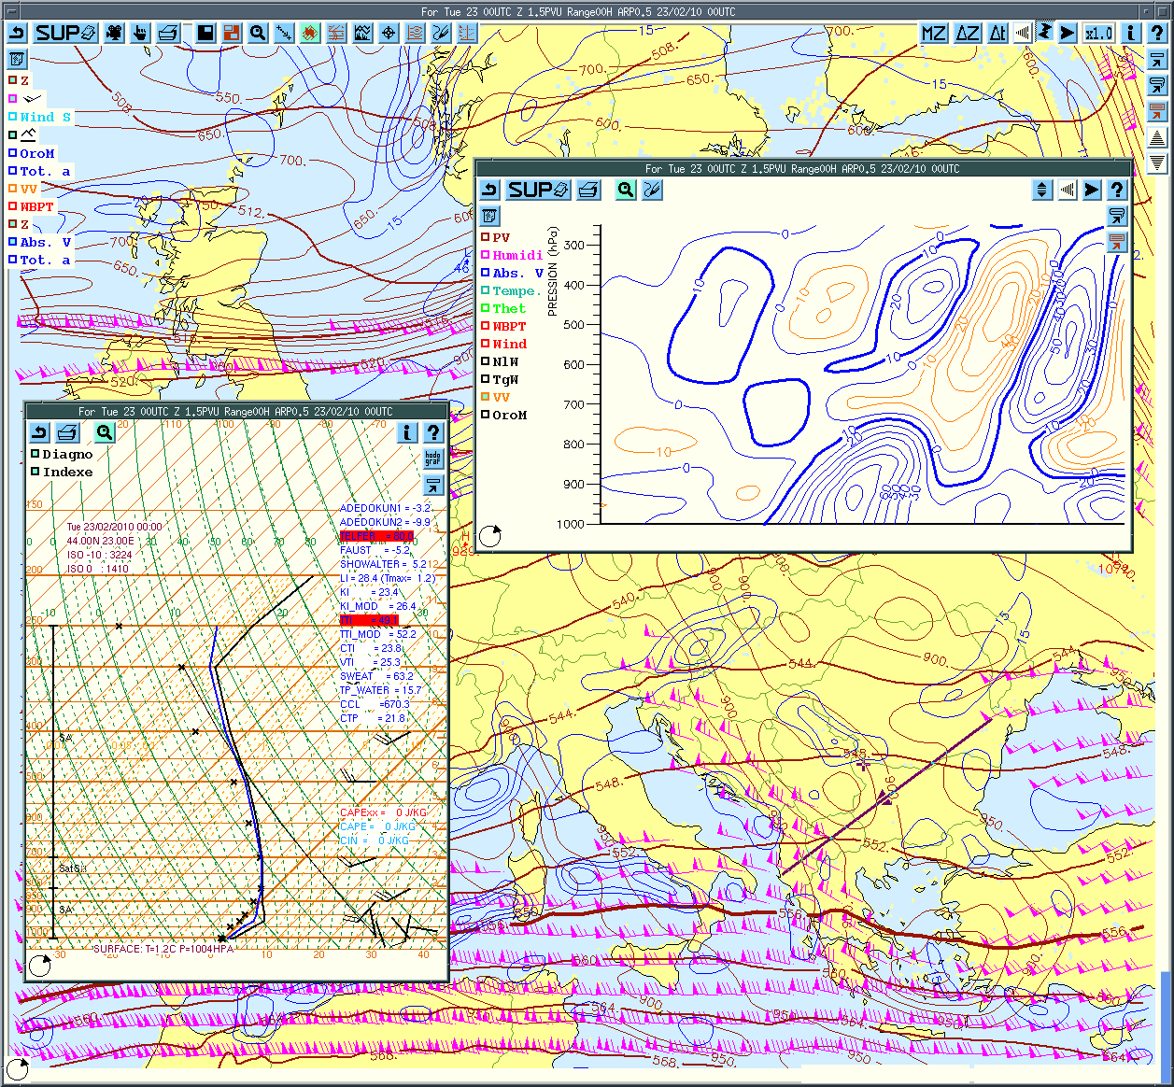
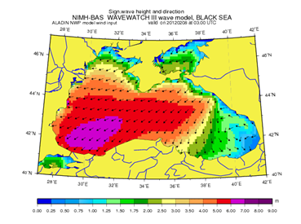
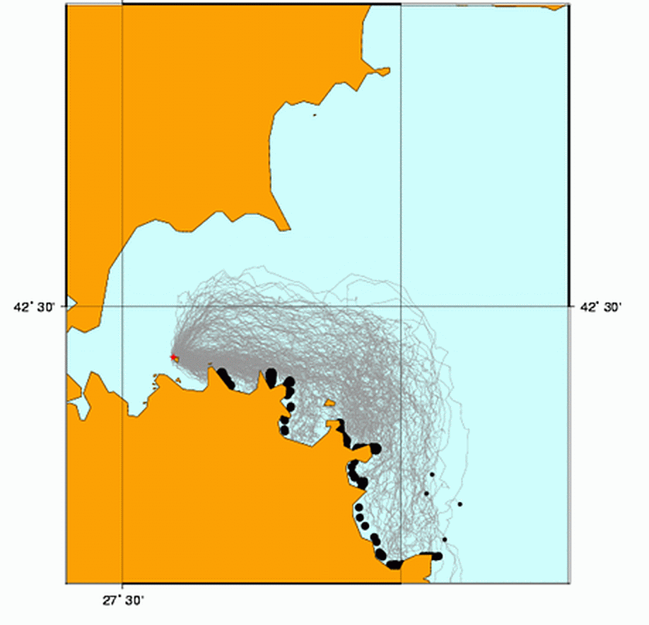
ALADIN model is the major forecasting tool in the NIMH, the production has its basis in a line of early warning systems
SYNERGIE system is a valuable tool in the work of forecaster
Field of significant wave heights. Forecast 08.02.2012 03:00 am. Universal Time (5:00 Bulgarian);model WAVEWATCH III (NCEP / NOAA).
Forecast of distribution of emergency oil spill in the Gulf of Burgas -numerical simulation model MOTHY (METEO_FRANCE).

Slide 13
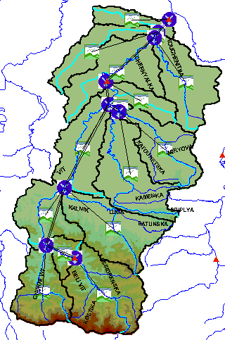
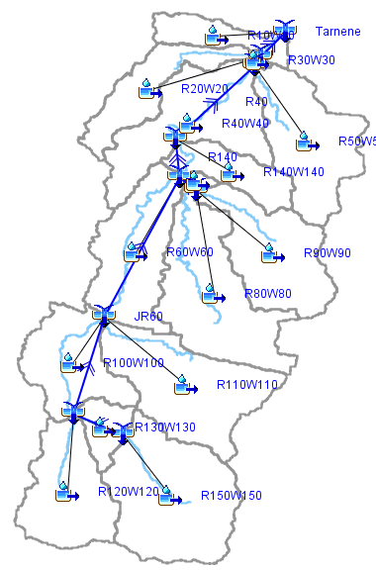
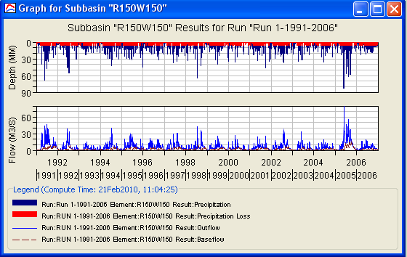
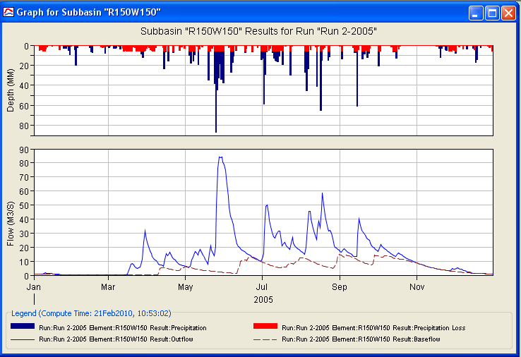
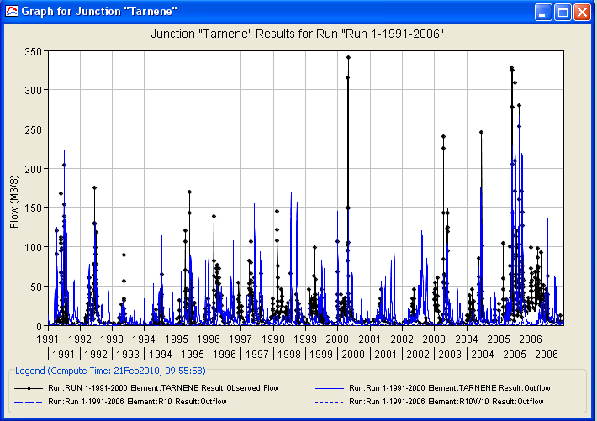
Hydrological modeling using HEC-HMS model (Vit river) to restored missing high waves

Slide 14
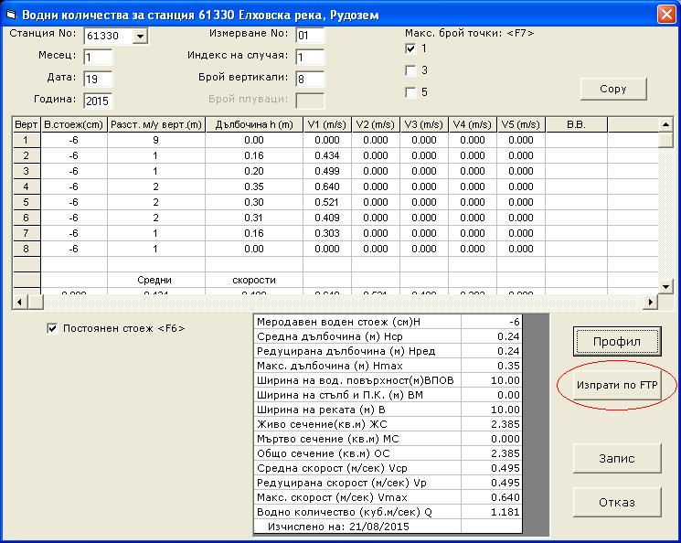
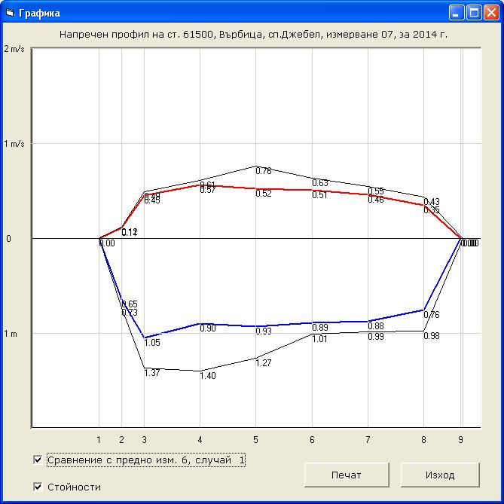
HYDRA
HYDRA calculates the average daily minimum and maximum level of position levels that match the month.
HYDRA calculates the corresponding water quantity method speed - area and typical dynamic and geometrical characteristics in Alignment.

Slide 15
Evaluation of the water resources distribution between the users of a river basin and assessment of their supply reliability employing numerical models of the water users scheme operation under assumed runoff and water use scenarios.
Legend
Map of the Tundja river basin
Graphical presentation of the water use scheme of the Tundja river basin with location of the reservoirs and water abstraction points and the type of the users.

Slide 16
Information products
Meteorological, climatic, hydrological and agrometeorological information analyses; hydrometeorological expertise and assessments of the resources of renewable energy sources
Early warning systems in case of natural disasters and industrial accidents in operational mode:
Bulgarian module of the early warning system for hazardous meteorological phenomena (METEOALARM)
System for issuing storm warnings for the Black Sea
Early warning system for floods throughout the country and for the trans-boundary rivers Tundzha and Maritsa
  Early warning system (ERS-V07) in case of nuclear accident with modules to account for the dose loading and radioactive source evolution
  Specialized complex studies and expert reports (for Kozloduy and Belene Nuclear Power Plants, Ministry of Regional Development and Public Works)
  Specialized hydrometeorological and agrometeorological databases
  National reports on the UN Framework Convention on Climate Change;

Slide 17
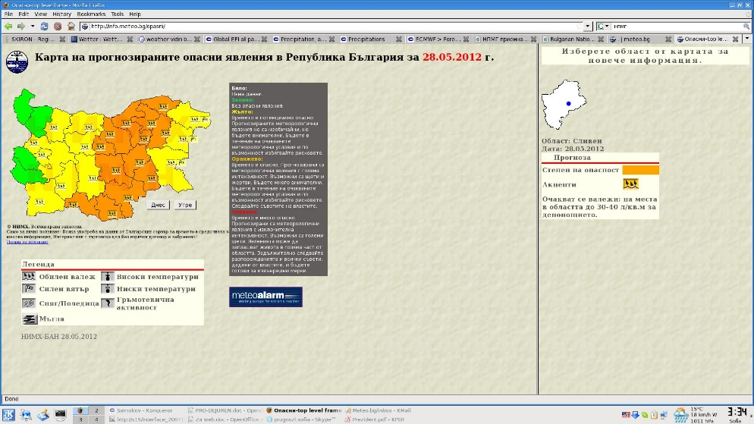
Forecasts and Information Services
Issuing of seasonal, monthly, medium, short and ultra short accurate weather forecasts and condition of the sea. Perform research activity on numerical and stochastic modeling of meteorological phenomena and processes and improving the reliability and quality and to develop methods for using satellite and radar information in weather forecast.
NIMH-BAS Web site for dangerous events

Slide 18
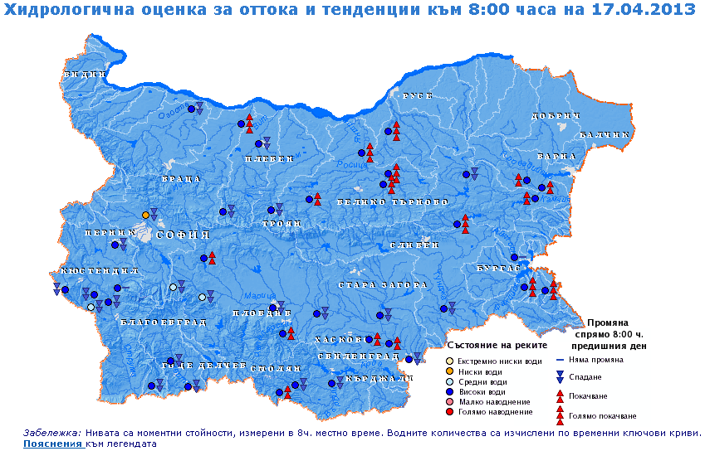
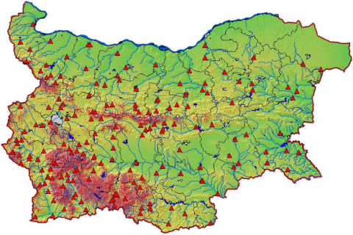
Hydrology services
Measurements of basic parameters of surface and groundwater. 63 river sections are monitored within the operational network including 18 telemetric stations.
Creating and maintenance of a database of the measured surface and groundwater characteristics. Evaluation and assessment of the river basins runoff and water resources statistics. Real time data processing and development of methodologies and software for hydrologic predictions. Evaluation of regional hydrologic parameters.

Slide 19
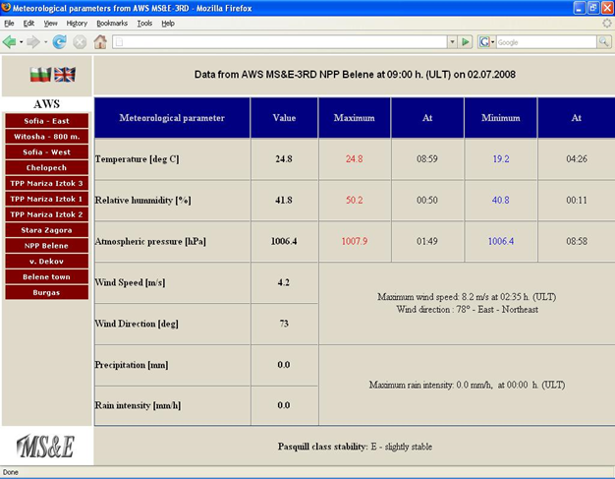
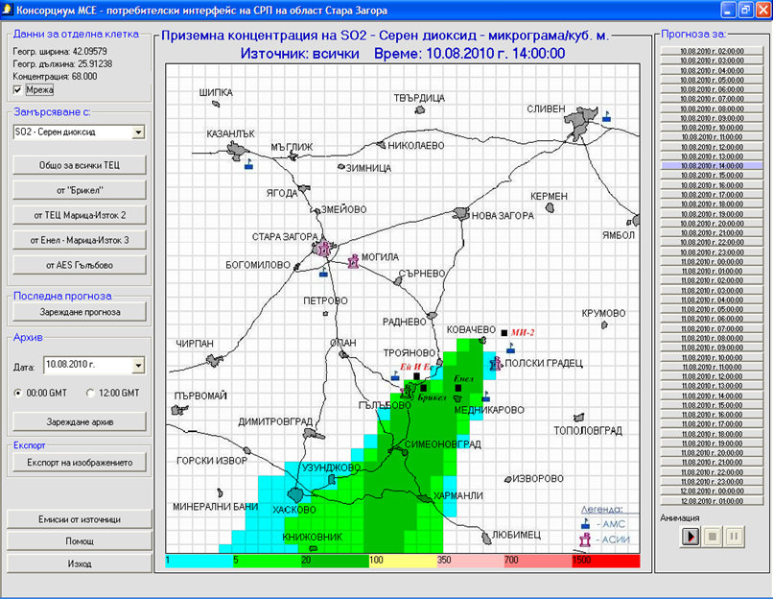
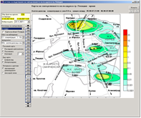
Research of meteorological aspects of air pollution. Atmospheric diffusion models, on-line early warning systems for forecast air pollution.

Slide 20
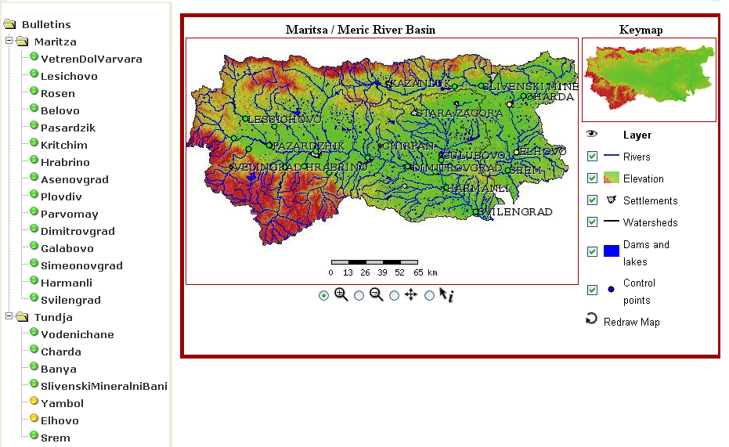
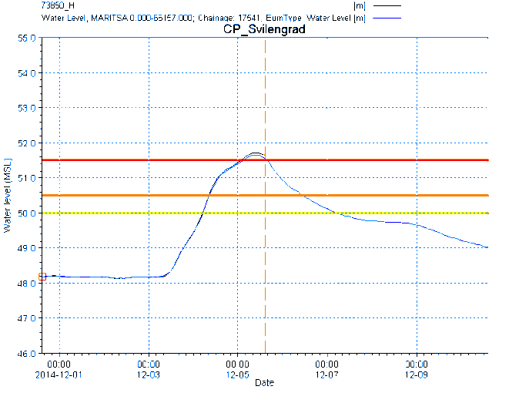
Develop and maintain complex Early warning systems as
precondition for disaster risk reduction

Slide 21
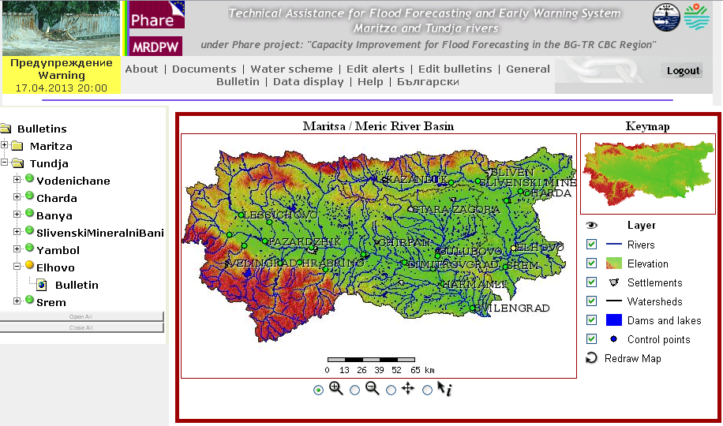
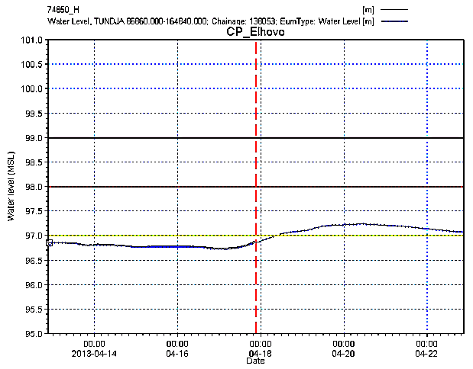
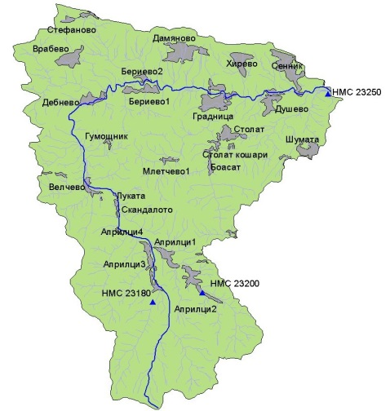
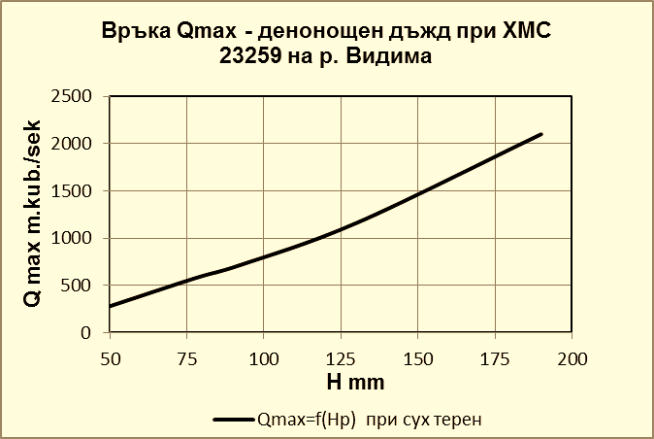
Development and application of lump for smaller catchments and spatially distributed for larger ones rainfall-runoff hydrologic models for prediction of floods on the base of days ahead weather forecasts for early warning and flood risk reduction.
    Established are EWS for the main course of Maritsa and Tundzha rivers till the border with TR; five days ahead flooding forecasts for 22 settlements along the rivers; installation of 12 telemetric hydrological and 17 precipitation/temperature stations; covered area of about 20000 km².
Qmax- rainfall relationship obtained by lump model for the Vidima river basin

Slide 22
NIMH organizes and performs scientific investigations in the field of meteorology, agrometeorology, hydrology, management and use of water resources in Bulgaria
Studies and applied investigations:
They are executed through projects financed by EU programs, WMO, National funds, public and private organizations and companies.
Studies include weather forecasting, numerical modeling, cloud physics, climatology, hydrology, agrometeorological forecasting, air pollution, assessments of the spread of pollutants in air and water assessments for water resources, water management and others.
Applied investigations include evaluation of hydrometeorological resources, methodologies for active effects on atmospheric processes, establishment of early warning systems, assessment the potential of the sun and wind considering the renewable energy and many others.

Slide 23
National Institute of Meteorology and Hydrology – BAS
Scientific investigations within projects of European and international programmes
Projects under the 5th, 6th, and the 7th framework programmes of the European Commission: ACCENT, QUANTIFY, SAFER, EnviroGRIDS, IncREO and others.
Projects related to bilateral and multilateral international cooperation: ALADIN, Enhancing capacity for flood forecasting in the Bulgarian-Turkish part of the River Maritsa and River Tundzha, DMCSEE, ORIENTGATE, ECOPORT8, TEN ECOPORT, ARDAFORECAST, WATER, SAAP4FUTURE; Scientific projects in the frame of different European and international programs and COST Action programs.

Slide 24
National Institute of Meteorology and Hydrology
Bulgarian Academy of Sciences
THANK YOU FOR YOUR ATTENTION!

