Slide 1

Department of Meteorology
CYPRUS
Ministry of Agriculture Rural Development and Environment

Slide 2
Certifications
ISO 9000 – 2015
NSA
EASA (ICAO Civil Aviation)

Slide 3
Structure

Slide 4
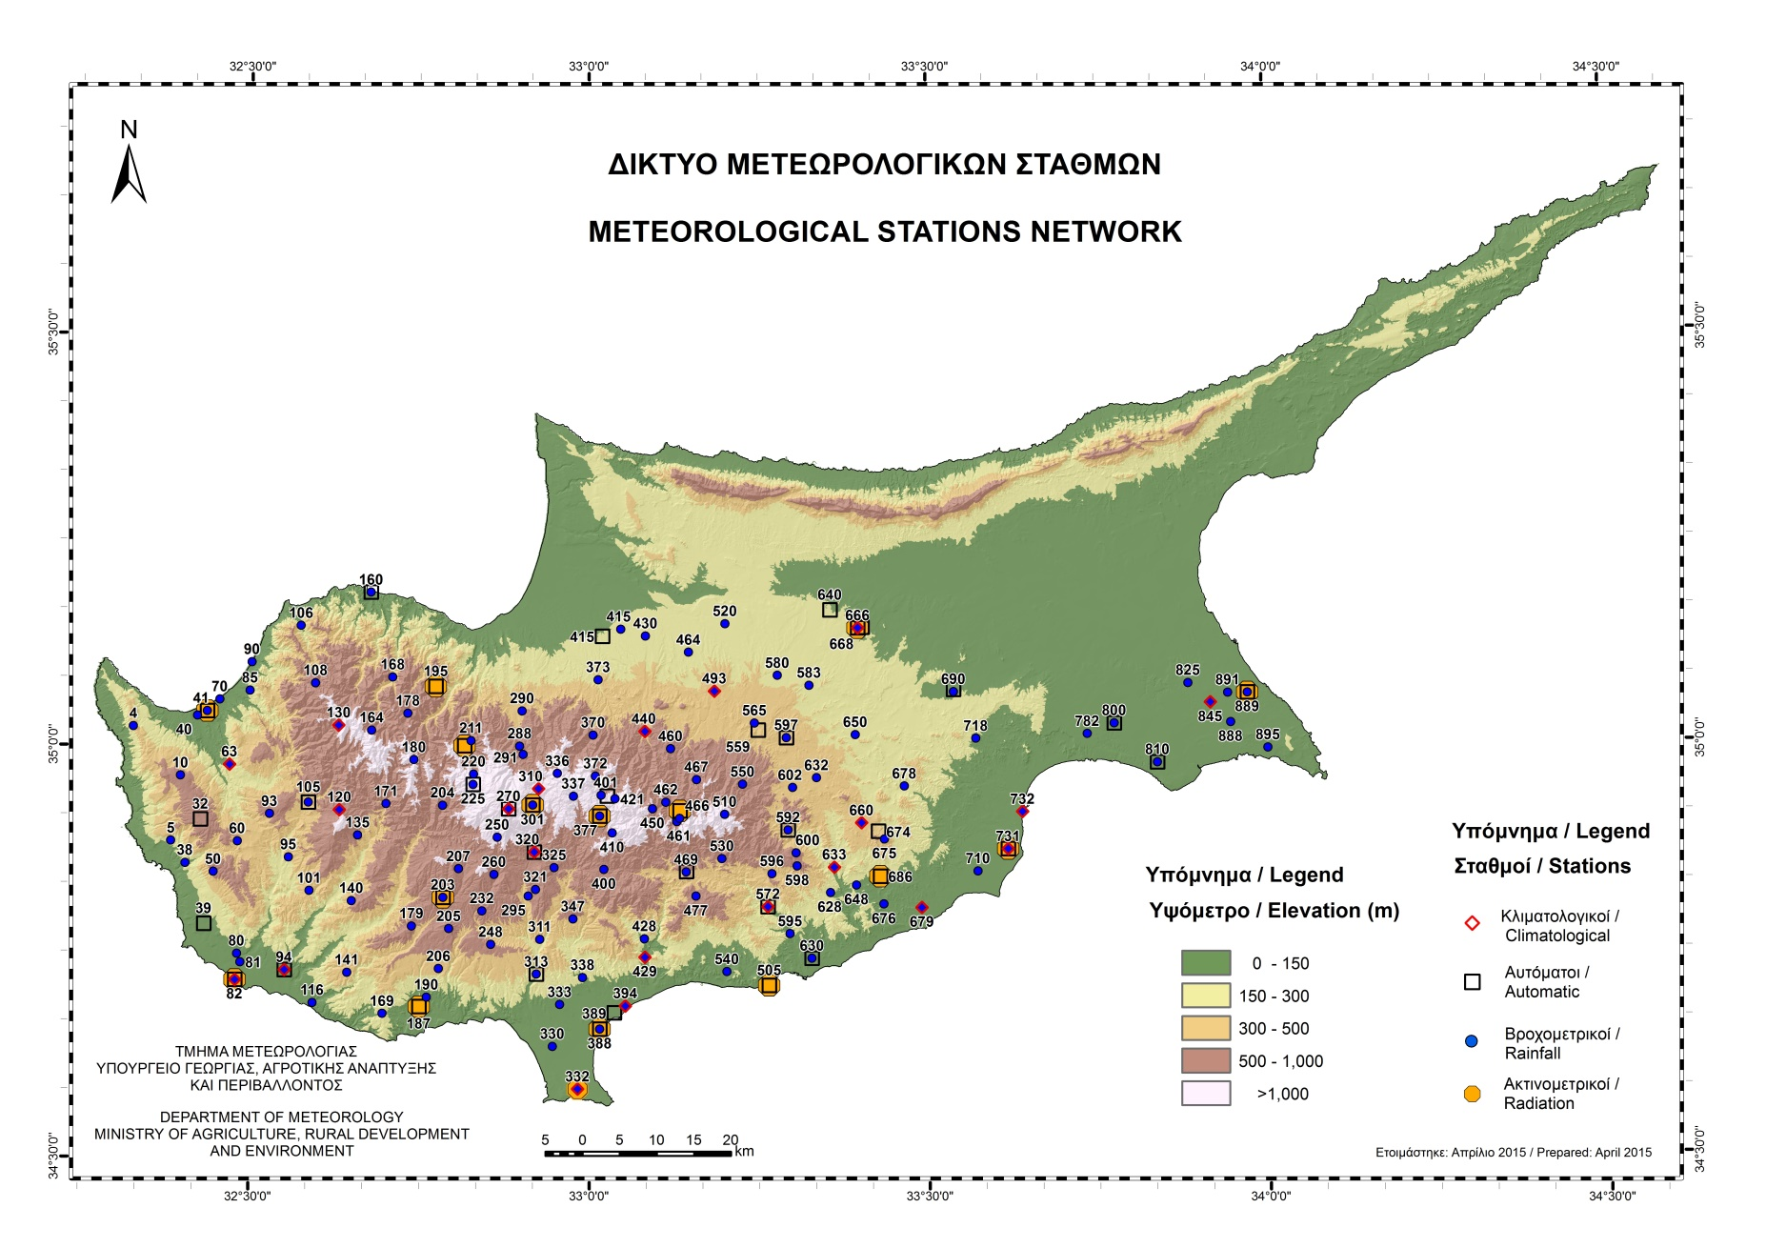
A fairly dense network

Slide 5
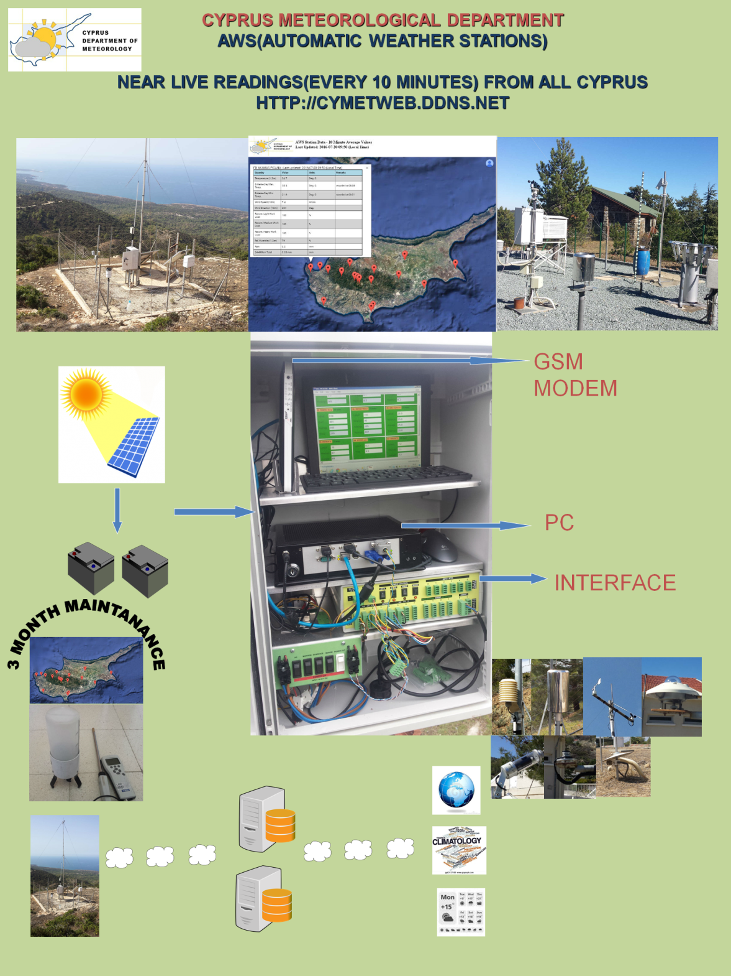
Automatization A main effort
Transform the old climatological stations to modern AWS with an “in house” developed procedure

Slide 6
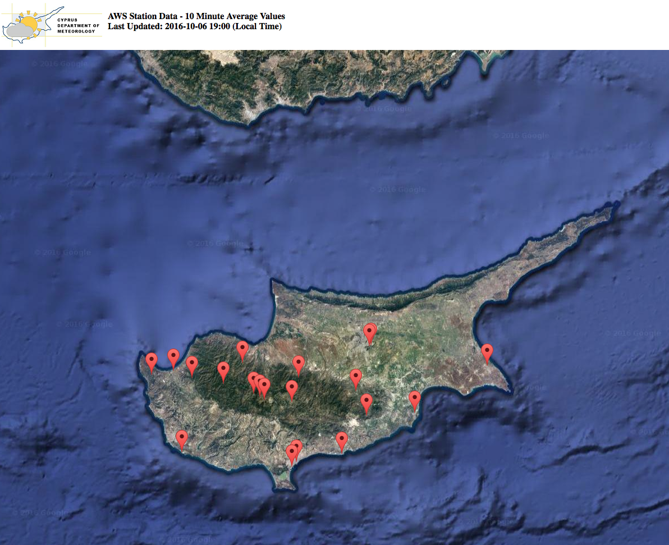
Today AWS network

Slide 7
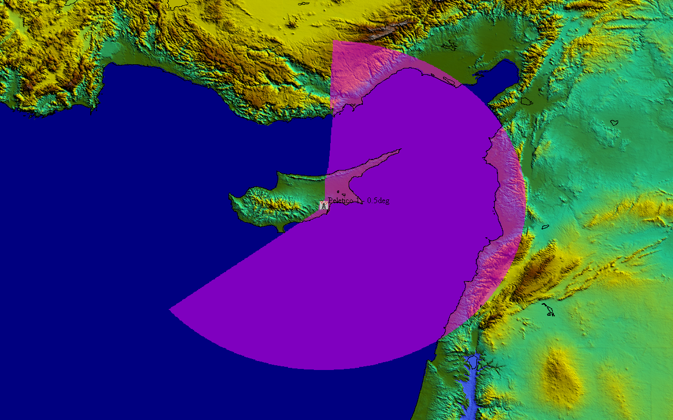
Radar network

Slide 8
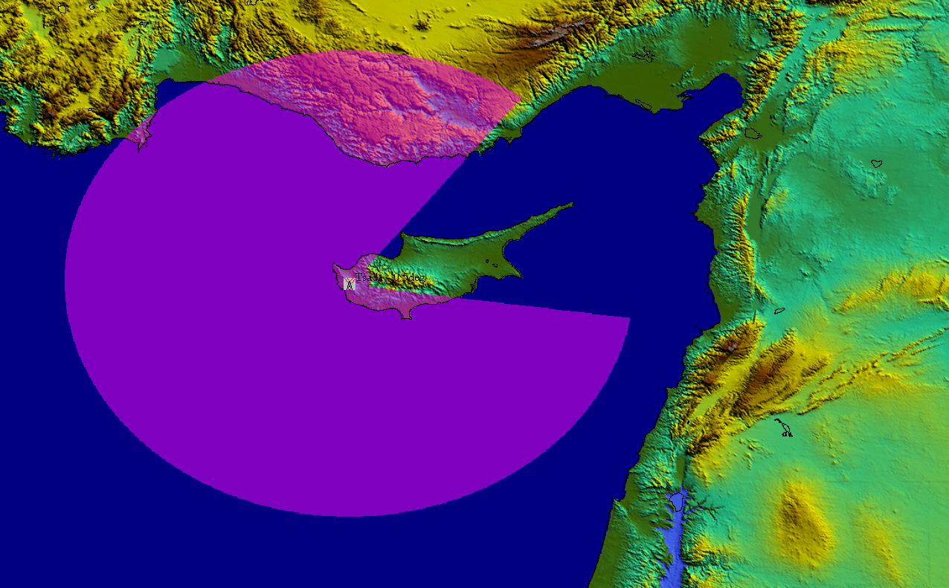
Radar Network

Slide 9
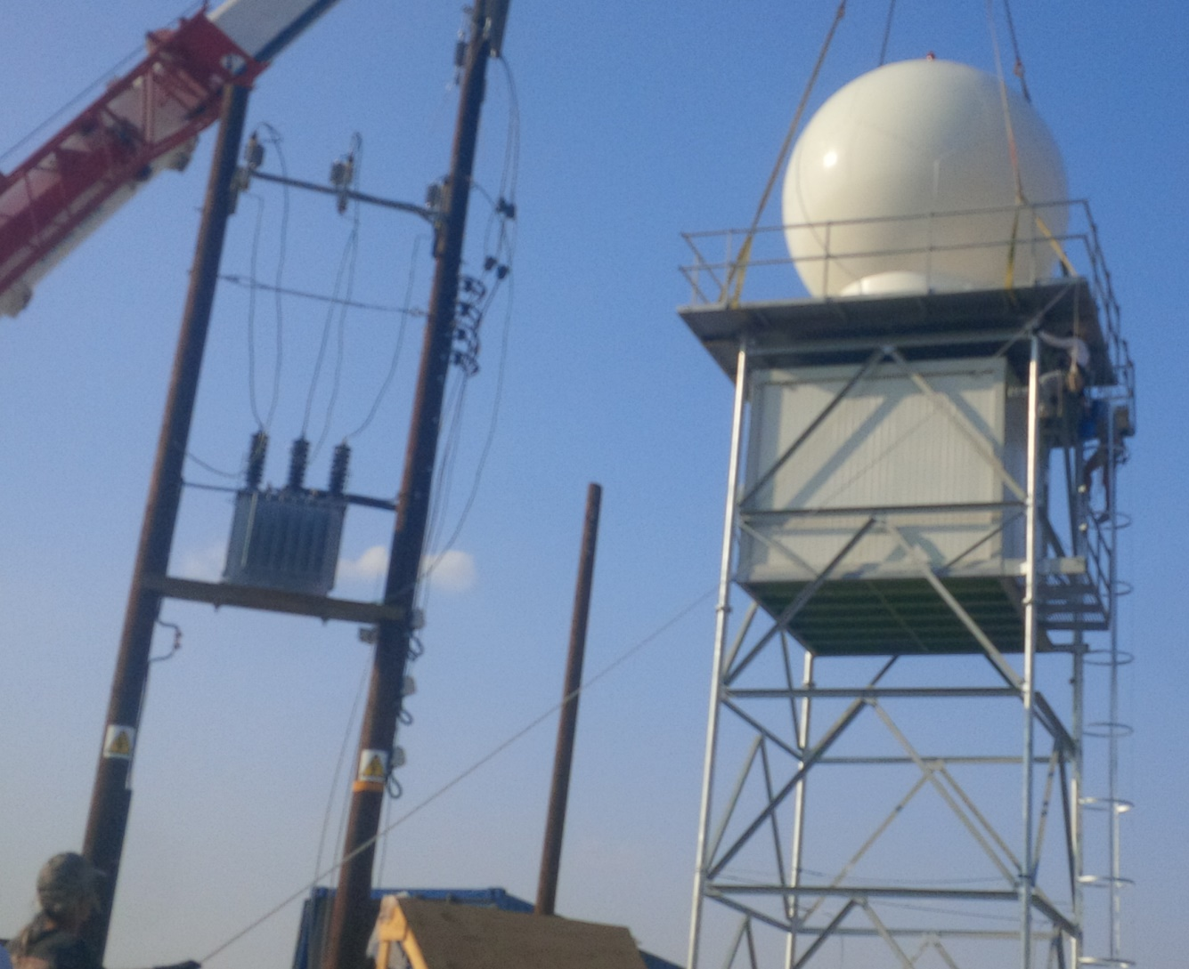
X - Band
Coverage of 150 Km
Private sector Procured: Services

Slide 10
NWP WRF
Twice per day
  0000Z (available at 0600Z), 1200Z (Available at 1800Z)
Initial & boundary conditions from the 0.5º × 0.5º NCEP (National Centers for Environmental Prediction) Global Forecasting System (GFS) analyses, at 6-hour intervals. It is a 3-domain setup with 2-way nesting for Domain 2 and Domain 3 (Cyprus is not an ECMWF member)
Post-Processing with NCL, output is provided in
  Graphical form (maps, icons, disseminated through http, soon in apps)
  Text form
  XML

Slide 11
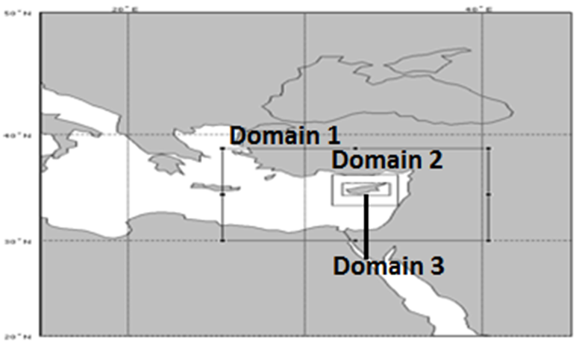
Domain Configuration

Slide 12
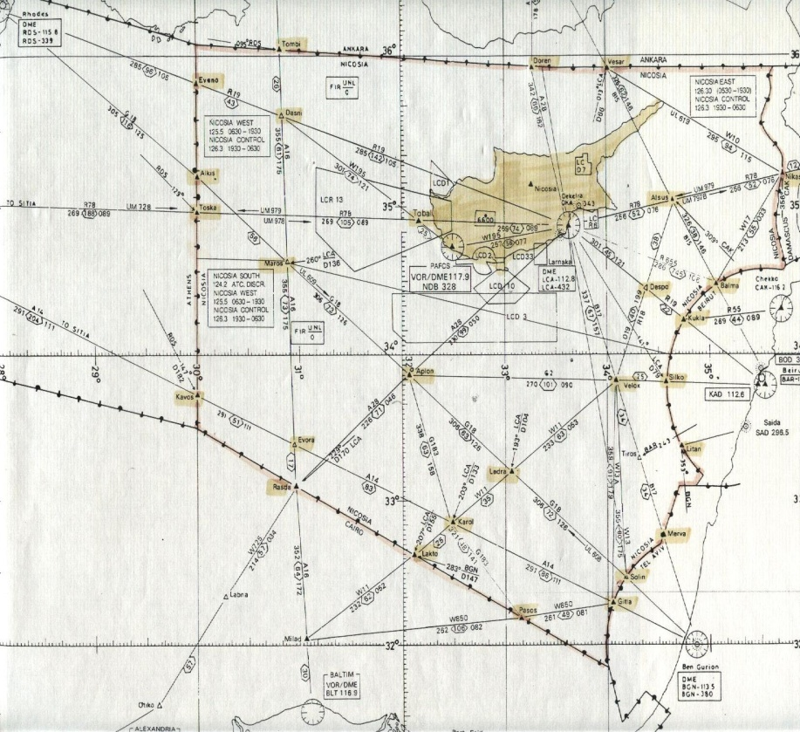
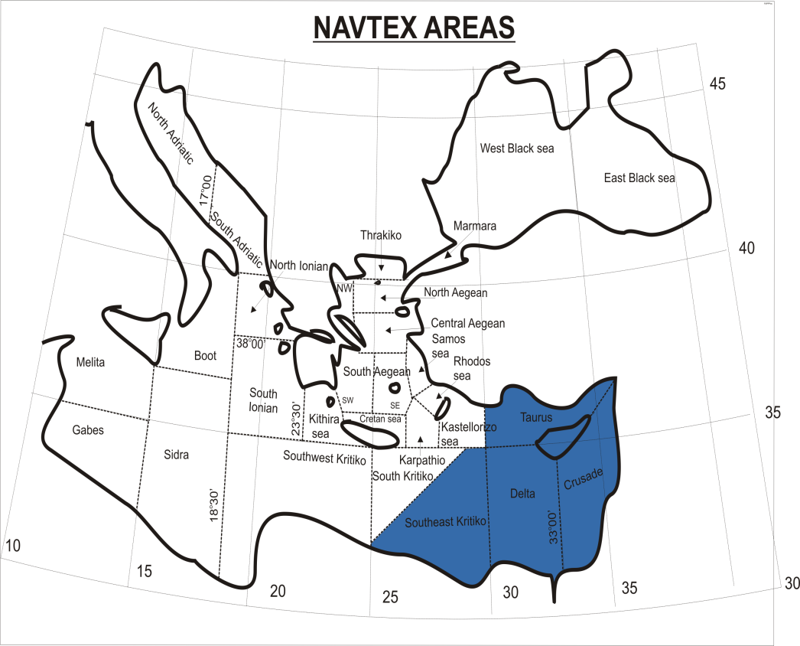
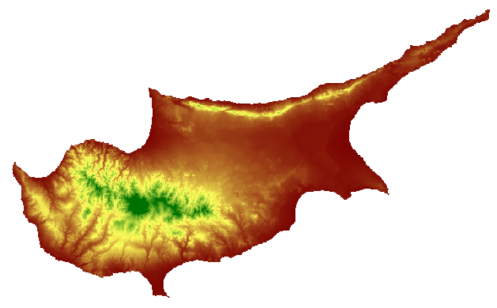
Areas of forecast

Slide 13
Clients
ECOMET: Products have a value and are sold, unless, some obligatory, can be downloaded for free from the Departments web page
Aviation
Marine
Energy
Academic organizations
Tourism industry
Technical organizations
General public

Slide 14
International Organisations - Cooperation
WMO
  Southeast Europe (SeeCOF)
  MedCOF
EUMETNET
OPERA
EMMA
ECOMET
BLUE Med
AVIMED

Slide 15
Resources
Budget: 3 million euro
Personnel: Not more than 62
              16 Scientific (Wx Forecasters, Climatologists)
                Physists and or Mathematicians with an MSc in Meteorology (most of them)
              46 Technicians (observers, support etc)
              Due to the economic situation vacancies are not filled

Slide 16
Ongoing and Forward
Quality control and data base
Dust Model (Serbia Hydro - Met. Service)
A more detailed WRF
MHEWS (on the 12th a meeting is scheduled between Department of Meteorology, Civil Defence and Waters Authority)

Slide 17
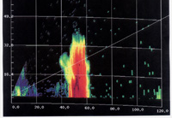
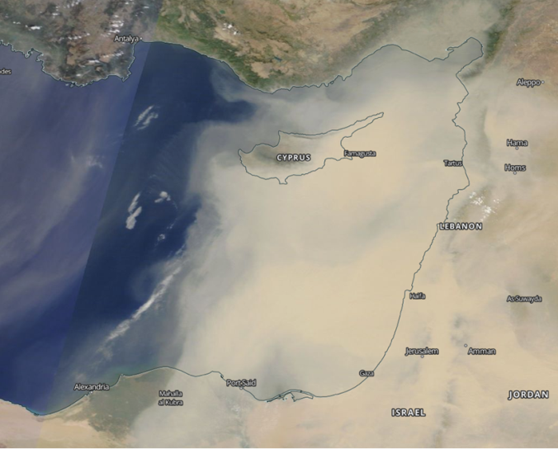
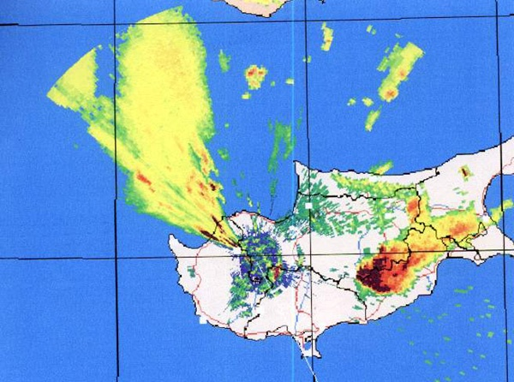
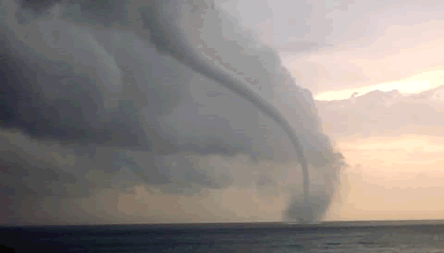
Why MHEWS

Slide 18
Communication
    Tel.: +357 22802934
    Fax. +357 22305500
    Wx Forecast +357 24802977
    Weather line +357 24817998
    Web page www.moa.gov.cy/ms
    E Mail metservice@ms.moa.gov.cy

Slide 19
Thank you

Slide 20
Structure

