Slide 1





STATE
HYDROMETEOROLOGICAL
SERVICE
134, Grenoble str, MD-2072, Chişinău, Moldova Republica of
Tel: (022) 77-35-00, 77-36-11
Fax: (022) 77-36-36
hidrometeo@meteo.gov.md
anticamera@meteo.gov.md

Slide 2
Organigram of the Service
Director
First Deputy Director
Deputy Director
Finance and
accounting dep.
Administrative-Organizatorical dep.
Foreign affairs and
European integration division
Meteorology
department
Hydrology
department
Environment
Quality
Monitoring
department
Research
and GIS
center
Comunication
And IT
center
Measure
meants
center
National Observation network
Maintance
division
Garage

Slide 3
The main tasks of the State Hydrometeorological Service are:
To monitor the state and evolution of the hydrometeorological conditions and environment quality with the purpose to protect the population and economical agents from dangerous hydrometeorological phenomena and from environmental pollution;
Elaborate meteorological, aeronautical, agrometeorological, hydrological forecasts as well as the forecast on the environmental pollution;
To issue warnings on hydrometeorological hazardous phenomena, as well as on the environmental pollution;
To meet the demand for hydrometeorological information of the population, economic agents, national security, public authorities;
Establish and operate the Hydrometeorological Data State Fund in support of hydrometeorological justification, design, construction and exploitation of socio-economic objects;
Participate in the international data exchange within the global observing system and to fulfill the commitments under the conventions and international agreements signed by the Republic of Moldova.

Slide 4
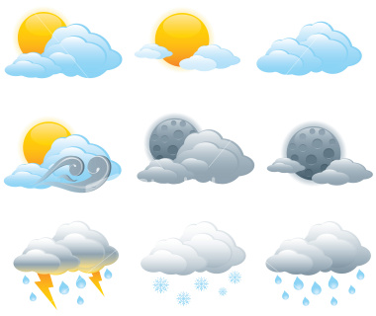
Meteorology Department
Department chief:
Treșcilo Lidia

Slide 5
Organigram of the Meteorology department
Meteorology department
Meteorology and climatology center
Agro
Meteorological monitoring center
Information management center
Meteorological forecast center
National Meteorological Observation network

Slide 6
Meteorological department is responsible for meteorology, agrometeorology and climatology domains.
Tasks:
organization, development and methodical guidance of the state system of meteorological and agrometeorological observations
issue of public meteorological forecasts (agrometeorological, climatic) and warnings about dangerous weather phenomena that are regularly disseminated to the central and local public authorities, mass media; provision of economic agents with specific information about unfavorable weather phenomena on a contract basic according to the scheme coordinated by the Ministry of Ecology and Natural Resources
issue of specific forecasts for economic agents in terms of contract;
control over use of hydrometeorological information by economic agents
delivery of specific information about hazard occurrence and intensity to juridical and natural persons as requested
systematic analysis, synthesis of meteorological and agrometeorological conditions; preparation and publication of informative material and systematic delivery of information to the local and central public authorities, economic agents and population

Slide 7
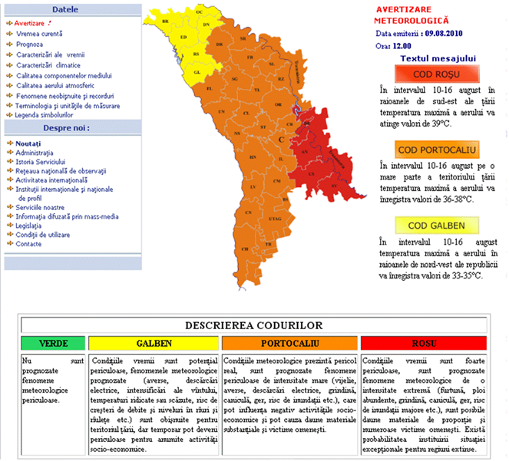
Meteorological warnings on the web-site www.meteo.md

Slide 8
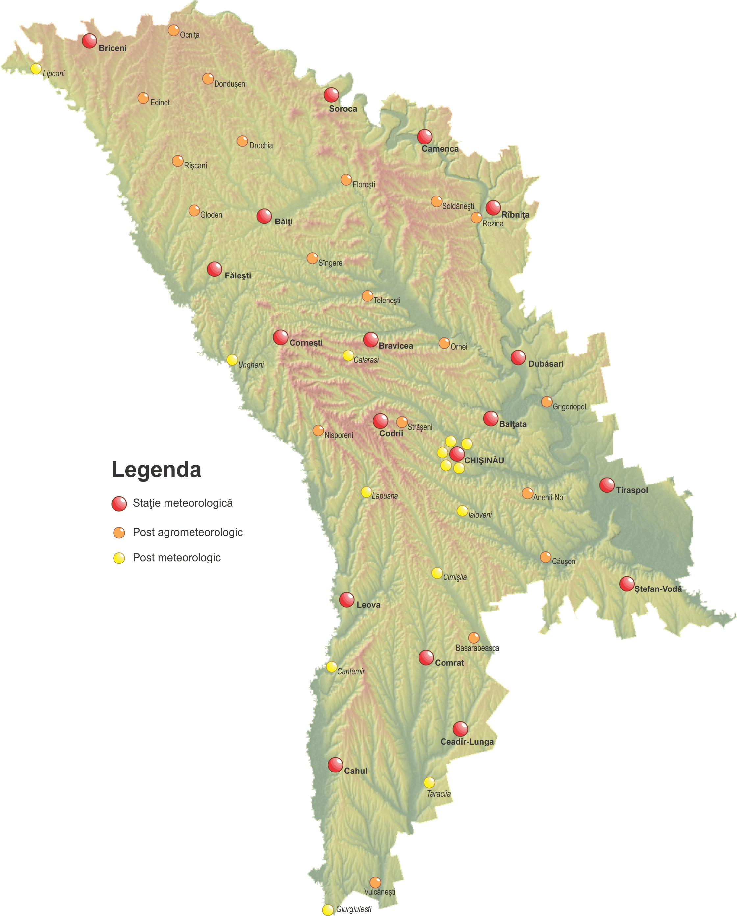
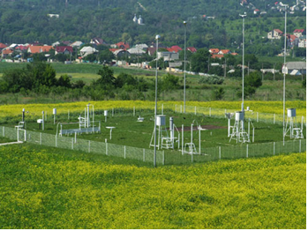
National Meteorological Observation network
At the moment national meteorological network includes:
14 meteorological stations;
32 meteorological and agrometeorological posts.

Slide 9
WMO
WMO
OMM
Scheme for transmitting meteorological information
«CLIMA»
«SYNOP»
Lunar, p.1
synthesis conditions
Hydromet., p.1
«SYNOP»
Regional Center
(Moscow, Russia)
ICȘIHMR-CMD
(Obninsc, Russia)
State Hydrometeorological center
«CLIMA»
National Institute of Meteorology and Hydrology
(Bucharest, Romania)
«CLIMA»
(tab.)
«SYNOP»
Climate data International Center
(Asheville, USA)
Telegram
«WAREP»
Telegram
«CLIMA»
Telegram
«SYNOP»
Meteorological stations

Slide 10
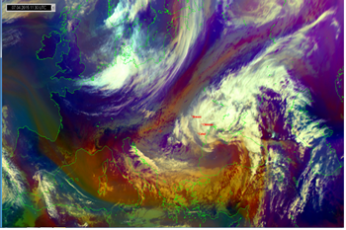
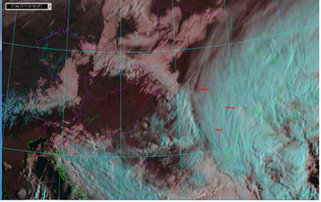

International projects in the meteorology area
In 2010, in a regional project of EUMETSAT, has been installed the receiver and satellite data visualization DAWBEE.
The UNDP Project "Support to National Planning Process Adaptation to Climate Change Moldova 's works were performed on the receiving member of the SHS program EUMETNET (EMMA / Meteoalarm and OPERA) from 1 January 2016.

Slide 11
In 2010 the World Bank started implementing the project "Disaster and Climate Risk Management in Moldova".
in the project was carried out:
in the project was carried out:
creating information system for viewing, processing, editing and production of automated data in forecasting the weather;
was purchased and put into operation meteorological radar DWSR-3501C;
were built buildings for 4 meteorological stations - Ceadîr-Lunga, Leova, Soroca and Balti;
modernization of meteorological monitoring by automating meteorological stations, the application of modern equipment for determining soil moisture, rainfall measuring sensors, sensor observations on the radiative balance sheet components.
was established calibration laboratory equipment.

Slide 12
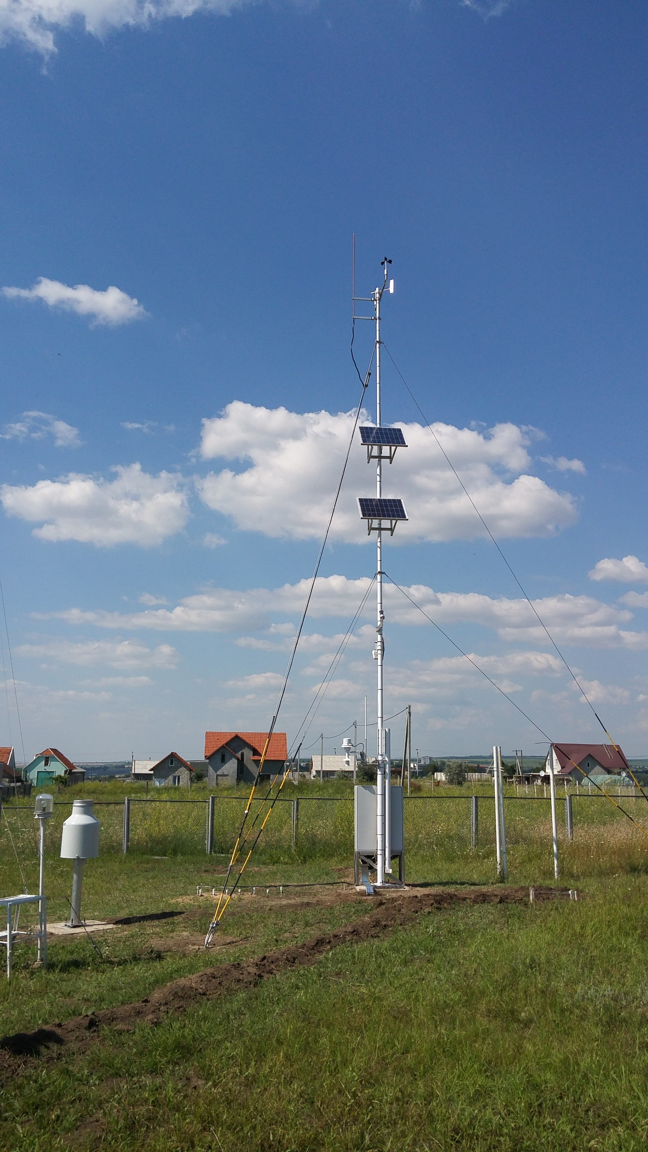
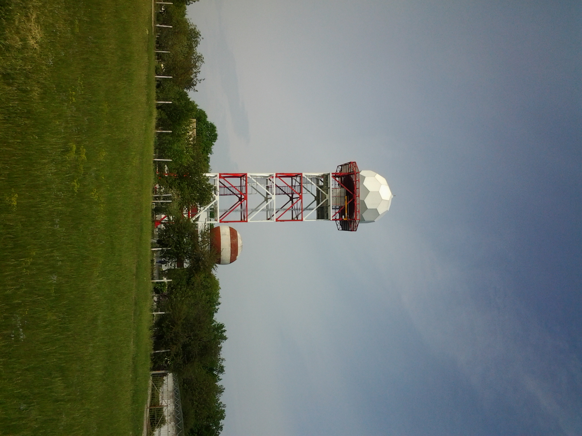
AWS
Radar

Slide 13
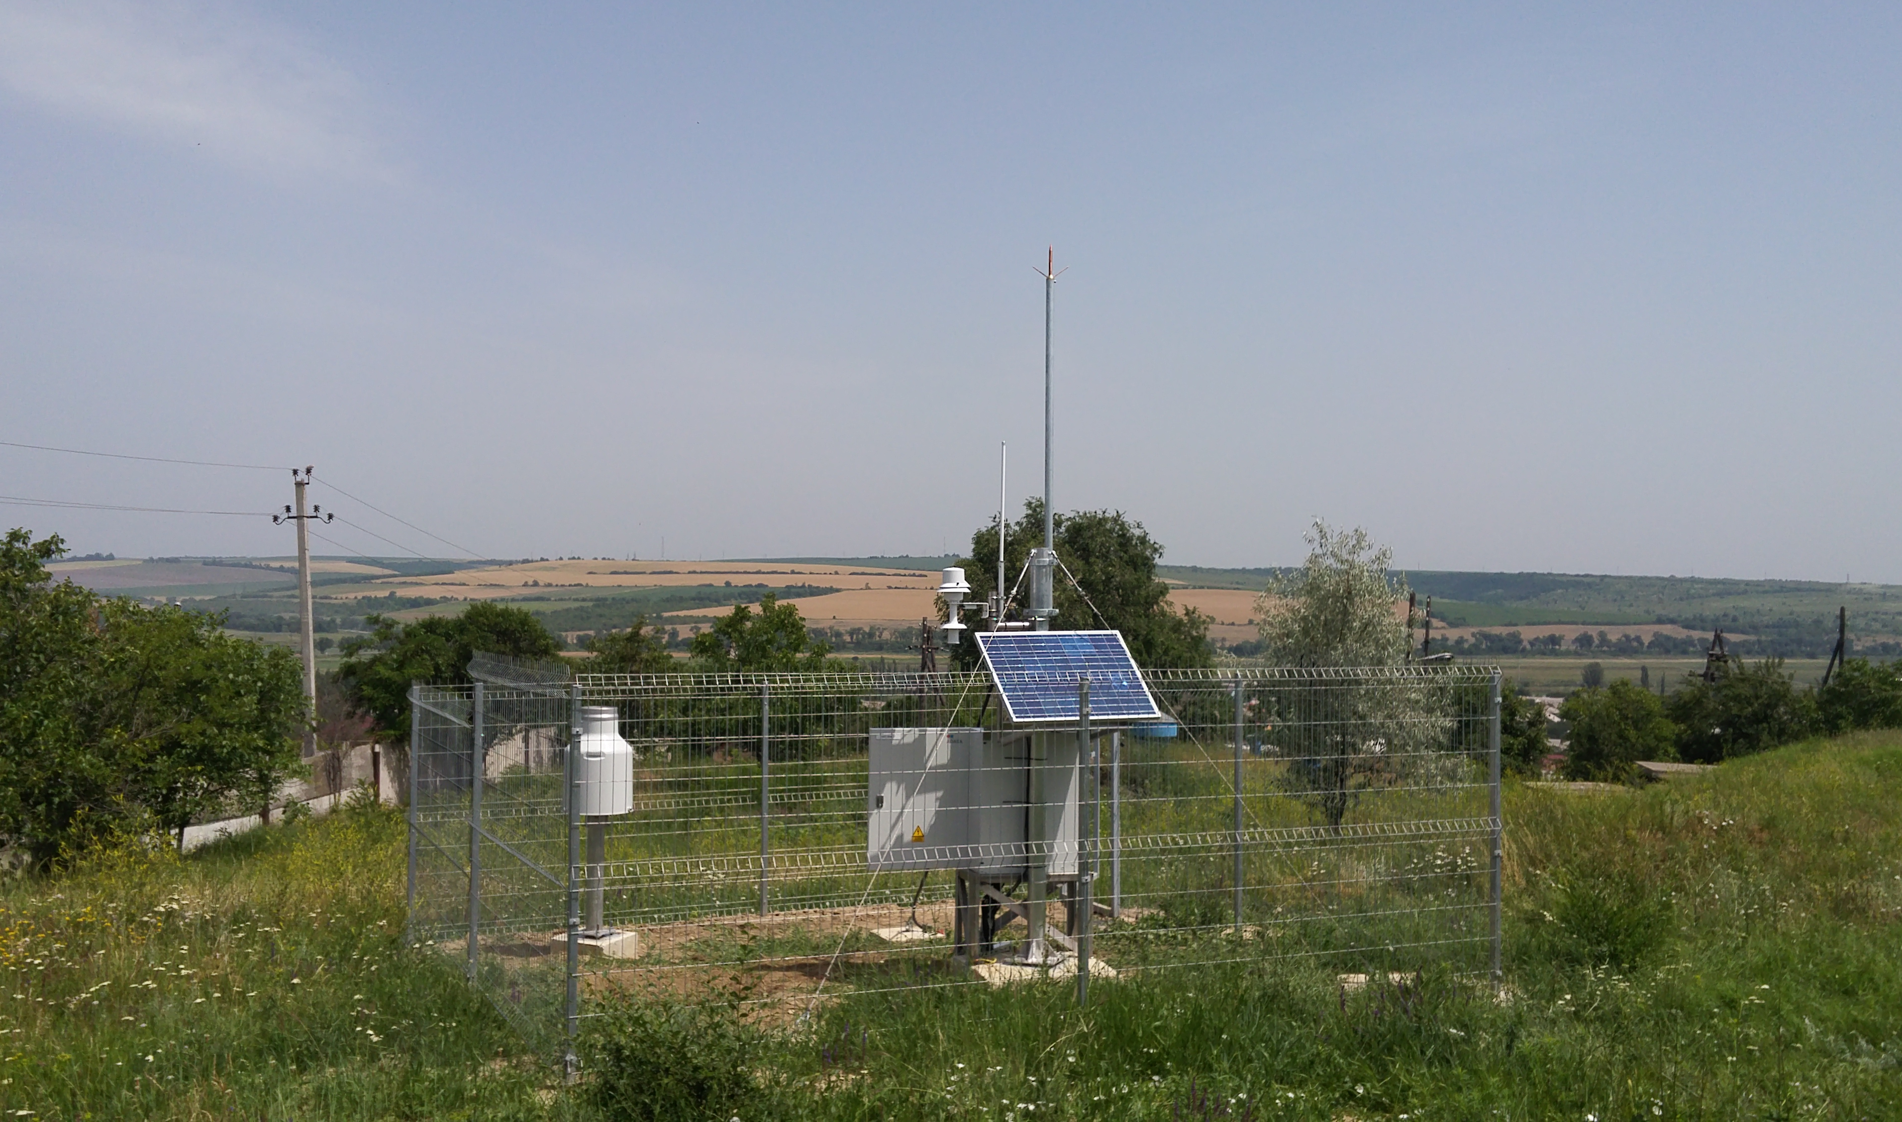
miniAWS

Slide 14
DepartmentHydrology
Department chief:
Valeriu Cazac

Slide 15
Organigram of the Hidrologycal department
Hydrologycal
department
Hydrology forecast
center
Hydrology monitoring center
Hydrographic and cadastral center
National Hydrological Monitoring network

Slide 16
The main activity
  Observation about surface water status and evolution
Ensuring CPA and LPA, economic agents and population
with hydrological information, forecasts, warnings
Making of Hydrological measurements
and hydrographical studies
Publication of annual and multiannual data
Filling National Fund Data

Slide 17
Monitoring of the River Basins in the Republic of Moldova
Hidrological station
Prut
Hidrological station
Dniester
Lipcani
PH-1 Șirăuti
PL- Lopatnic
PL- Corpaci
PL- Dumeni
PL- Costești
PH-2 Braniște
PH-1 Ungheni
PH-2 Leușeni
PH-1 Bălăsinești
PH-1 Trinca
PH-1 Bîrlădeni
PH-1 Cajba
PH-1 Pîrlița
PH-2 Sărata Răzeși
PH-2 Giurgiulești
PH-2 Leova
Cantemir
Cahul
PH-2 Brînza
Giurghiulești
PH-1 Taraclia
PH-1 Ceadîr-Lunga
PH-1 Hîncești
A- Marenii Noi
A- Gura Bîcului
CH-1 Căușeni
A- Naslavcea
A- Unguri
PH-1 Hrușca
A- Nimireuca
PL-Camenca
A- Camenca
PL-Rîbniița
PL-Dubăsari b.am.
PH-2 Dubăsari b.av.
A-Criuleni
Vadul lui Vodă
PH-2 Grigoriopol
PH-1 Bender
A-Talmaza
Răscăieți
PH-1 Olănești
Tudora
PH-1 Nezavertailovca
PH-1 Camenca
PH-1 Beloci
PH-1 Molochișul Mare
PH-1 Mateuți
PH-1 Andreevca
PH-1 Doibani
PH-1 Goian
PH-1 Chișinău
H M C
PH-2 Soroca
PH-1 Bălți
PH-1 Jelobc
PH-1 Cubolta
PH-1 Sevirova
PH-1 Telenești

Slide 18
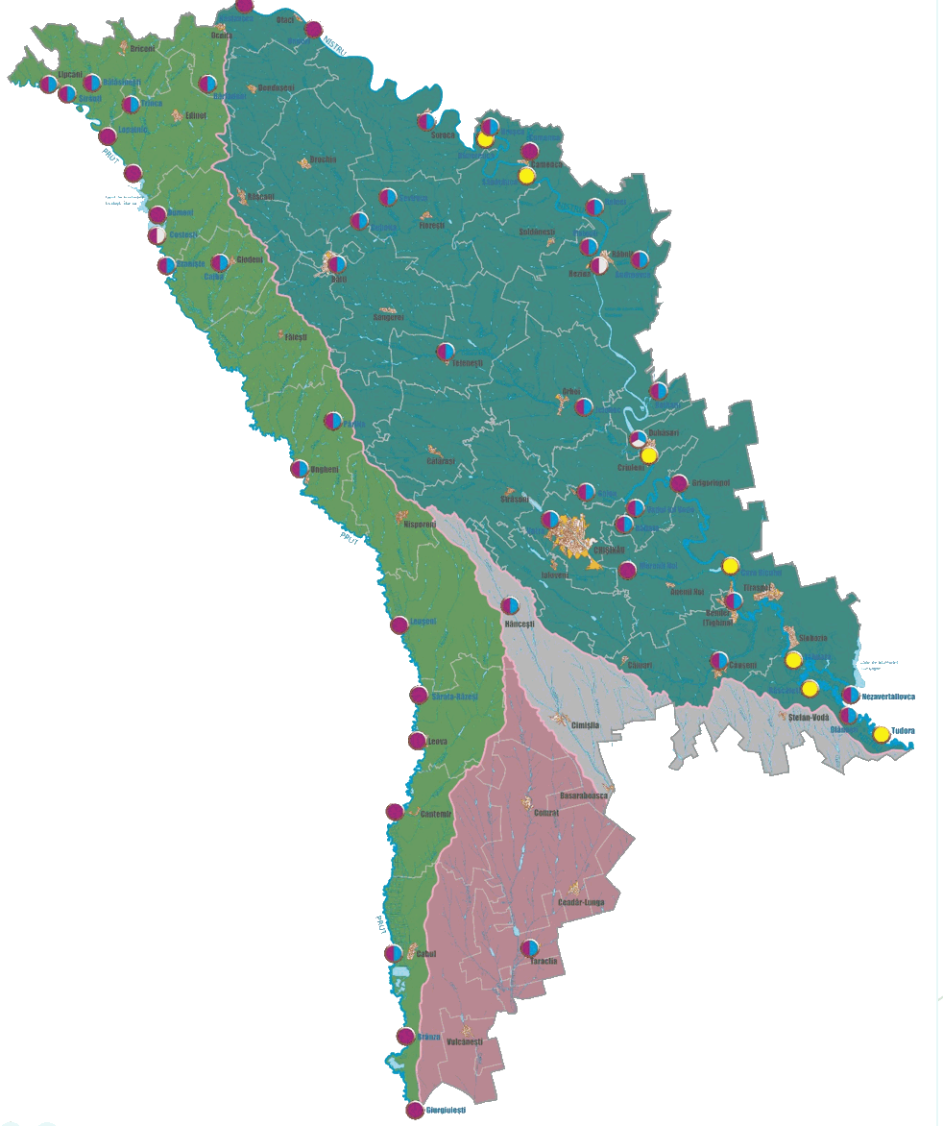
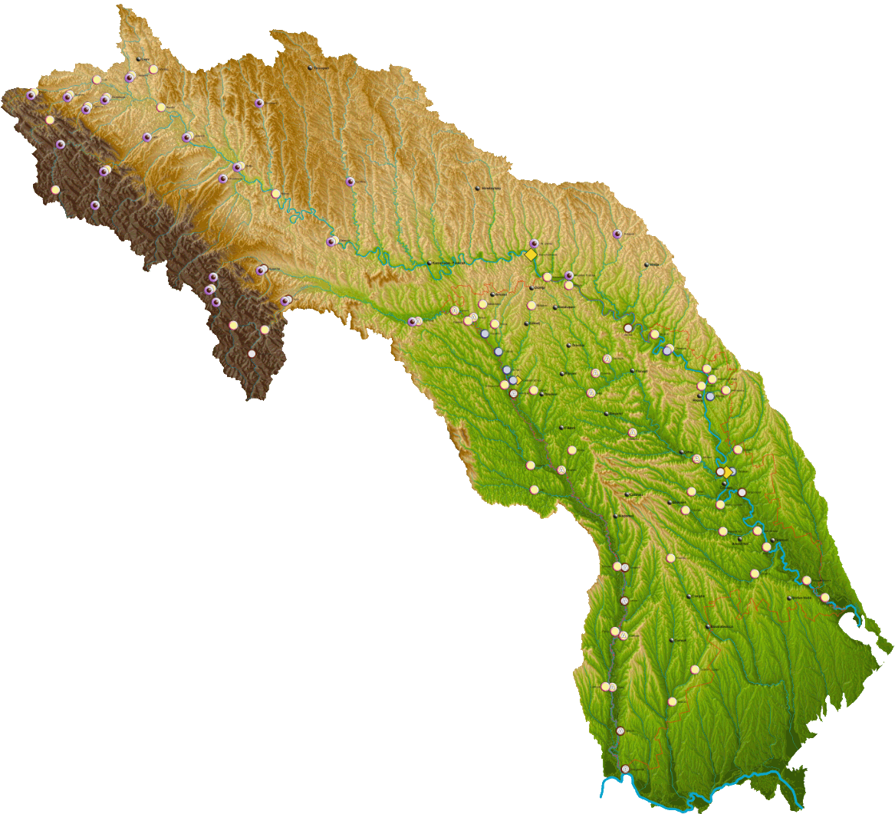
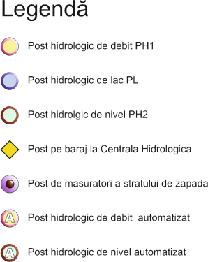
Hydrological Monitoring network
International (Dniester and Prut)
Novodnestrovsk
Cernauti
H D
Dubasari
Iasi
Chisinau
Tiraspol
Odessa
National
R N M H
Bucuresti

Slide 19
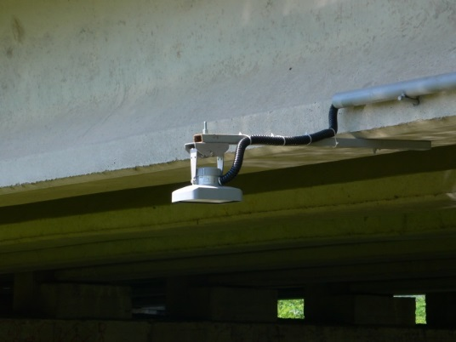
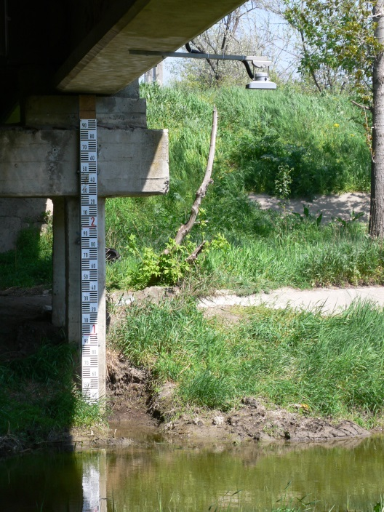
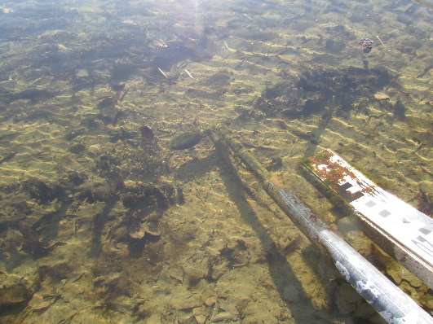
Modern technologies used in the
National Network of Hydrological Monitoring
Level sensor
Speed sensor
Speed sensor

Slide 20
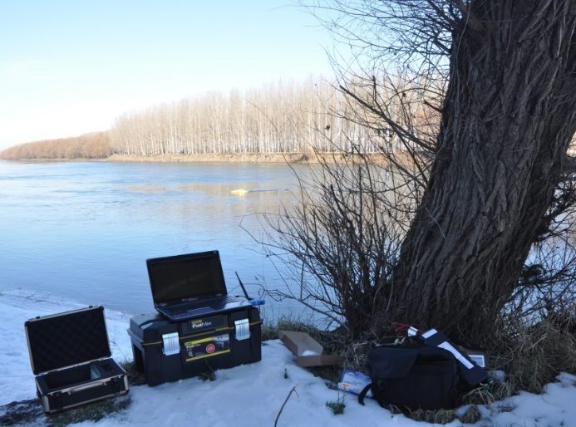
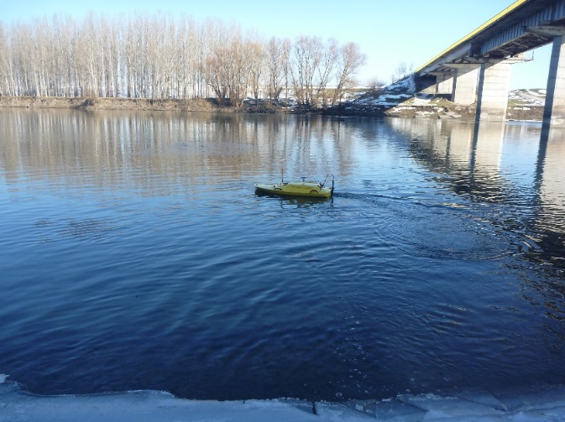
Modern technologies for
making bathymetric measurements
Hydrologic
Sonar
Z-boat 1800

Slide 21


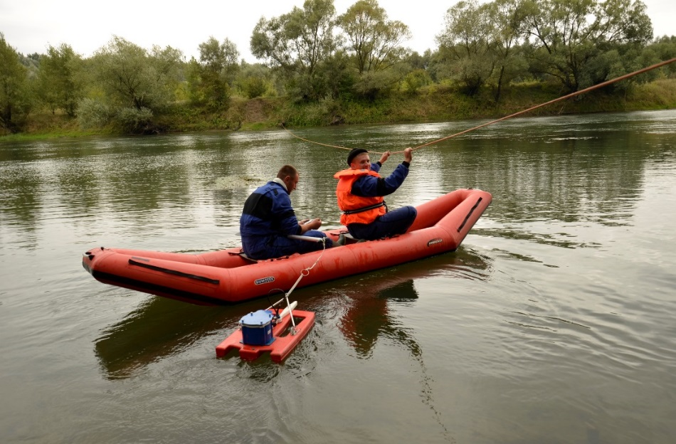

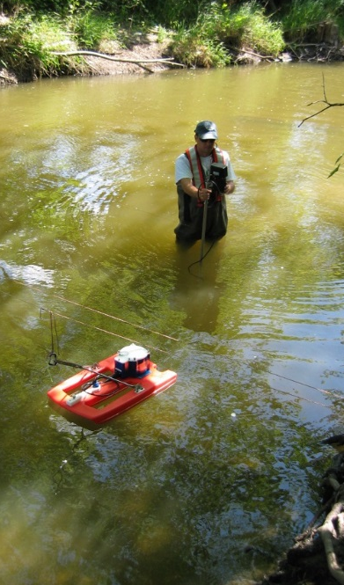
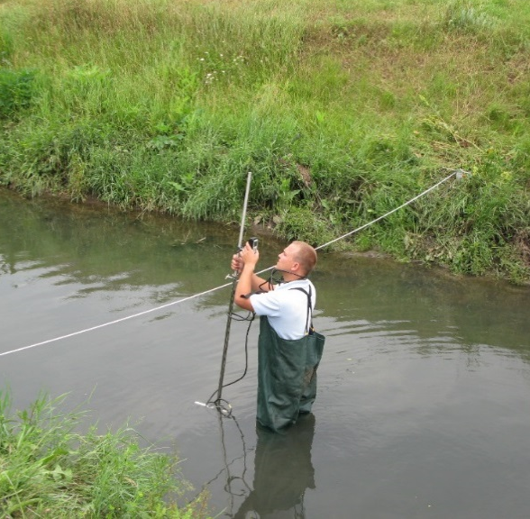
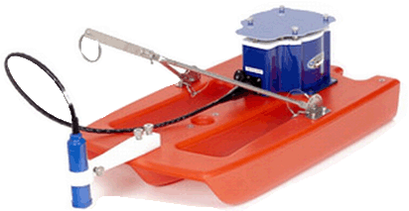
Equipment for flow measurement

Slide 22
Environment Quality Monitoring Department
Department chief:
Gavril Gîlcă

Slide 23
Organigram of the EQM Department
Air Quality Monitoring Center of Atmospheric and Environmental Radioactivity
Integrated Ecological Monitoring Centre and Information management
Environment Quality Monitoring Department
Atmospheric Air Quality Monitoring Department (Balti town)
Soil Quality Monitoring Center
Surface Water Quality Monitoring center
Physico-Chemical Analysis Center
Forwarding group
Hydrobiology group
Hydrochemistry group

Slide 24
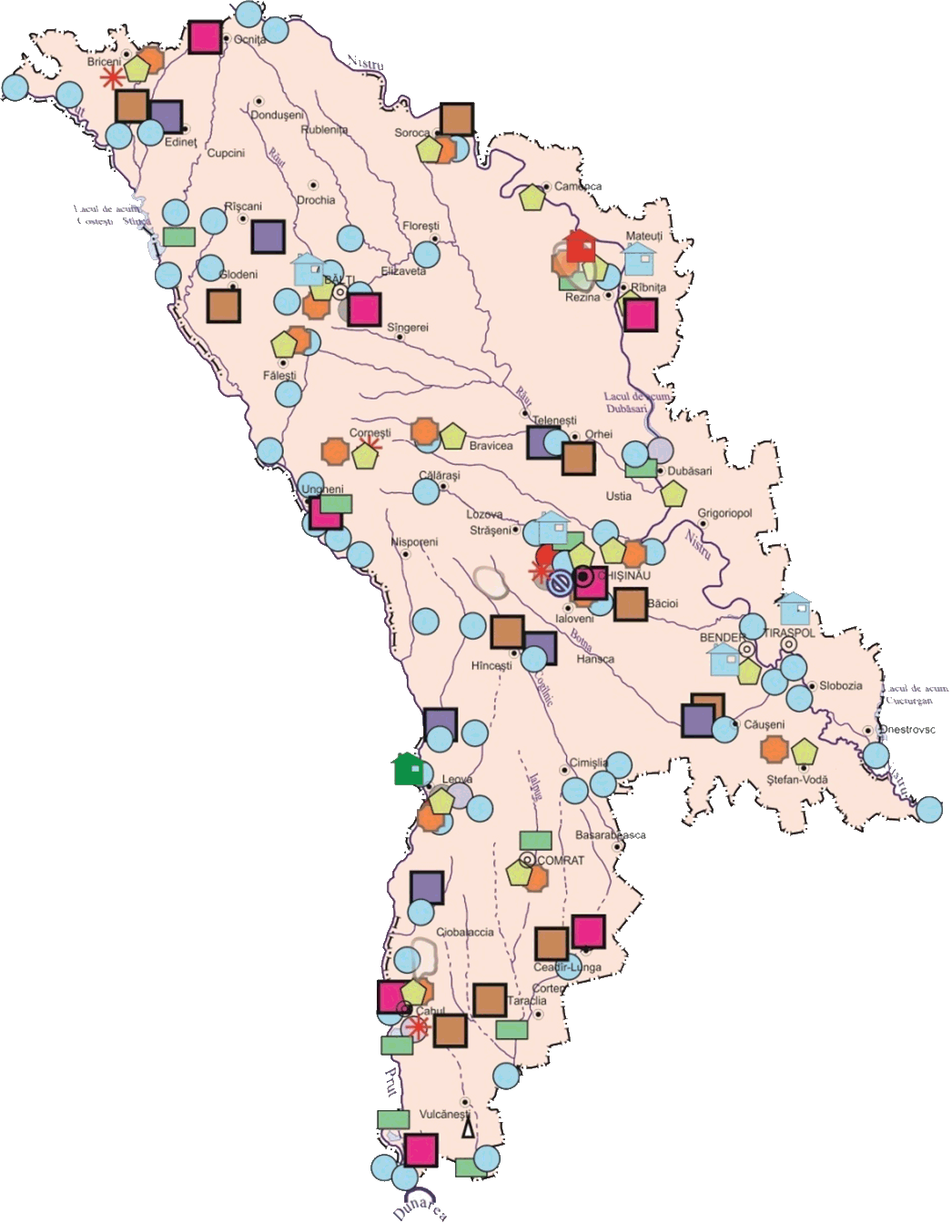
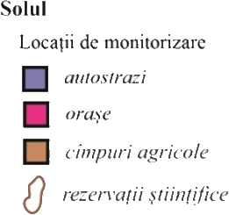
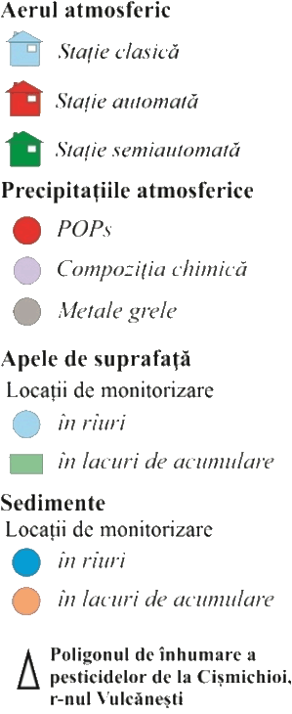
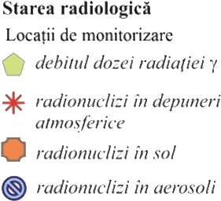
Network monitoring
of air quality and surface water

Slide 25
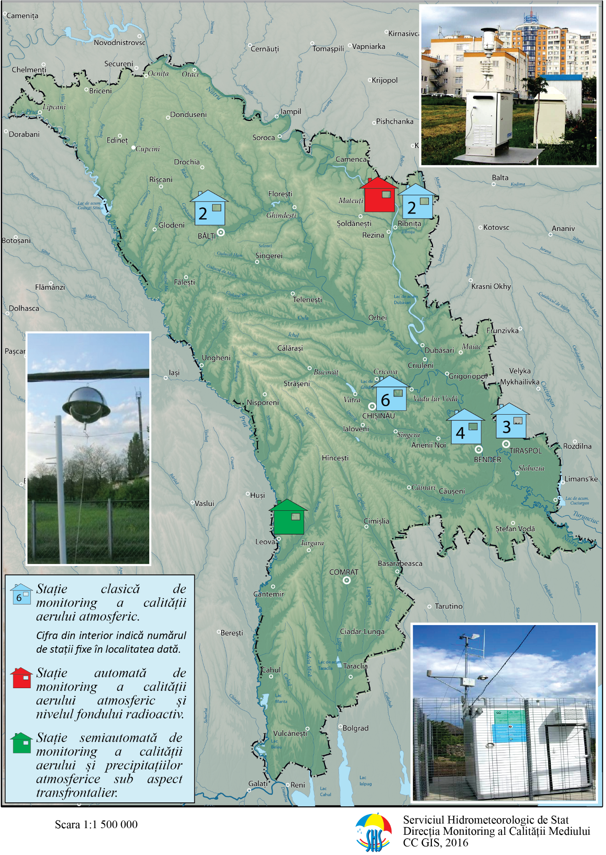
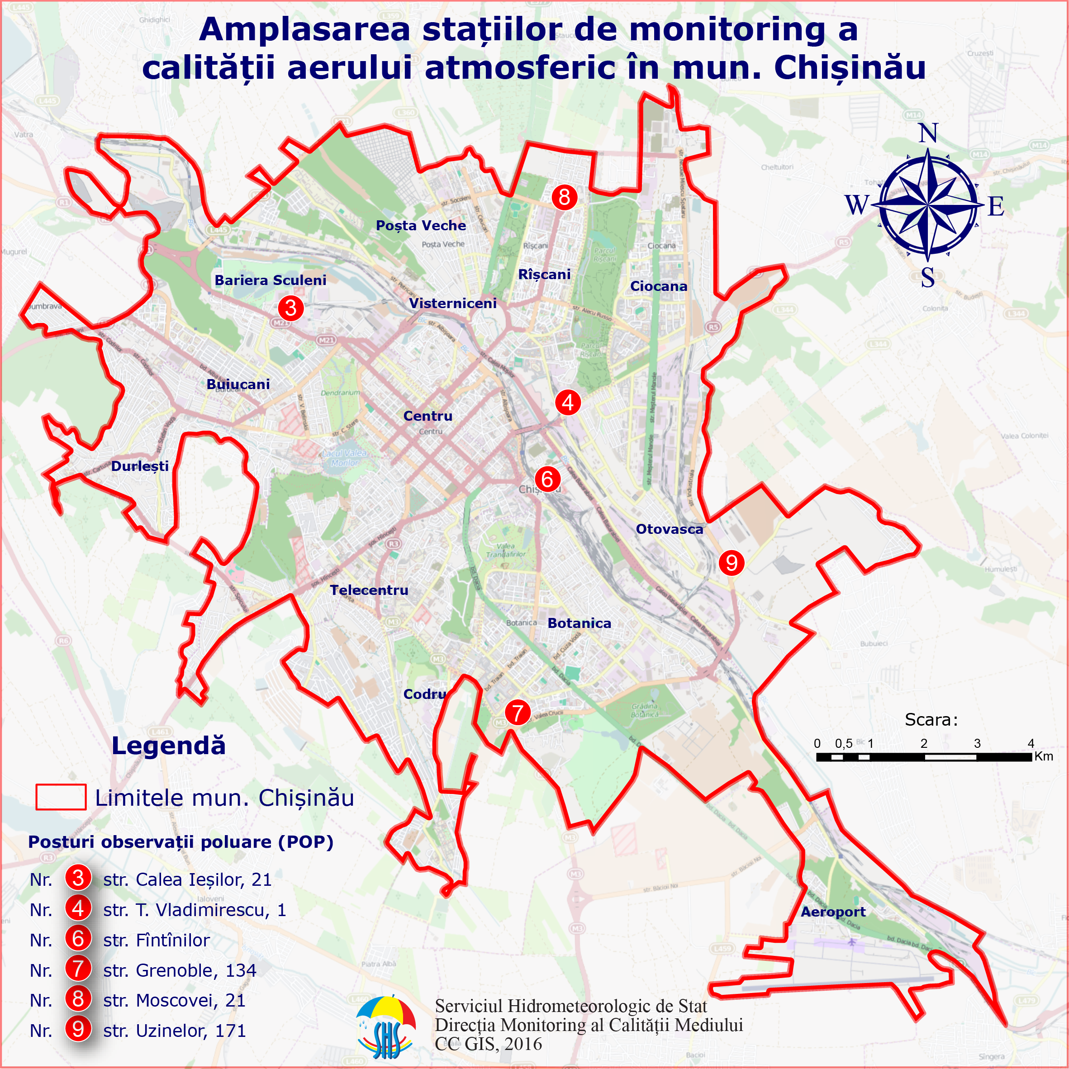
Network monitoring
of air quality
Placement POP in Chisinau

Slide 26
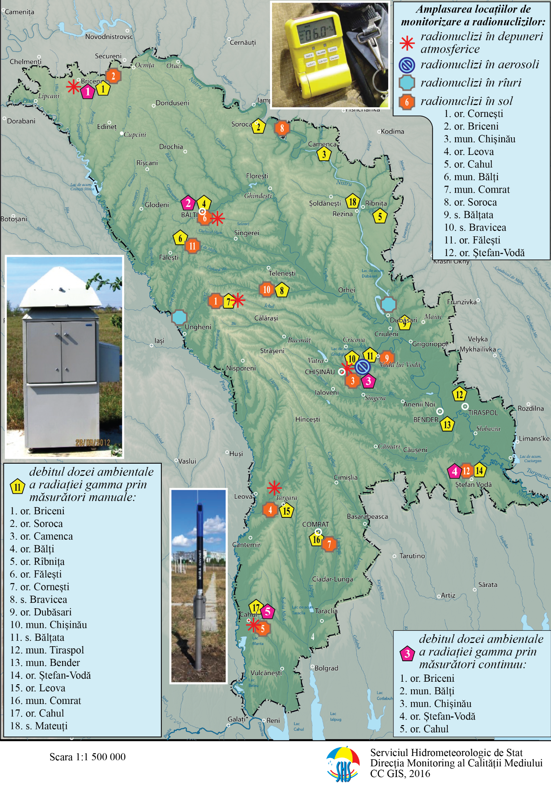
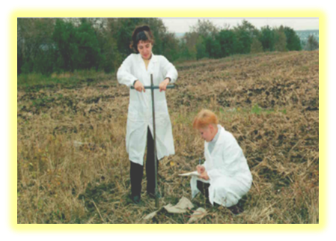
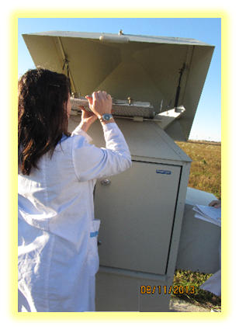
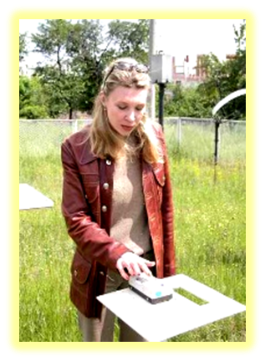

Environmental Radioactivity Monitoring

Slide 27

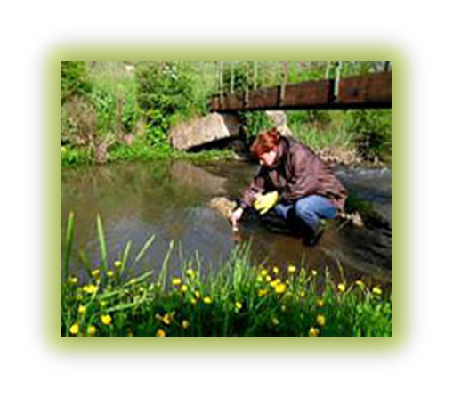


Center Surface Water Quality Monitoring (CSWQM)

Slide 28
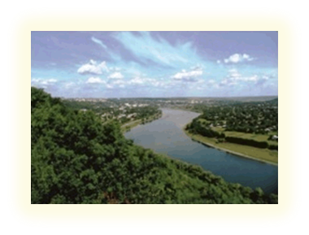
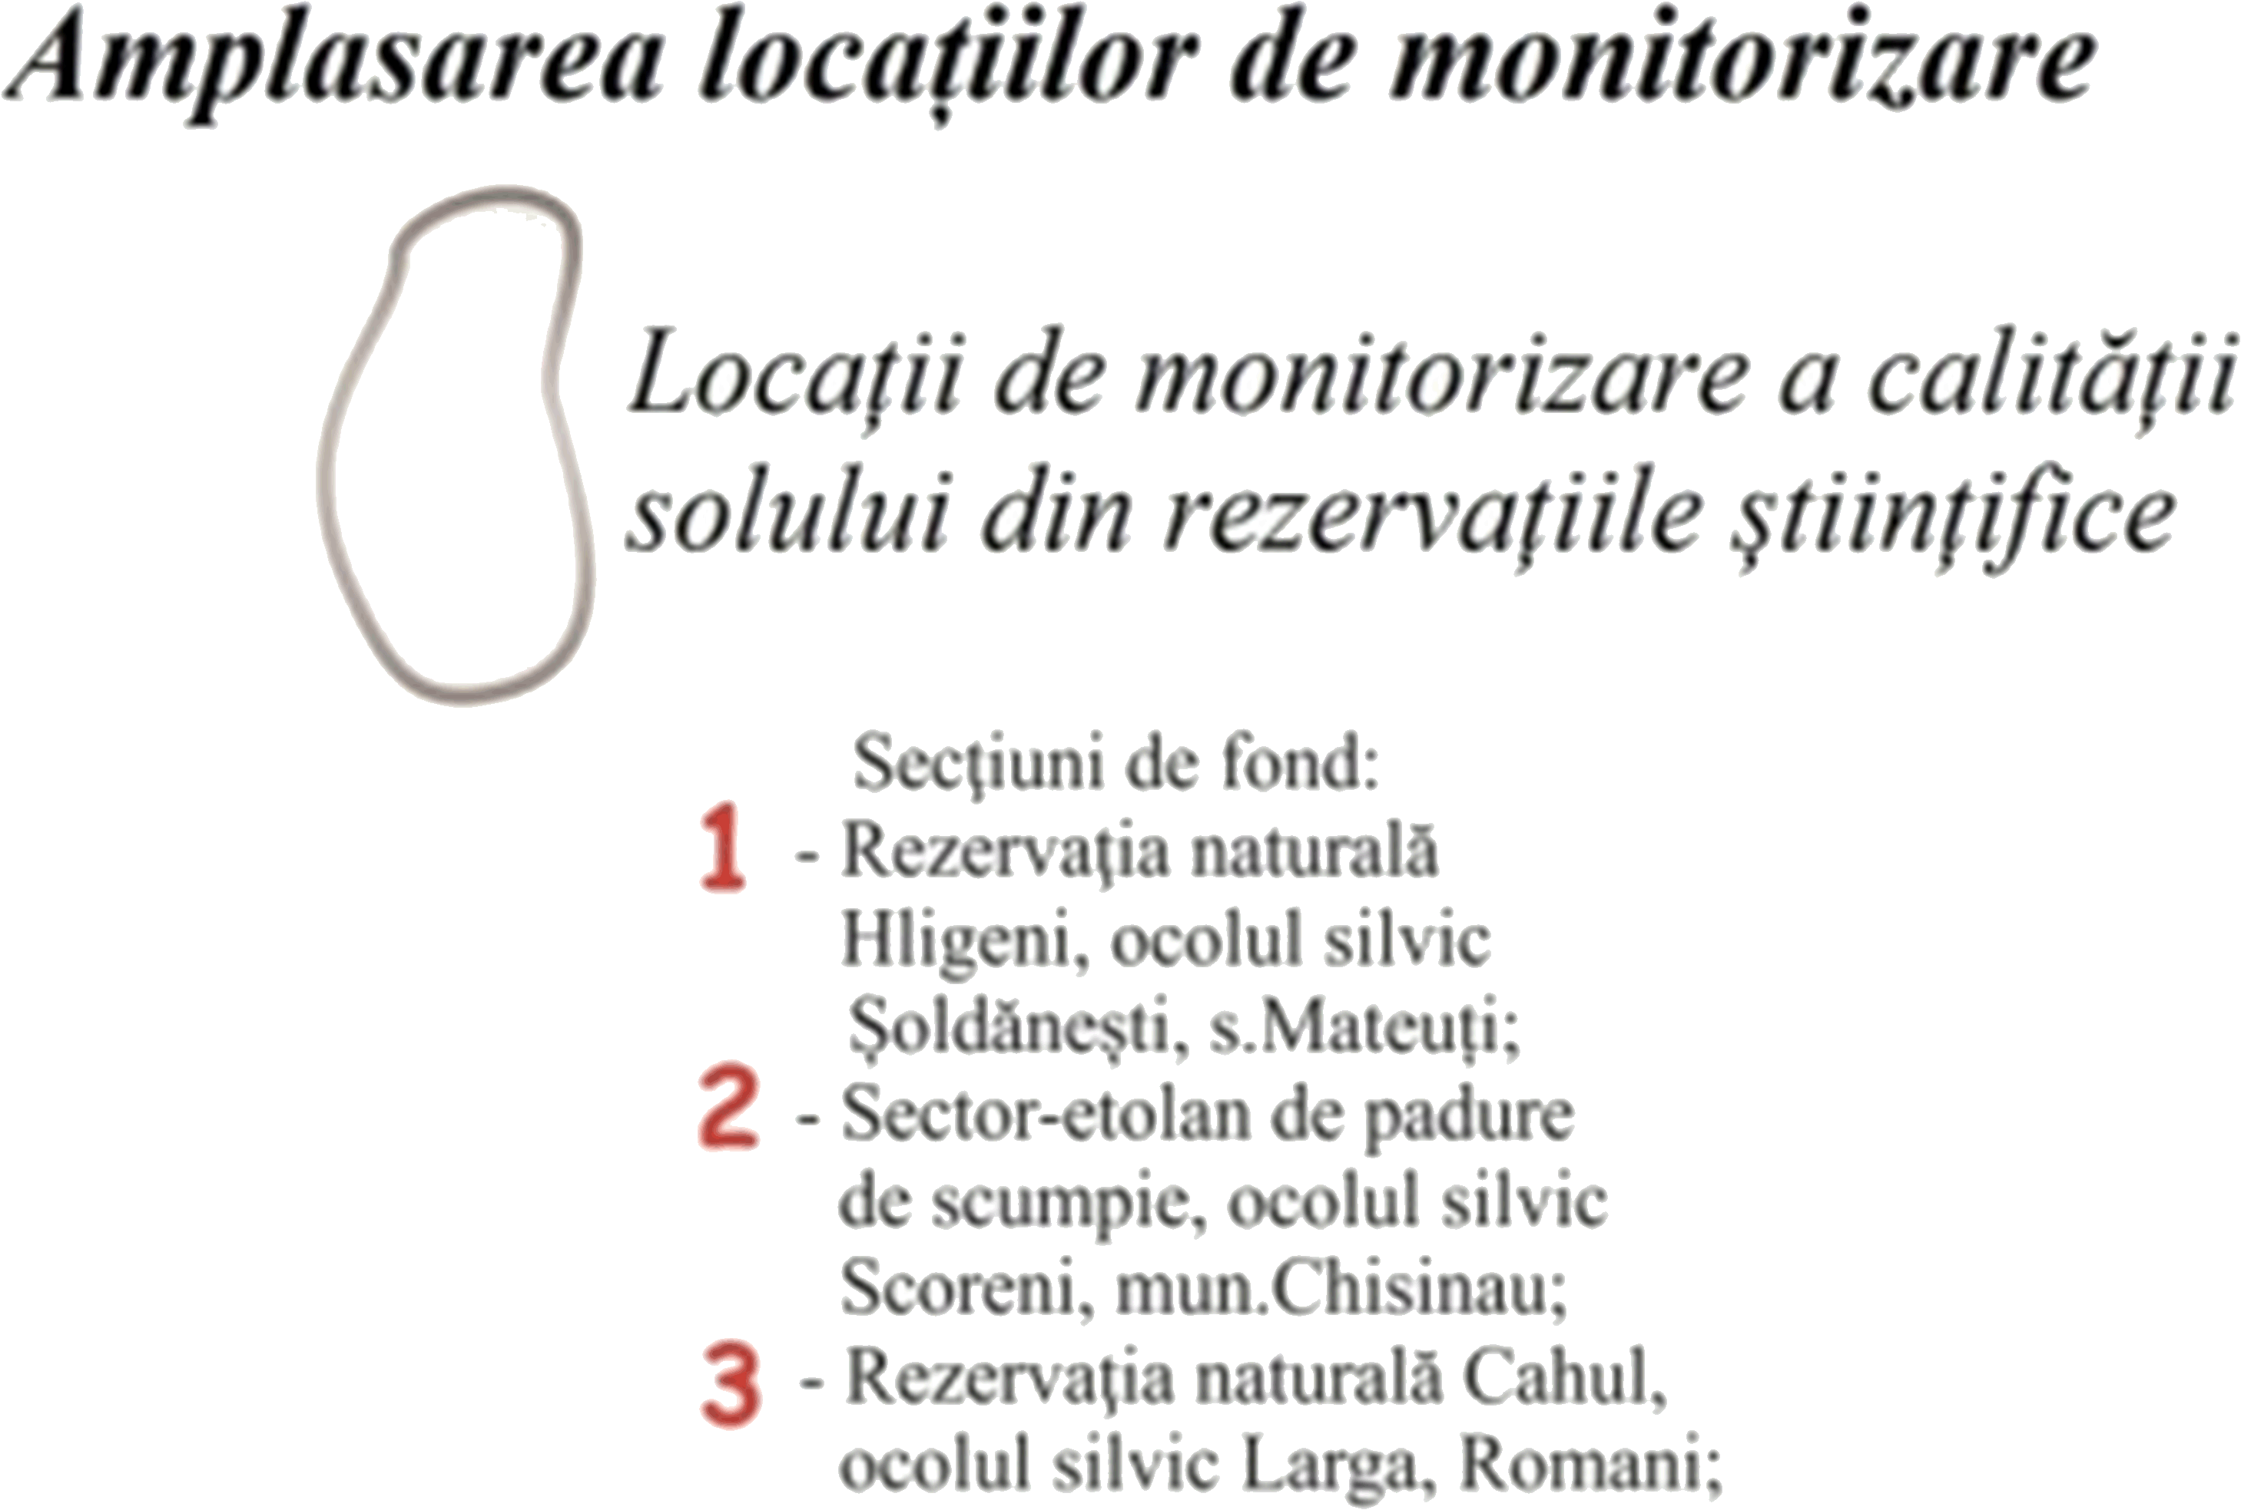

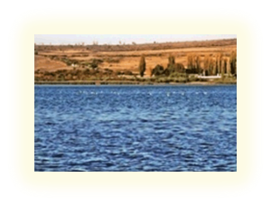
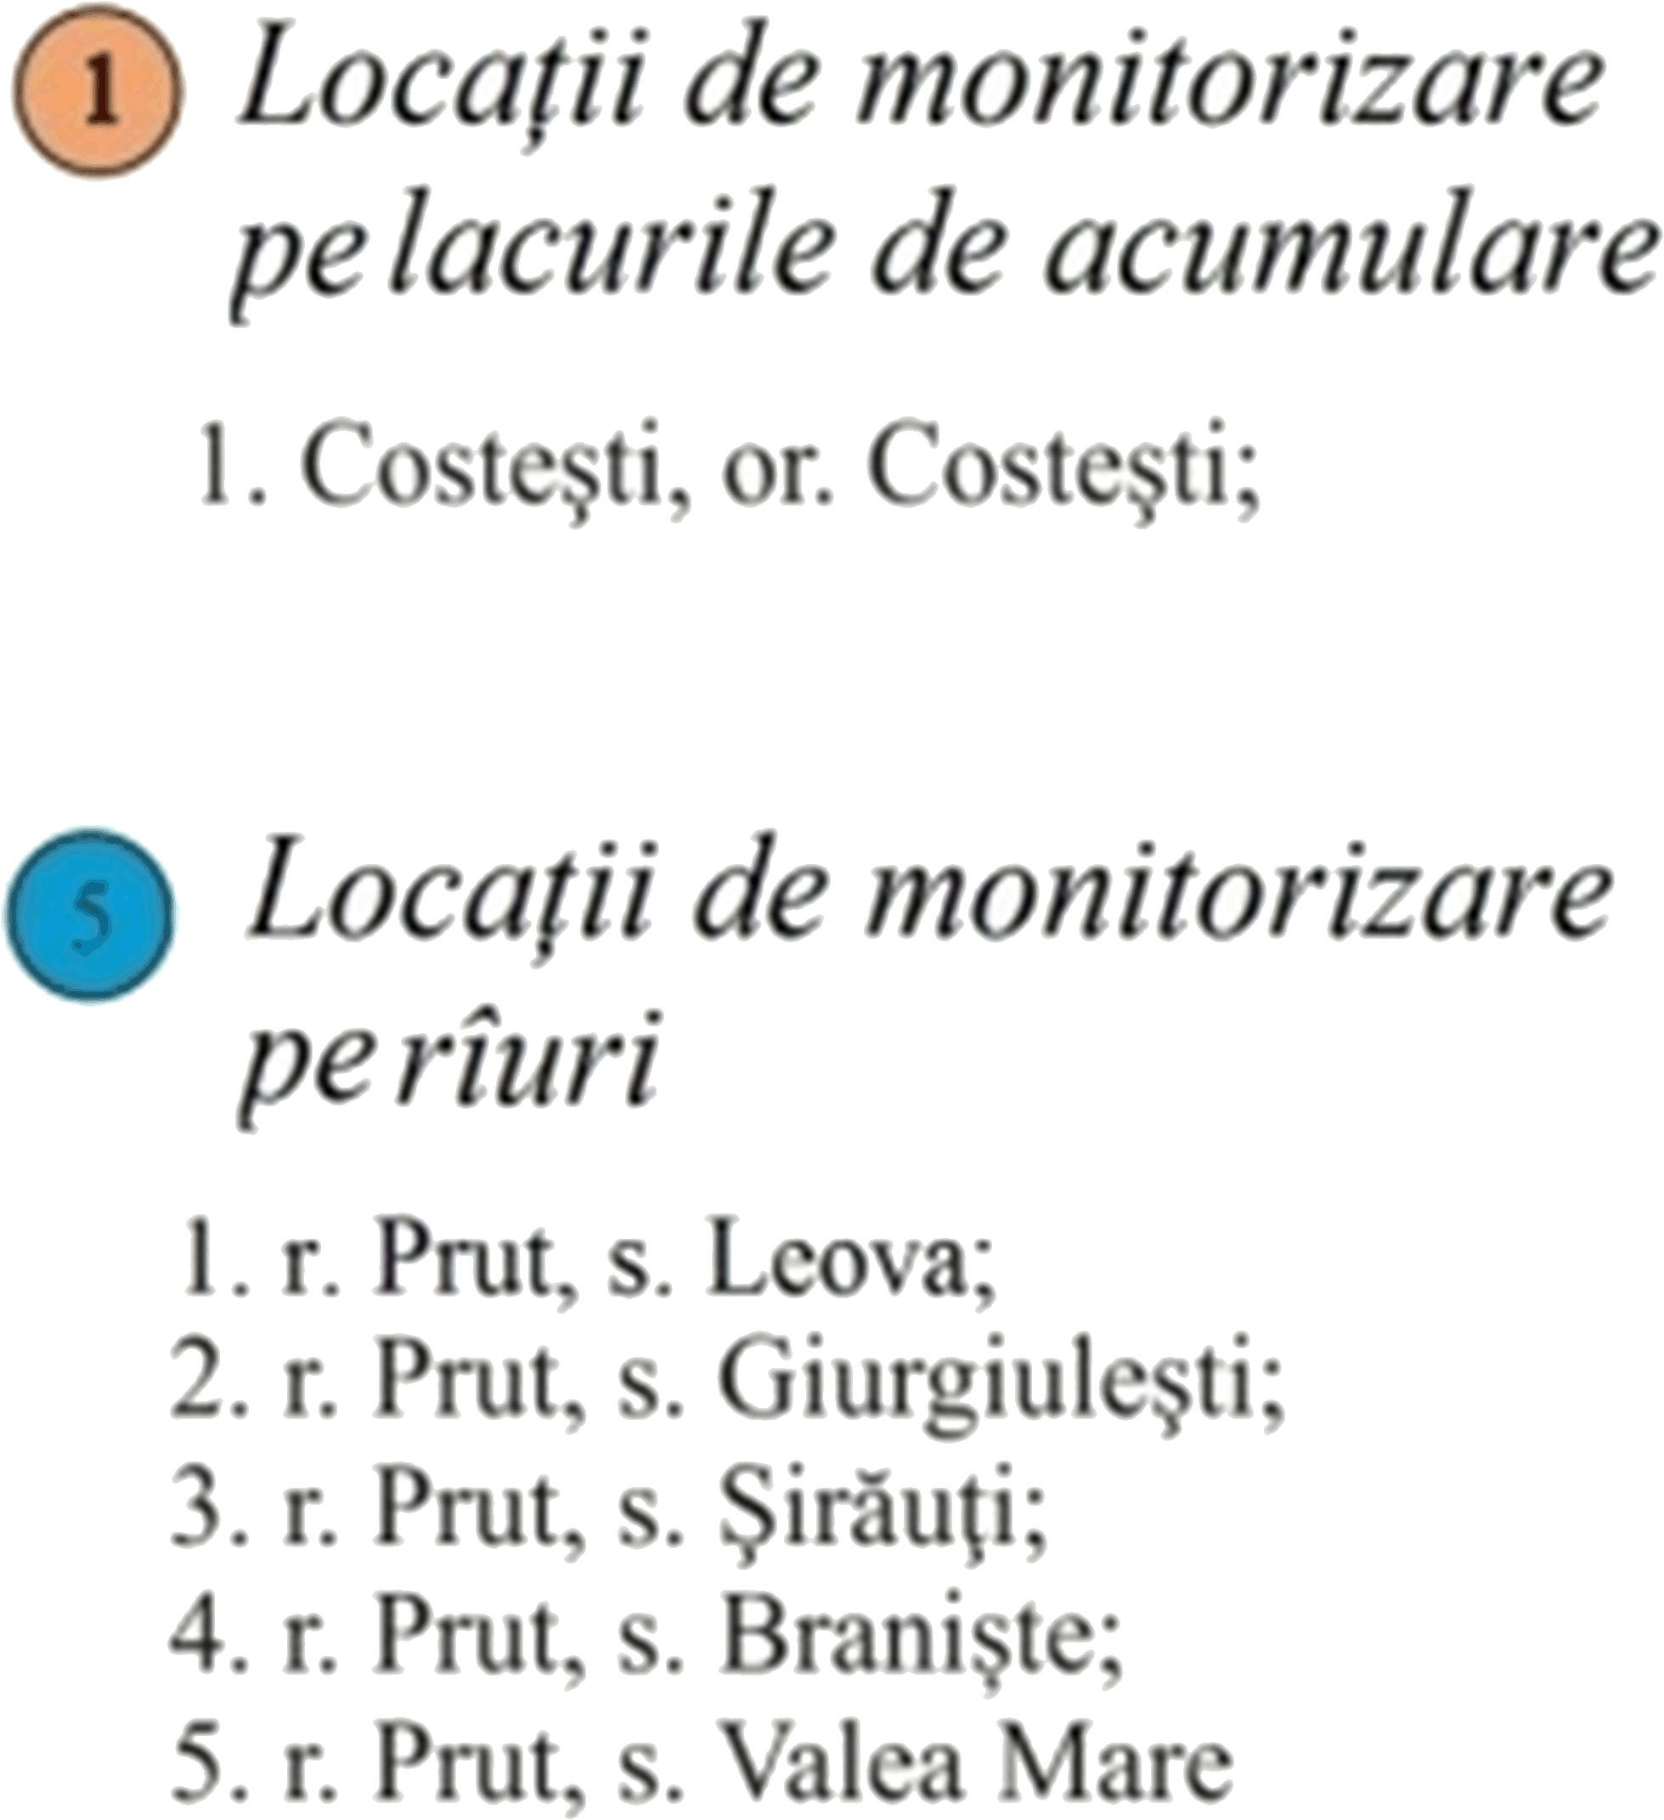
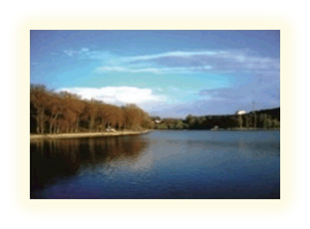

Soil Quality Monitoring Network (SQMN)
Natural sediments from lakes, rivers and water basins of the Republic of Moldova
Fields and farm lands

Slide 29
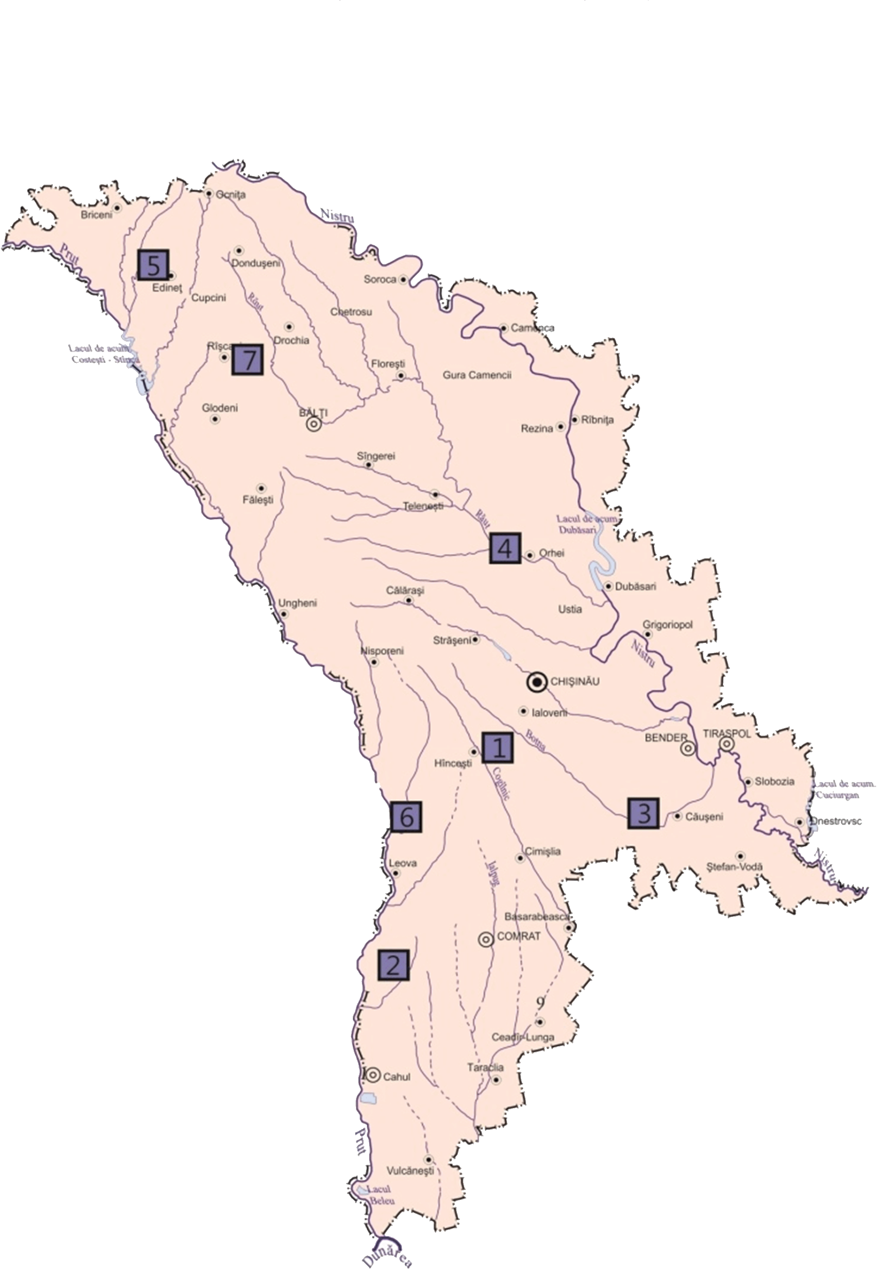
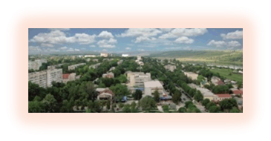

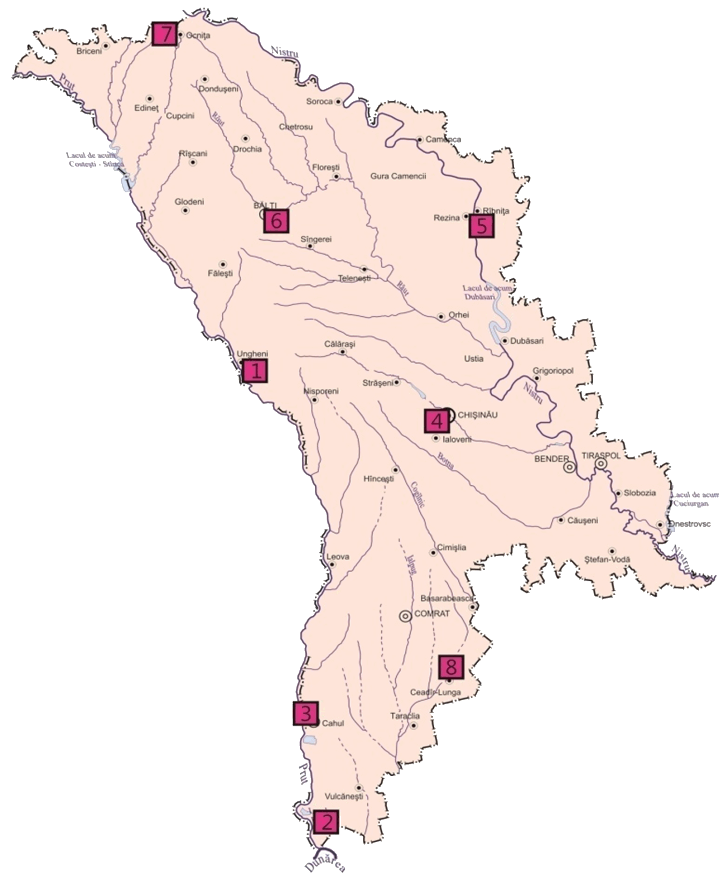
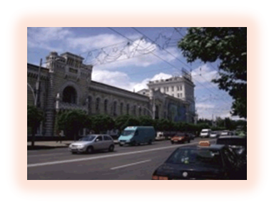

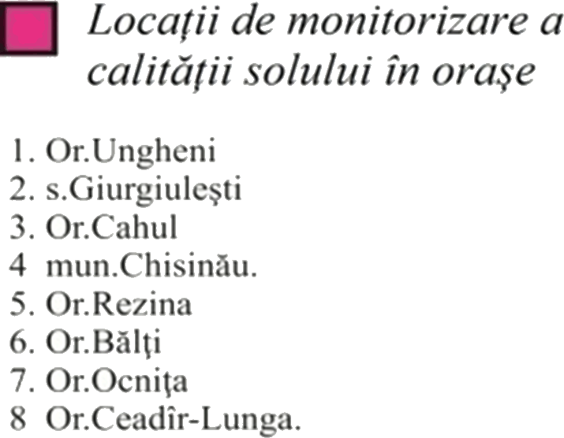
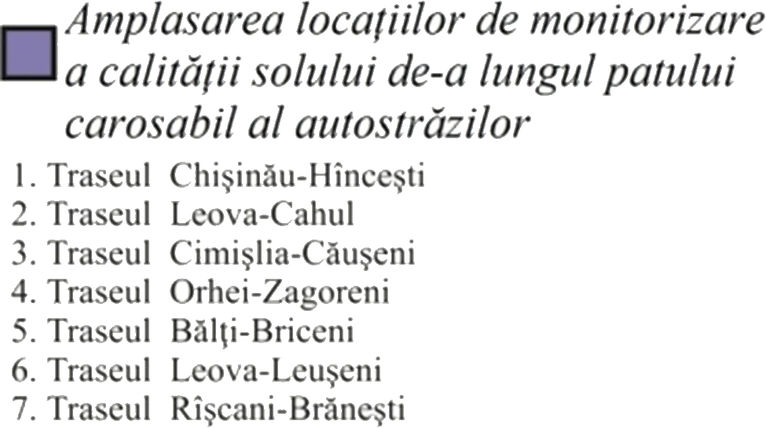
Soil Quality Monitoring Network (SQMN)
Lands located near roads with varying degrees of intensity of movement
Urban lands in cities and towns

Slide 30

Thank you for attention
Questions?

