Slide 1
Republika e Kosovës
Republika Kosova-Republic of Kosovo
Qeveria - Vlada - Government
MINISTRY OF ENVIRONMENTAL AND SPATIAL PLANNING
KOSOVO ENVIRONMENTAL PROTECTION AGENCY
HYDROMETEOROLOGICAL INSTITUTE OF KOSOVA
Hydrometeorological institutE of kosovo
Letafete LATIFI, Director of HMIK
Letafete.Latifi@gmail.com

Slide 2
HMIK MANDATARY
According to the Law for hydro-meteorological activity of Kosovo and Law for environment protection, HMIK is obligated to:
1. monitor atmospheric conditions, atmospheric processes and weather forecast;
2. Monitor hydrological processes and measurements and
3. monitor air quality, water surface and soil quality.
hydrometrical measurements in Kosovo dates from 1923 while monitoring of atmospheric conditions and atmospheric processes started from 1949.
This system has a special importance for state in particular and a general importance for the global caste of environment pollution and international exchange of data monitoring as well.
Our Institute operate under the MESP, concretely under the KEPA.

Slide 3
CHART OF ORGANISATION FOR KEPA
KOSOVO ENVIRONMENTAL PROTECTION AGENCY - KEPA
INSTITUTE FOR SPATIAL PLANNING
HYDROMETEOROLOGICAL INSTITUTE
INSTITUTE FOR NATURE PROTECTION
TWO DIRECTORATES OF NATIONAL PARKS
administrative office
Assistant/translater
driver/technical assistant
DIRECTORAT FOR MONITORING, REORTING AND ASSESMENT OF ENVIRONMENT

Slide 4
CHART OF ORGANISATION FOR HMIK
DIRECTORAT OF HMIK
DIVISION OF HYDROLOGY
DIVISION OF
LABORATORY FOR AIR,WATER AND SOIL ANALYSES
DIVISION OF METEOROLOGY

Slide 5
CURRENT SITUATION IN THE HMIK
There are :
9 (nine) meteorological and climatological stations,
27 hydrometric stations
12 automatic stations for air quality monitoring
54 sampling point for water quality
2800 sampling locations for soil monitoringnitoring
Laboratory for chemical analysis and sampling preparations
Have a MCH software for data archiving and processing

Slide 6
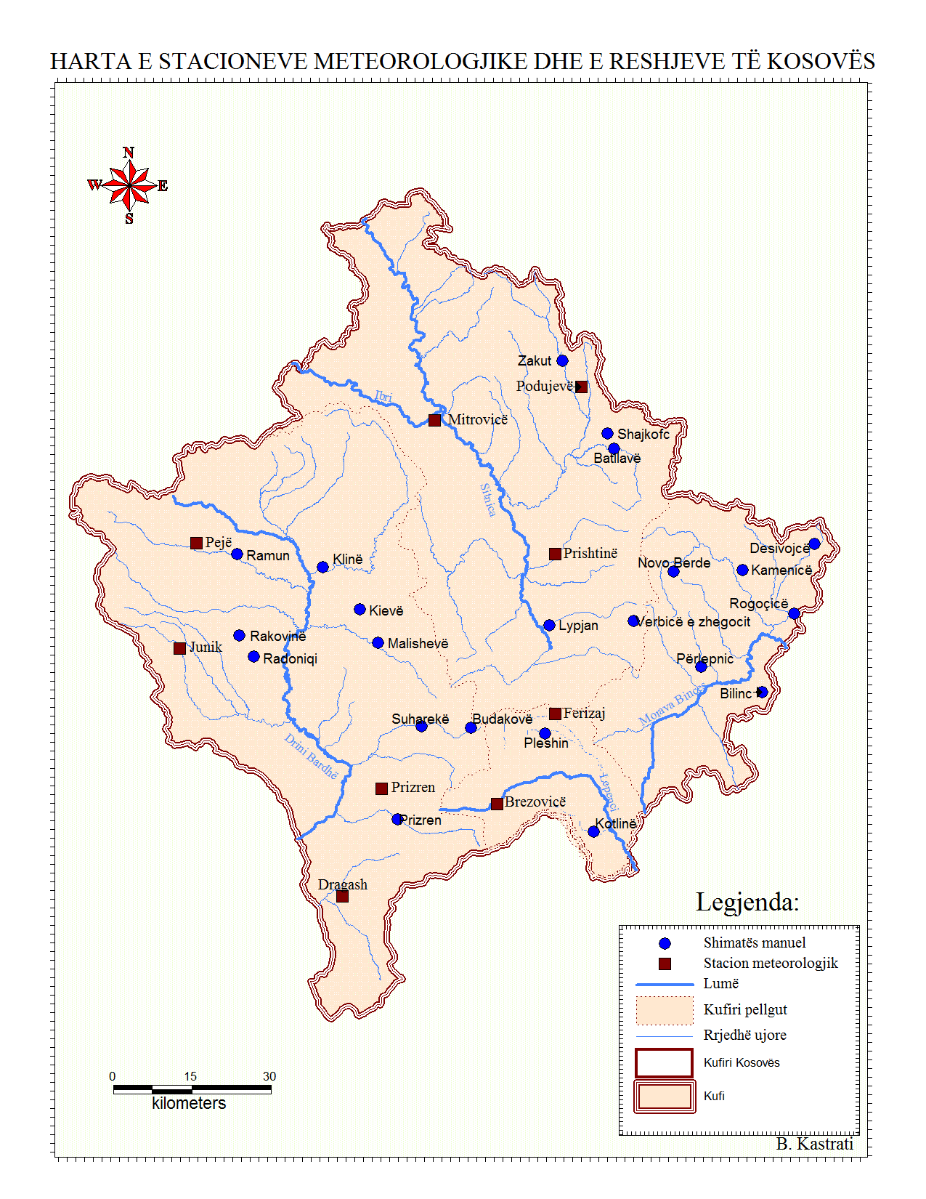
NETWORK OF METEOROLOGICAL AND RAIN GAUGE STATIONS
9 METEOROLOGICAL AND CLIMATOLOGICAL AND
22 RAIN GAUGE STATIONS

Slide 7
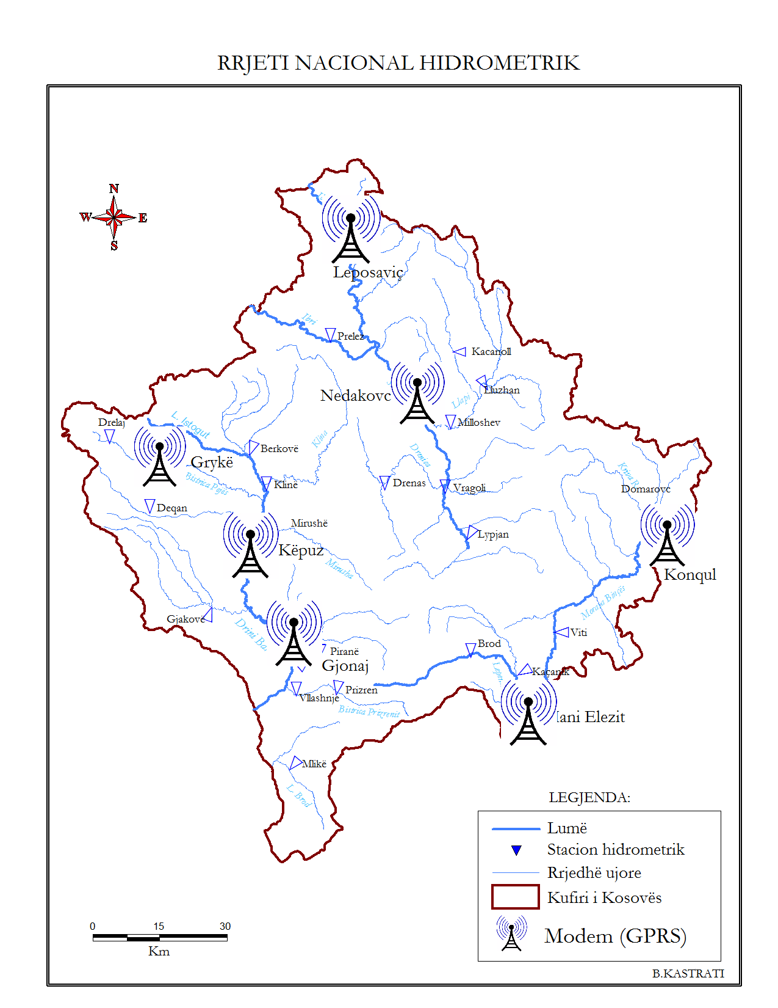
NETWORK OF HIDROLOGICAL STATIONS
27 automatic stations
7 from them are with transfer data in real time on central software

Slide 8
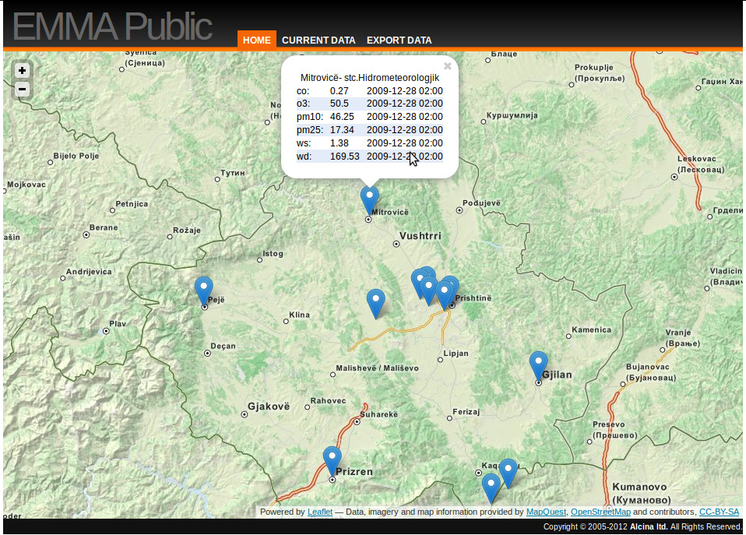
NETWORK OF AIR QUALITY MONITORING
12 stations where monitor gas polluters and dus- PM10/PM2.4

Slide 9
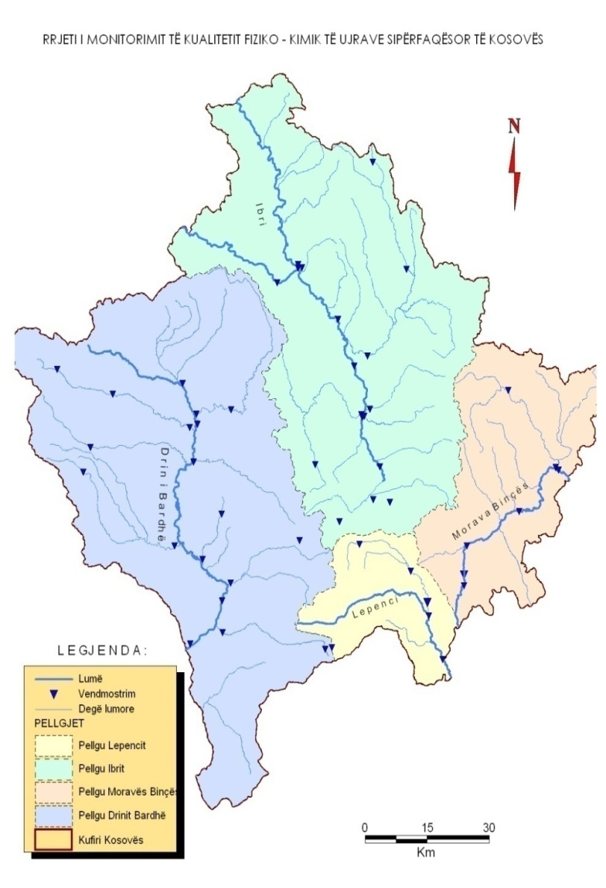
Network of water quality monitoring
54 sampling locations

Slide 10
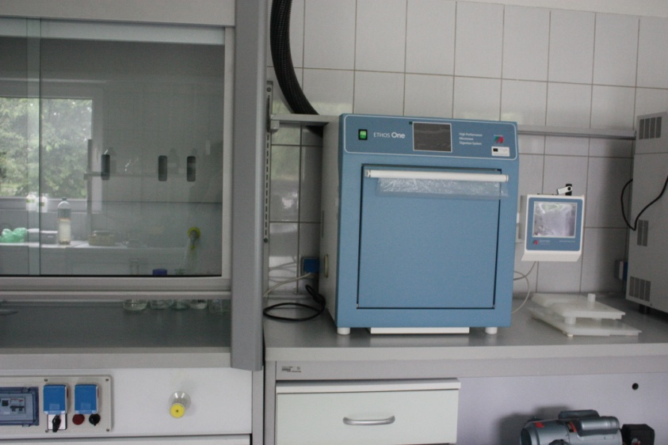
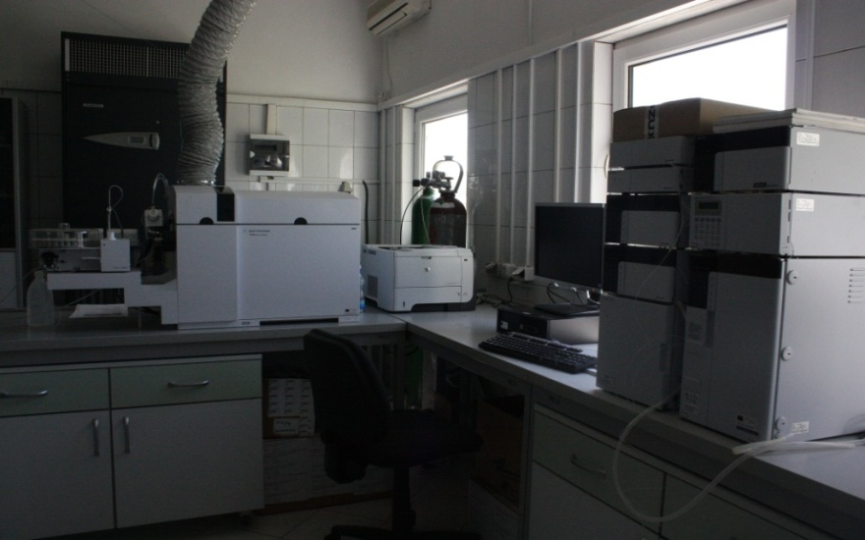
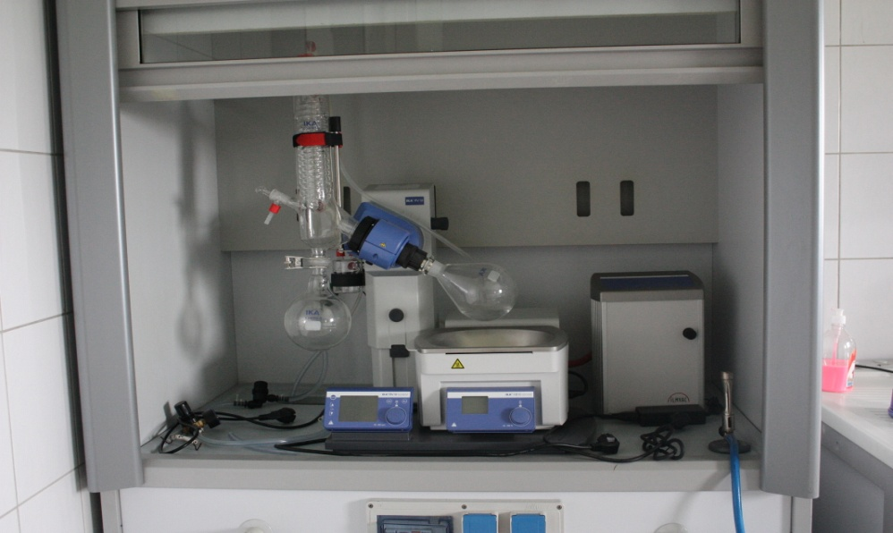
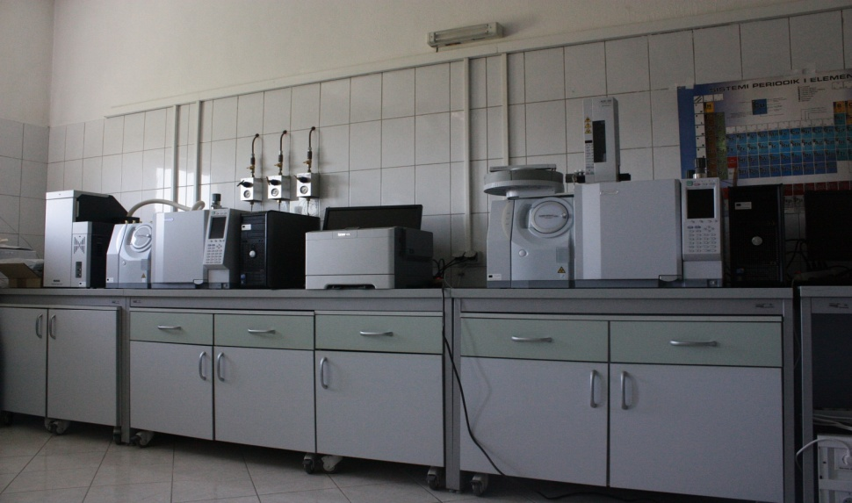
Chemical Laboratory

Slide 11
ESTABLISHED A DATA BASA AND ARCHIVE OF DATA
database
MCH software &
Server
Hidrological
Climatological
Environmental data
(air , water and soil quality)
Meteorological

Slide 12
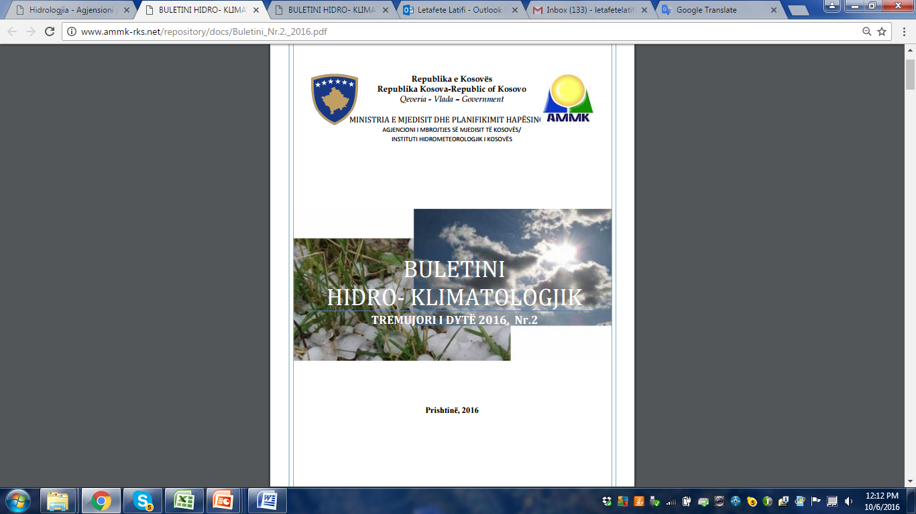
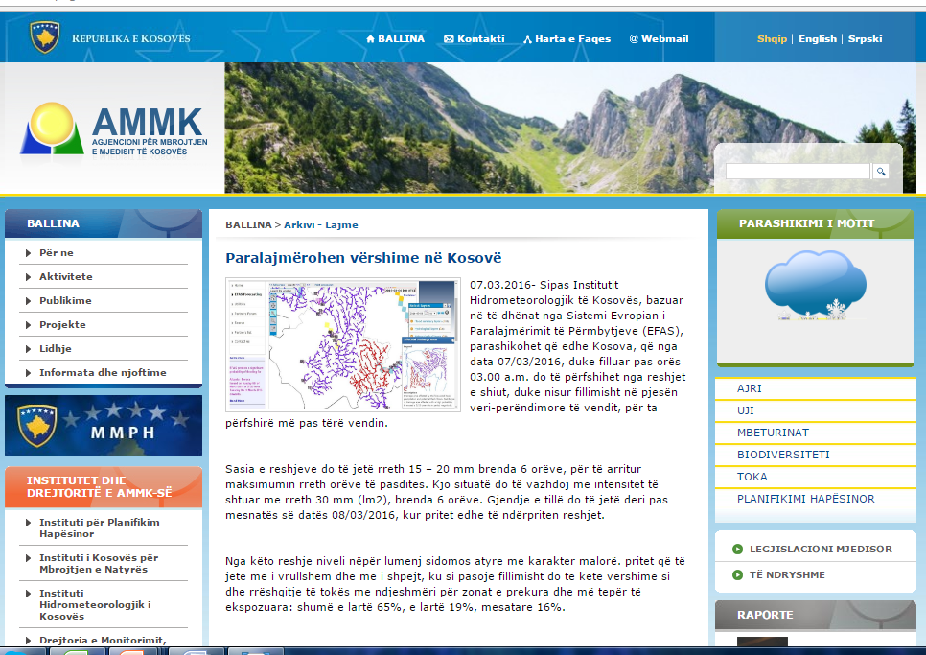
The public Information
Through the report that upload on KEPA web page,http://www.ammk-rks.net/
Media

Slide 13
PROJECTS DEVELOPED
GIZ GmbH
Climat change adaptation in west ballkan for River basen Drin/Buna
REHABILITATION OF HYDROMETRIC NETWORK
2014 - 2016
MEMBERSHIP IN EFAS
(European Flood Awareness System)
calculate SPI
Standardisation of precipitation index
MCH
Meteorological, Climatological and Hydrological
Data Base Management System

Slide 14
ACHIVEMENT DURING 2015-2016
The renovated, 21 automatic hydrological stations, 5 (five) from them in real time transfer data, investment from our government;
Establish a database archive;
Membership in EFAS network;
Started to public the bulletin for hydro-climatology and year book

Slide 15
For the future
Proposed actions
Installation of the automatic stations in Kosovo.
Establish a radar system
Training or education of meteorological staf

Slide 16
THANK YOU FOR YOUR ATTENTION

