Slide 1
Meteosat Third Generation Presentation to ICEED-10 21 Sept. 2010
By Bruno Mullet
MTG System Architecture
EUM/MTG/VWG/10/0378
Presentation to ICEED-10
21 September 2010

Slide 2
Topics
MTG to Secure Continuity and Evolution of Services
Overview of MTG System
Programme Implementation and Schedule
MTG Missions and their Benefits
EUM/MTG/VWG/10/0378
Presentation to ICEED-10
21 September 2010

Slide 3
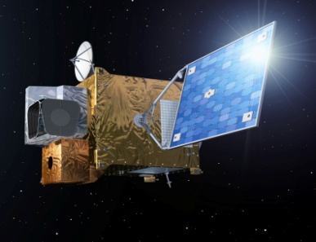
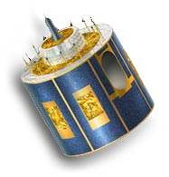
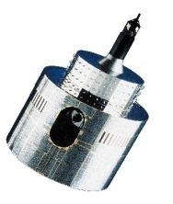
MTG to Secure Continuity and Evolution of EUMETSAT Services
1977
2002
2017 and 2019
MOP/MTP
MSG
MOP/MTP
MSG
MTG-I and MTG-S
Observation missions:
- Flex.Comb. Imager: 16 channels
- Infra-Red Sounder
Lightning Imager
UVN
3-axis stabilised satellites
Twin Sat configuration
Class 2,5 - 3 ton
Observation missions:
- SEVIRI: 12 channels
GERB
Spinning satellite
Class 2-ton
Observation mission:
MVIRI: 3 channels
Spinning satellite
Class 800 kg
Implementation of the EUMETSAT Mandate
for the Geostationary Programme
Atmospheric Chemistry Mission (UVN-S4):
via GMES Sentinel 4
EUM/MTG/VWG/10/0378
Presentation to ICEED-10
21 September 2010

Slide 4
MTG System Concept
MTG Space Segment Configuration
Twin Satellite Concept, based on 3-axis platforms
Imaging Satellites (MTG-I)
Sounding Satellites (MTG-S)
The payload complement of the MTG-I satellite consists of
• The Flexible Combined Imager (FCI)
• The Lightning Imager (LI)
• The Data Collection System (DCS) and Search and Rescue (GEOSAR)
The payload complement of the MTG-S satellite consists of
• The Infrared Sounder (IRS)
• The Ultra-violet, Visible and Near Infrared Sounder (UVN).
UVN is provided as GMES Sentinel 4 Instruments
EUM/MTG/VWG/10/0378
Presentation to ICEED-10
21 September 2010

Slide 5
MTG Provides a Total of Five Missions Compliant to the User Needs
Full Disk High Spectral resolution Imagery (FDHSI), global scales (Full Disk) over a BRC = 10 min, with 16 channels at spatial resolution of 1 km (8 solar channels)
and 2 km (8 thermal channels)
High spatial Resolution Fast Imagery (HRFI), local scales (1/4th of Full Disk) over a BRC = 2.5 min with 4 channels at high spatial resolution 0.5 km (2 solar channels)
and 1.0 km (2 thermal channels)
InfraRed Sounding (IRS), global scales (Full Disk) over a BRC = 60 min at spatial resolution of 4 km, providing hyperspectral soundings at 0.625 cm⁻¹ sampling in two bands: Long-Wave-IR (LWIR: 700 – 1210 cm⁻¹ ~ 820 spectral samples)
Mid-Wave-IR (MWIR: 1600 – 2175 cm⁻¹ ~ 920 spectral samples)
Lightning Imagery (LI), global scales (80% of Full Disk) detecting and mapping continuously the optical emission of cloud-to-cloud and cloud-ground discharges. Detection efficiency between DE=90% (night) and DE=40% (sun overhead, thick clouds)
UVN Sounding, implemented as GMES Sentinel 4 Instruments provided by ESA
EUM/MTG/VWG/10/0378
Presentation to ICEED-10
21 September 2010

Slide 6
MTG in Orbit Deployment Scenario
‘14 ’15 ‘16 ‘17 ‘18 ‘19 ‘20 ‘21 ‘22 ‘23 ‘24 ‘25 ‘26 ‘27 ‘28 ‘29 ‘30 ‘31 ‘32 ‘33 ‘34 ‘35 ‘36 ‘37 ‘38 ‘39 ‘40
MSG-4
MTG-I1
Dec-17
MTG-I2
MTG Full Operational
Configuration
Dec-22
MTG-I3
Jan-26
MTG-I4
Dec-30
2018–2039: At least 20 years of Operational Service – Imaging Missions
MTG-S1 with S4
Jun-19
MTG-S2 with S4
Jun-27
2020–2036: At least 15.5 years of Operational Service – Sounding
EUM/MTG/VWG/10/0378
Presentation to ICEED-10
21 September 2010

Slide 7
MTG System Concept
- Ground Segment, composed of
Ground Station Facility (GSTF) – TTC (Telemetry, Tracking and teleCommand), and MDA (Mission Data Acquisition);
Mission Operations Facility (MOF);
Instrument Data Processing Facility (IDPF);
Application Ground Processing system:
Level 2 Processing Facility (L2PF);
Satellite Application Facilities (SAFs);
Multi-Mission Elements (MME) – e.g EUMETCast, EUMETSAT Data Centre, EO Portal; Infrastructure Facilities and Supporting Facilities;
EUM/MTG/VWG/10/0378
Presentation to ICEED-10
21 September 2010

Slide 8
MTG – Overall System Configuration - Overview
Satellites: Full operational configuration: • two MTG-I
• one MTG-S
Ground segment (GS):
• MCC (GS elements at HQ
• GSt (Ground Stations)
• SAFs (de-centralised GS
elements)
Satellites P/L
MTG-I :
FCI, LI , plus
DCS, and SAR
MTG-S: IRS , UVN
EUM/MTG/VWG/10/0378
Presentation to ICEED-10
21 September 2010

Slide 9
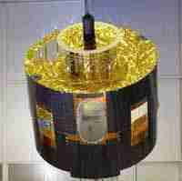
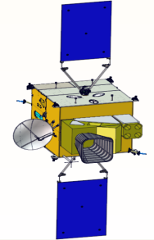
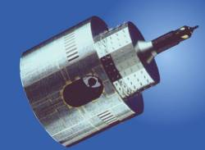


MTG – New challenges in Information Technology
Meteosat evolutions:
2002
2017
2019
1977
1 Imager – 3 Channels
2.25 km HR – 4.5 km
30 Min RC
1 Imager – 12 Channels
1km HRV – 3km
15 Min RC
1 Imager – 16 Channels
0.5 & 1km HR – 1 & 2 km
10 Min RC + LI
1 IR Sounder- 2 Bands
4 km
60 Min RC + UVN-S4
MSG
Raw data link - L-Band
3.2 Mbps
3.2 Mbps
3 Mbps
Raw data link - KA-Band
MTG
>/= 100 Mbps
to be disseminated ?
Initially
limited to 100 Mbps
on future EUMETCast
(current assumption)
340 - 400 Mbps
340 - 400 Mbps
EUM/MTG/VWG/10/0378
Presentation to ICEED-10
21 September 2010
Slide: 9

Slide 10
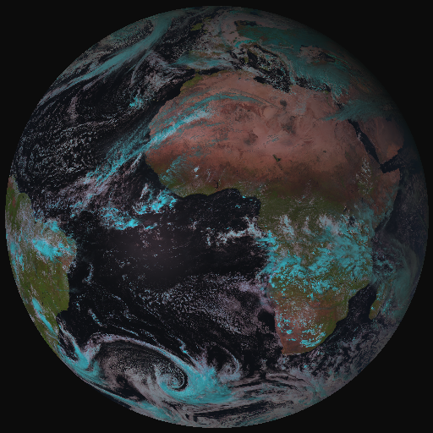
From SEVIRI to the FC Imager
HRFI → RSS
MTG FCI outbids MSG SEVIRI observations on cloud, aerosol, moisture and fire:
by adding new channels
by improving temporal-,
spatial-, and radiometric
resolution
FDHSI → FDSS
Coverage Repeat cycle FDHSI mission Full Disc 10 min
HRFI mission 1/4 FD 2.5 min
EUM/MTG/VWG/10/0378
Presentation to ICEED-10
21 September 2010

Slide 11
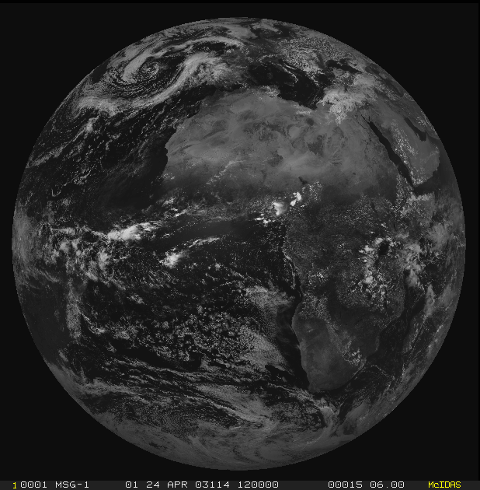
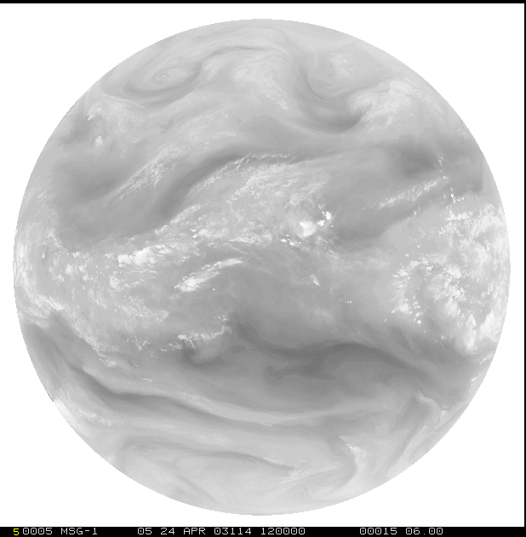
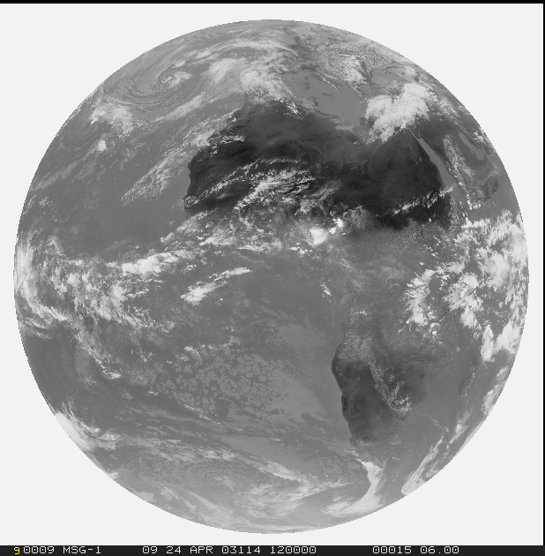
From MVIRI through SEVIRI to FCI on MTG
1=VIS0.6
12=HRV
2=WV6.2
EUM/MTG/VWG/10/0378
Presentation to ICEED-10
21 September 2010
3=IR10.8

Slide 12
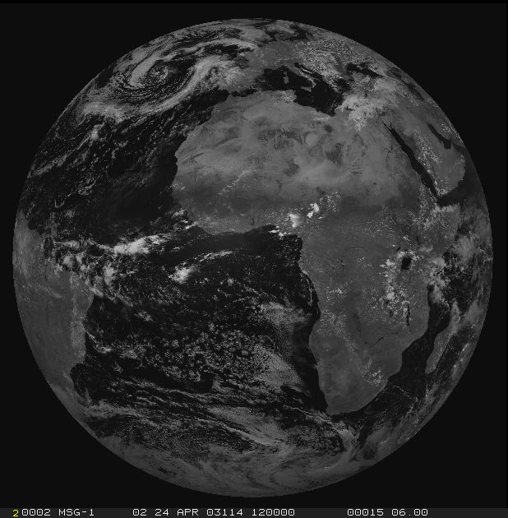
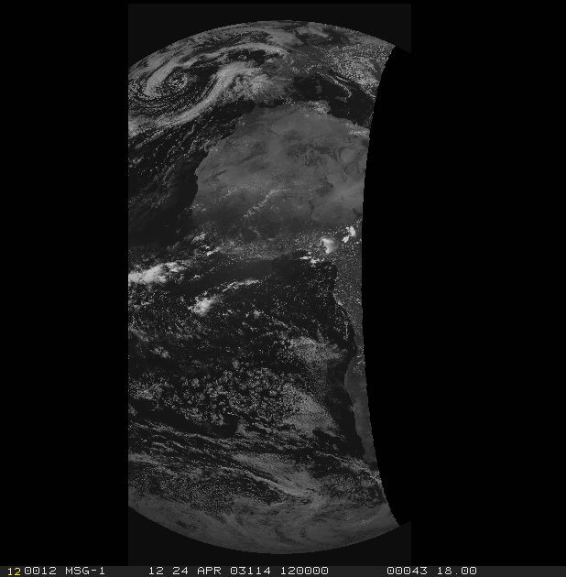
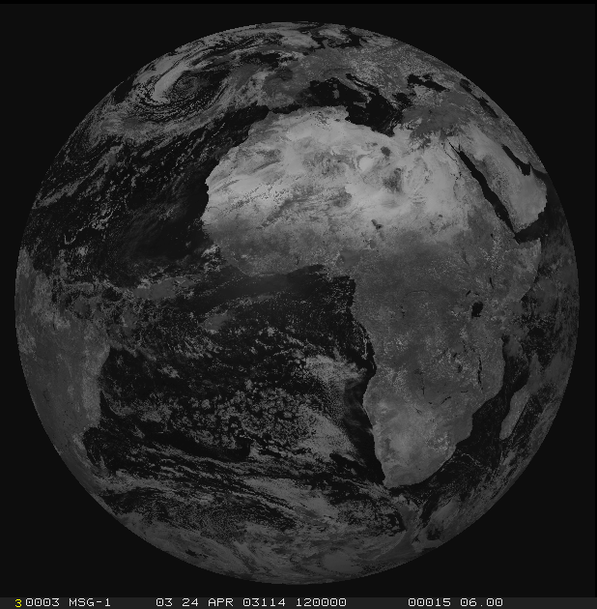
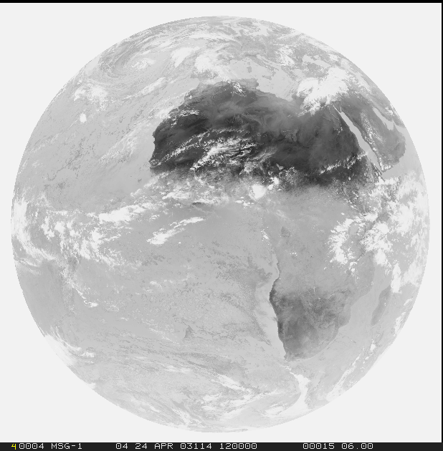
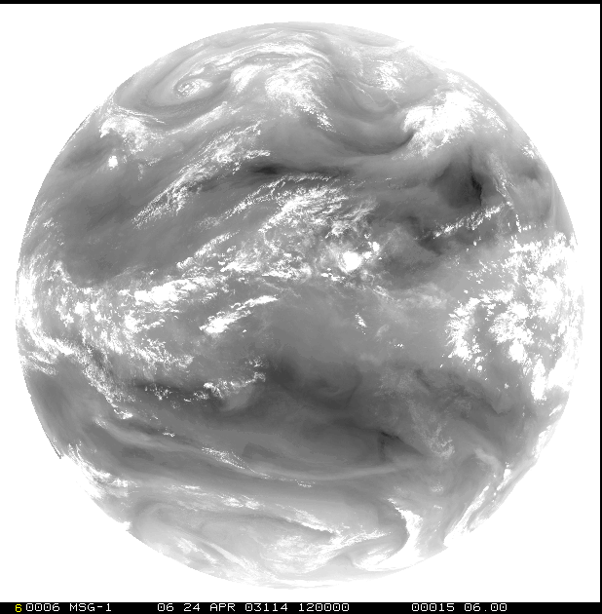
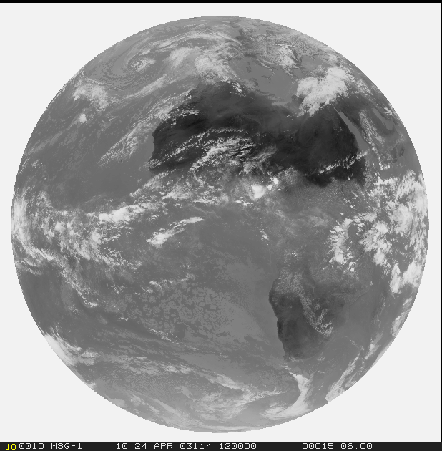
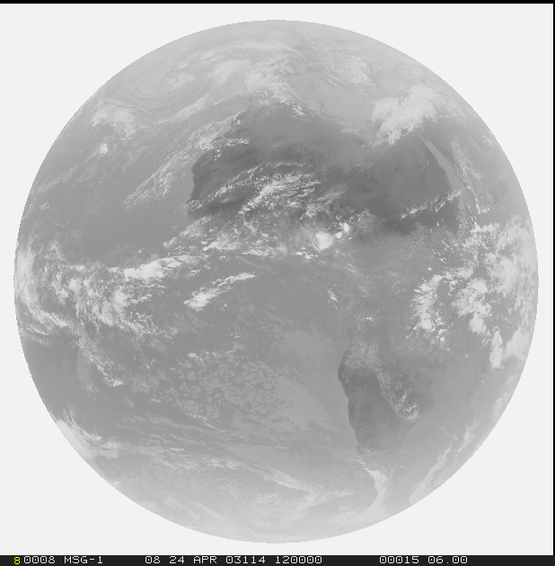
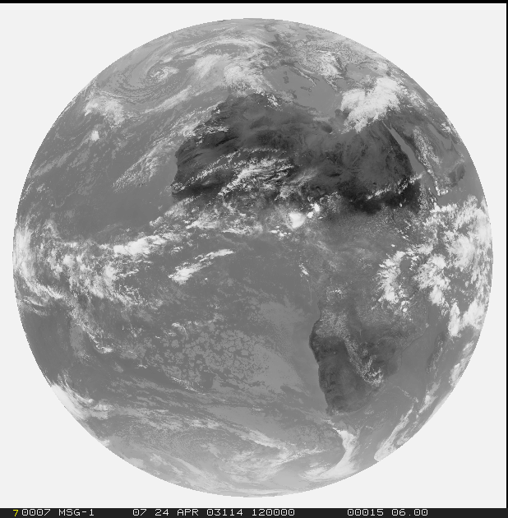
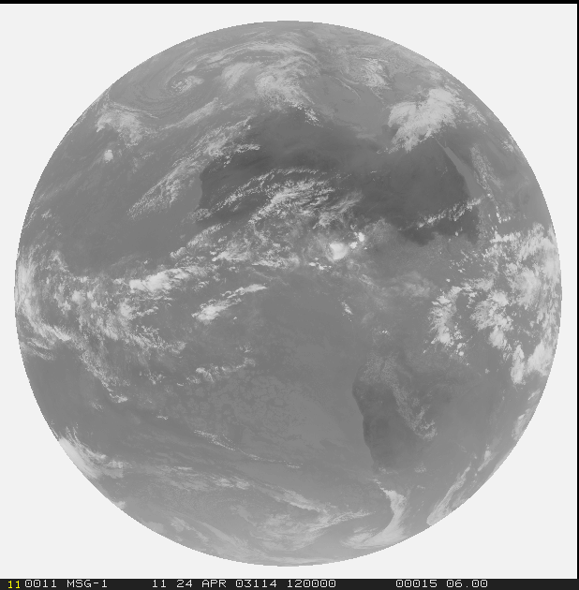
From MVIRI through SEVIRI to FCI on MTG
1=VIS0.6
2=VIS0.8
12=HRV
3=NIR1.6
4=IR3.8
5=WV6.2
6=WV7.3
7=IR8.7
8=IR9.7
9=IR10.8
10=IR12.0
11=IR13.4
EUM/MTG/VWG/10/0378
Presentation to ICEED-10
21 September 2010

Slide 13
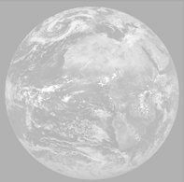
From MVIRI through SEVIRI to FCI on MTG
1=VIS0.4
2=VIS0.5
3=VIS0.6
4=VIS0.8
5=NIR0.9
6=NIR1.3
7=NIR1.6
8=NIR2.2
9=IR3.8
10=WV6.2
11=WV7.3
12=IR8.7
13=IR9.7
14=IR10.5
15=IR12.3
16=IR13.3
EUM/MTG/VWG/10/0378
Presentation to ICEED-10
21 September 2010

Slide 14
MTG Missions FCI – Main Benefits
The 0.444 µm and the 0.51 µm channels will permit surpassing current aerosol retrievals especially over land – also an important contribution to air quality monitoring.
The 0.91 µm channel will provide during daytime total column precipitable water especially over land surfaces.
The 1.375 µm channel will improve detection of very thin cirrus clouds not seen by the current system introducing errors in all clear sky products.
The 2.26 µm channel will provide the capability for an improved retrieval of cloud microphysics.
The improved spatial resolution (1 km and 2 km) and the extended dynamical range (from 350 K to 450 K) of the 3.8 µm channel will firstly outbid the fire detection quality of MSG and secondly outbid the quality of products as Fire Radiative Energy (FRE) – a climate relevant product directly related to the CO₂ production of active fires.
EUM/MTG/VWG/10/0378
Presentation to ICEED-10
21 September 2010

Slide 15
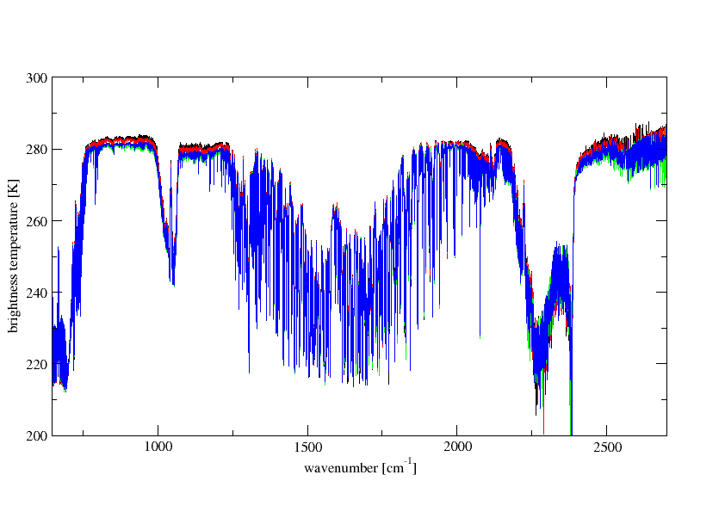

MTG-IRS to Detect ‘River Like Moisture Flows’
MTG-IRS mission will deliver unprecedented information on
horizontal and vertical gradients of moisture, wind and temperature between measurements of individual radiosondes and hyperspectral soundings from the polar orbiting satellites.
T(p) Sfc O₃ Sfc
H₂O(p) CO
700 – 1210 cm⁻¹
1600 – 2175 cm⁻¹
Temp (CO2)
Surface, Clouds
Surface,
Clouds
Surface,
Clouds
CO
O3
N2O,
Temp (CO2)
Temp (CO2)
H2O, CH4, N2O
EUM/MTG/VWG/10/0378
Presentation to ICEED-10
21 September 2010
EUM/MTG/VWG/10/0307
Presentation to Luxemburg
12 August 2010

Slide 16
MTG-IRS Concept
MTG-IRS Operations Scenario
LAC -4
~ 300 stares for Full Disc Coverage
~ 75 stares Local Area Coverage (LAC)
LAC-1/2/3/4 repeat cycle: 15 min including 2-3 min for calibration
Basic Repeat Cycle Pattern over 6 hours:
5 times LAC-3 plus LAC-4
4 times LAC-2 plus LAC-4
3 times LAC-1 plus LAC-4
LAC-4 (Europe) covered every 30 min
all LACs have at least 3 consecutive measurements with 30 min repeat cycle
LAC -3
LAC -2
LAC -1
EUM/MTG/VWG/10/0378
Presentation to ICEED-10
21 September 2010

Slide 17
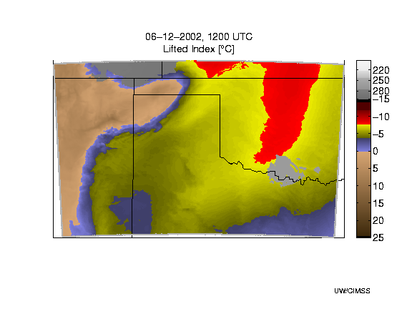
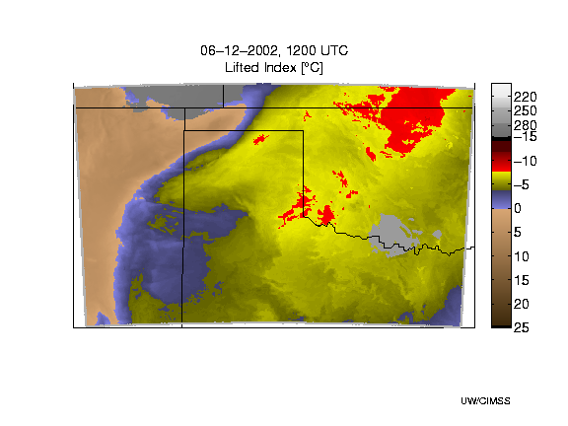
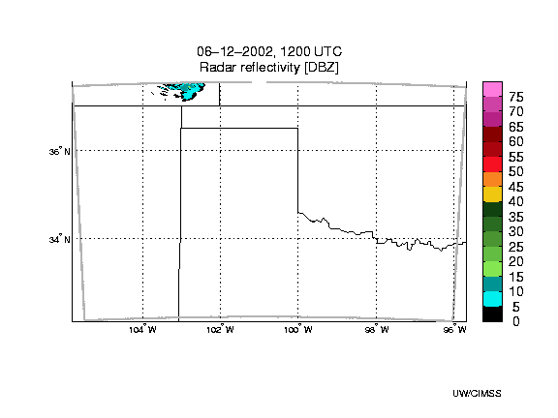
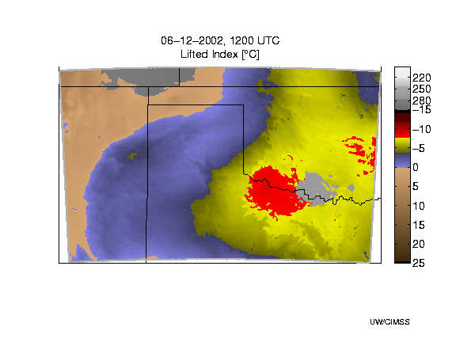
GEO Advanced IR Sounder for Storm Nowcasting
True
MTG-IRS
Red = extreme instability
Simulated Radar
MTG-FCI
© Copyright UW/CIMSS
H. Revercomb, J. Li, J. Li, J. Otkin, and T. Schmit
Notes:
LI>0 stable, -3 to 0 moderately stable, -6 to -3 moderately unstable, -6 to -9 very unstable, -6 to -9 extreme instability

Slide 18
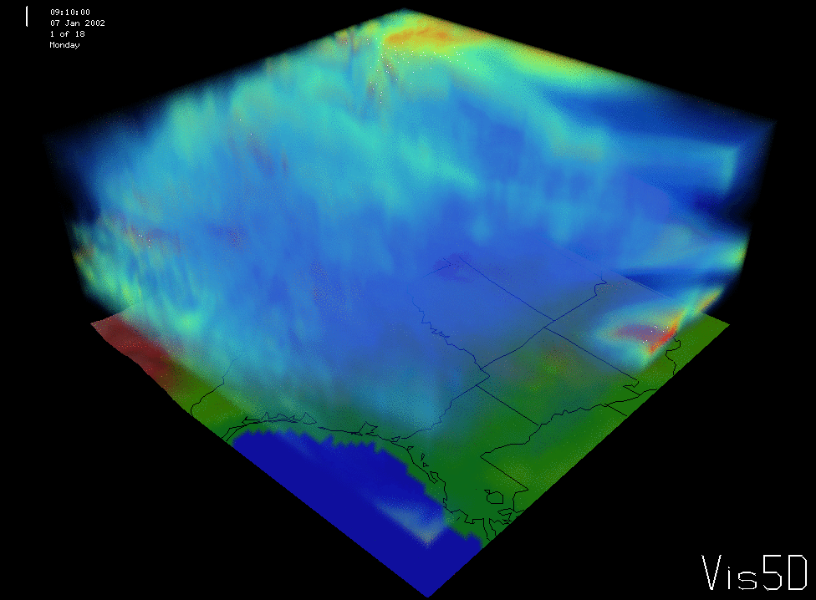
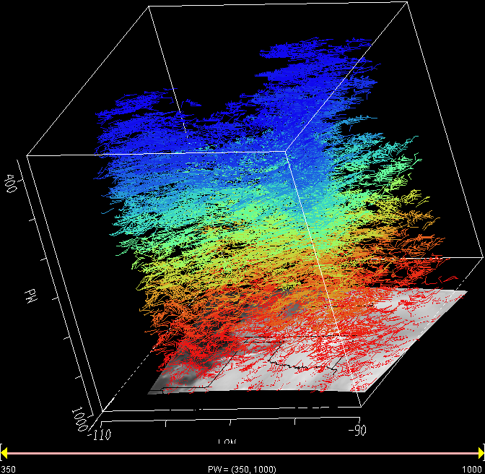
MTG-IRS Provides Information on Atmospheric Dynamics
time sequence of water vapour structures simulated AMVs
EUM/MTG/VWG/10/0378
Presentation to ICEED-10
21 September 2010
Courtesy W.L. Smith

Slide 19
MTG Missions IRS – Main Benefits
The IRS (30 min repeat cycle over Europe) will fill large spatial and temporal voids in the 12-hour time standard radiosonde observations and will allow time and space interpolation of moisture/temperature observations taken from the polar orbit.
The IRS derived information on low tropospheric moisture and its changes in time is expected to lead to a better depiction of the hydrological cycle in models, potentially providing better precipitation forecast.
The IRS will provide information on vertically resolved atmospheric motion vectors with improved height assignment, which in particular is beneficial for the tropical areas having only a weak coupling between the dynamic and thermodynamic atmospheric fields.
The IRS will provide information to identify pre-convective situations supporting NWC applications to forecast convective initiation.
IRS will support forecasting pollution and monitoring of atmospheric minor constituents through its capability to provide estimates of diurnal variations of tropospheric contributions of atmospheric trace gases as O₃ and CO.
EUM/MTG/VWG/10/0378
Presentation to ICEED-10
21 September 2010

Slide 20
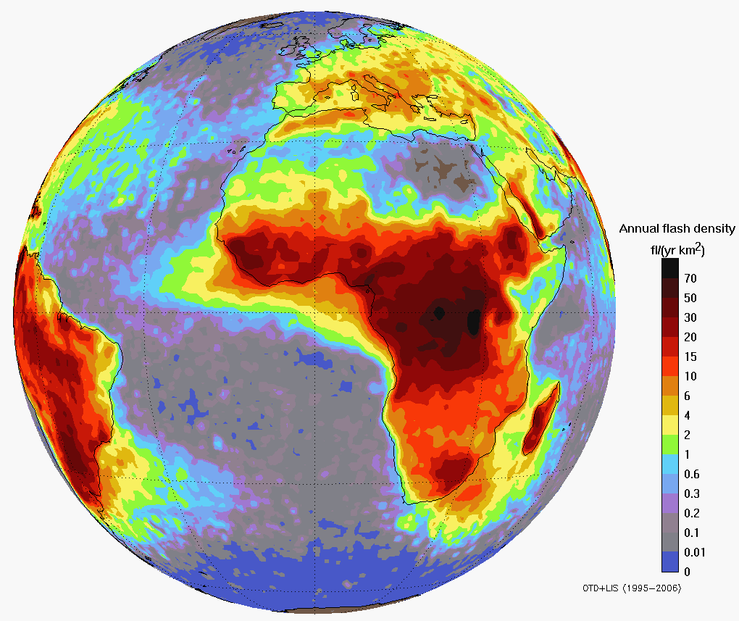
MTG Lightning Imager (LI)
The Lightning I on MTG measures/maps Total Lightning:
Cloud-to-Cloud Lightning (IC) and Cloud-to-Ground Lightning (CG)
Detect, Monitor, Track and Extrapolate in Time
Where/If Lightning Will Potentially Cause
Severe Damages
Development (Intensity/Movement) of active convective areas
Monitoring of Storm Lifecycle
Validation of Convective Initiation Forecast
Support to Climate and Air Chemistry
EUM/MTG/VWG/10/0378
Presentation to ICEED-10
21 September 2010
Slide: 20

Slide 21
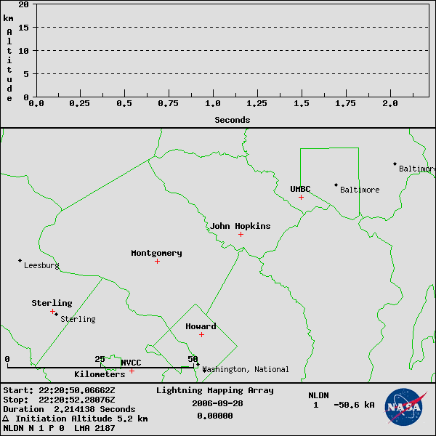
DC Area LMA – Lightning Discharge
2.2 sec hybrid flash
50 km horiz extent
Initiation at 5.2 km
VHF Sources 2187
CG strike at 2 s
EUM/MTG/VWG/10/0378
Presentation to ICEED-10
21 September 2010

Slide 22
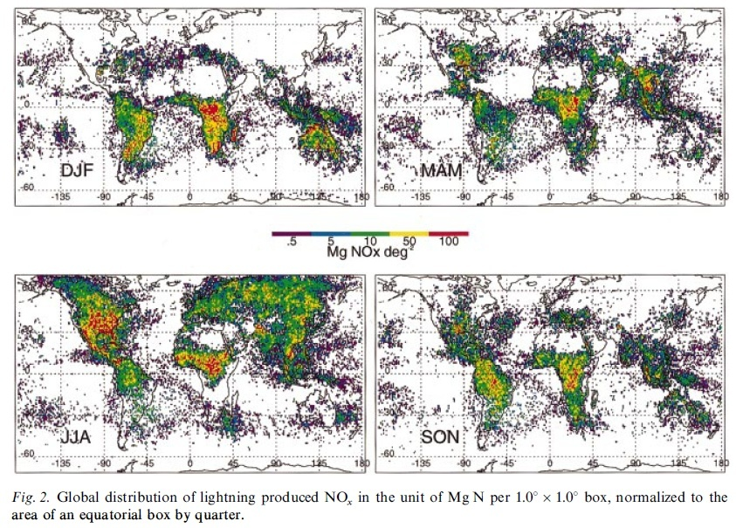
OTD Lightning-NOx Production
Nesbitt, S. W., et al. ,
Seasonal and global NOx
production by lightning
estimated from the
Optical Transient Detector
(OTD),
Tellus (2000), 52B, 1206
EUM/MTG/VWG/10/0378
Presentation to ICEED-10
21 September 2010

Slide 23
MTG Missions LI – Main Benefits
The MTG LI measurements of total lightning (IC+CG) will complement the global CG lightning measurements of ground based systems (e.g. ATDnet) improving the quality of information essential for air traffic routing and safety
MTG-LI/ATDnet IC+CG lightning information to assess the impact of climate change on thunderstorm activity by monitoring and long-term analysing lightning characteristics (coordination with NOAA GLM mission on GOES-R and GOES-S essential: a major part of the globe is covered)
IC+CG information on a global scale as prerequisite for studying and monitoring the physical and chemical processes in the atmosphere regarding NOx, playing a key role in the ozone conversion process and acid rain generation
IC+CG information on a global scale with known error-characteristic is a prerequisite for: assimilation in regional models to improve very short range forecasts of convective events verification/validation of algorithms to nowcast (time and location) convective initiation
EUM/MTG/VWG/10/0378
Presentation to ICEED-10
21 September 2010

Slide 24
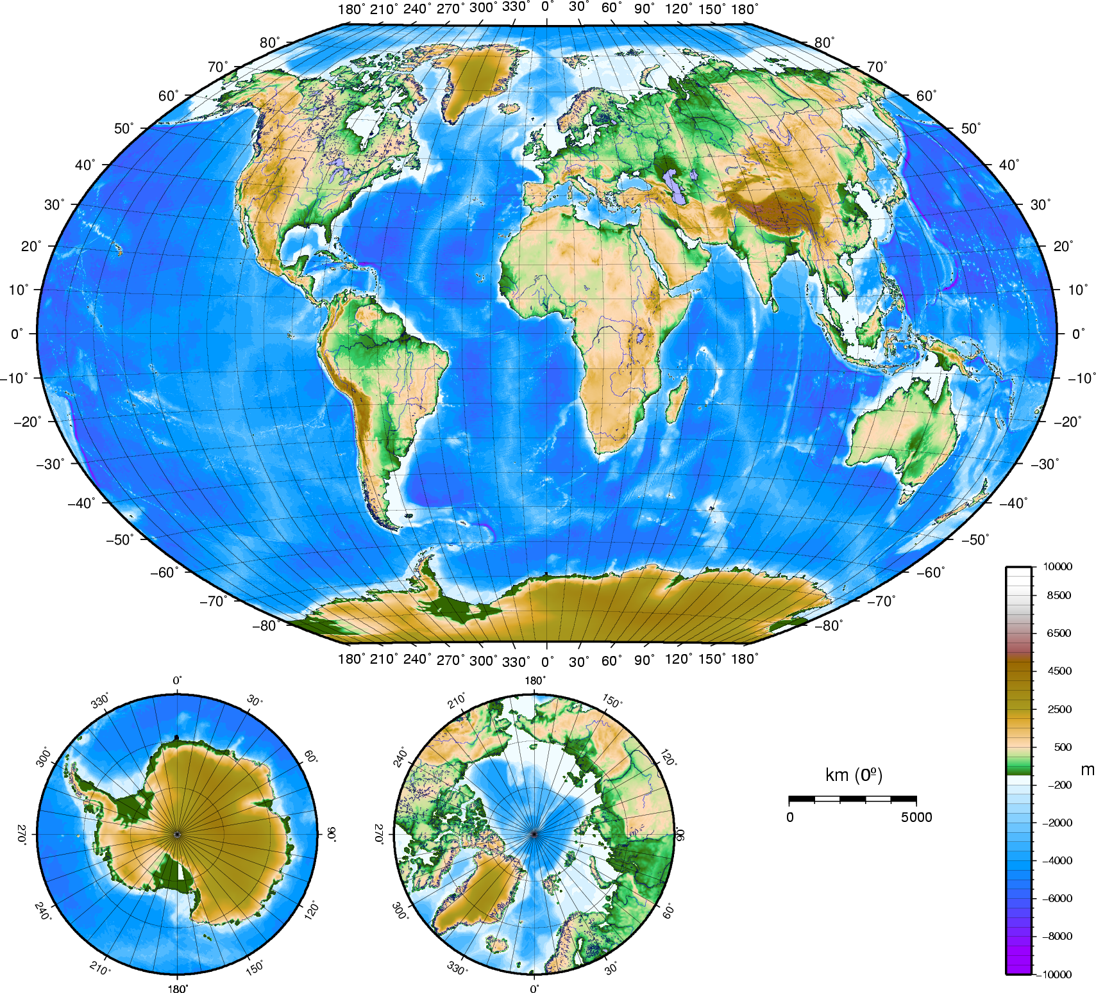
MTG-S will Accommodate GMES Sentinel 4 Ultraviolet Visible Near-infrared (UVN)
The GMES Sentinel-4 sounding mission is achieved through the Ultraviolet, Visible & Near-infrared (UVN) Instrument accommodated on the MTG-S satellites
covering Europe every hour
taking measurements in three spectral bands ( UV: 305 - 400 nm;
VIS: 400 - 500 nm,
NIR: 750 - 775 nm )
with a resolution around 8km.
The primary data products are O3, NO2, SO2, HCHO and aerosol optical depth.
EUM/MTG/VWG/10/0378
Presentation to ICEED-10
21 September 2010

Slide 25
GMES Sentinel-4 UVN Observation Requirements
Sentinel-4
EUM/MTG/VWG/10/0378
Presentation to ICEED-10
21 September 2010
EUM/MTG/VWG/10/0307
Presentation to Luxemburg
12 August 2010

Slide 26
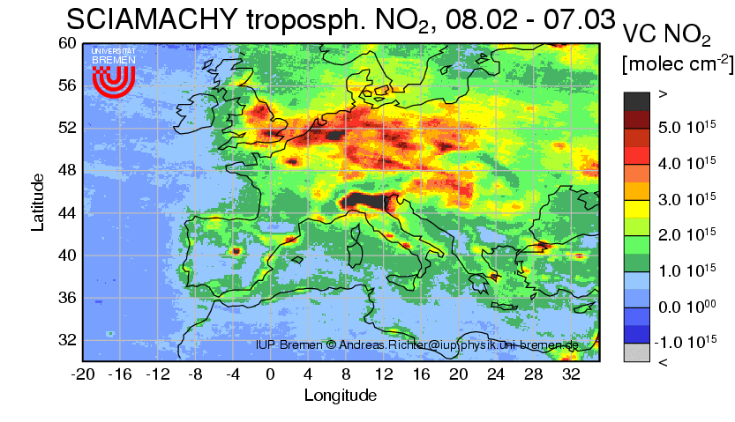
Synergies on MTG for Tropospheric Chemistry and Air Pollution Applications
MTG-IRS
S4-UVN on MTG
MTG-FCI MTG-LI
O₃, CO, NO₂, SO₂, VOC(H₂CO, CHOCHO), Aerosol/PM
MTG-IRS, S4-UVN on MTG and MTG-FCI/MTG-LI will provide unique and relevant data for tropospheric monitoring applications
EUM/MTG/VWG/10/0378
Presentation to ICEED-10
21 September 2010

Slide 27
User Priorities on MTG Missions
MTG information on the ‘fast’ component of the hydrological cycle will improve warnings on the location and intensity of severe storm hazards,
The MTG enhanced information on convective/non-convective events, critical weather situations (~ fog, sand/dust storms, icing,..), fires, volcanic ash eruptions will allow surpassing present capabilities to provide warnings to the community,
MTG information on horizontally, vertically, and temporally (4-D) resolved gradients of moisture, wind, and temperature is expected to deliver a breakthrough regarding precipitation forecasts via assimilation into advanced non-hydrostatic regional models.
MTG information on carbon monoxide and ozone in the troposphere (IRS and UVN) and nitrous oxides generated by lightning will be a significant contribution to atmospheric chemistry and air quality applications,
MTG information on location and intensity of lightning will support warnings on lightning strikes for aviation and surface related business.
EUM/MTG/VWG/10/0378
Presentation to ICEED-10
21 September 2010
Slide: 27

