Slide 1
Contributors
Mr. Hayrettin BACANLI
Turkish State Meteorological Service
Head of Research and Information Department
hbacanli@dmi.gov.tr
Mr. Alper AKÇAKAYA
Turkish State Meteorological Service
Head of Research Division
aakcakaya@dmi.gov.tr
Mr. Ayhan SAYIN
Turkish State Meteorological Service
asayin@dmi.gov.tr
With the contribution of HRC, WMO, NOAA and USAID.

Slide 2
Background of the FFGS project
The WMO Congress XV in 2007 approved the implementation of a Flash Flood Guidance System (FFGS) project with a global coverage, developed by Commission for Hydrology (CHy) jointly with WMO Commission for Basic System (CBS) in collaboration with the US National Weather Service, the US Hydrologic Research Centre and USAID/OFDA.
On 25 February 2009 WMO signed a Memorandum of Understanding (MoU) with USAID, HRC, and NOAA on the implementation of the project. Based on the Memorandum of Understanding, WMO, HRC and USAID agreed to start preparations for the implementation of the project in the Black Sea and Middle East Regions.

Slide 3
Participating Countries
Specifically the countries that to be included in a first phase of the global project are decided in the initial workshop held in Istanbul on 29-31 March 2010 are Armenia, Azerbaijan, Georgia, Turkey, Iraq, Syria and Lebanon. Romania and Bulgaria are seen as potential candidates in a possible later phase of the project.
The project will be phased over a five year period, with the bulk of the development and implementation activities occurring during the first three years. The last two years of the project will focus on training, system evaluation and validation of system outputs.

Slide 4
General Objective of the Project
To contribute towards reducing the vulnerability of regions around the world to hydrometeorological disasters, specifically flash floods, by developing and implementing flash flood guidance systems to strengthen regional capacity to develop timely and accurate flash flood warnings.

Slide 5
Purpose of the Regional Flash Flood Guidance System- Black Sea and Middle East Regions – component (BSME-FFG)
Development and implementation of a regional flash flood guidance and early warning system in the Black Sea and Middle East Regions.
The approach will entail development of infrastructure first on a global scale to then support the development of the regional implementation of technology, training, protocols and procedures to address the issues of mitigating the impacts of flash floods.

Slide 6
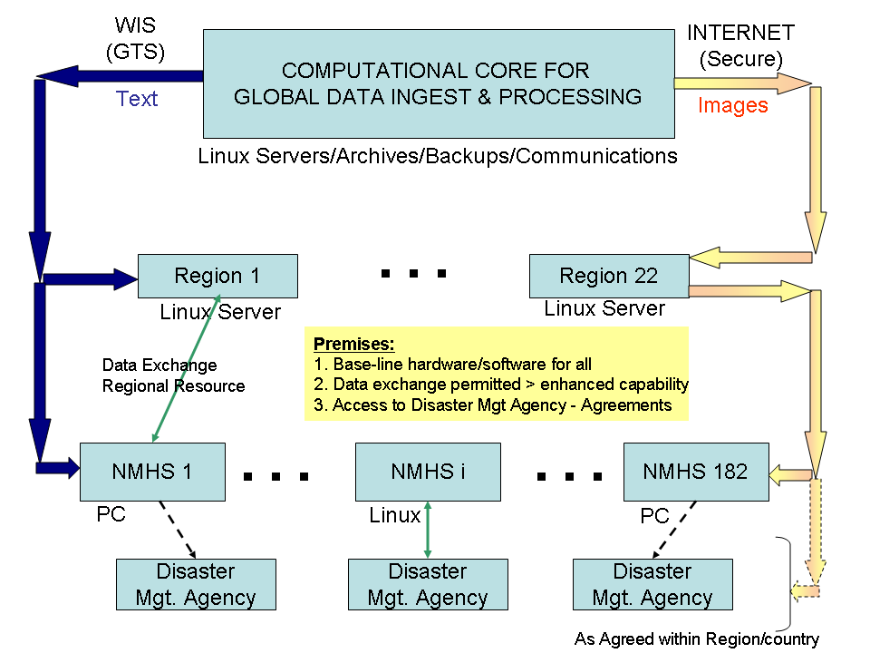
Design Concept

Slide 7
Needs
Flash Floods are very significant disasters globally:
Highest number of deaths per people affected;
More than 5,000 people perish annually.
BUT there are no discernible trends for loss reduction:
No flash flood warnings for vast populated areas of the world;
Lack of local expertise and of regional cooperation;
Little in situ data in small regions;
Large-river flood-warning strategies are ineffective for flash floods;
Climatic changes in many regions result in increased intensity storms.

Slide 8
Natural Causes of Flash Floods
Intense rainfall from slow moving thunderstorms or
tropical systems;
Orographic rainfall in steep terrain;
Soil saturation or impervious land surfaces.
Hydraulic channel properties

Slide 9
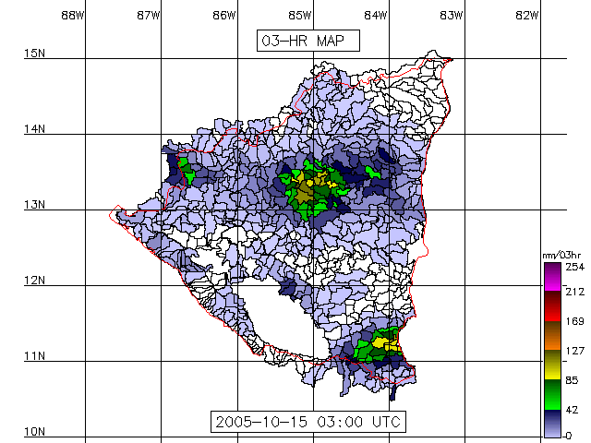
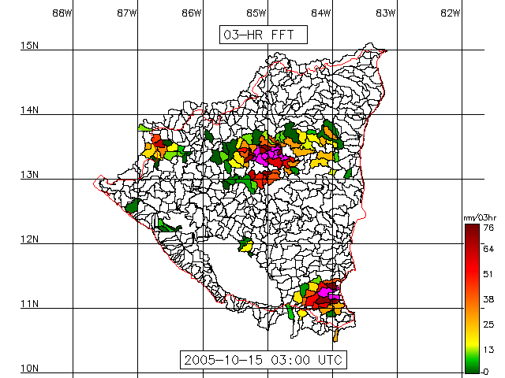
Flash Flood Guidance
Flash Flood Guidance (FFG): The amount of rainfall of a given duration over a given basin that is required to generate bankfull flows at the outlet of the draining stream.

Slide 10
Flash Flood Guidance System
Satellite Rainfall
Air Temperature
Rainfall Data Quality Control& Merging
Gauge Rainfall
Snow Model
Daily Potential ET Processor
Flash Flood Guidance Model (Real Time Update)
Soil Moisture
TERRAIN
STREAMS LULC
SOILS
(Spatial Data)
Threshold Runoff Model
Flash Flood Guidance

Slide 11
FFGS Attributes
Global/Regional
Observations
& Models
Computational
Core
Local Data
Adjustments and Warning Core
Computational
Component
Local Products
& Uncertainty
Local or Country
Warning Generation System
Processed
Local Data
Regional Center
Local or Country
Warning Dissemination System
Public Warnings
11
HRC FFGS
11

Slide 12
Proposal
Turkish Meteorological Service would like to
work with ICEED members for the extension of
Black Sea and Middle East Flash Flood Guiding
System (FFGS) to ICEED region.

Slide 13
Thank you for kind your attention…

