Slide 1
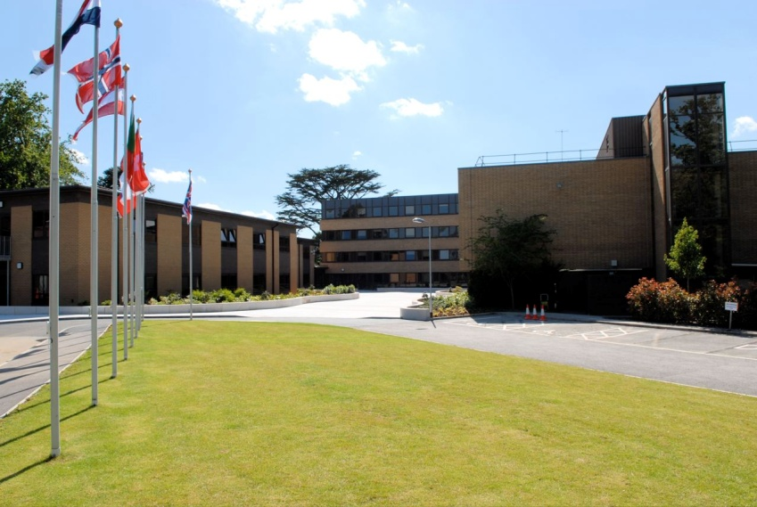
The European Centre for Medium-Range Weather Forecasts
Manfred Klöppel
Scientific and Technical
Assistant to the
Director-General
Manfred.Kloeppel@ecmwf.int
www.ecmwf.int

Slide 2
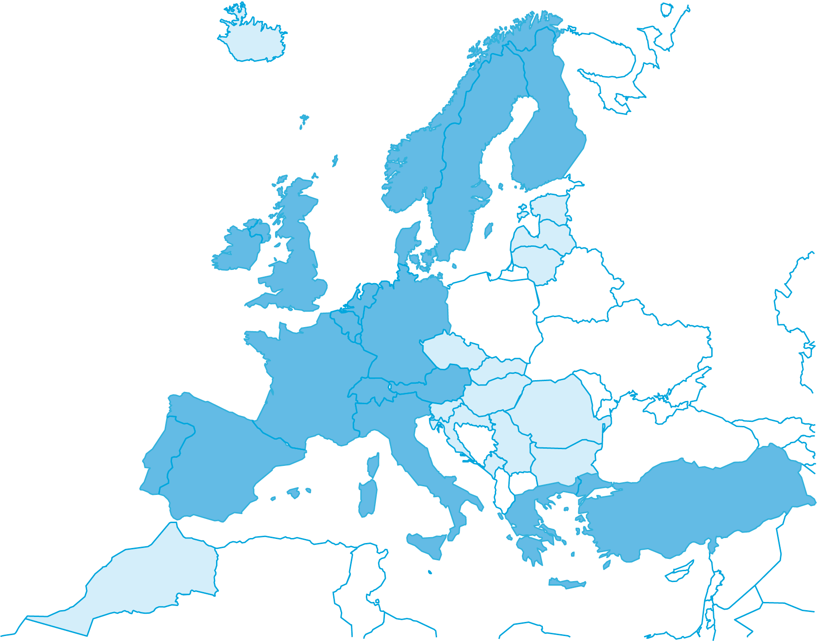
Supporting States and Co-operation
Austria Greece Portugal
Belgium Ireland Spain
Denmark Italy Sweden
Finland Luxembourg Switzerland
France The Netherlands Turkey
Germany Norway United Kingdom
Co-operation agreements or working arrangements with:
Bulgaria Lithuania ACMAD
Czech Republic Montenegro ESA
Croatia Morocco EUMETSAT
Estonia Romania WMO
Hungary Serbia JRC
Iceland Slovakia CTBTO
Latvia Slovenia CLRTAP

Slide 3
ECMWF: a component of the EMI
Shared and coordinated observation systems
and related services
EUMETSAT
(satellites)
EUMETNET/
EUCOS
(others)
Information Systems and services
Analyses, forecasts and support to decision making
Climate monitoring
Archiving and reanalysis
Methods, tools and know-how
Web, push and pull services
ECMWF
EUMETNET
National Met Services
Users/Customers/Decision makers
Notes:
The building blocks are there - in the air.

Slide 4
Key developments/events
New forecast cycle: increased horizontal resolution
16/32 km
Good early warnings for several major severe weather events
Amended Convention entered into force on 6 June 2010
New Member States
ERA-CLIM proposal selected for FP7 funding
Climate monitoring
Negotiations started with Bosnia Herzegovina and FYROM
Corporate ECMWF video (Annual Report 2009)

Slide 5
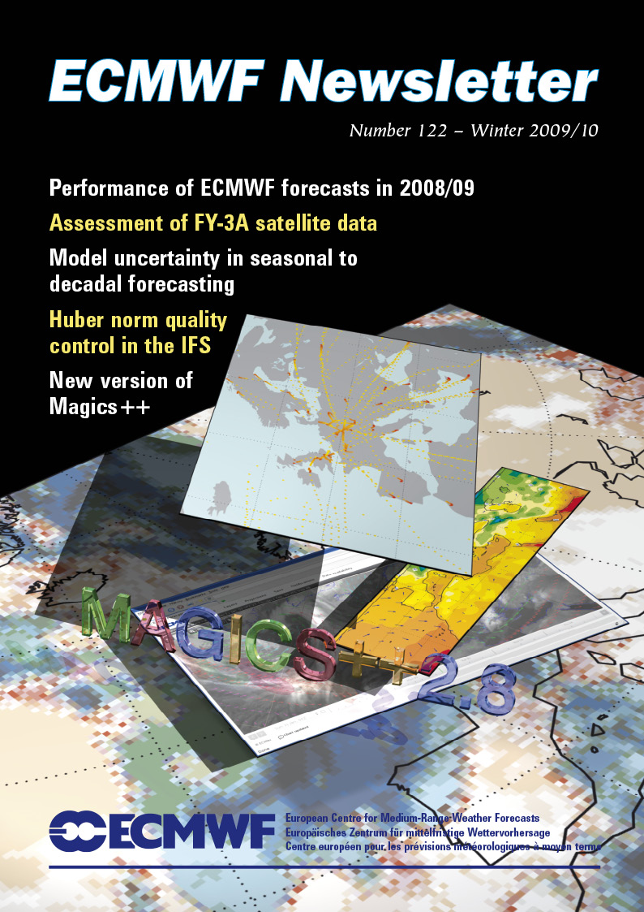
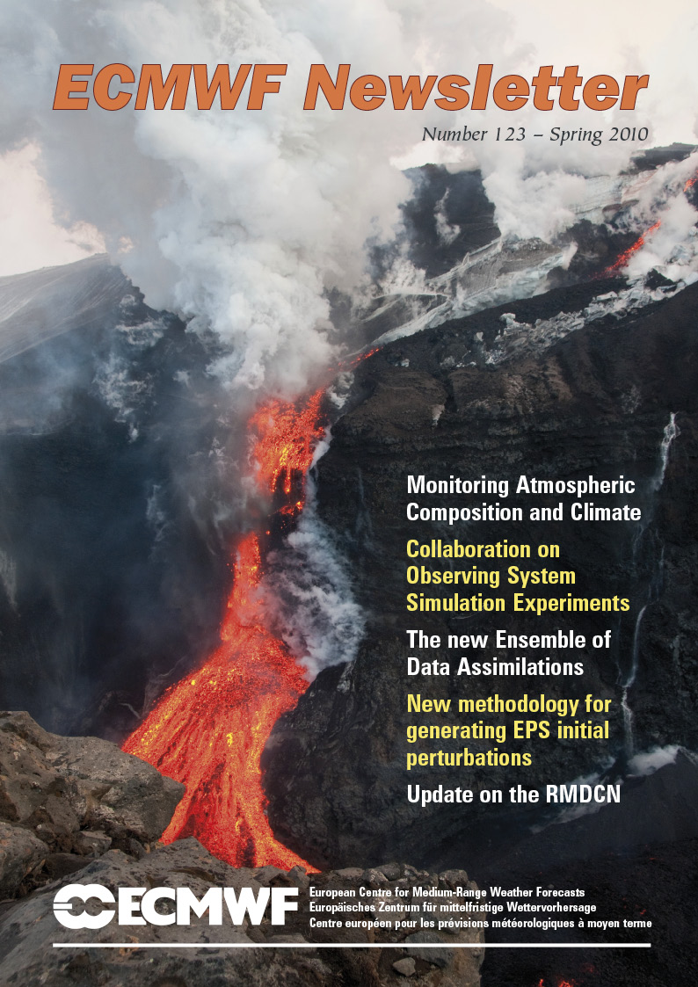
Thank you for your attention

