Slide 1
Weather Radar Network in Turkey
Fırat BEŞTEPE
DMI Expert
Electrical and Electronics Engineer, MSc
Remote Sensing Division
Turkish State Meteorological Service

Slide 2
Outline
Definition and Basic Principle of RADAR
Weather Radars
History of Weather Radars in Turkey
Weather Radar Network in Turkey
General Overview of Operational Radar Sites
Sample Radar Images
Notes:
This is the outline of my presentation. I am going to start with the definition and basic principle of radar and continue with weather radar systems. Then, I will say some words about the history of weather radars in Turkey and talk about weather radar network. Finally I will give a general overview of each operational radar site and conclude with some nice radar products.

Slide 3
Definition and Basic Principle of RADAR
The acronym RADAR stands for RAdio Detection And Ranging.
When a radio pulse is transmitted to the atmosphere through antenna, it interacts with the targets and a small fraction of transmitted pulse is reflected back to the radar antenna.

Slide 4
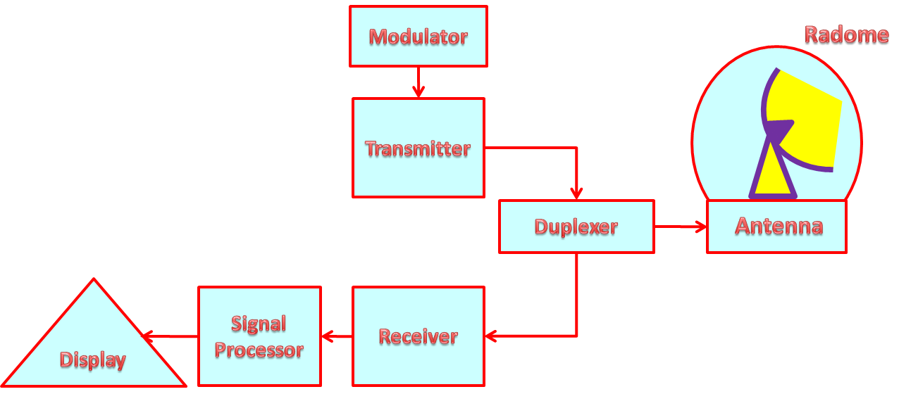
Block Diagram of RADAR
Notes:
Ok, a general radar system consists of these main parts. An antenna surrounded by radome, transmitter and modulator, receiver, duplexer, signal processor and a display unit. The EM signal is transmitted to the atmosphere through antenna. The radome protects the antenna from environmental effects.
Oku.

Slide 5
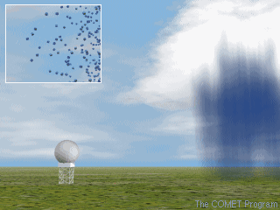
Weather RADAR
Weather radar is an active remote sensing device utilized for atmospheric observation.
Weather radar can detect and track the weather targets in the atmosphere in real time.
The targets of interest for a weather radar are hydrometeors such as raindrops hailstones, snowflakes, sleet particles, etc.
Notes:
Oku.
However some non-meteorological targets such as birds, insects, dust can sometimes be observed by radar operators for clear air detection.

Slide 6
Weather RADAR
The most important questions required to be answered related with weather forecasting and monitoring are;
How much? (quantity or intensity)
Where? (location)
What period of time? (temporal information)
Conventional observation equipments can answer these questions as well, however they provide only spot measurements in the spatial and temporal course of an event. However, a radar allows full-coverage weather monitoring with the highest temporal and spatial resolution.
Weather radars are very important devices for meteorology and hydrology in measuring areal precipitation and observing its development and direction of motion.
Notes:
Oku.

Slide 7
Weather RADAR
To detect precipitation quantitatively, locate it and track its motion.
To detect severe weather activities and forecast their future position and intensity.
To estimate the types of precipitation (rain, snow, hail, etc.).
To analyze storm structure and its potential.
To perform short-term (up to 6 hours) weather forecasting, namely Nowcasting.
To provide data for hydrological models.
Notes:
When looking at the usage areas as a summary, a weather radar is used to
… OKU

Slide 8
History of Weather RADARs in Turkey
In Turkey, Turkish State Meteorological Service (TSMS) is legally responsible for installing and operating the weather radars and archiving their data.
In 1970s and 1980s, TSMS was using analog meteorological radars which are exhibited in TSMS museum in Ankara now.
However, the modern weather radar era in Turkey started in late 1990s. With the tender in 1997, Gematronik Company installed a Doppler Radar in Ankara in 2000. This C-Band Doppler Radar is a quite early sample of a fast switch type polarimetric radars in the world.
Afterwards with the Project of TEFER (Turkey Emergency Flood and Earthquake Recovery), three more C-Band Doppler Weather Radar systems were installed by Mitsubishi – Hazama Consortium in Istanbul, Zonguldak and Balikesir provinces in 2003.
Notes:
Ok, let’s look at the historical development of weather radar network in Turkey.
Oku.

Slide 9
In 2006, TSMS decided to extend the weather radar network with new C-band doppler radars and established a feasibility commision composed of experts from relavant diciplines in TSMS. This commision fulfilled a long-term study and presented a very comprehensive report in June 2007 forming the developement process of TSMS radar network.
According to the feasibility report, in addition to existing 4 radars, 16 more C-Band Doppler Weather Radars in total were planned in order to cover all parts of the country.
As a first step after feasibility study, TSMS went out to a tender for six C-band Doppler Weather Radars in 2008 and Vaisala Company got this tender.
Within the scope of the contract signed between TSMS and Vaisala in December 2008, the installation of two out of six C-band Doppler Weather Radars were completed and set into operation recently.
Notes:
Oku.

Slide 10
Turkish Weather RADAR Network
As of today, the operational radars are;
Ankara (June, 2000) : C-Band Polarimetric Doppler
İstanbul (March, 2003) : C-Band Doppler
Balıkesir (March, 2003) : C-Band Doppler
Zonguldak (March, 2003) : C-Band Doppler
İzmir (May, 2010) : C-Band Polarimetric Doppler
Muğla (July, 2010) : C-Band Polarimetric Doppler
Notes:
As of today, with two new Vaisala radars, the number of operational radars in TSMS Radar Network reached to 6;.
As you see, three of them are dual , the other three are single polarization. We will look at the features of each radar a bit more detailed later.
Oku.

Slide 11
RADAR Locations in Turkey
İstanbul
Zonguldak
Samsun
Trabzon
Balıkesir
Ankara
İzmir
Muğla
Hatay
Antalya
Represents the operational radars.
Represents the scheduled radars to be installed until mid-2012 by Vaisala
Notes:
This is a picture of cloud taken by an amateur camera in Turkey. What is interesting about this picture, it really looks like Turkey Map. So, I thought I can show radar locations over this so-called Turkey Map as a niceness. The moving icons represent the operational radars and the stationary ones represent the scheduled but not installed yet radars. The red circled ones are Vaisala radars.

Slide 12
Doppler Mode RADAR Coverages
Notes:
This is again a picture of radar locations but over real Turkey map together with the Doppler Mode coverage patterns. This map also shows the terrain according to the DTED data. The brighter parts of the map represent higher regions, the darker parts represent lower regions. This view demonstrates the very complicated topography of Turkey, which is the biggest difficulty for radar operations in Turkey. Most parts of Europe have smooth and very regular terrain, this is really a lucky situation from topography point view.

Slide 13
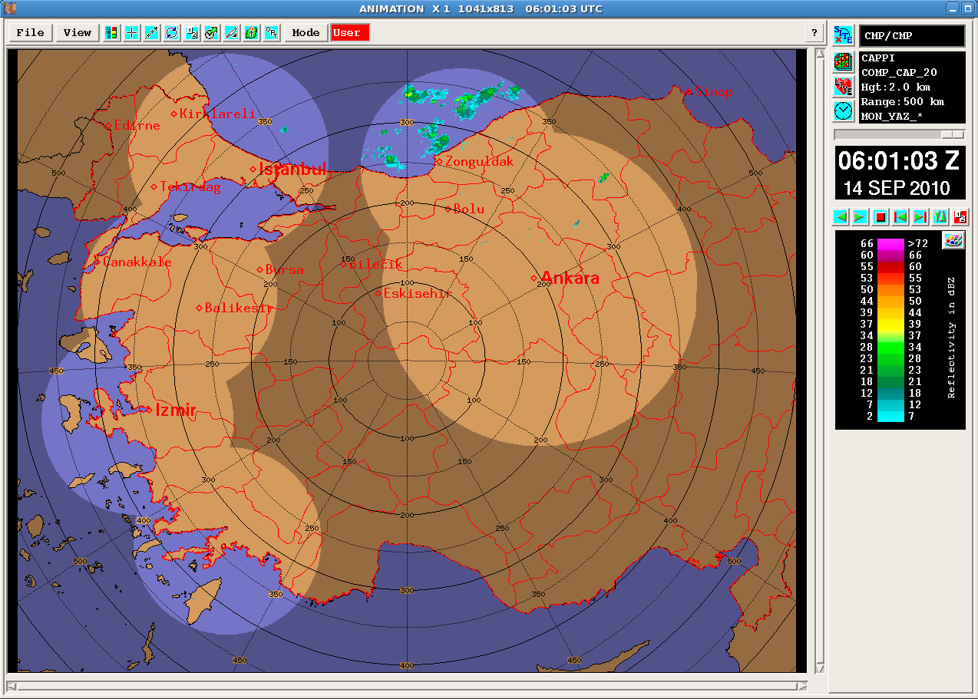
Doppler Mode RADAR Composite Image
Notes:
13
This is Doppler Mode Composite of six operational radars. Let me explain what does doppler mode means very briefly. The weather radars are operated in two major modes, doppler mode and intensity mode. In intensity mode, radar does not care about the velocity of target, because it does not have high velocity measuring capability, so it just tries to scan long ranges, around 300 kms for C-Band, and detect the location of target. However, in doppler mode radars scan relatively short ranges, around 120 kms for C-band, and can measure higher velocities. Radar can not scan long ranges with high velocity measuring capability. So this is a trade off, and called as Doppler Dilemma. Let’s look at intensity mode composite of same radars.

Slide 14
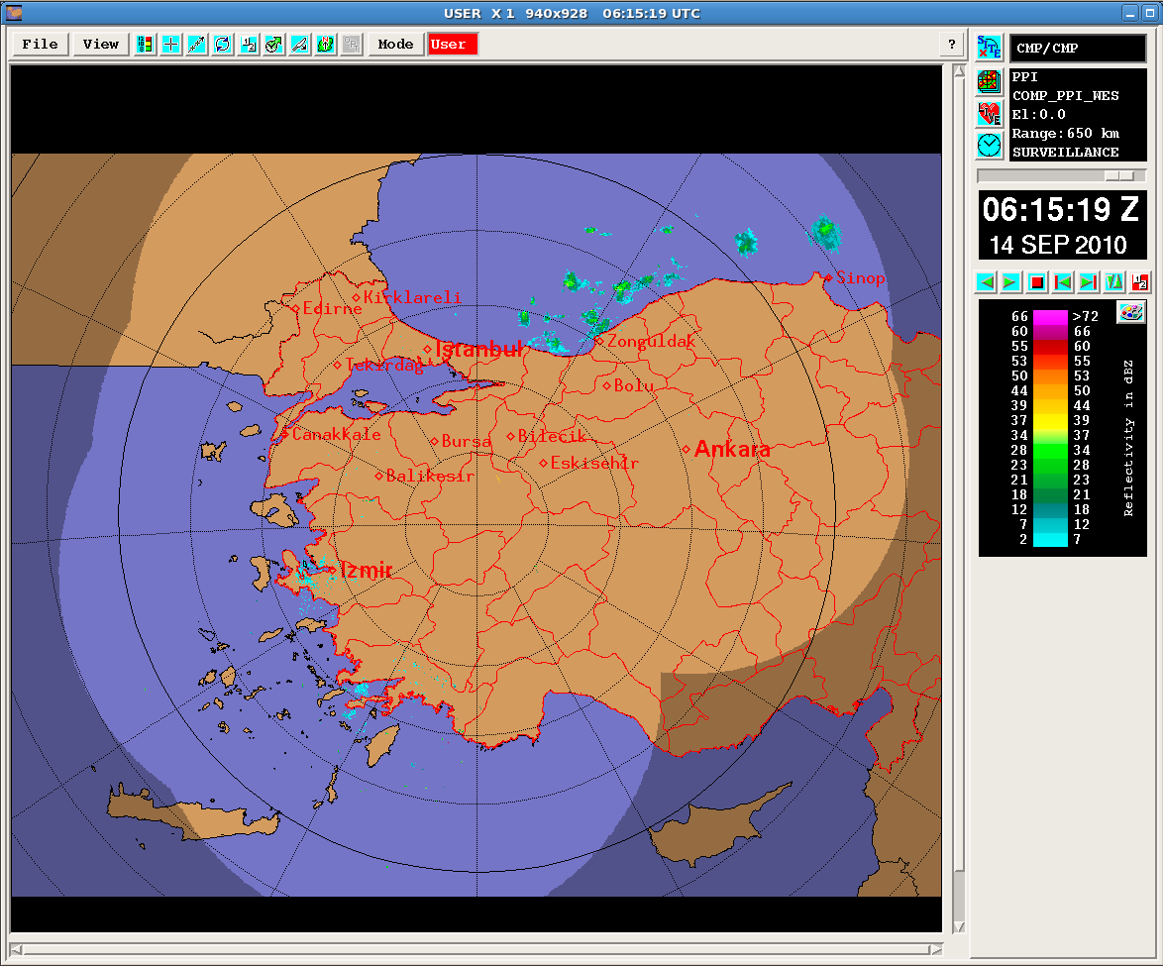
Intensity Mode RADAR Composite Image
Notes:
14
This is long range intensity mode composite of six operational radars, it sometimes called as surveillance mode.

Slide 15
Intensity Mode Coverage of 10 RADARs (Operational 6 and Scheduled 4)
Notes:
This slide shows the coverage analysis of 10 radars, 6 operational and 4 scheduled, in intensity mode. You can easily see the beam blockage in mid parts. I hope we will be able to see radar composite images of these 10 radars before the summer of 2012.

Slide 16
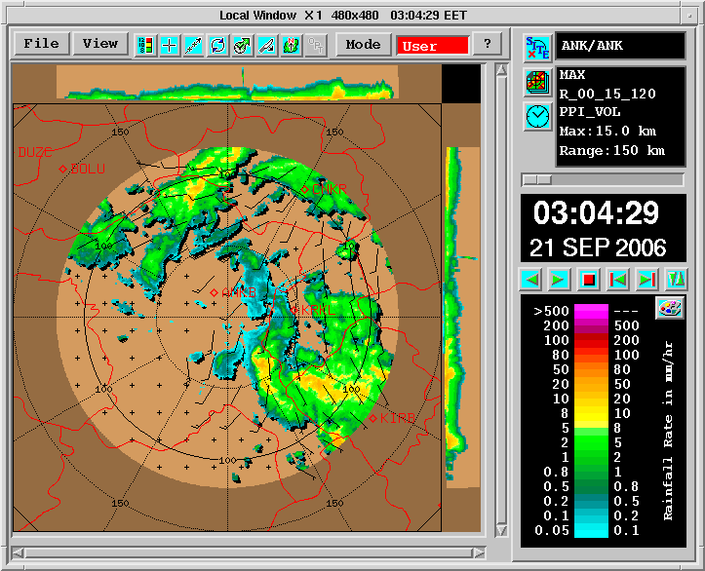
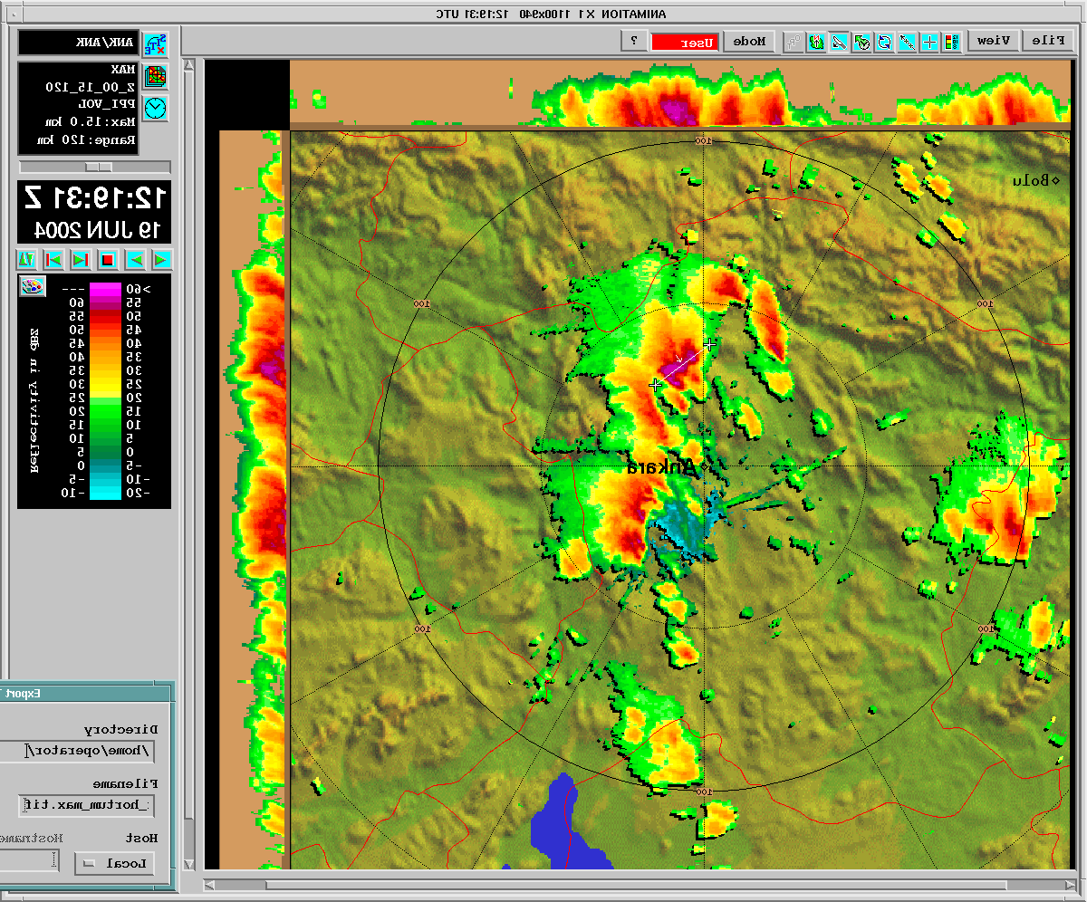
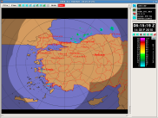
Radar Data Flow Infrastructure
Notes:
I want to say some words on what are the steps of radar product generation from EM signal to end user product. The reflected back signal sensed by radar antenna is converted to raw data by signal processor. The raw data, which is stored in RDA WS at radar site first, includes some radar parameters such as reflectivity, radial velocity, spectral width, and so on. This raw data is transmitted to radar system center through a communication system. The communication system may be based on satellite or a combination of radio links and terresterial lines. Generally, like our systems, it is recommended to have one main and one backup communication systems, becuase when main line is cut, the data transfer can go on over the backup line. When the raw data reached to the center, the radar products are generated by RPG WS, and distributed to different nodes in order to be used for different purposes.

Slide 17
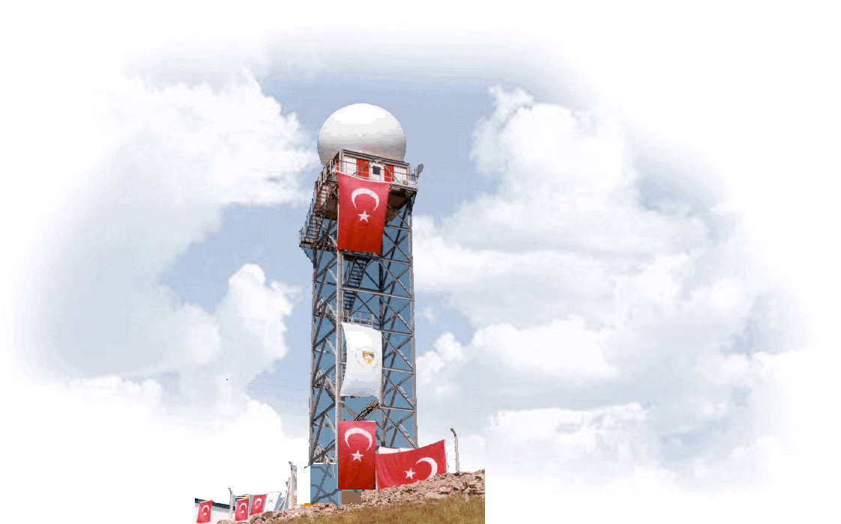
Ankara RADAR
C-band Dual Polarization Doppler Radar, located in Elmadağ-Ankara, operational since June 2000.
Polarization : Dual (Switch Mode)
Transmitter : Klystron
Height : 1807 meter
Latitude : 39°47’53” N
Longitude : 32°58’15” E
Tower : 32 meter Steal construction
Firm : AMS - Gematronik
Notes:
Now let’s look at some features of each operational radar with site pictures.

Slide 18
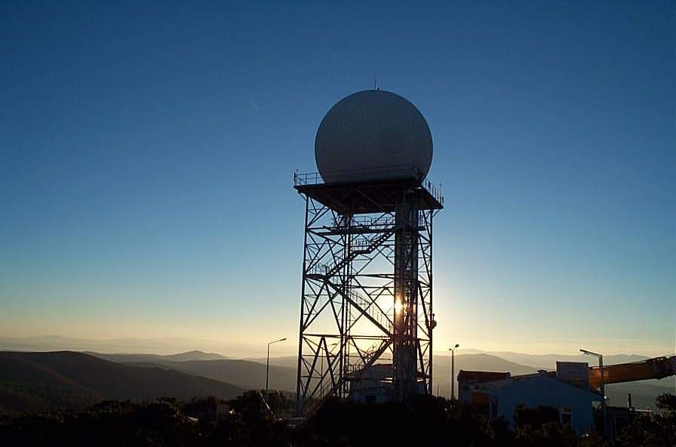
İstanbul RADAR
C-Band Doppler Meteorological Radar, located at Büyükkuşkaya Hill, operational since March 2003.
Polarization : Single
Transmitter : Klystron
Height : 378 m
Latitude : 41° 20′ 30″ N
Longitude : 28° 21′ 30″ E
Tower : 20 m Steal construction
Firm : Mitsubishi
Notes:
Istanbul radar may be the one which is given the greatest importance, because it covers the city center of Istanbul.

Slide 19
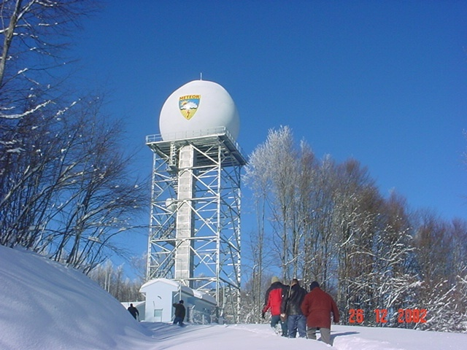
Zonguldak RADAR
C-Band Doppler Meteorological Radar, located at Acısu Hill, operational since March 2003.
Polarization : Single
Transmitter : Klystron
Height : 1108 m
Latitude : 41° 10′ 55″ N
Longitude : 31° 47′ 54″ E
Tower : 25 m Steal construction
Firm : Mitsubishi
Notes:
Oku.

Slide 20
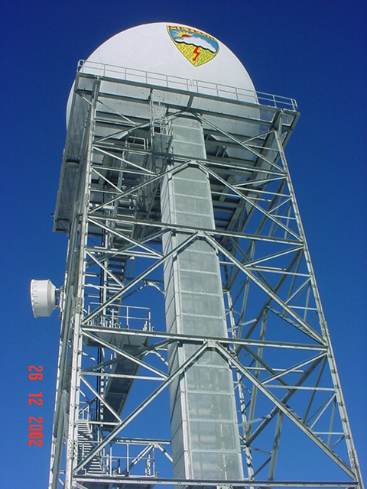
Balıkesir RADAR
C-Band Doppler Meteorological Radar, located at Akcaldedesi Hill, operational since March 2003.
Polarization : Single
Transmitter : Klystron
Height : 642 m
Latitude : 39° 44′ 26″ N
Longitude : 27° 37′ 10″ E
Tower : 25 m Steal construction
Firm : Mitsubishi
Notes:
Balikesir radar is the third and the last one of Mitsubishi radars. It is again a single polarization, klystron tube radar with 25 m steal construction tower.

Slide 21
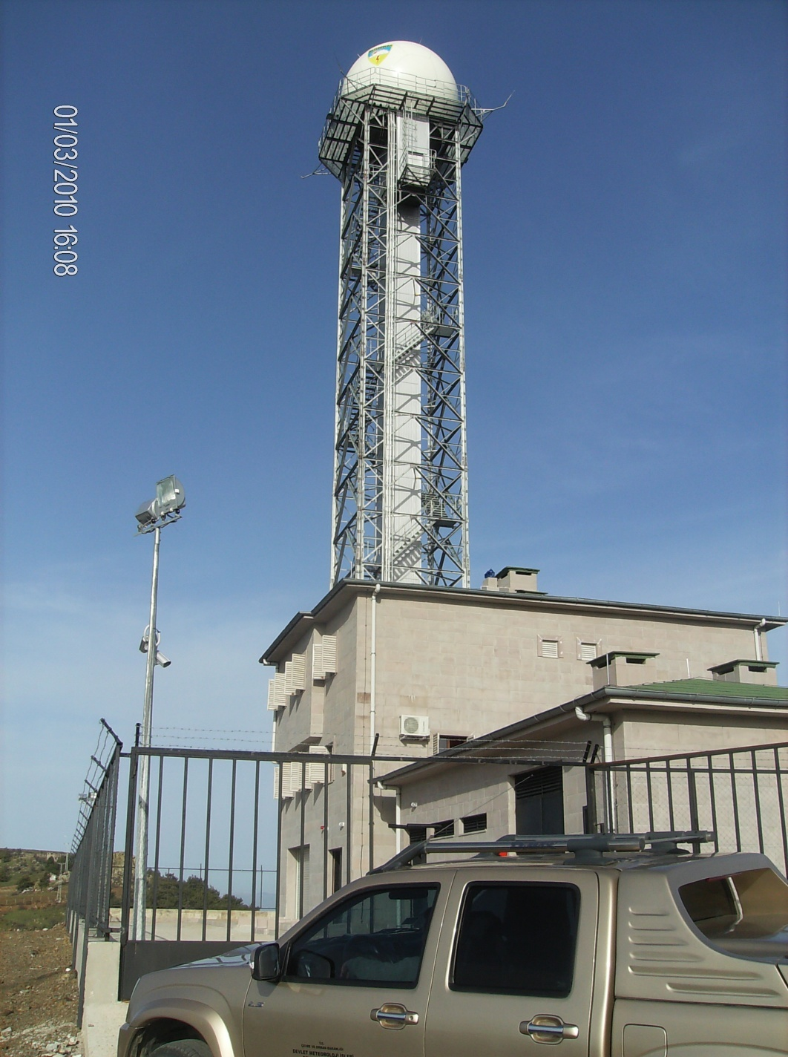
İzmir RADAR
C-band Doppler Radar, located in Çatalkaya-İzmir, is operational since May 2010.
Polarization : Dual (STAR Mode)
Transmitter : Klystron
Height : 973 meter
Latitude : 38° 18’ 41.0’’ N
Longitude : 27° 00’ 04.1’’E
Tower : 40 meter Steal construction
Firm : Vaisala
Notes:
Izmir radar is the one of two newest Vaisala radars and has a 40 m steal construction tower which is the highest radar tower in Turkey. It is a dual polarization radar with klystron like all others.

Slide 22
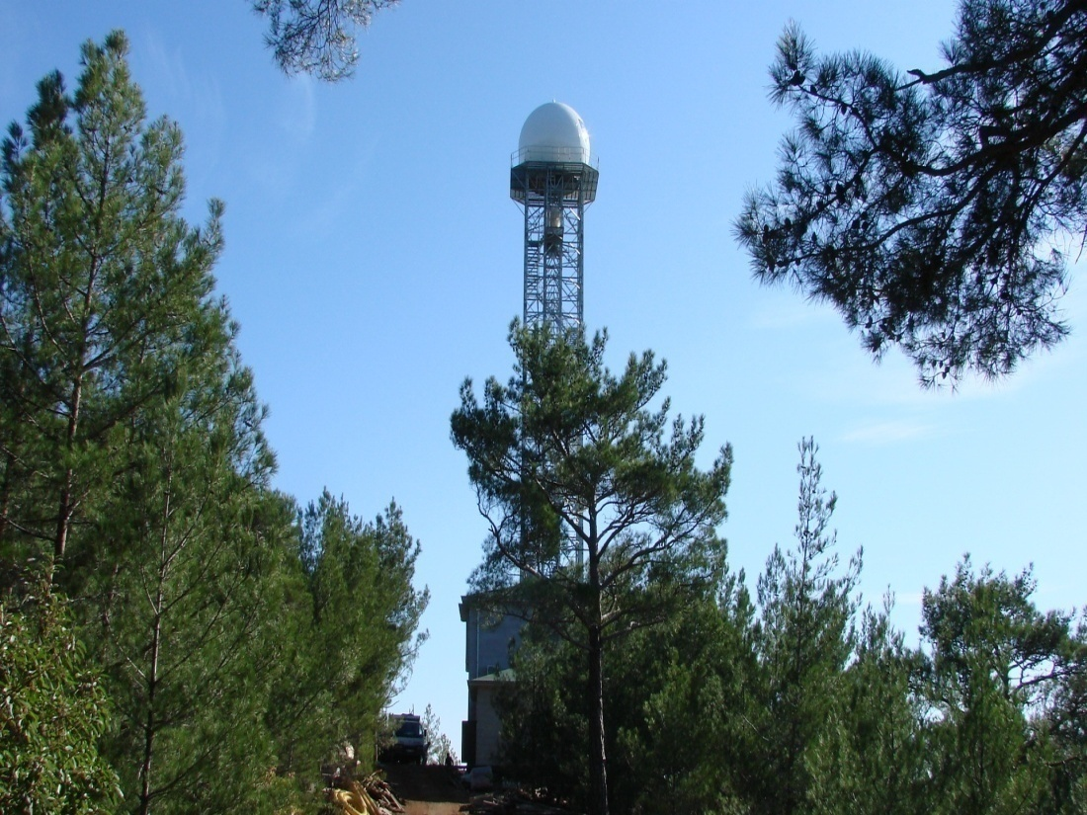
Muğla RADAR
C-band Doppler Radar, located in Marmaris-Muğla, is operational since July 2000.
Polarization : Dual (STAR Mode)
Transmitter : Klystron
Height : 960 meter
Latitude : 36° 53’24.18” N
Longitude : 28° 19’ 39.43” E
Tower : 30 meter Steal construction
Firm : Vaisala
Notes:
And finally other new Vaisala radar is Mugla radar, it has completely same parameters except tower height.

Slide 23
Future Plans
The Turkish State Meteorological Service (TSMS) primarily aims to cover all country with 20 in total C-Band Doppler Radars as soon as possible.
Within the scope of contract signed with Vaisala in December 2008, two of six C-Band Polarimetric Doppler Weather Radars were already installed and set into operation recently.
Within the scope of same contract the remaining four C-Band Doppler Radars will be installed until mid-2012 according to the schedule below:
Antalya (2011) : C-Band Polarimetric Doppler
Adana (2011) : C-Band Polarimetric Doppler
Trabzon (2012) : C-Band Doppler
Samsun (2012) : C-Band Doppler
The biggest difficulty in Turkey for weather radar operations is the complicated and irregular topography and accordingly the beam blockage. In this sense, TSMS plans to fill the gaps in the C-Band Radar Network with short range X-Band Radars.

Slide 24
Doppler Mode Coverage of 20 RADARs (Operational 6 and Scheduled 4 and Planned 10)
Notes:
T

Slide 25
Intensity Mode Coverage of 20 RADARs (Operational 6 and Scheduled 4 and Planned 10)

Slide 26
MAX (Maximum Display)
Notes:
26

Slide 27
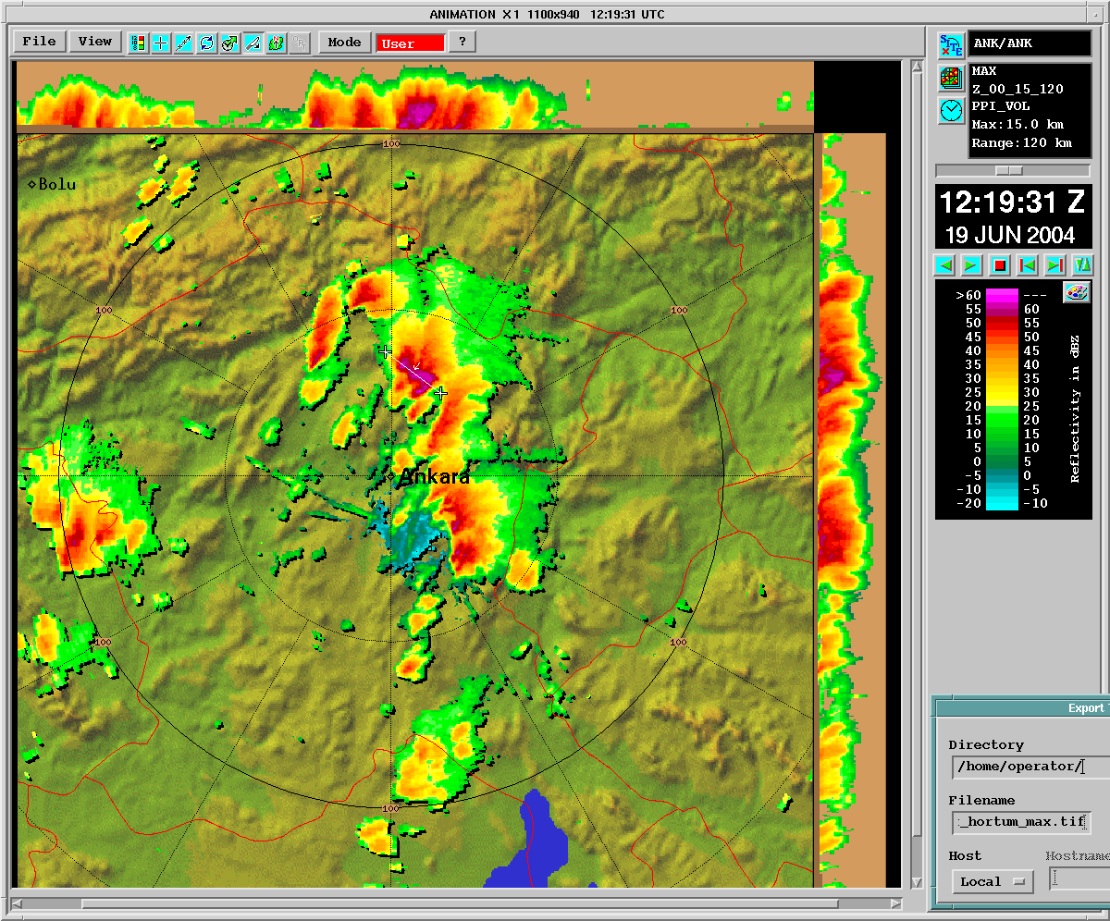
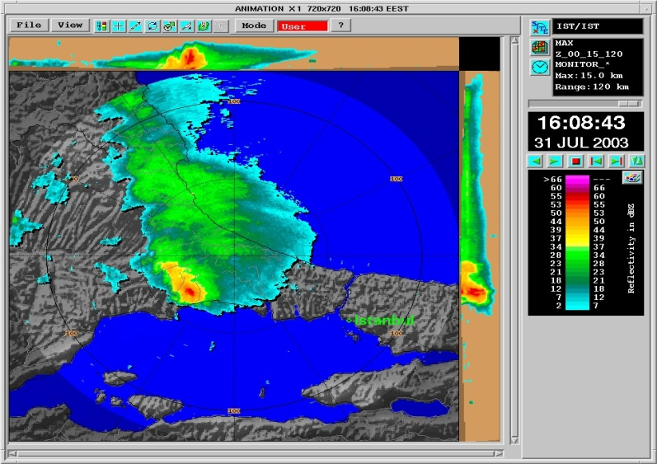
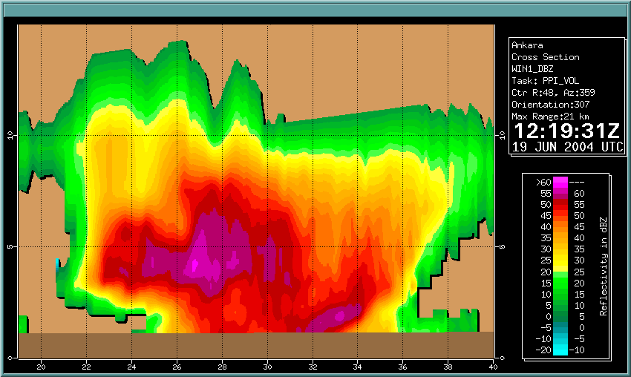
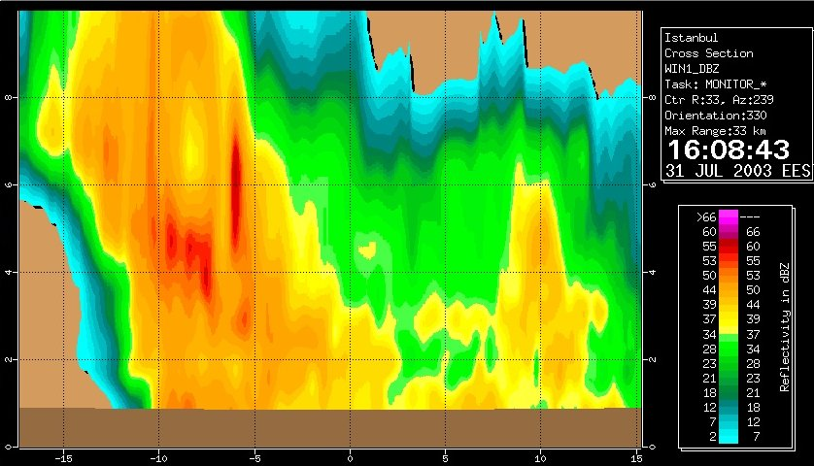
A tornado and it’s vertical profile
A storm and it’s vertical profile
Notes:
27

Slide 28
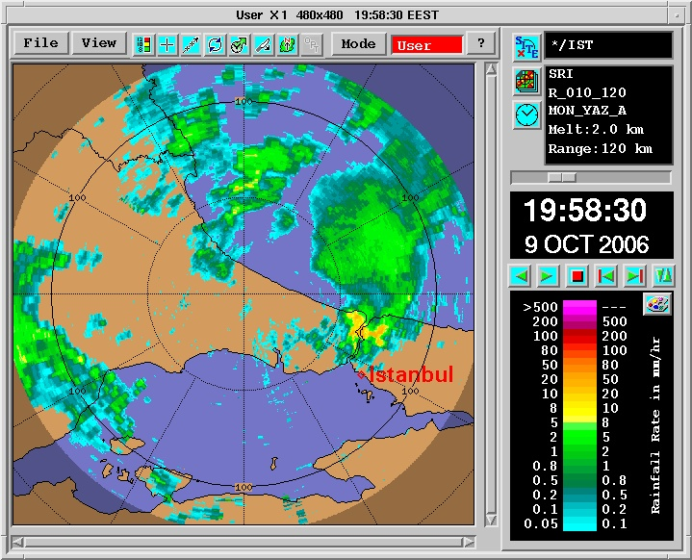
SRI (Surface Rainfall Intensity)
Notes:
28

Slide 29
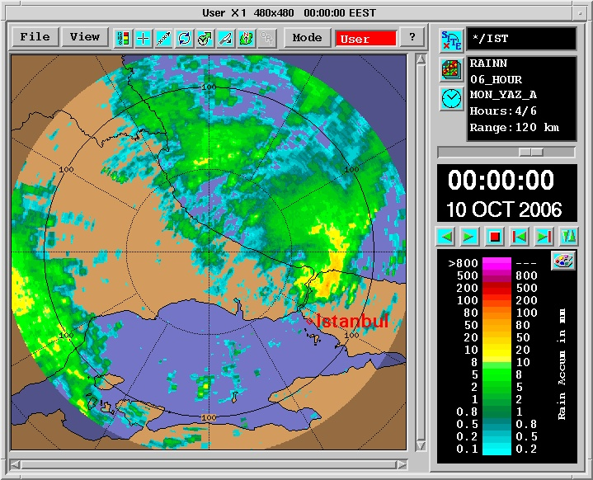
Rain Accumulation (RAINN)
Notes:
29

Slide 30
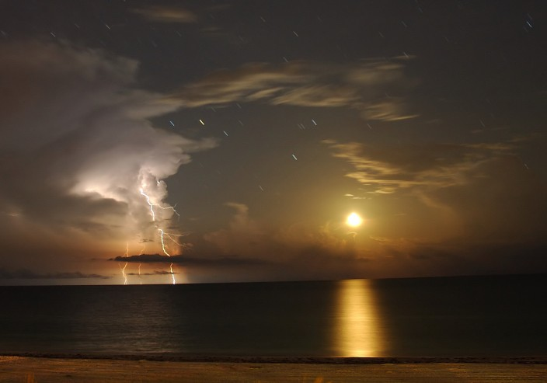
Thank you!

